Slide 1
Cerenkov Counters
Threshold
Ring Imaging
(RICH)
Direct Internal Reflection (DIRC)
Charles Hyde
18 July 2011
Old Dominion University

Slide 2
Cerenkov Radiation
Four-vector current of a point charge q travelling at velocity v through a medium of index of refraction n
  J^{µ} = [ρc, J] = q v^{μ} δ⁽³⁾(r−vt) v^{μ} = [c, v]
Maxwell’s equation for the vector potential in medium
  ☐_{n}A^{µ} = 4π J^{µ}
  Fourier transform and invert with Cauchy integral
Classical or Quantal solution
  Light is emitted in a broadband pulse with wave-vectors pointing in a cone of half angle given by
  cosθ_{C} = 1/(n v/c)
  Optical analog of sonic boom for all wavelengths λ of light s.t.
  n(λ) > v/c

Slide 3
Cerenkov Cone
Constant phase
  λ = vacuum wavelength.
  f = c/λ = optical frequency
  cosθ_{C}= c/(nv)
    θ_{C} →0
    as v→c/n⁺
λ/n(λ)
θ_{C}
v>c/n(λ)
v/f
λ/n(λ)
θ_{C}
v/f = λv/c

Slide 4
Cerenkov Light Intensity
pdg.lbl.gov: Chapter 23.7, or solve for A^{µ}
  Number of photons produced per unit particle pathlength dx (charge ze and speed v) and per unit wavelength bandwidth dλ in medium of index of refraction n(λ).
Example: high energy electron (v/c≈1) in CO₂ at STP.
  n=1.0000+4.1•10⁻⁴
  Integrate λ from 300 to 600 nm (typical PMT sensitivity)
    dN/dx ≈ 30 optical photons per meter of flight path
    Multiply by 20% Quantum Efficiency of PMT
      6 photo-electrons detected per meter of flight path in active gas.
      One photo-electron is one electron knocked out off the photocathode by a photon. Typical PMT gain is 10⁶ with pulse in 10 ns = 160µA pulse per photo-electron = 8 mV into 50Ω.
Increase signal by extending PMT sensitivity into UV.
  50% gain if cutoff extended to 200 nm
  UV optics, UV transparent PMT glass are expensive
  n→1 as λ → X-ray, natural cutoff of Cerenkov emission.
RF Cerenkov emission exists, but is too weak (1/λ²) for single particle detection.

Slide 5
Cerenkov Detector as Particle Identifier
Cerenkov Detectors are sensitive to particle velocity.
Tracking in magnetic field determines particle momentum.
p = mvγ
Cerenkov + Tracking → Mass → ID
Particle ID is hard
  Worth the effort to get every Cerenkov photo-electron

Slide 6
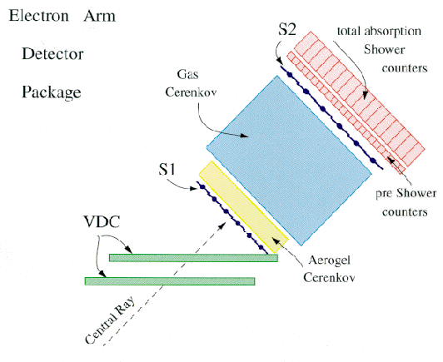
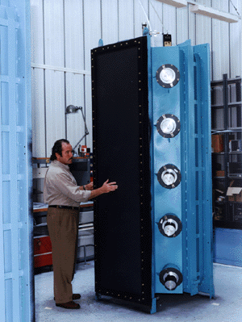
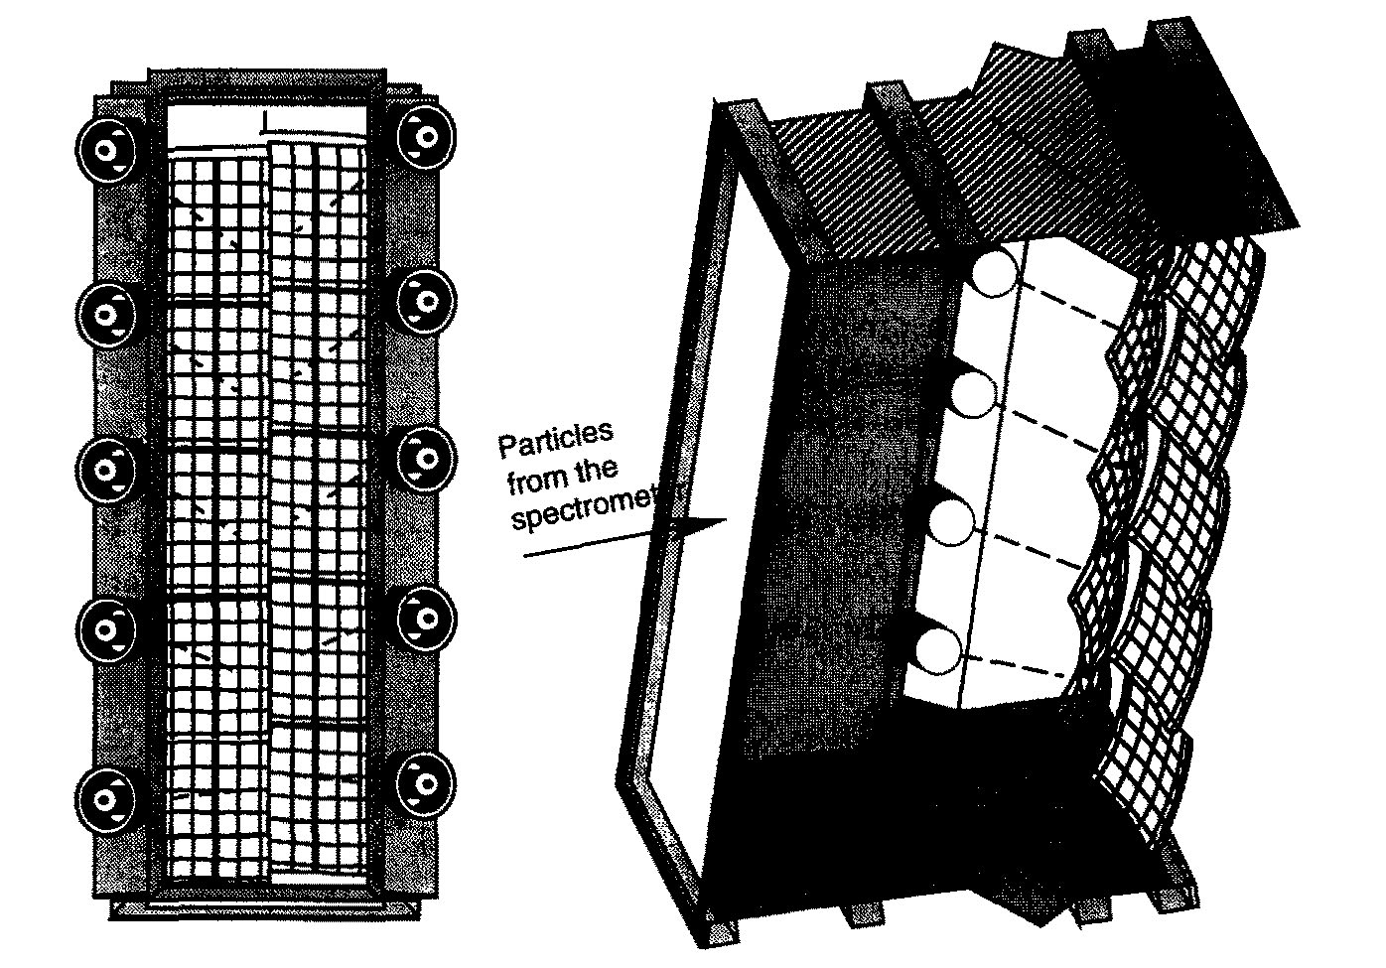
Threshold Cerenkov Detector
Hall A High Resolution Spectrometer
HRS Detector Stack
1.0-1.5 m CO₂ Cerenkov
  1 atm
  60x220 cm² aperture for incident particles
  Ten mirrors, directing light to ten 5”φ PMT
  ≈ 7 photo-electrons (p.e.)

Slide 7
Electron I.D. in CO₂ Cerenkov
Threshold for light emission v/c > 1/n
p > mc/[(n+1)(n-1)]^{1/2} n-1 = 4.1•10⁻⁴
  Electron threshold (m_{e}c²= 511KeV):
    p_{e} > 18 MeV/c
    As v_{e}→c, θ_{C}→1.6°
  Charged pion threshold (mc²=140 MeV):
    p_{π}> 4.8 GeV/c
For momenta from 0.02 to 4.8 GeV/c, if a particle makes a Cerenkov signal in the CO₂, than it is an electron.
  Particle ID is not 100% robust.
    For p_{π} > 0.6 GeV/c, the pion can kick out an energetic electron (δ-ray) with p_{e}> 20 MeV/c. This electron can produce a full Cerenkov signal and give a false electron i.d.
    This happens with 1-2% probability.
  Supplement Electron I.D. with an Electromagnetic Shower Counter / Calorimeter.

Slide 8
Pion/Kaon I.D. in a threshold Cerenkov Detector
Aerogel detector.
  Aerogel is a SiO₂–air colloid. The granularity is smaller than the wavelength of light. Approximately homogenous, extremely light material (a little bit visibly cloudy, and extremely hydroscopic).
  Material Parameters:
    density ρ = 0.1—0.3 g/cm³,
    n−1.0 = 0.25ρ = 1.025 – 1.075
    Bridges gap from gasses (n-1 <0.001) to liquids and solids (n>1.2)
Hall A Threshold Aerogel Cerenkov
  n=1.025
    Threshold for charged pions:
    p_{π} > 0.63 GeV/c
    Threshold for charged kaons (m_{K}c² = 0.5 GeV):
    p_{K} > 2.2 GeV/c
  A particle of momentum between 0.6 and 2.2 GeV/c that fails to fire the Aerogel Cerenkov must be heavier than a pion
    Candidate kaon or proton.
    Use time of flight (direct measure of speed for protons with p < 2 GeV/c

Slide 9
Ring Imaging Cerenkov Counter
Two particles of equal momentum, but different masses, will produce Cerenkov light cones of different opening angles θ₁, θ₂.
An optical system of focal length f will image the Cerenkov cones onto circles of radius f tanθ_{C}.
Measure r_{i}=f tanθ_{i}
  θ_{i}= tan⁻¹(r_{i}/f)

Slide 10
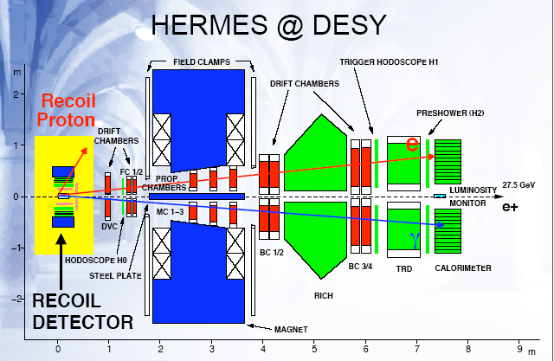
HERMES Experimental Setup
e↑+N ⇒ e’ + h +X in DIS
2 identical RICH modules

Slide 11
HERMES Dual Radiator RICH
Nuclear Instruments and Methods in Physics Research A 479 (2002) 511–530
Aerogel and C₄F₁₀.
  425 Aerogel tiles per module
8 Mirrors per module
2000 Philips XP1911 (¾”) PMTs per module
Two modules (above and below 27 GeV electron beam)

Slide 12
Hadron PID: HERMES RICH: NIMA 479 (2002) 511-530
Identify p, K and p
from 2 to >12 GeV/c
5.5 GeV K+
C4F10 gas
REAL DATA from NIMA 479 (2002) 511
14.6 GeV e-
1.5 GeV π-
(e,e’π⁻K⁺)X
event
aerogel
Two radiators: aerogel and gas
PMTs as photon detector
Focusing Optics
resolution δθ ≈ 10 mr
gas

Slide 13
HERMES Dual RICH performance
2x2000 PMT
For a β≈1 particle
  Aerogel ring ≈ 10p.e.
  C₄F₁₀ ring ≈ 20 p.e.
Angular resolution:
δθ_{C} ≈ ±10 mr
5.5 GeV/c kaon, Aerogel ring, no gas ring.
1.5 GeV/c π⁻,
Aerogel ring, no gas ring.
14.6 GeV/c e⁻,
Aerogel ring and gas ring.
Slower particles give bigger rings, until at v=c/n, θ_{C}→90° & r→∞

Slide 14
CLAS12 Dual RICH
Small angle, photo-sensors must be “inside”.
C₄F₁₀
Aerogel
PMTs
Mirror

Slide 15
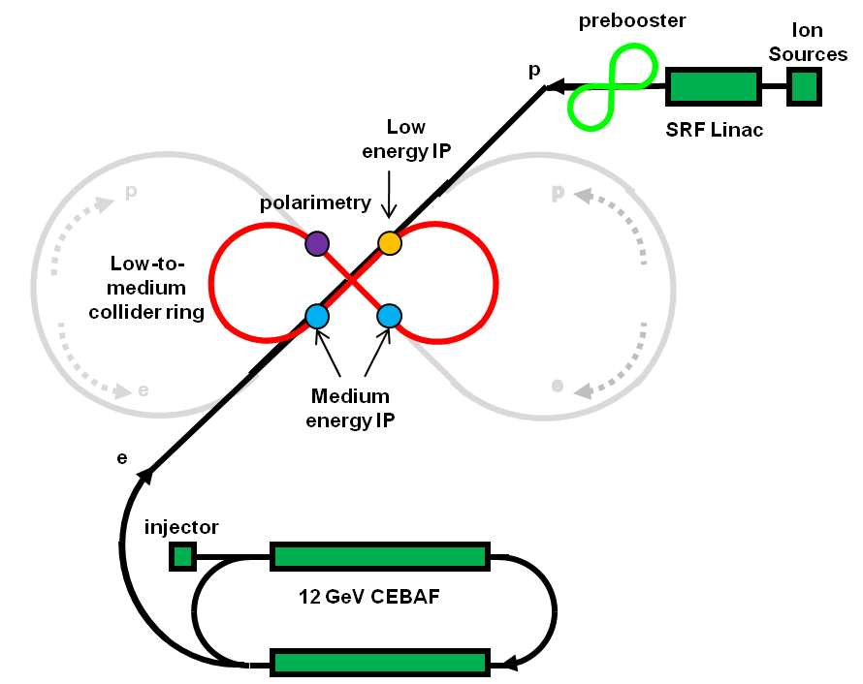
Conceptual Layout for an
Electron-ion Collider at JLab (2020s)
Upgrade option to ~ 200 GeV/c proton
Three compact rings:
3 to 11 GeV electron
Up to 12 GeV/c proton (warm)
Up to 90 GeV/c proton (cold)

Slide 16
EIC Detector Cartoons

Slide 17
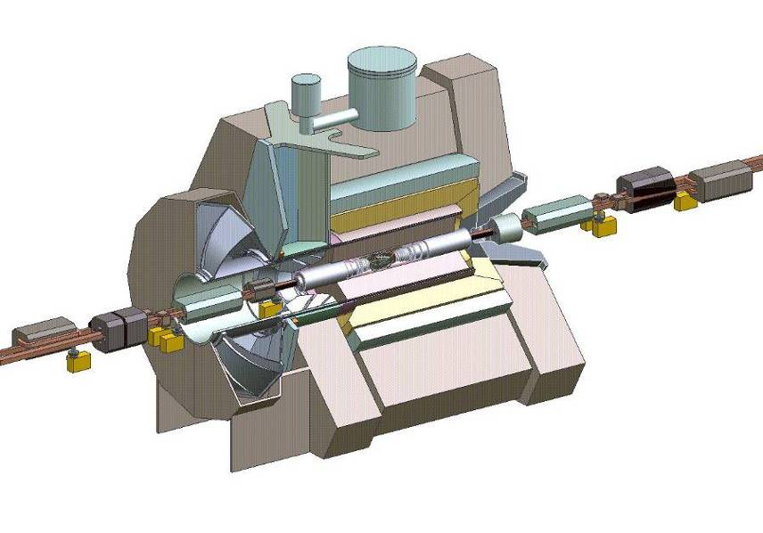
BABAR layout
THE BABAR DETECTOR
Instrumented Flux Return
19 layers of RPCs,
(upgraded to LSTs)
All BABAR DIRC slides today:
J.S., RICH 2002/4, Giessen 2009
1.5 T Solenoid
Drift Chamber
40 layers (24 stereo)
DIRC
e⁺ (3.1 GeV)
Electromagnetic
Calorimeter
6 580 CsI crystals
e– (9.0 GeV)
center of mass energy
≈ M_{ϒ(4S)} =10.58 GeV/c²
βγ = 0.56
Silicon Vertex Detector
5 layers of double sided silicon strips

Slide 18
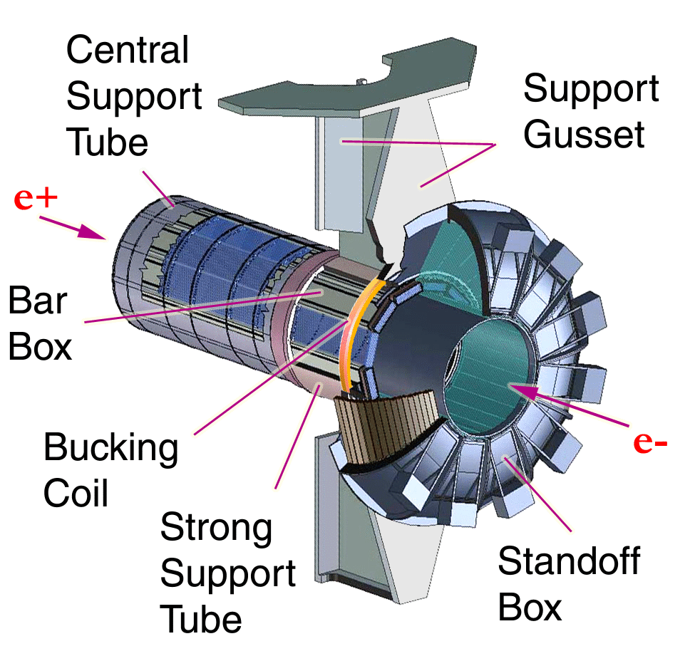
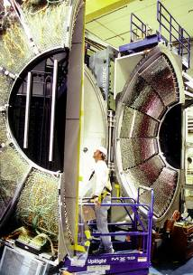
THE DIRC IN BABAR
DIRC thickness:
2 cm SiO₂ active
8 cm radial incl. supports
19% radiation length
at normal incidence
DIRC radiators cover:
94% azimuth,
83% c.m. polar angle
DIRC photon detection array:
10,752 PMTs ETL 9125

Slide 19
Total Internal Reflection of Cerenkov Light
Fused Silica
  n(SiO₂) = 1.47
  Industrial production processes
  Highly transparent from 180 to 800 nm
Cerenkov angle θ_{C} = 47°
  θ_{C}(pion at 2 GeV/c) = 47.0°
  θ_{C}(kaon at 2 GeV/c) = 45.5°
    Δθ_{C}(2 GeV/c) = 27 mr
    Δθ_{C}(4 GeV/c) = 7 mr
cosθ_{C} < sinθ_{C} → total internal reflection at normal track incidence.

Slide 20
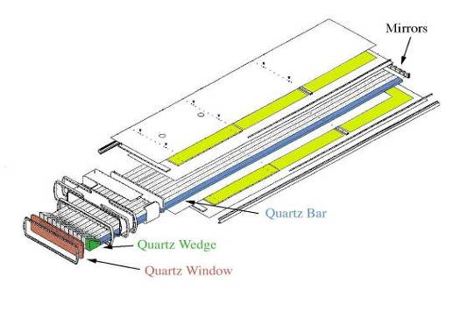
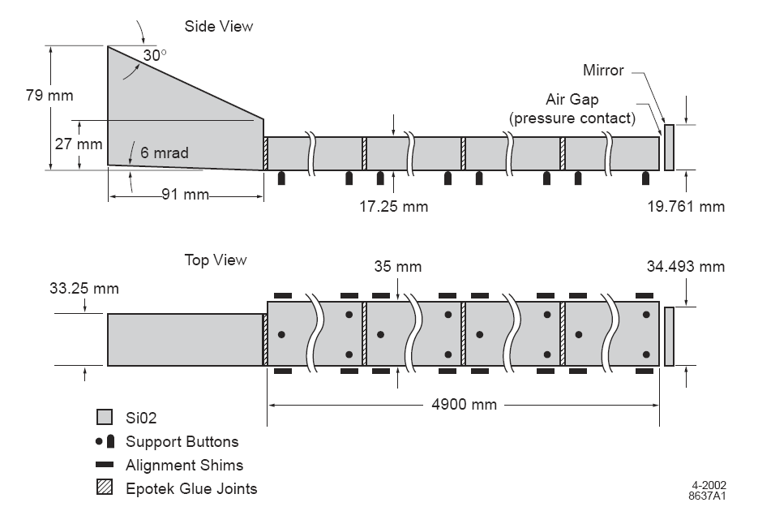
THE DIRC IN BABAR
Bar box: 12 bar boxes in BABAR
12 long (4.9m) bars per box
17.25 mm thick ×35 mm wide
150μm air gap between bars
dry nitrogen flow
11000
PMTs
(29mmφ)
H₂O
Long bar: 4 short (1.225m) bars
Fused silica (SiO₂)
Mirror on forward end
Wedge on readout end

Slide 21
BABAR DIRC Pinhole Proximity Imaging
Non focusing image formation in expansion volume of 6000 litre pure H₂O
Roughly 1m radius volume
Simple analysis: Ignore
  n(SiO₂)-n(H₂0)= 1.47−1.33 difference.
  6 mr incline of bottom of wedge
Consider two particles of different velocities passing through the 17 mm thickness
  The two tracks produce two wedges of parallel light at angles θ₁ and θ₂ in the plane of a particular azimuth of the Cerenkov cone.
  The light from each track illuminates 17 mm in vertical ascension, or ~ 1 PMT
  The images of these two light sources will be separated by L(θ₂− θ₁) ≈ (1 m) Δθ
  Single pixel resolution by L(θ₂− θ₁) > 29 mm/√12 = one-σ spatial resolution of single PMT (diameter 29 mm).
  Angular resolution δθ ≈ [(29 mm)/(1.0 m)] / √(12 N_{pe})
    N_{pe} = Number of photo electrons detected > 25
    δθ ≈ 1.5 mr (rms)
6 mr incline at bottom of wedge
  Half of light has last reflection off bottom of bar: θ = θ_{C}
  Half of light has last reflection off bottom of wedge:
  θ = θ_{Cv}+ 6 mr.
  Vertical image size is reduced by (1m)(6mr) to ~ 12 mm.

Slide 22
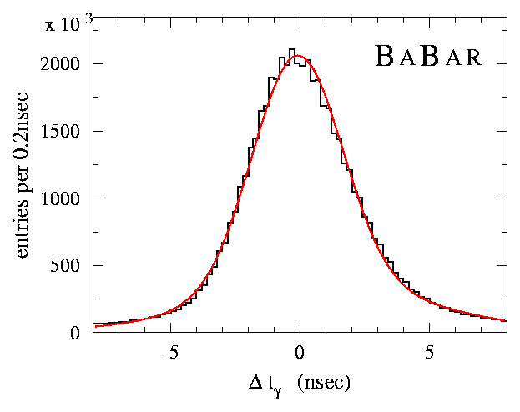
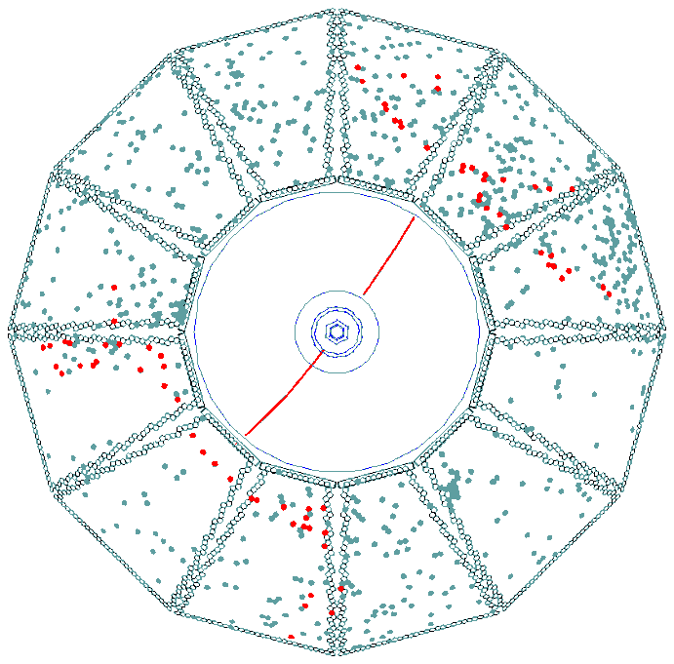
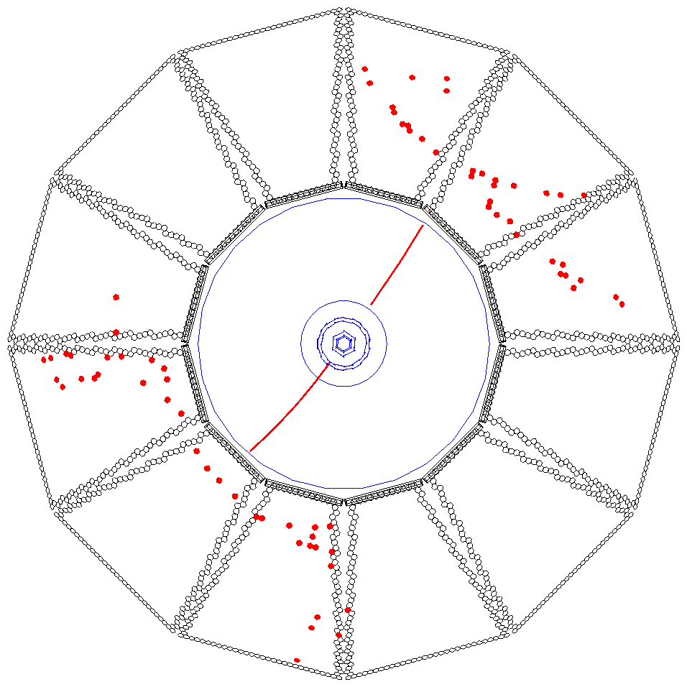
DIRC RECONSTRUCTION
For BABAR DIRC time information provided powerful tool
to reject accelerator and event related background.
σ(Δt) = 1.7 nsec
Calculate expected arrival time of Cherenkov photon based on
• track TOF
• photon propagation in radiator bar and in water
Δt: difference between measured and expected arrival time
± 300 nsec trigger window → ± 8 nsec Δt window
(~500-1300 background hits/event) (1-2 background hits/sector/event)
Δt (nsec)
Δt also used to
determine event
time for
“self-triggering”
of DIRC.
→
Notes:
22

Slide 23
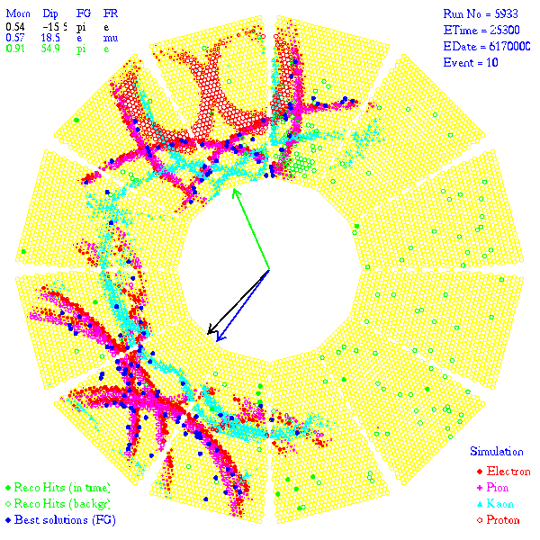
DIRC RECONSTRUCTION
DIRC likelihood
Calculate unbiased likelihood for observed PMT signals
to originate from e/μ/π/K/p track or from background.
( Likelihood: Pdf(θ_{c}) ⊗ Pdf(Δt) ⊗ Pdf(N_{γ}) )
Two complementary reconstruction algorithms:
• iterative process to maximize event likelihood, full correlation of all tracks;
• individual track fit provides θ_{c}, σ(θ_{c}), number of signal/background photons.
Reflection ambiguities: for BABAR Δt cut reduced these from up to 16 to typically 2-3
Particle ID is based on
log likelihood differences
of the five hypotheses.
Example: Comparison of real event to simulated response of BABAR DIRC
to e/π/K/p.
Notes:
23

Slide 24
DIRC Resolution

Slide 25
Chromaticity

Slide 26
Topics for EIC R&D
Conventional design
  SiO₂ penetrating Flux return on electron side
  Expansion volume and ≥ 10,000 PMT
Compact Design inside magnetic field
  Focusing optics (prism, mirrors), expected readout 30x30 cm²
  Small pixel size photo-detectors
    Micro Channel Plate PMT
    SiPMT
  Test performance in magnetic field up to 4 Tesla
Simulate Cerenkov Reconstruction
Simulate backgrounds
  Beam related neutrons
  Synchrotron Radiation X-rays
  Bremsstrahlung, etc.

Slide 27
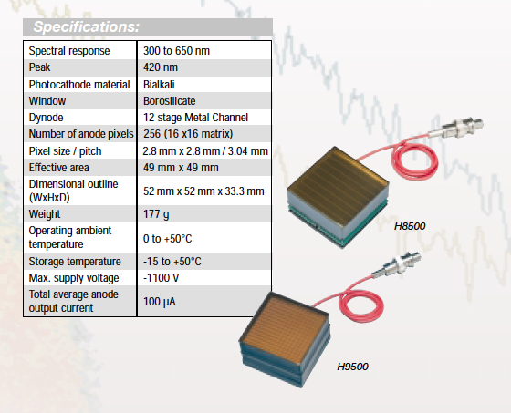
Compact Photo-Sensors
Metal channel PMT
(3mm)² pixel size
Q.E. 20%
  Improvements to 40%?

Slide 28
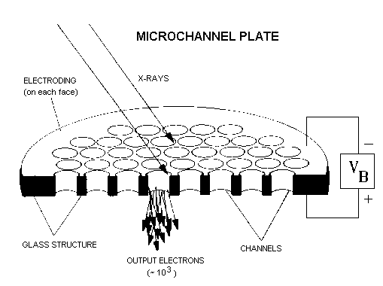
µChannelPlate (MCP)
http://hea-www.harvard.edu/HRC/mcp/fmcp.gif
Burle, 5 micron and 2 micron
typical channel diameter 6-10 µm
  R&D for 2µm
  pixel size limited by channel diameter.
Two MCP stages in chevron pattern to achieve gain ~10⁶
Budker Institute (Novosibirsk) for PANDA DIRC
Very fast!
  30 ps TTS (1 p.e.)
Q.E. ~ 20%
packing fraction ~25%
  use lenses to focus onto active area?
Moderate sensitivity to high magnetic fields
Barnyakov, NIMA567 (2006)
instr08.inp.nsk.su/reports/Barnyakov.pdf

Slide 29
MCP-PMT in 1-2 Tesla Magnetic Field
Budker Institute
  Gain decrease by factor 0.2 in 1.6 T field at 30°
  Quantum Efficiency decreases by only 20%

Slide 30
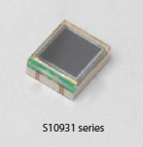
Photo-sensors
MultiPixelPhotonCounter (MPPC) = SiPMT
Geiger avalanche saturates each pixel
  Each pixel is saturated by a single photo-electron
  Pixels can be ganged together for multi-photon detection at lower granularity.
  900 pixels (100µ)² in 3mm x 3mm format
  Gain ~10⁶
  time resolution 500 ps rms per photon
  Fill factor up to 80%
  Quantum Efficiency up to 65%
  Noise: 10 KHz/pixel at 0.5 p.e. threshold
  Operating bias voltage ~70 V
Rapid development
  60,000 MPPC for T2K Near Detector
© Hamamatsu

Slide 31
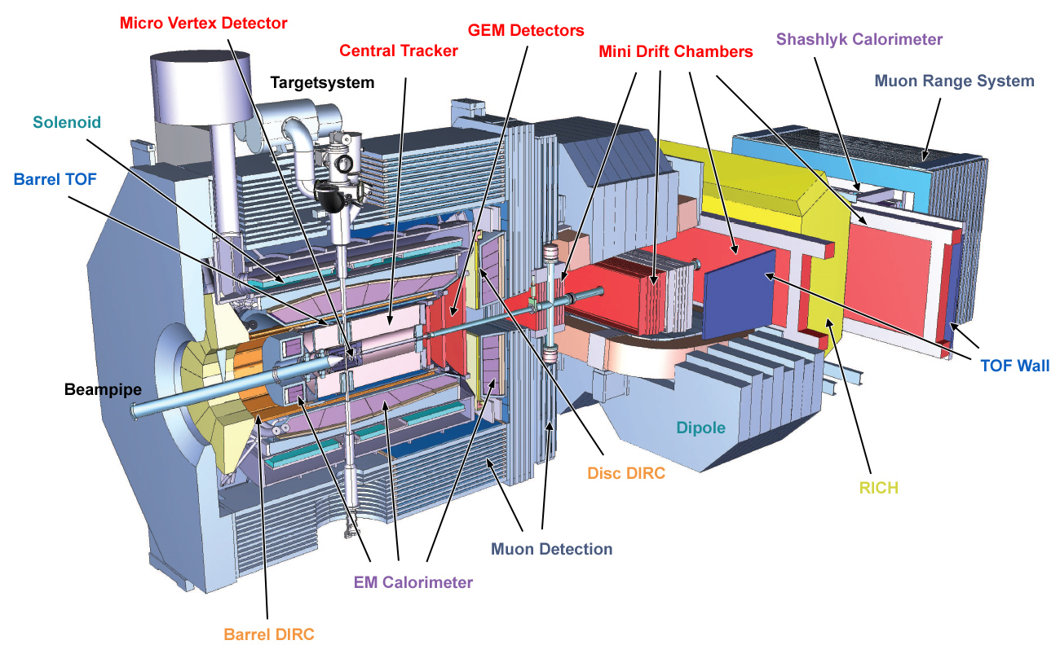
PANDA DETECTOR
p
Endcap DIRC
EM Calorimeter
(lead tungstate)
Barrel DIRC

Slide 32
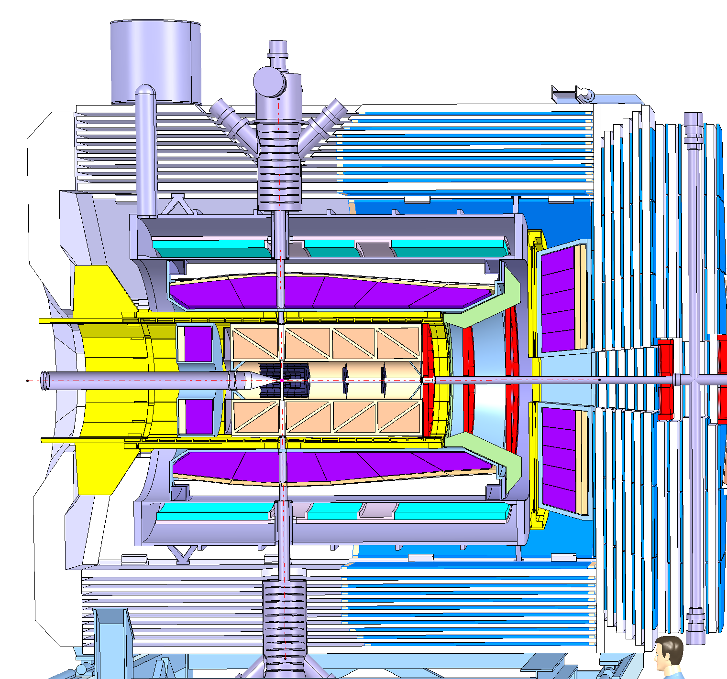
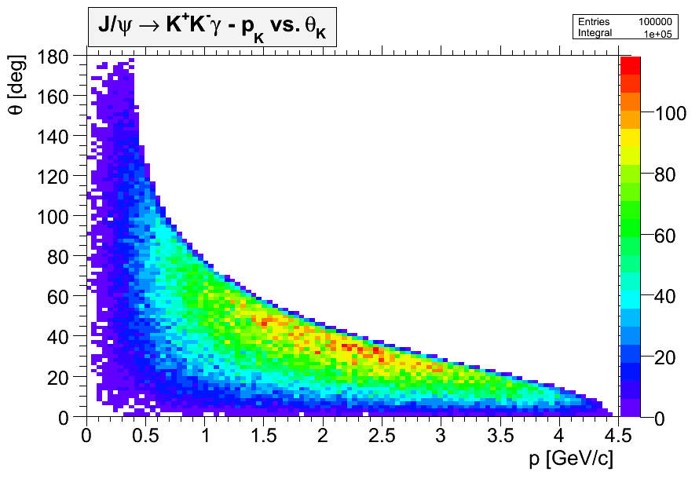
DIRC IN PANDA
Particle Identification coverage of the two DIRC detectors
Disk DIRC
Barrel DIRC
Endcap
Kaon distribution of the radiative decay
J/ψ -> K⁺K⁻ γ
(search of glue balls)
Barrel DIRC
Endcap Disk DIRC

Slide 33
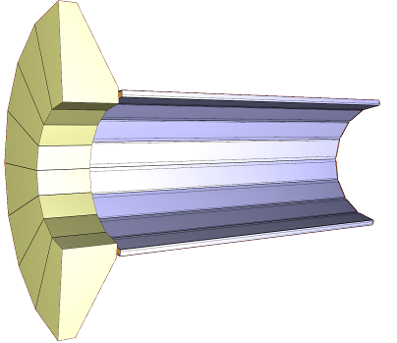
PANDA BARREL DIRC
Improved version of proven BABAR-DIRC design
More compact, faster, focusing optics
  96 radiator bars, synthetic fused silica
  17mm (T) × 33mm (W) × 2500mm (L)
  Focusing optics: lens system
  Compact photon detector: array of
  Burle Planacon MCP-PMT
  or Geiger-mode APD,
  total 7000-10000 channels.
  Fast photon detection: MCP-PMT/gAPD plus
  fast TDC/ADC (ToT) electronics
  → 100-200 ps timing.
Still investigating several design options:
mirror focusing, radiator plates, photon detection outside magnetic field
Photon detectors
and electronics
Radiator bars
Focusing optics

Slide 34
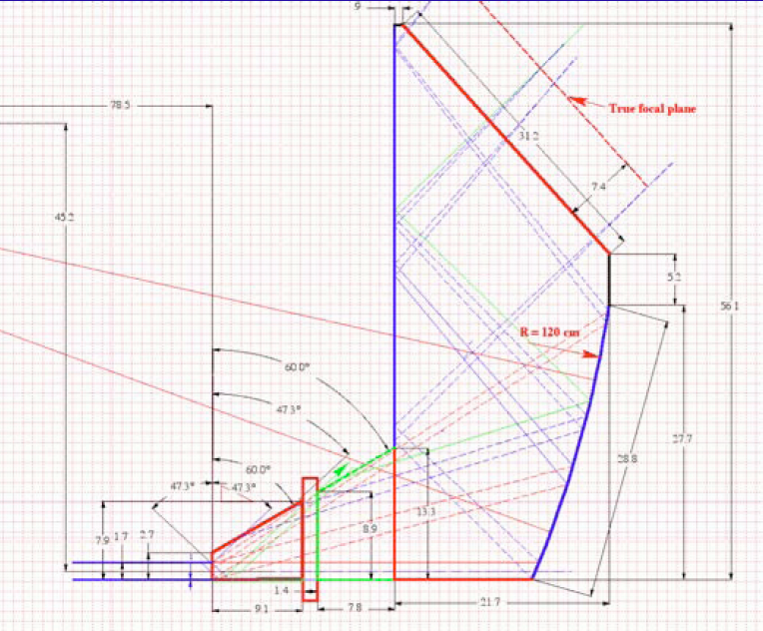
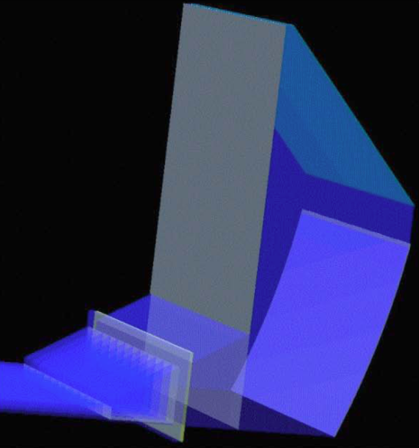
FDIRC FOR ITALIAN SUPERB
Focusing DIRC (FDIRC) Design:
large synthetic fused silica block (Corning) for expansion region and focusing.
“Camera” approach:
each of the 12 bar boxes read out with one optically isolated block/readout module.
Additional wedge required to image all photons on cylindrical mirror of focusing block.
side view
G4 model
Figures from
J. Va’vra
RICH2010

Slide 35
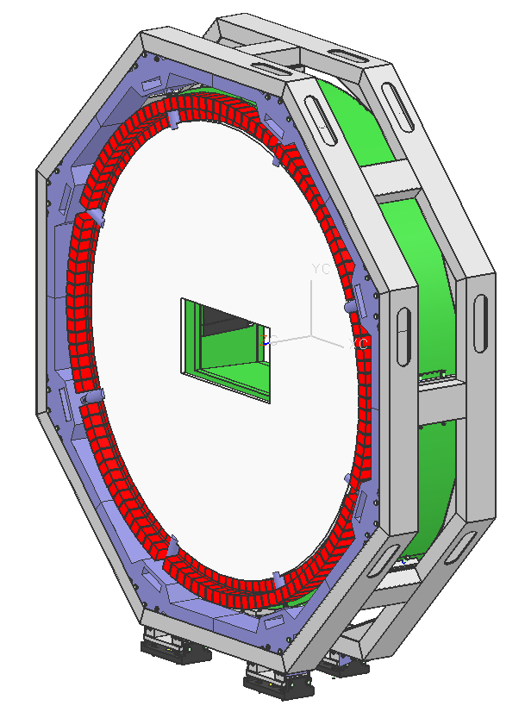
PANDA FOCUSING DISK DIRC
mechanical
support
Image reconstruction in 2D (X, Y)
Timing used for event correlation and background subtraction
Radiator: synthetic fused silica,
20 mm thick, 1100 mm radius
Focusing optics for imaging with dispersion correcting element (LiF)
Compact detection plane on each light guide (50x50 mm²)
128 light guides, 4096 R/O channels
fused silica
disk
lightguides
and photon detectors
Notes:
explain radiator choice
explain mechanical constraints

Slide 36
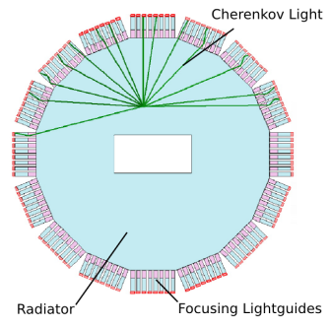
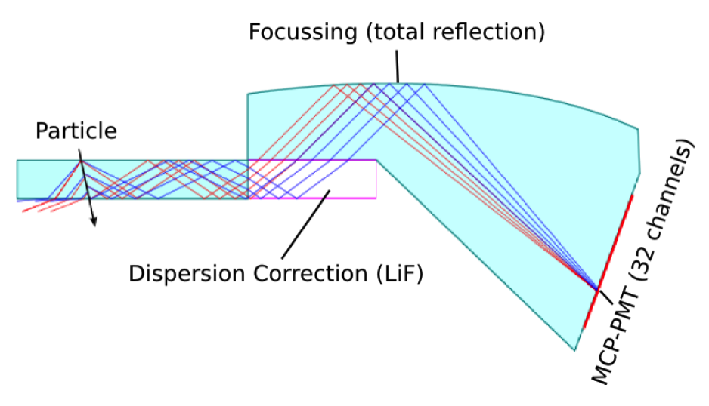
PANDA FOCUSING DISK DIRC
Direct measurement of Cherenkov angle
→ need expansion region
Design of expansion region = light guide
compromise between compact size and
performance with given MCP-PMT size
Transition from fused silica
to LiF and back has two-fold
prism effect and mitigates dispersion

Slide 37
Limitations on DIRC Resolution
Pixel size
  (adjustable by focusing optics, expansion volume, Photo Sensor technology)
Tracking Resolution
  Need ~ 1mr prediction of axis of Cerenkov cone
Flatness and Parallelism of Fused-Silica
  Industrial process ~ $10K/bar

Slide 38
BNL funded EIC Detector R&D grant
How can we best adapt and improve the DIRC concept for an EIC detector.
  Simulations and design work
  Prototyping with GSI
  Photosensor testing at JLab?
Three year proposal.
  $115K funded in first year to ODU, JLab, CUA, GSI collaboration.
  Second and Third year funding to be resubmitted in Nov. 2011.

Slide 39
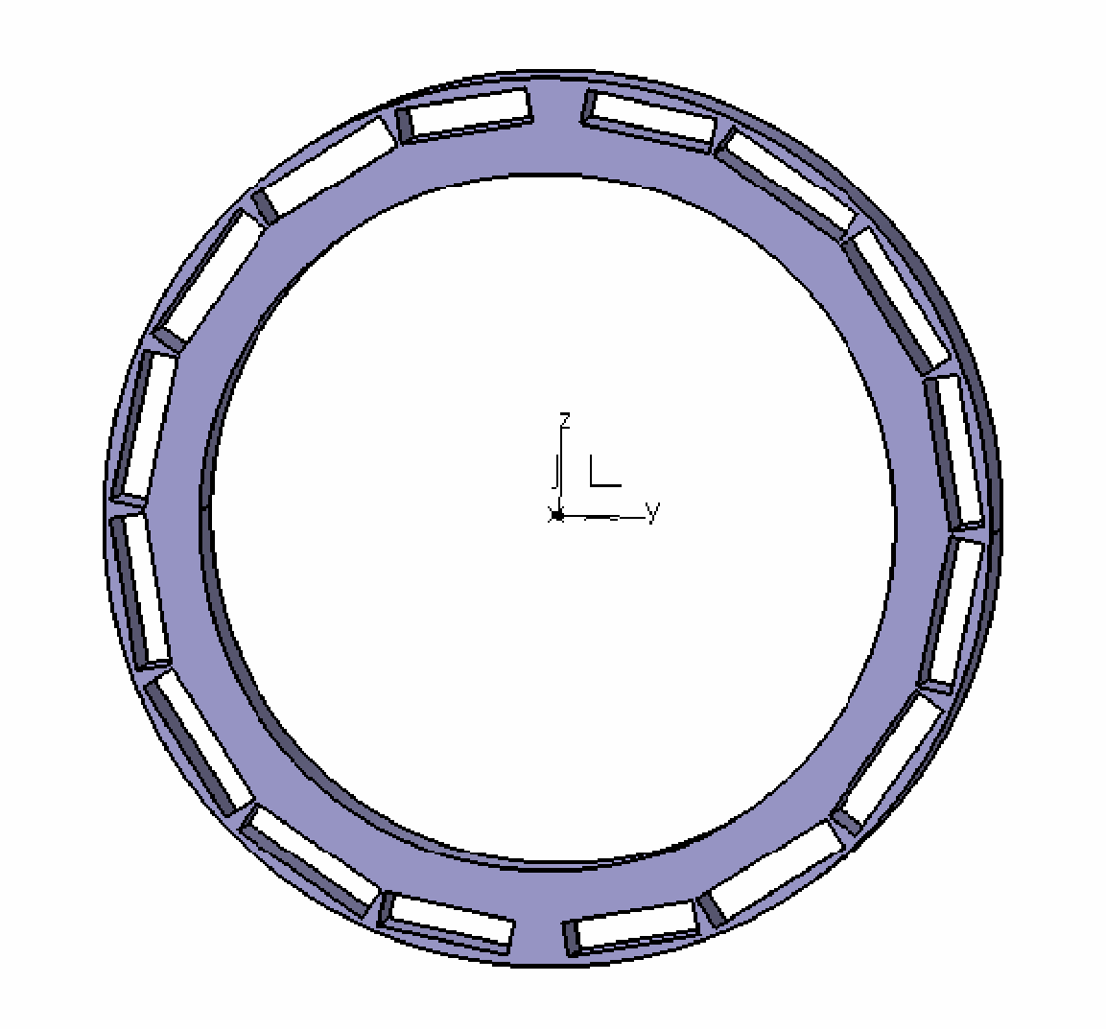
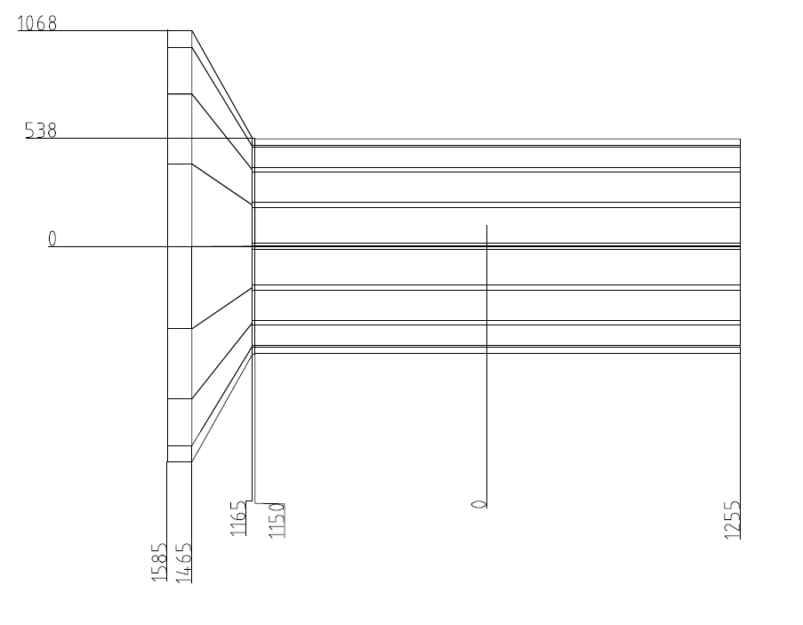
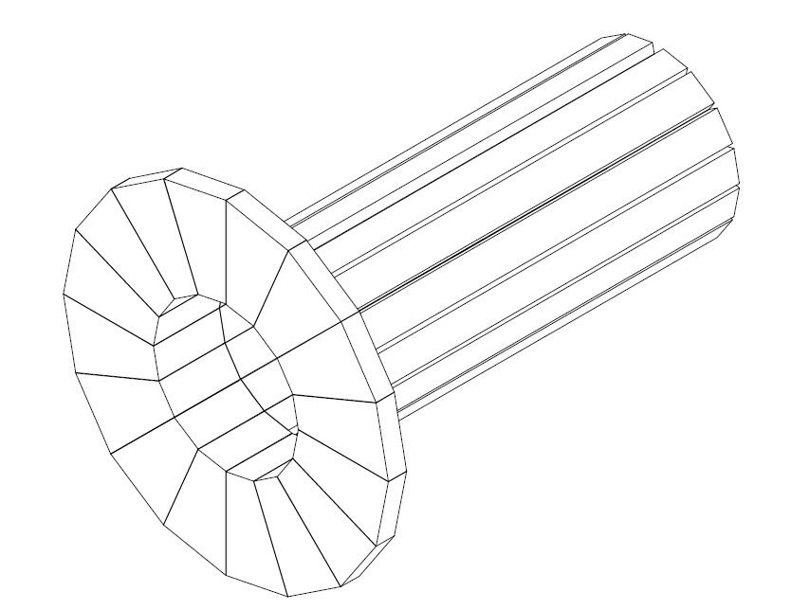
PANDA BARREL DIRC DESIGN
Barrel DIRC design, readout inside magnet yoke.
(prelim. dimensions)
Barrel radius ~50 cm, length ~250 cm,
gap (2*one bar) for target pipe at 12 o’clock and 6 o’clock,
Expansion volume depth ~30 cm, height ~50cm
(plus space for PMTs and cables).

Slide 40
HERMES single event display
(e,e’)X event.

Slide 41
Ring Imaging Cerenkov Counter: PID
Two particles of equal momentum, but different masses,
  Cerenkov light cones of opening angles θ₁, θ₂.
  Focused rings of radii r_{i} = f tanθ_{i}

