Slide 1
Forward and Far-Forward
Detection at ELIC
EIC-JLab Detector Workshop
04-05 June 2010
Jefferson Laboratory
Charles E. Hyde
Université Blaise Pascal, and
Old Dominion University

Slide 2
Forward Particles of a 6x60 GeV collider
“Forward” is defined relative to ion beam
  Important issues also for low Q2 tagging on electron side, not addressed here.
SIDIS and exclusive processes produce “jet” fragmentation particles (γ, π, K, etc).
  These particles fill the full 4π laboratory detector space,
Exclusive, DIS, Rapidity gap events produce ultra forward baryons, and forward mesons from dissociation.
  Exclusive: ep → epγ
  SIDIS or RapGap: ep → e’K…Λ…
  Deep Exclusive or SIDIS production of forward Δ, Λ will produce forward mesons and nucleons
    mesons: momenta ~(m/M)P ~8 GeV/c θ ~ (0.2 GeV/c) / (8 GeV/c) ~25 mrad
    nucleons: P~50 GeV/c, θ ~4 mrad
Photoproduction can produce forward mesons [nearly] up to beam momentum

Slide 3
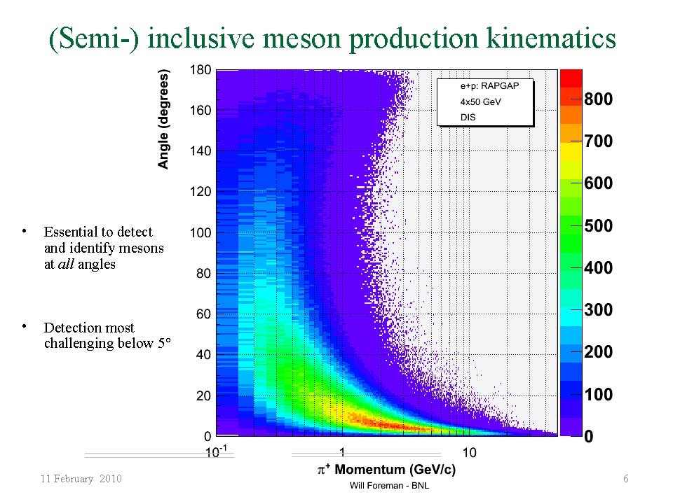

Slide 4
IR Optics (ions) at 60 GeV
3000
5
0.25
0.25
BETA_X&Y[m]
DISP_X&Y[m]
Size_X[cm]
Size_Y[cm]
IP
IP
0
0
0
0
0
BETA_X
BETA_Y
DISP_X
DISP_Y
50
0
Ax_bet
Ay_bet
Ax_disp
Ay_disp
50
Q1 aperture = 7 cm (@ 7m)
Q3 aperture =10 cm (@12 m)
→ 7T peak fields
Particles < 0.5° = 10 mrad through FF quads
P⊥< 600 MeV/c
FF triplet : Q3 Q2 Q1
Q1 G[kG/cm] = -9.7, 1m
Q2 G[kG/cm] = 6.9, 2m
Q3 G[kG/cm] = -6.8, 1m

Slide 5
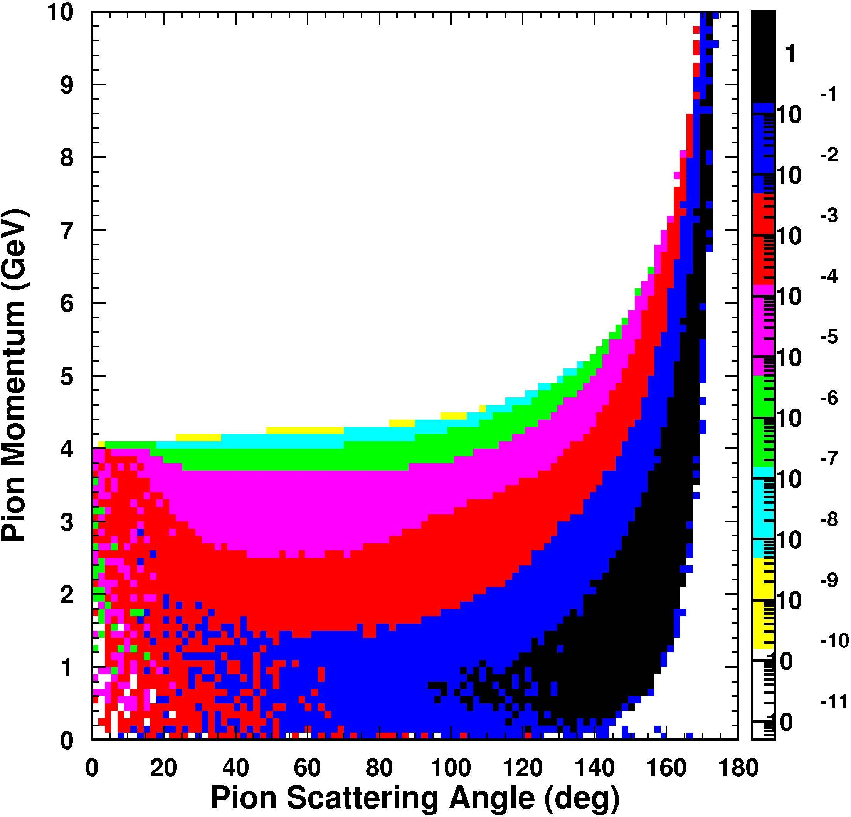
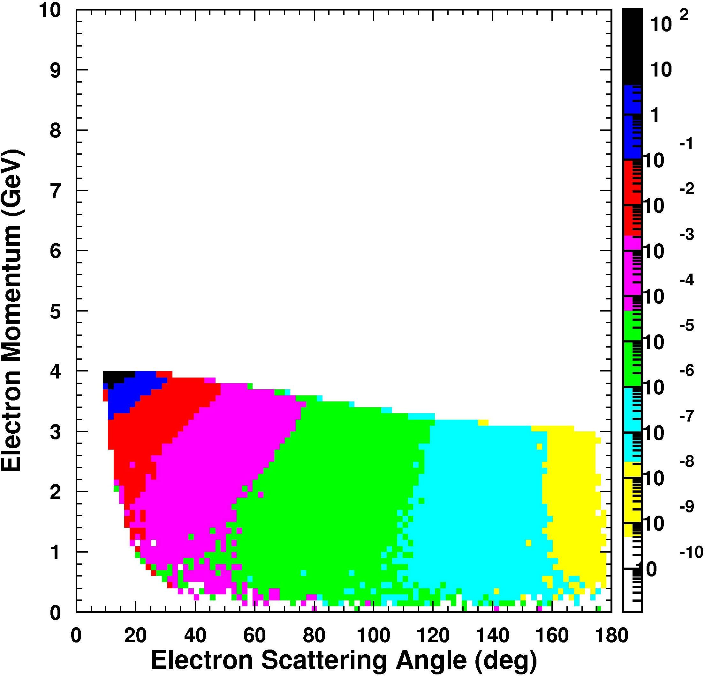
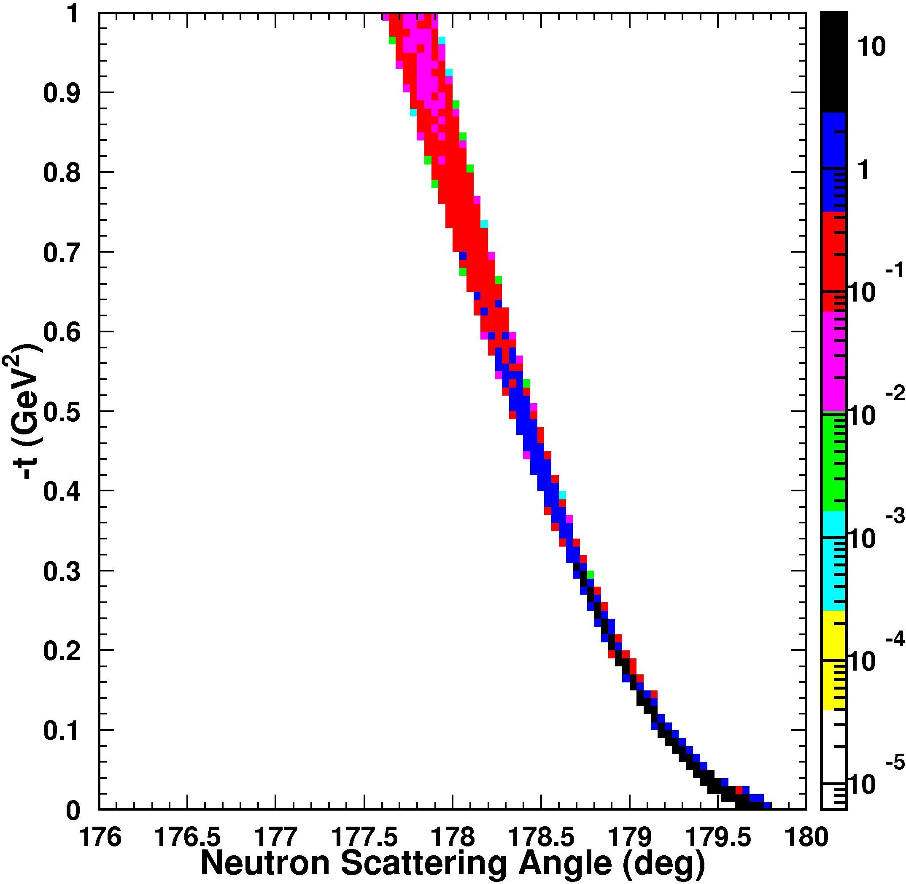
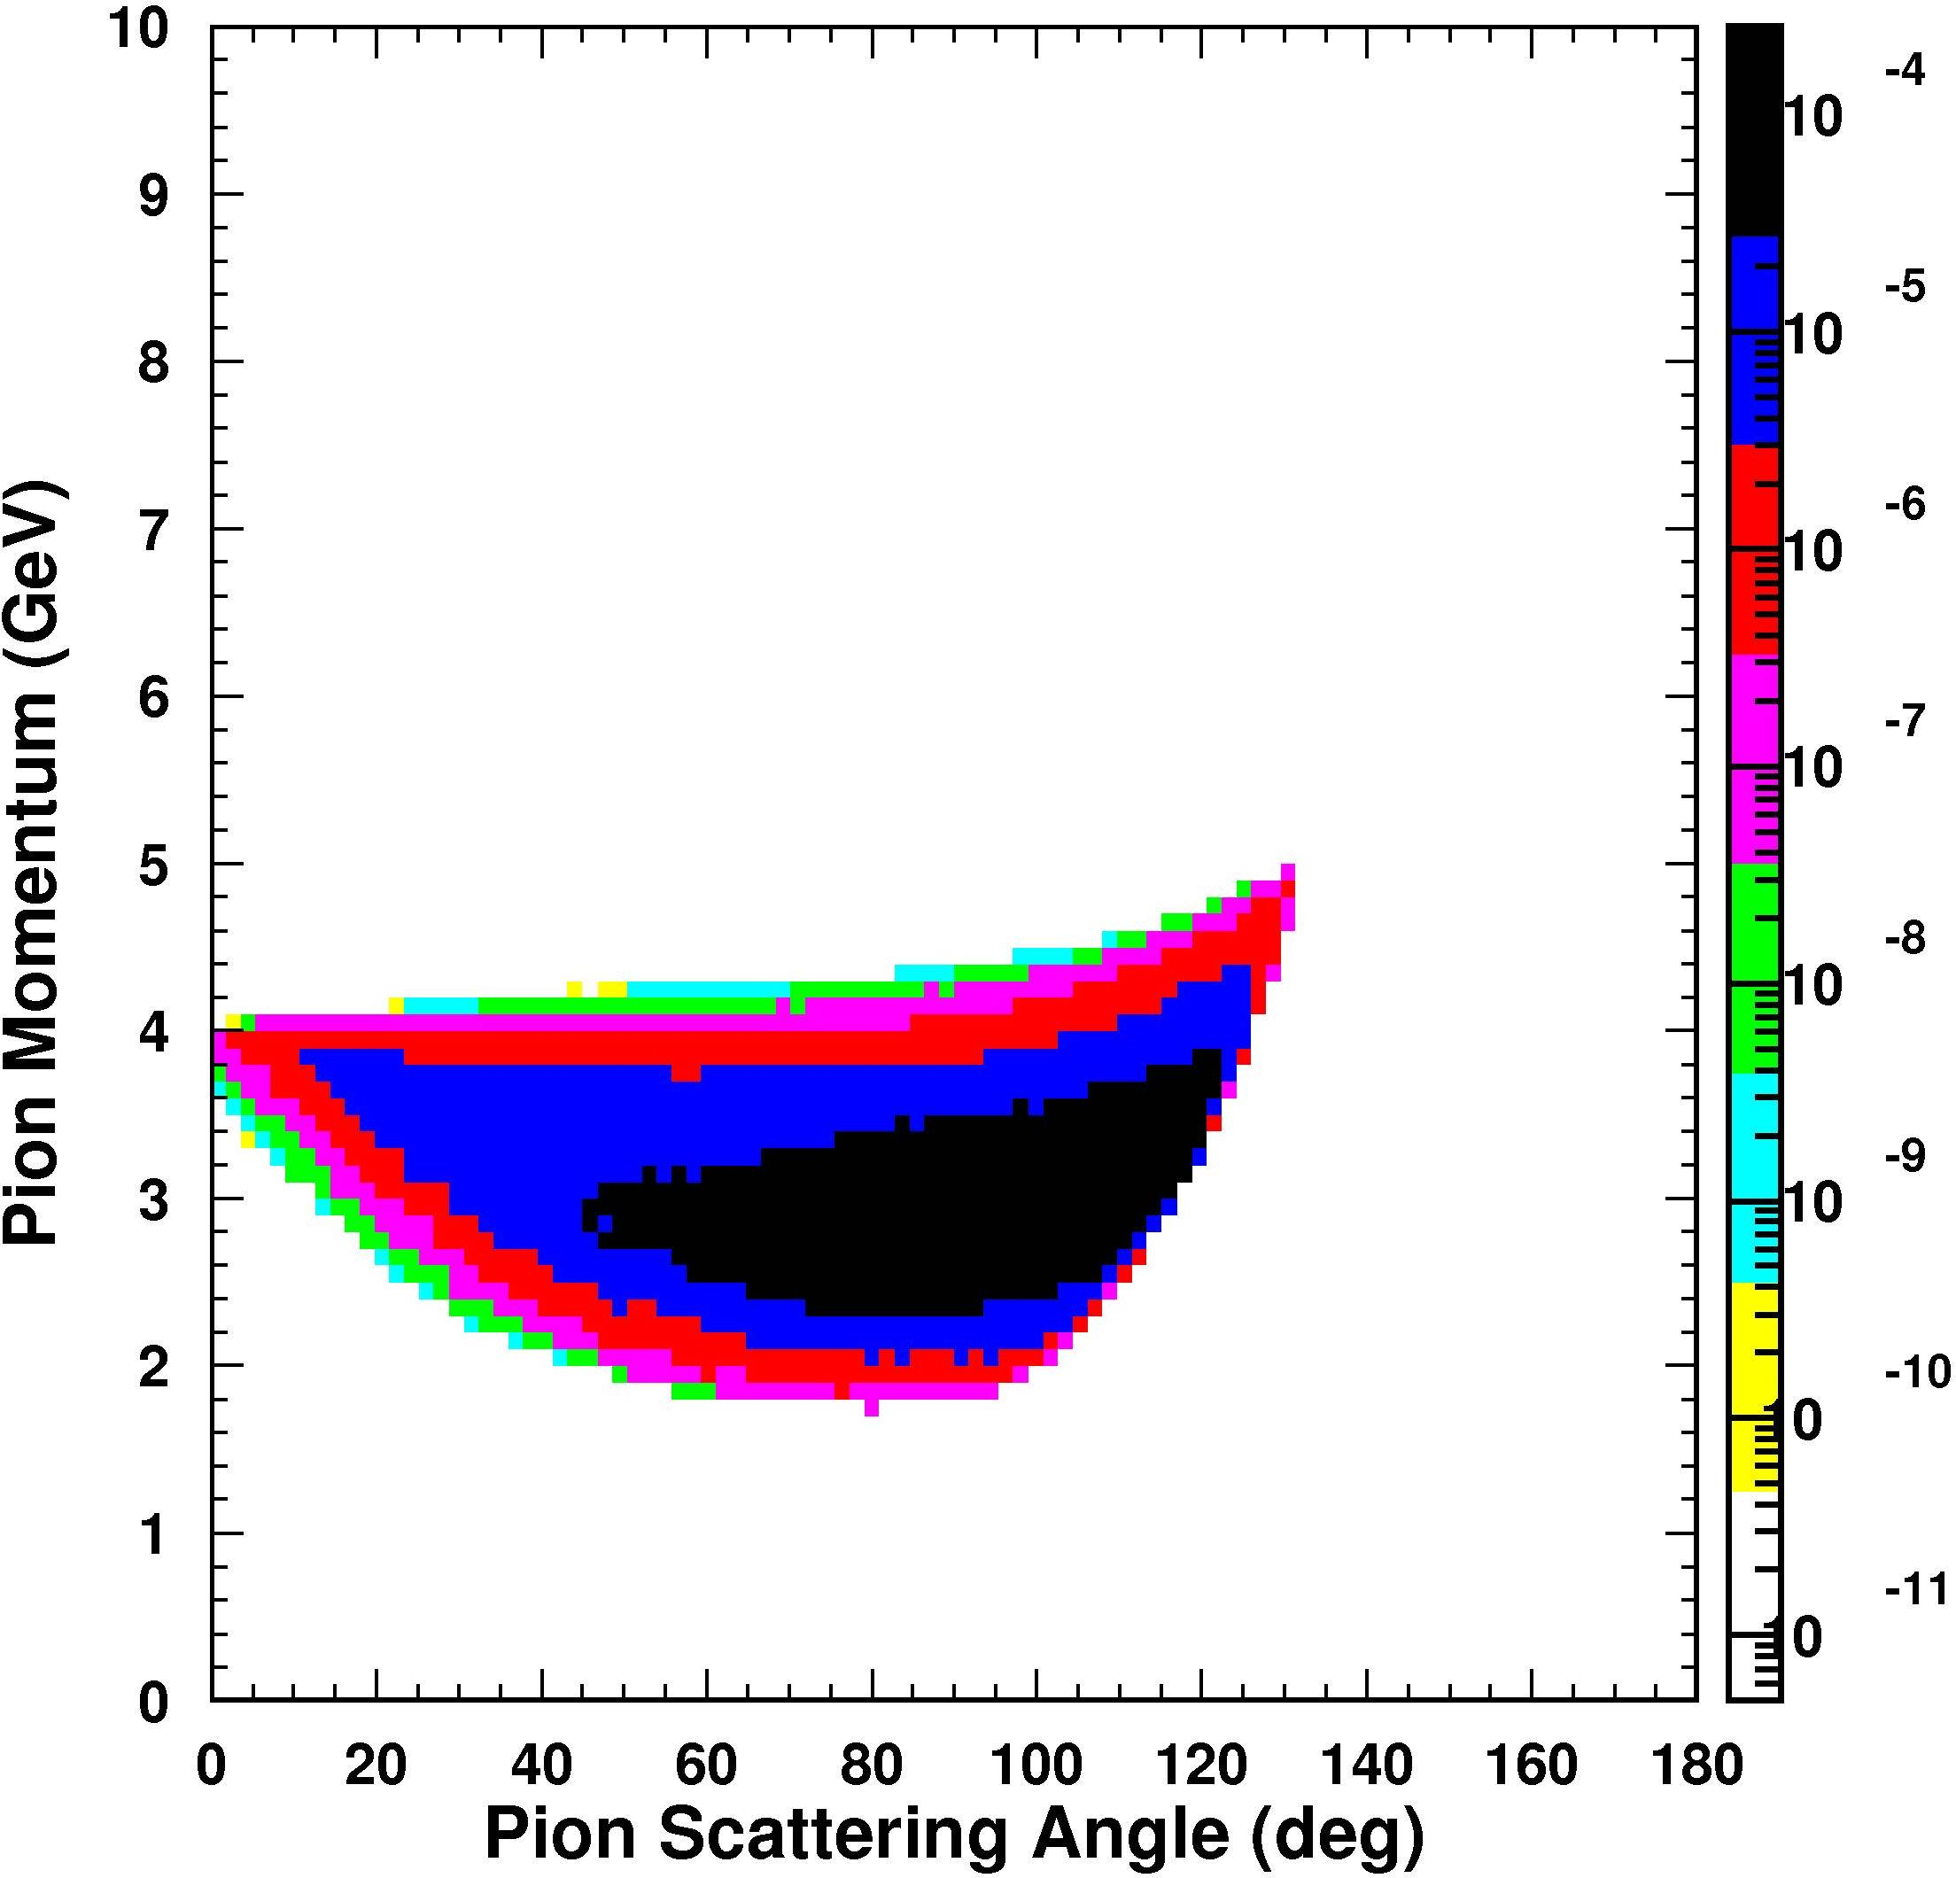
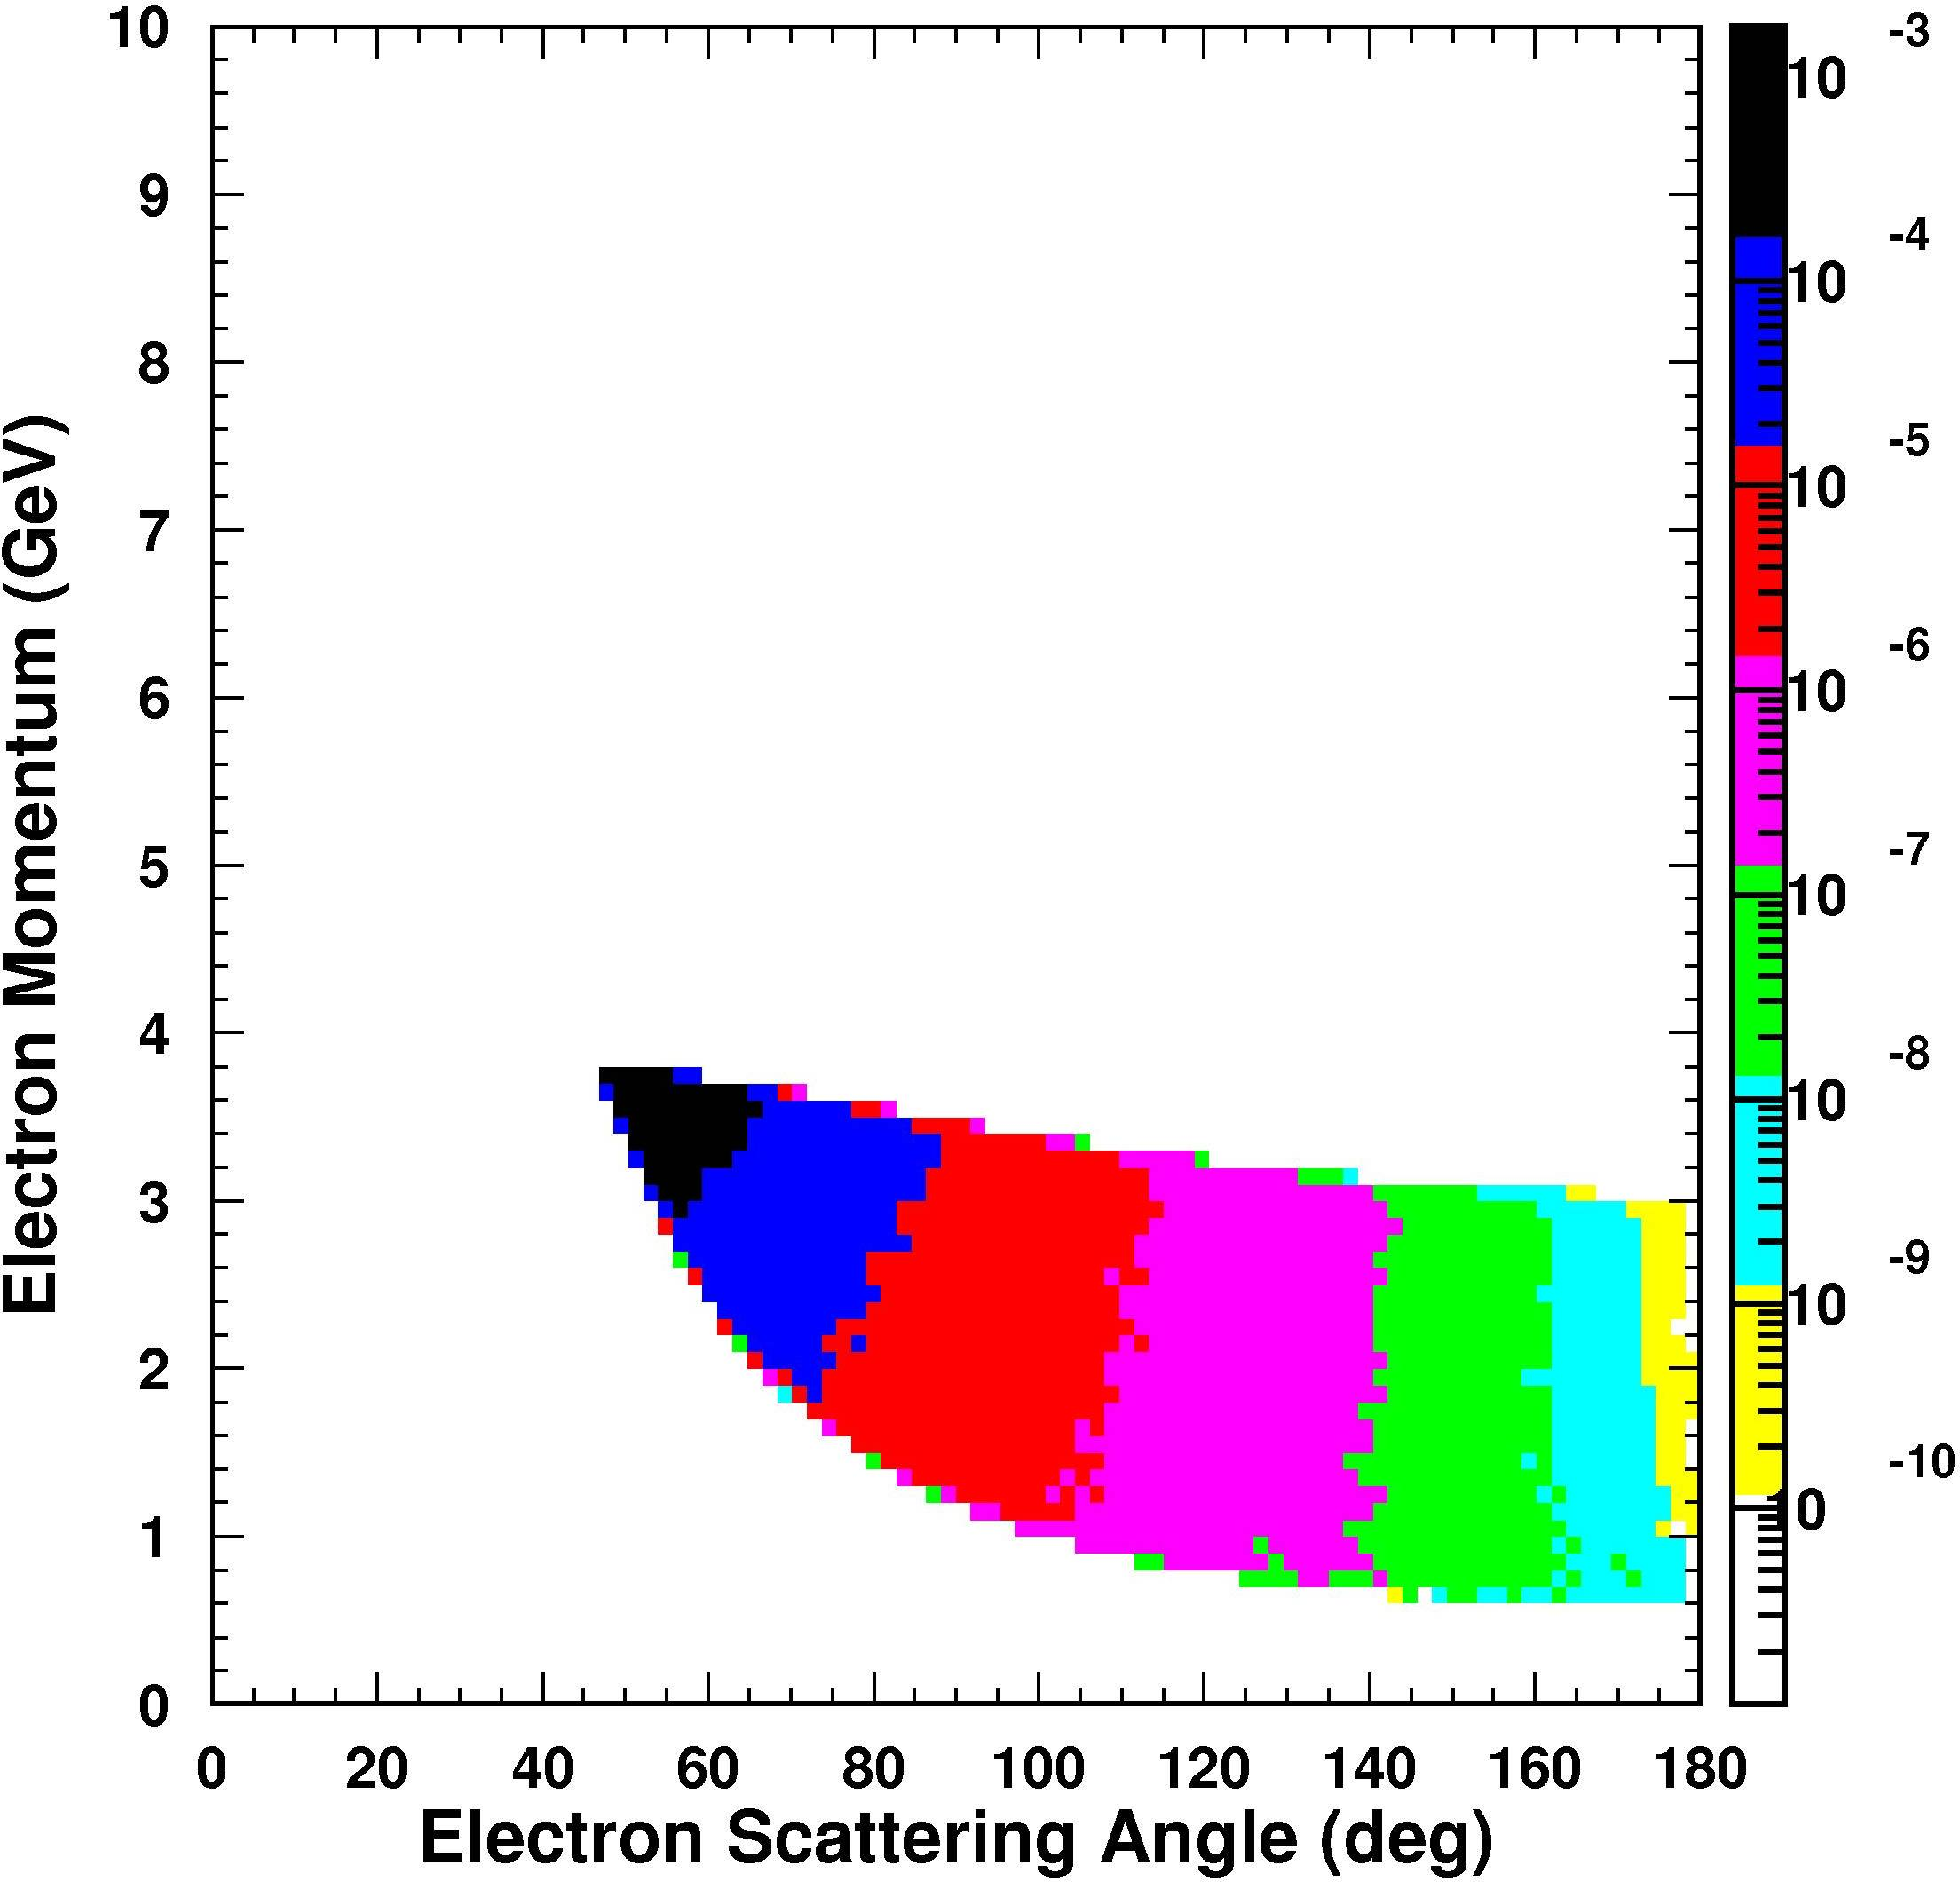
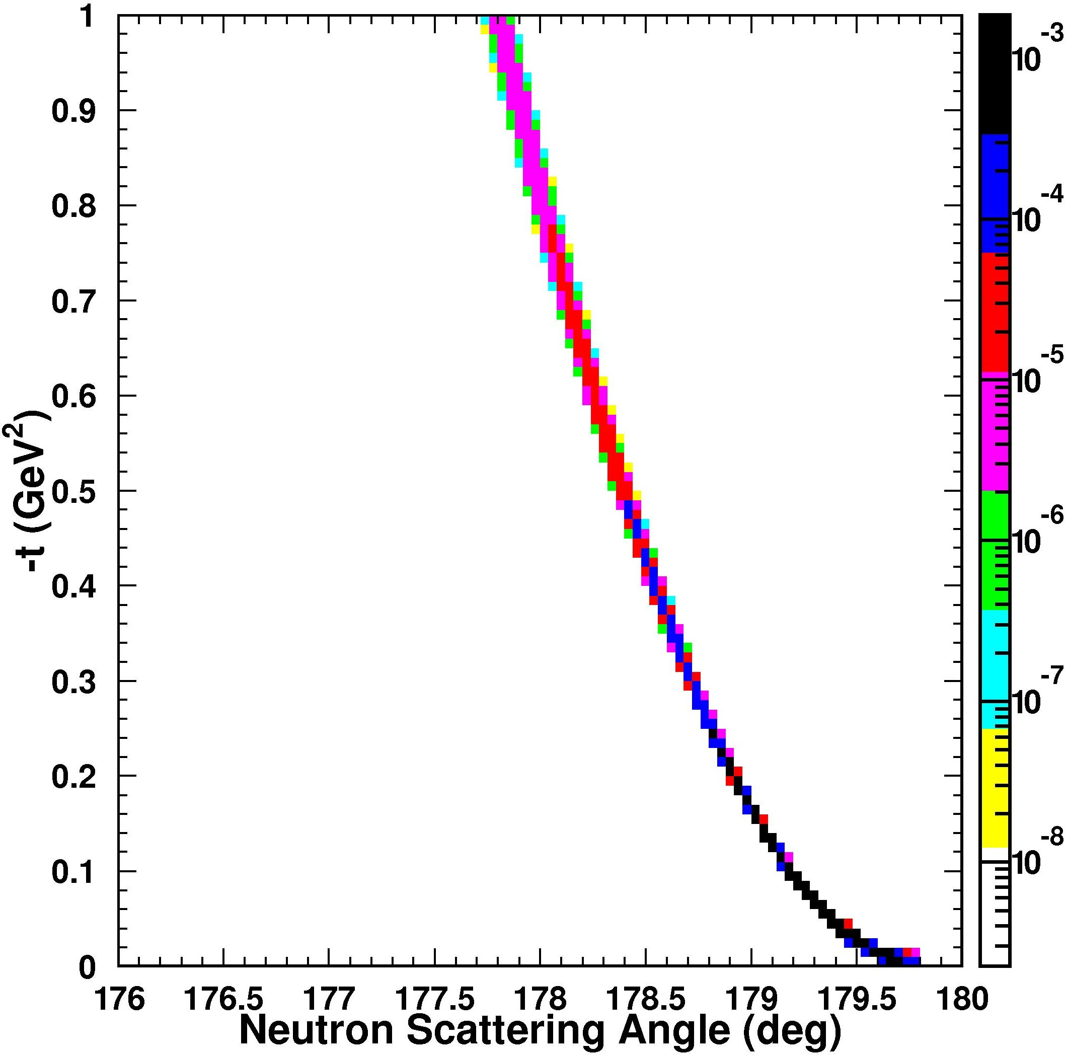
Low Q² (J/Ψ) vs high Q² (light mesons) – 4 on 30 GeV
mesons
scattered electrons
recoil baryons
forward mesons: low Q², high p
low-Q² electrons in electron endcap
60 GeV
no Q² cut
mesons in central barrel:
2 < p < 4 GeV
high-Q² electrons in central barrel:
1-2 < p < 4 GeV
Q² > 10 GeV²
t-distribution unaffected
Tanja Horn
Notes:
5

Slide 6
Neutral vs Charged Particle Detection
Forward Spectrometer
  Maximum available space on ion line is ~2m
    After Endcap RICH, Before Final Focus Quads
Dipole option
  Maximum analysis of charged particles
Off Axis trajectory through Solenoid + dipole bend of charged particle trajectories complicates detection of neutrons at 0° through FFQ1-Q3
  No drift space between dipole and FFQ1 to separate beam from 0° neutrons
  Instead use Dipole to cancel perpendicular field component of solenoid.
    Neutrons now parallel to beam through quads

Slide 7
Precession of Trajectories in Solenoid
60 GeV/c Deuteron
100 mrad
4 Tesla Solenoid.

Slide 8
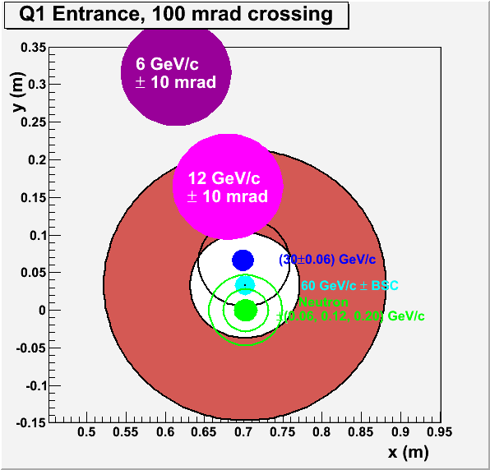
Precession of Trajectories in Solenoid
4 Tesla x 3m
at 100 mrad
G ~10 T/m
  Oversized quad
  7 T max. field
Primary N=Z beam, proton and neutron spectators in Q1 acceptance
Need B_{x}dl=−1.2 Tm from Dipole to align charged and neutral trajectories through Q1-Q3
Neutron cone larger at lower beam momenta?

Slide 9
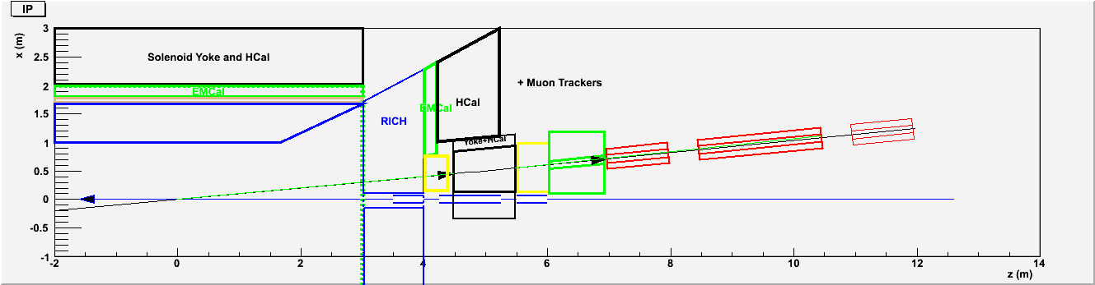
Forward Tracking
1.2 Tm vertical bend Dipole
  Cancels ⊥ B-field of Solenoid
  Tracking + EMCal + NeutronCal between dipole and Q1
    Trajectories in shadow of Q1 are tracked
      12 GeV/c for < 10mr
    Wide angle neutrons detected by annular HCal.
  0° neutrons and Charged particles aligned through Q1-Q3
    Need 20 cm aperture of Quads Q4, Q5, Dipole at 15-20 m

Slide 10
Momentum Resolution of Forward Tracker
Measure points to 100μ over 0.5 m length before and after dipole
  δθ ~0.3 mrad.
Dipole Bdl = −1.2 Tm
  Bending angle
  θ = (ecBdl)/(pc) = (0.3GeV)/(pc)
Momentum Resolution
  δp/p = δθ/θ = pc/(1000 GeV)
  1% at 10 GeV/c
  0.5% at 5 GeV/c

Slide 11
Ion Ring – Beam envelopes
FF Quads @ about 10 m, σ_{x,y} = 2-3 mm
Very forward tagging?
~ 20 meters
σ_{x,y} = 0.2 mm
IP
Beam-stay-clear area near IP, before Q1: 10-12 σ → 2.5 cm @ 7 m = 0.2 deg
Beam-stay-clear area away from IP: 8-10 σ → 2 mm @ 20 m = 0.1 mr

Slide 12
Far Forward Tracking
20-40 Tm Dipole at 20m
  Need 1-2 m drift space :
  Dispersion ~ 1 m /100%
    Not [anti-symmetric] Lattice dispersion:
    Dispersion of a 0° particle at IP
  β ~ D
Lattice Admittance ΔP/P ~0.003 = 10 δP/P
“Recoil” ion with (P’-P)/P > 0.005
  x> 5 mm
  BSC ~ 10 [εβ/γ]^{1/2} ~1 mm
  δx = 100 μ → dp||/p =10⁻⁴ → better than intrinsic beam spread
Neutron Detection in ZDC
  Neutron P⊥<60 MeV/c cone is 20 mm radius
  Separated from Beam by 200 mm after 2m drift
  10 mm resolution at 25 m → δθ = 0.4 mr → δp⊥= 12 MeV/c

Slide 13
Conclusions
Almost continuous (if not perfectly hermetic) detection is possible for forward and far-forward charged and neutral particles.
  Modest dipole allows full tracking and PID, even in Quad shadow
  Dipole Bdl = − Solenoid [Bdl tanθ]
    Resolution will be degraded if Solenoid B-field or crossing angle is reduced
Study 30m propagation through Beam Line optics for far forward exclusive protons, spectator protons, neutrons…
  Coherent Nuclei?
  Heavy fragments?
  Neutron evaporation
Start building a Monte Carlo!

Slide 14
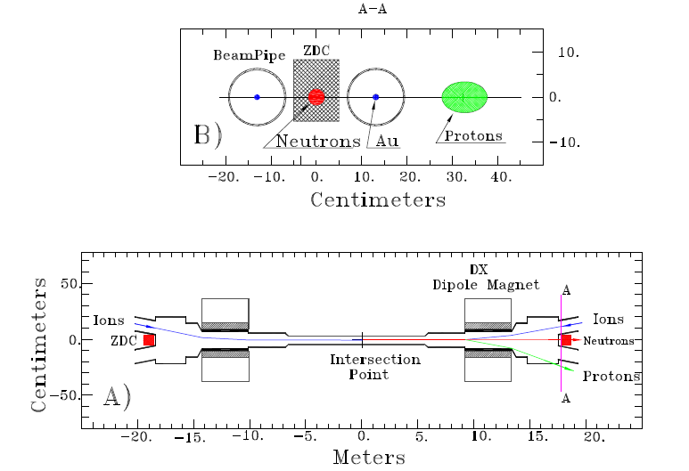
RHIC – Zero Degree Calorimeter
arXiv:nucl-ex/0008005v1
Context: The RHIC ZDC’s are hadron calorimeters aimed to measure evaporation neutrons which diverge by less than 2 mr from the beam axis.
<2 mr at 18 meters from IP → neutron cone ~ 4 cm
ZDC = 10 cm (horizontal) x 13 cm (vertical)

Slide 15
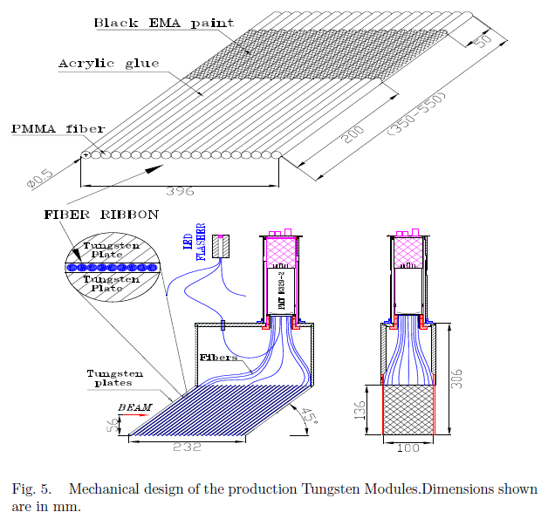
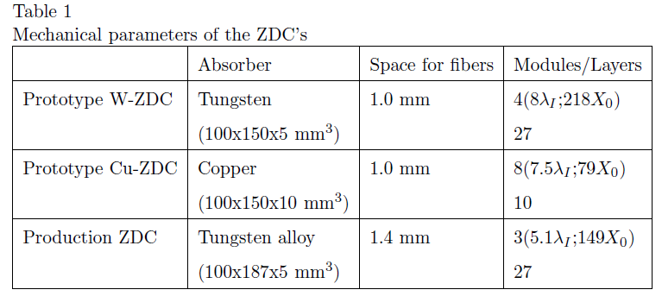
ZDC Dimensions
27 layers of 5 mm → 13.5 cm
3 modules → 40 cm thickness
60% Shower containment 1 cm from edge
9% + 8%[GeV/E_{n}]^{1/2}

Slide 16
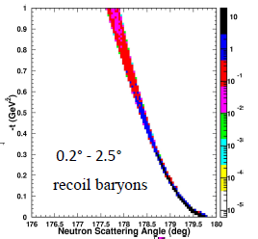
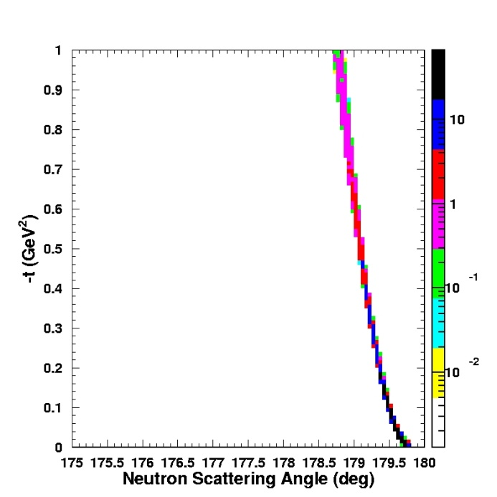
Detector/IR in simple formulas
t ~ E_{p}²Θ² → Angle recoil baryons = t^{½}/E_{p}
E_{p} = 30 GeV
E_{p} = 60 GeV
ΔΘ = 1.3
Must cover between 1 and 5 degrees (
Should cover between 0.5 and 5 degrees
Like to cover between 0.2 and 7 degrees

Slide 17
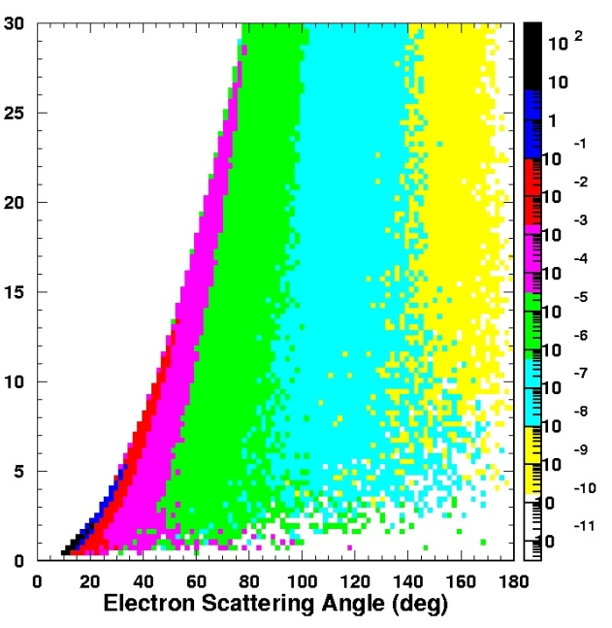
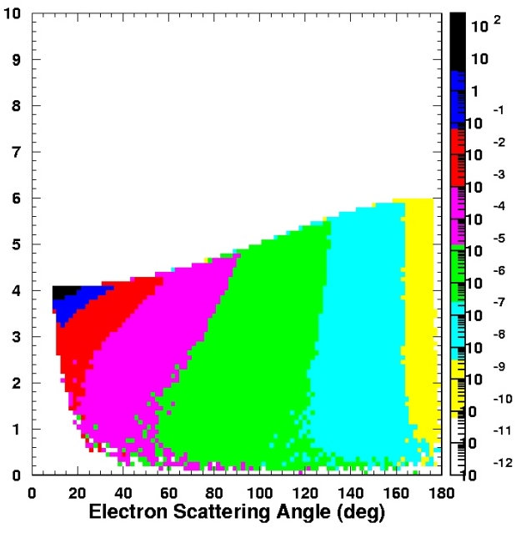
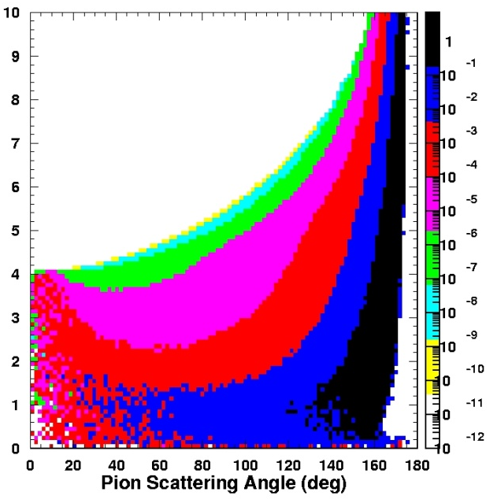
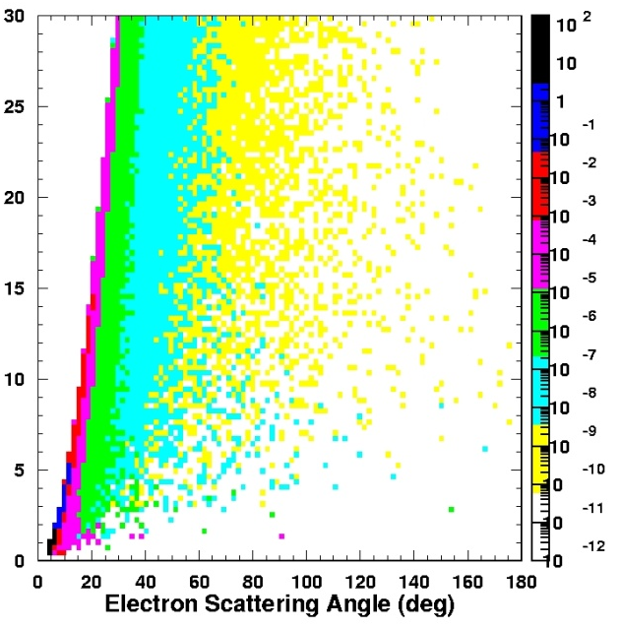
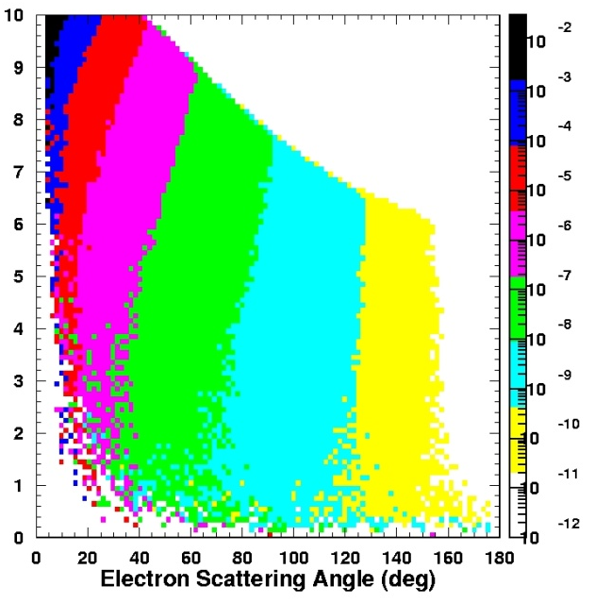
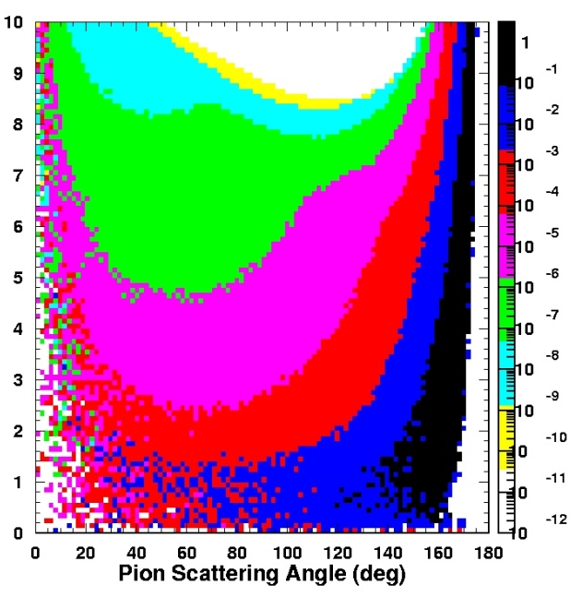
Deep exclusive kinematics:
ep → eπ⁺n
Tanja Horn
electron beam energy
Q² (GeV²)
4 on 60 GeV
p (GeV/c)
p (GeV/c)
Q² (GeV²)
11 on 60 GeV
p (GeV/c)
p (GeV/c)

Slide 18
Locations of Ion FF Quads
Name: Drift1 Q1 Drift2 Q2 Drift3 Q3 Drift4
Δz = 7m 1m 0.25m 2m 0.25m 1m 4.24m
z_{end} = 7 8 8.25 10.25 10.5 11.5 15.74 m
Q4 Drift5 Q5 Dr 6
G +0.6 0 -13.8 0 kG/cm
L 1.0 1.95 1.0 0.6 m
FF triplet : Q3 Q2 Q1
Q1 G[kG/cm] = -9.7, 1m
Q2 G[kG/cm] = 6.9, 2m
Q3 G[kG/cm] = -6.8, 1m

Slide 19
Crossing Angle
Crab Cavity
  Present state of art = 50 mr
  Plan for 60 mr.
    Redo Slide 8 for 60 mr

