Slide 1
Summary of EIC Detector Workshop 4—5 June 2010 Talks on web http://conferences.jlab.org/eic2010/
Jefferson Laboratory Users Group
07-09 June 2010
Charles E. Hyde
Université Blaise Pascal, and
Old Dominion University
Organizing Committee Pawel Nadel-Turonski (JLab) Tanja Horn (Catholic U.)
C.E.H.
Sponsored by
JLab and JSA

Slide 2
EIC Detector
Status of concept for a Collider Detector
Optimize for 6 GeV x 60 GeV
Range from 3x20 to 11x60
At least two detectors desired
Review of critical detector technologies
Focus on particle ID
Tracking
Integration of Detector, Interaction Point, Accelerator Lattice
Forward meson detection and far-forward baryon tagging.
Small angle and/or 0° electron tagging

Slide 3
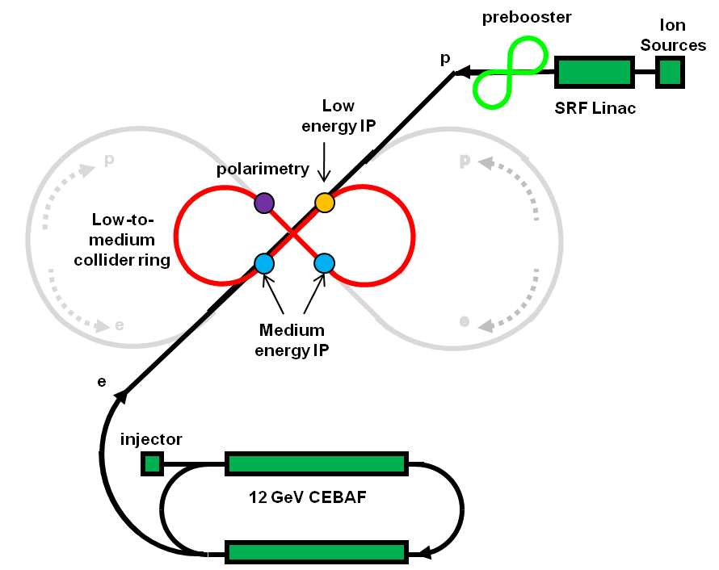
MEIC@JLab – Detector Layout
Electron energy: 3-11 GeV
Proton energy: 20-60 GeV
Special IP?
s = 250 - 2650 GeV²
Can operate in parallel
with fixed-target program
MEIC = EIC@JLAB
1-2 high-luminosity detectors
Luminosity ~ 10³⁴ cm⁻²s⁻¹
Low backgrounds
Special detector?
< 1 km circumference
Note: RHIC is 3.8 km
ELIC = high-energy EIC@JLab
Phase-II upgrade?
1.4 km circumference
Notes:
3

Slide 4
Detector requirements
1. Mainly driven by exclusive physics
Hermeticity (also for hadronic reconstruction methods in DIS)
Particle identification (also SIDIS)
Momentum resolution (kinematic fitting to ensure exclusivity)
Forward detection of recoil baryons (also baryons from nuclei)
Muon detection (J/Ψ)
Photon detection (DVCS)
2. But not only ...
Very forward detection (spectator tagging, diffractive, coherent nuclear, etc)
Vertex resolution (charm, strangeness)
Hadronic calorimetry (jet reconstruction)

Slide 5
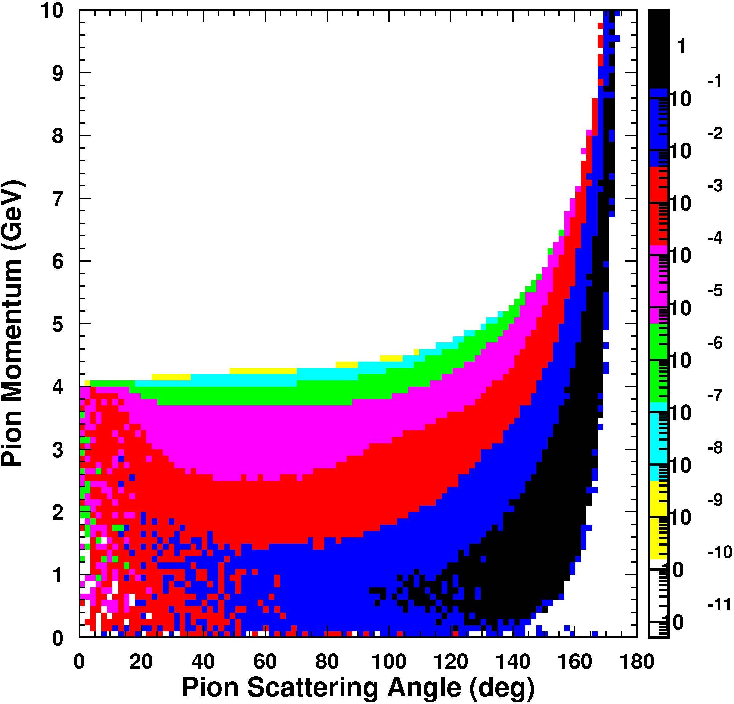
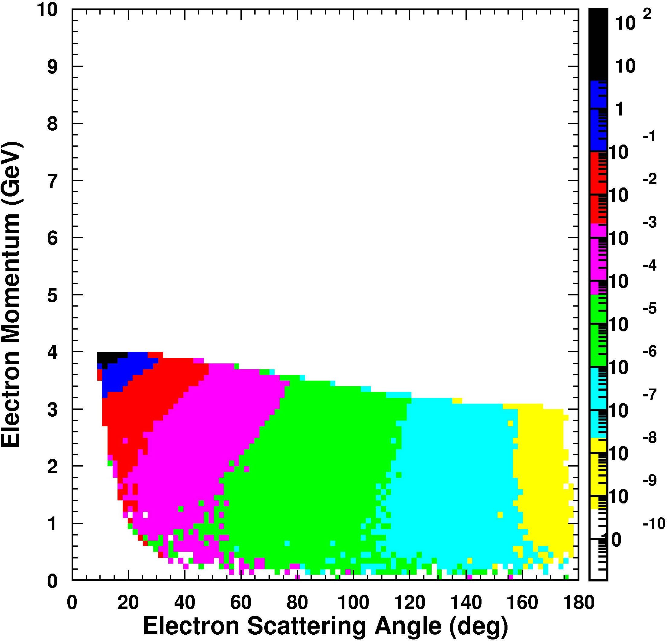
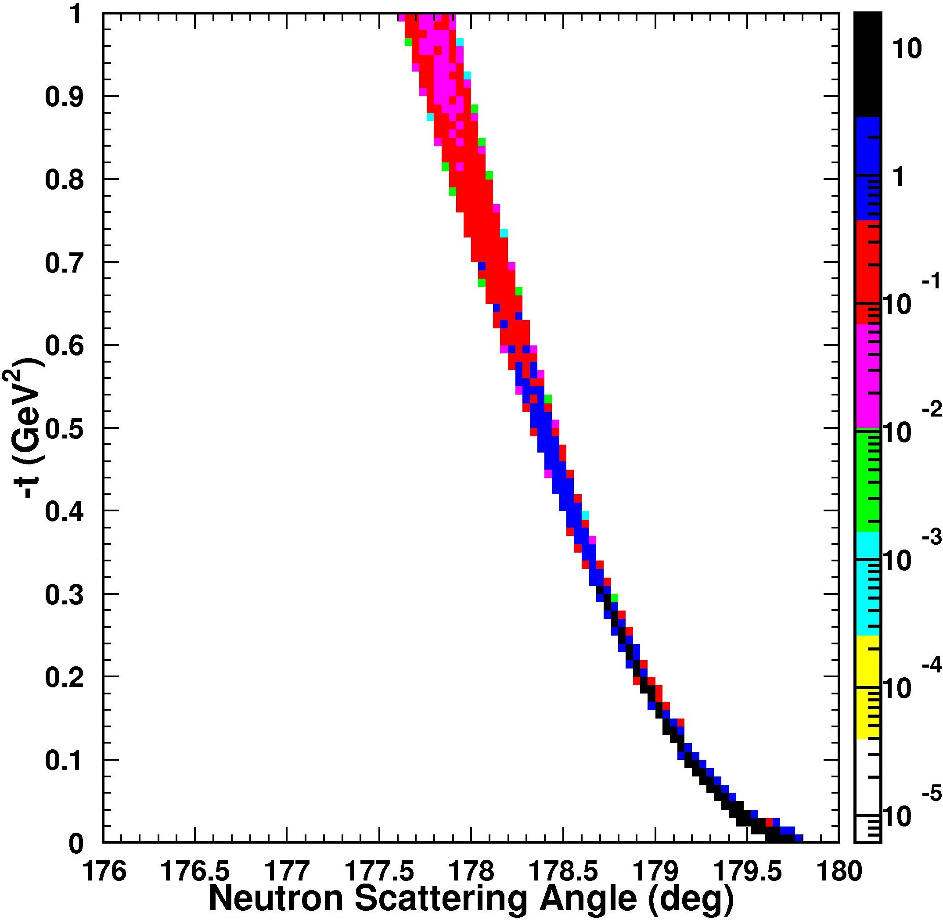
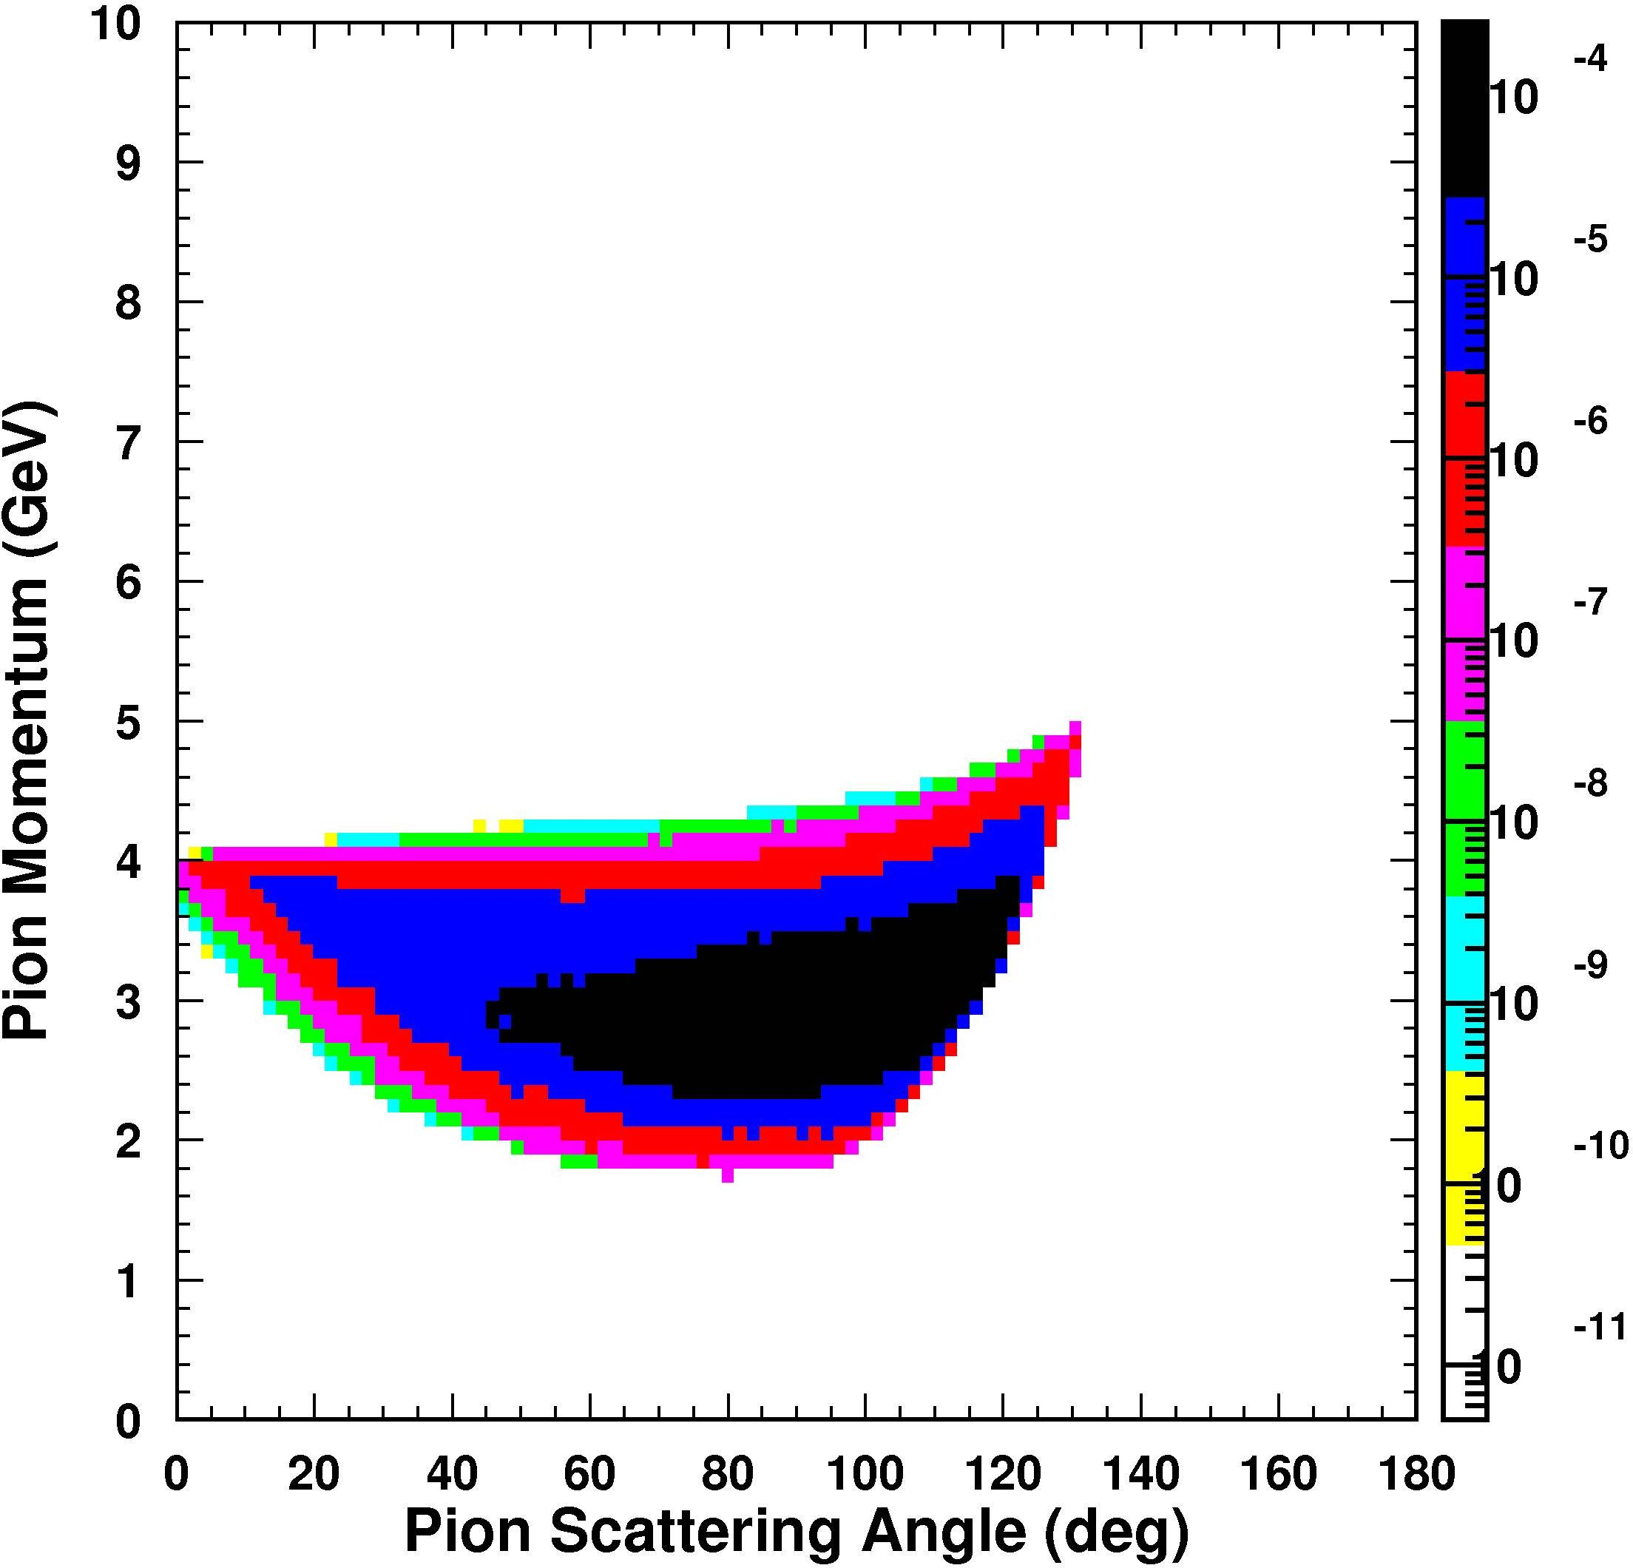
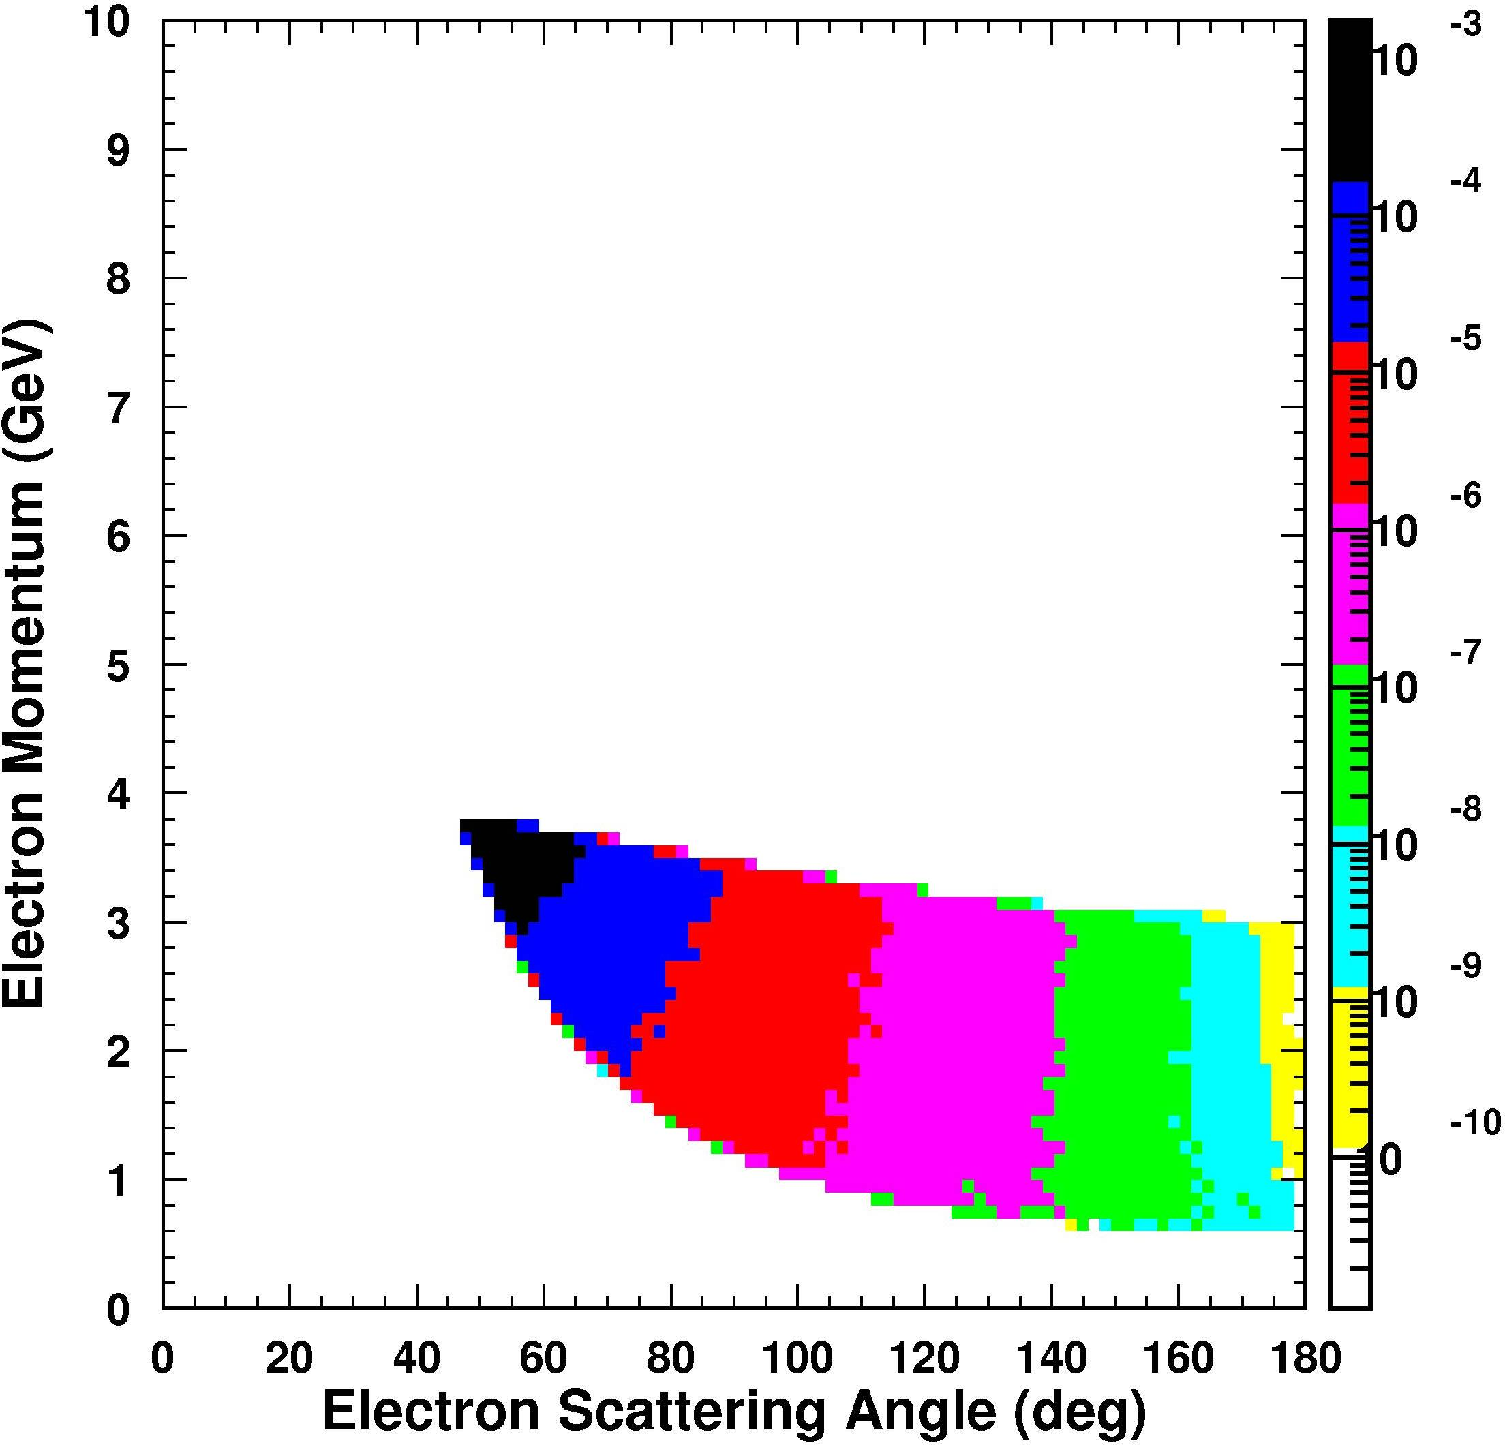
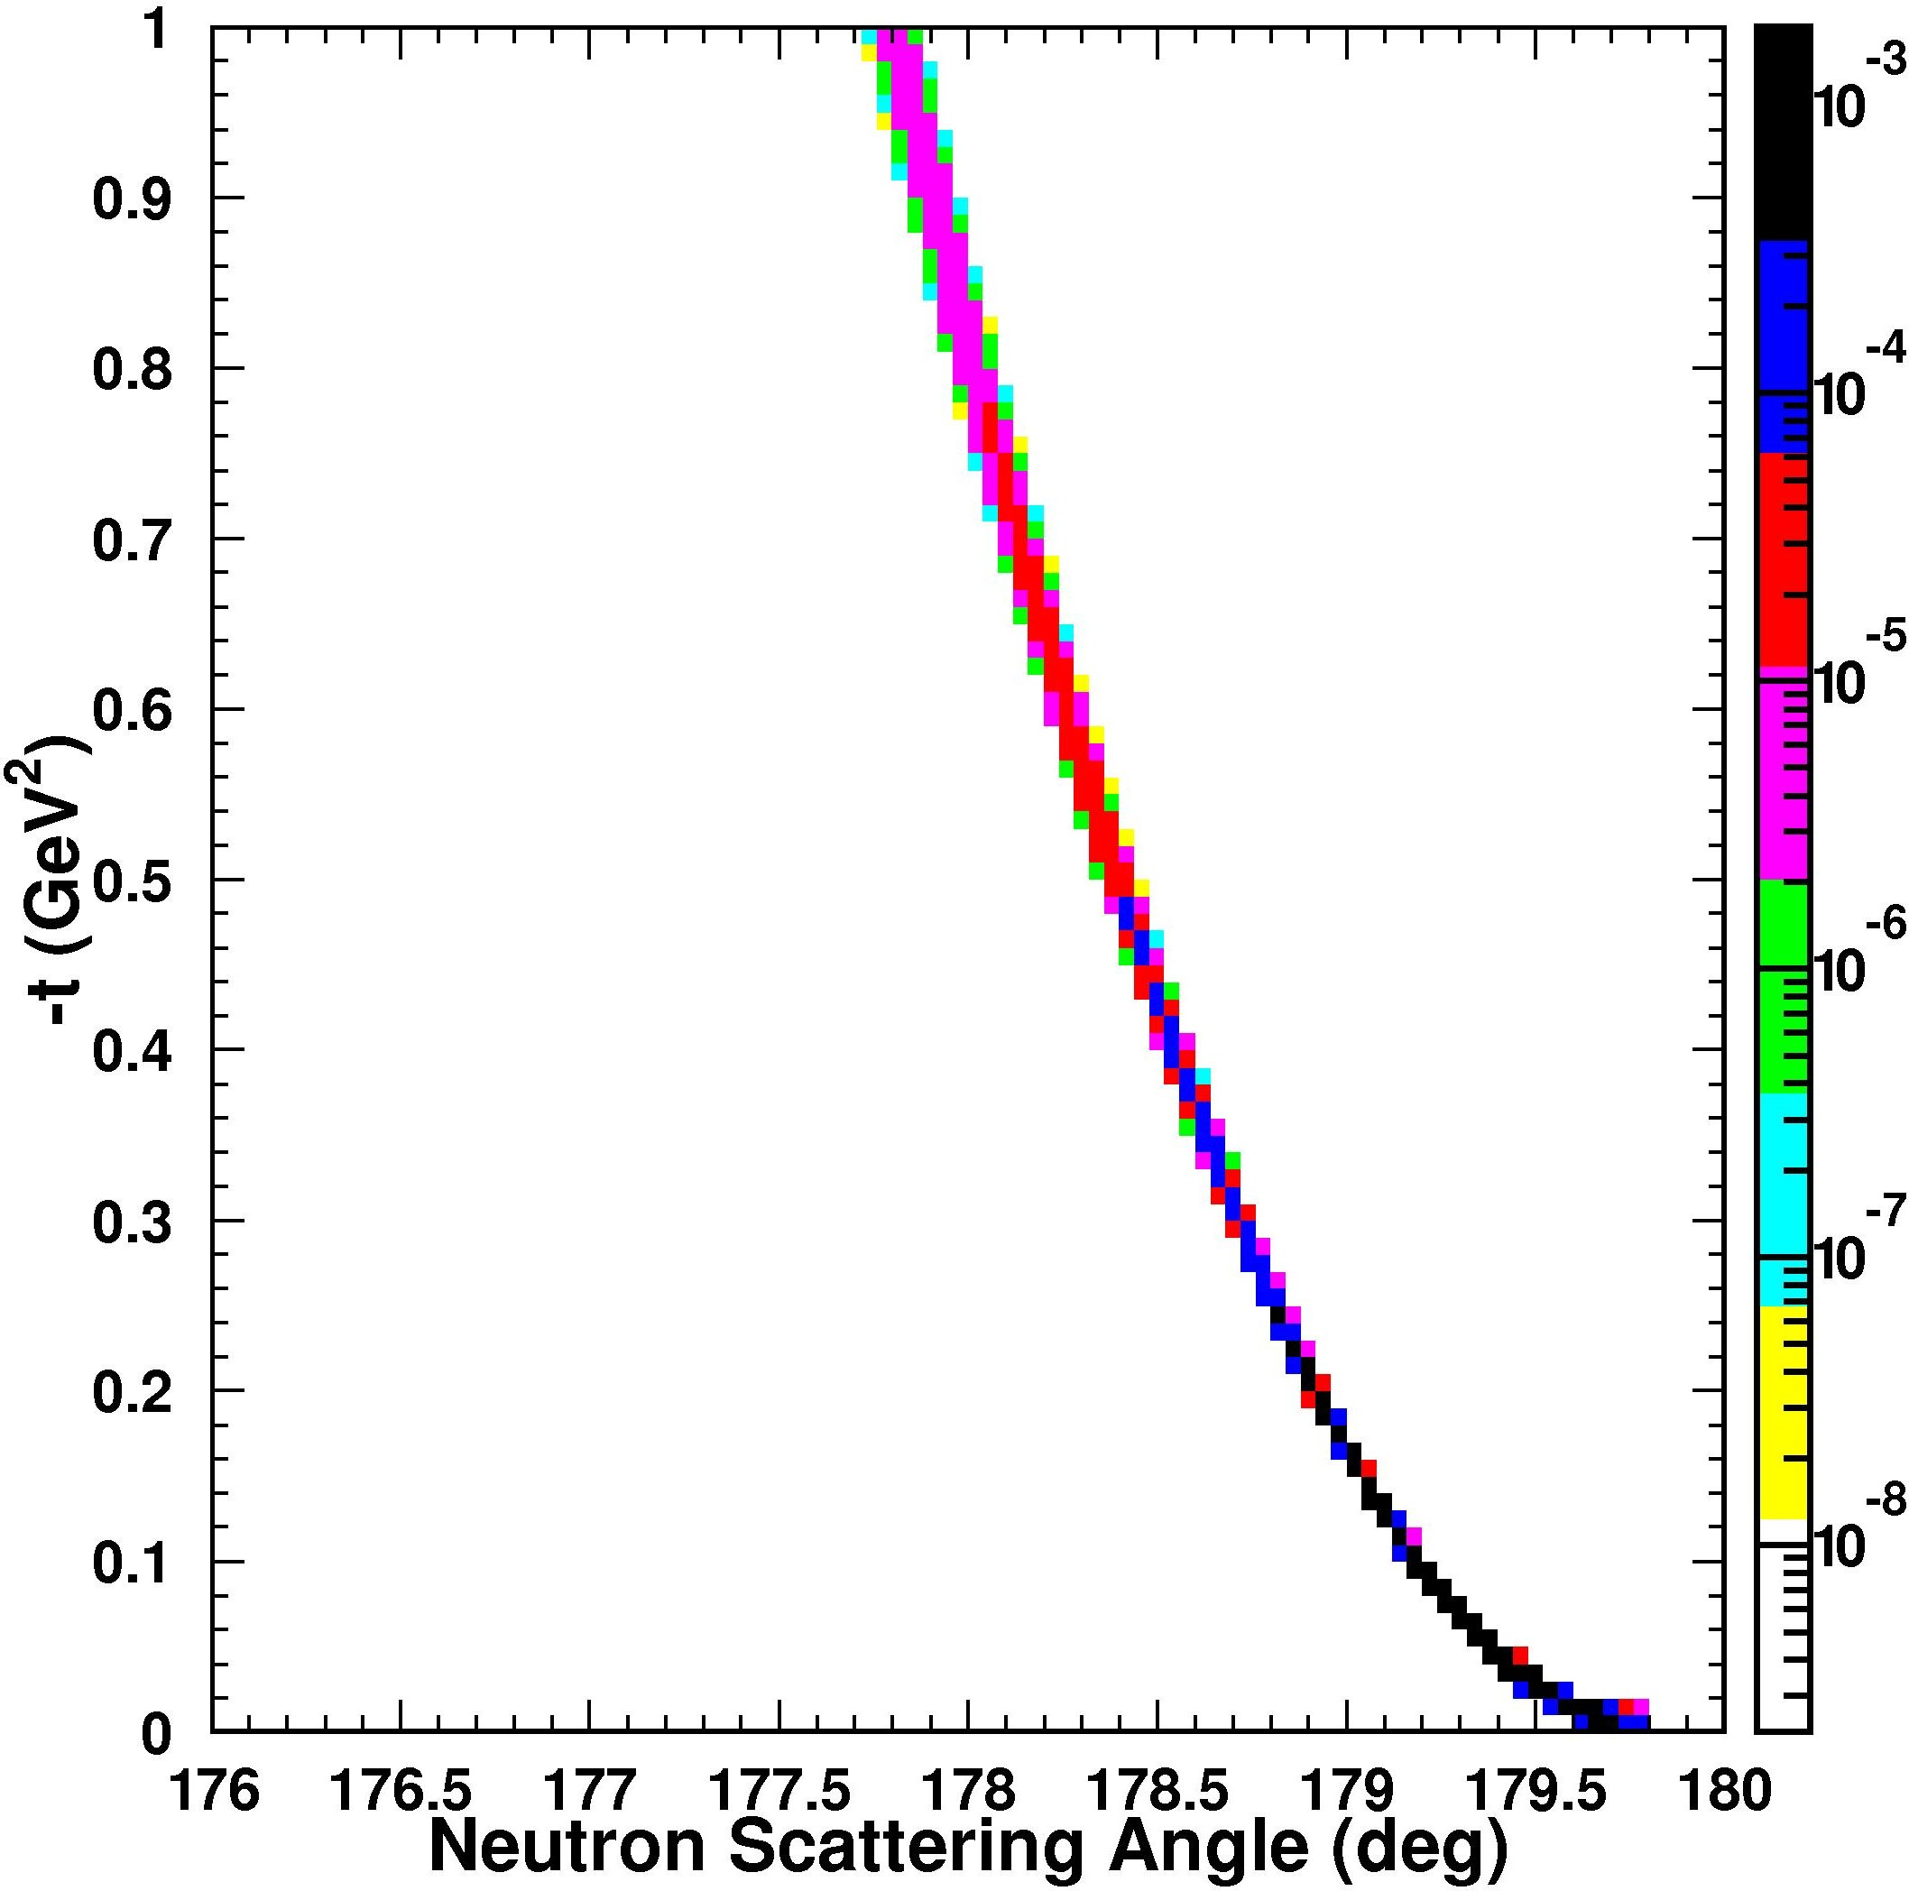
Low Q² (J/Ψ) vs high Q² (light mesons) – 4 on 30 GeV, (x_{B}<0.1)
mesons
scattered electrons
recoil baryons
forward mesons: low Q², high p
low-Q² electrons in electron endcap
no Q² cut
mesons in central barrel:
2 < p < 4 GeV
high-Q² electrons in central barrel:
1-2 < p < 4 GeV
Q² > 10 GeV²
t-distribution unaffected
Tanja Horn
Notes:
5

Slide 6
Particle ID:
PMT based RICH counter
HERMES dual RICH (Aerogel+CF4) E. Cisbani (INFN)
DIRC: Jochen Schwiening (GSI)
“images” of Cerenkov cone propagated by total internal reflection in solid fused Silica
BABAR + proposals for PANDA, Super-B etc.
π/K/p separation up to >4 GeV/c
dEdX / TOF / RICH N. Smirnov (Yale)
ALICE high momentum RICH R&D (p>10 GeV) : Cs or CsI photo-cathode evaporated onto micro-pattern amplifier/readout
EM Calorimetry (e/γ/π) S. Stepanyan
PbWO₄ Crystals
Sampling : Pb-Scin, W-Si, Shashlyk
Hadronic Calorimeter : S. White (BNL)
Zero Degree Neutron Detection

Slide 7
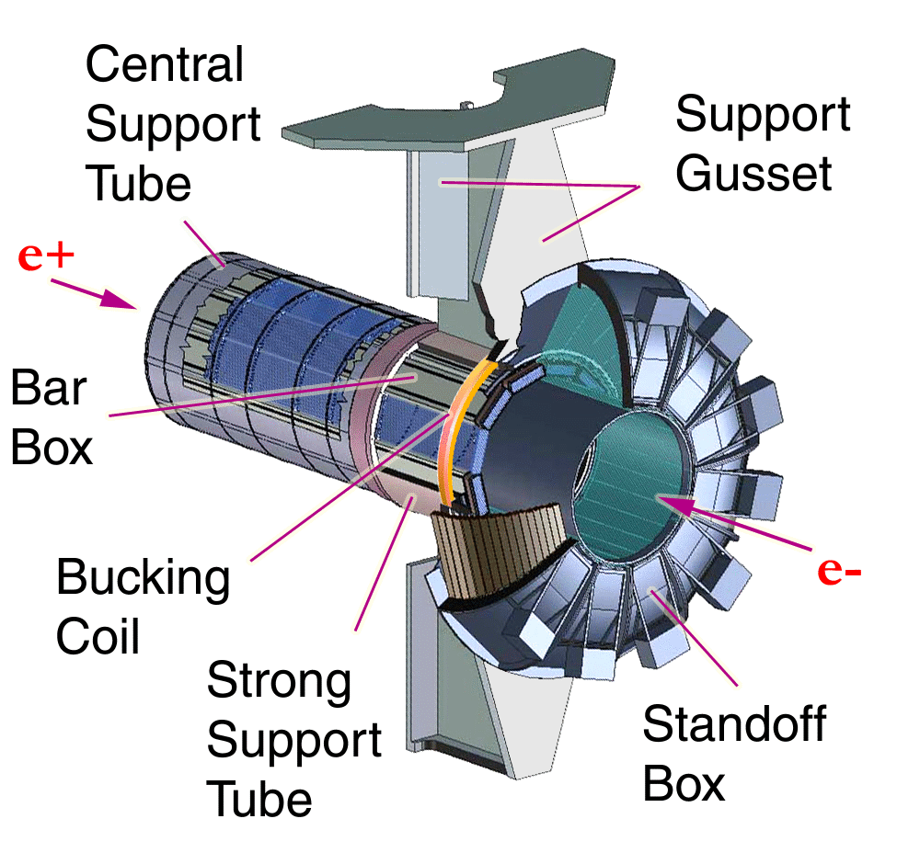
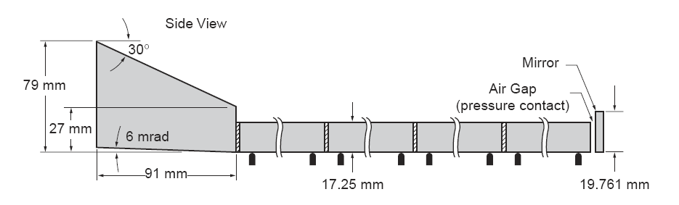
The DIRC in BABAR
DIRC thickness:
8 cm radial incl. supports
19% radiation length
at normal incidence
DIRC photon detection array:
10,752 PMTs ETL 9125
π/K separation up to 4 GeV/c
K/p up to 7 GeV/c

Slide 8
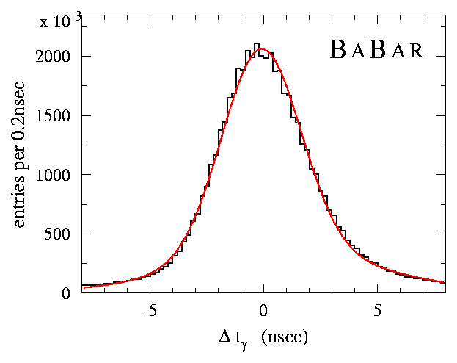
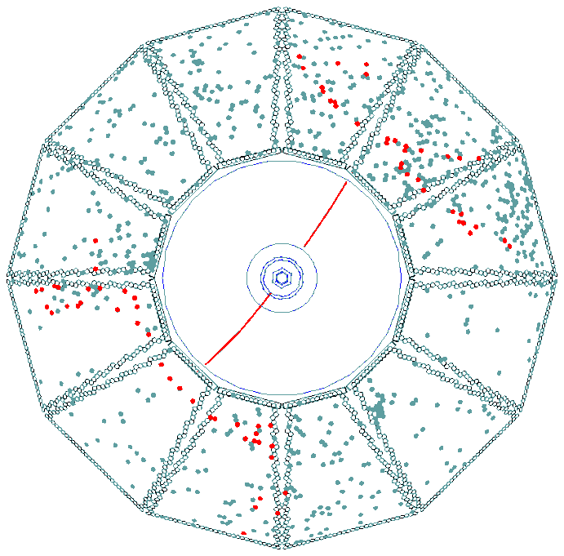
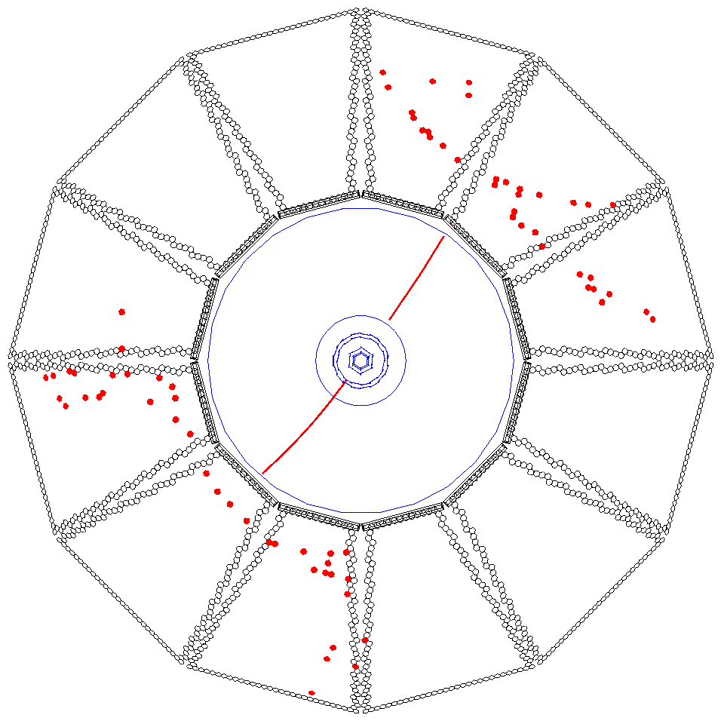
DIRC RECONSTRUCTION: (x,y,t)
For BABAR DIRC time information provided powerful tool to reject accelerator and event related background.
σ(Δt) = 1.7 nsec
Calculate expected arrival time of Cherenkov photon based on • track TOF • photon propagation in radiator bar and in water
Δt: difference between measured and expected arrival time
± 300 nsec trigger window → ± 8 nsec Δt window (~500-1300 background hits/event) (1-2 background hits/sector/event)
Δt (nsec)
Δt also used to determine event time for “self-triggering” of DIRC.
→
Notes:
8

Slide 9
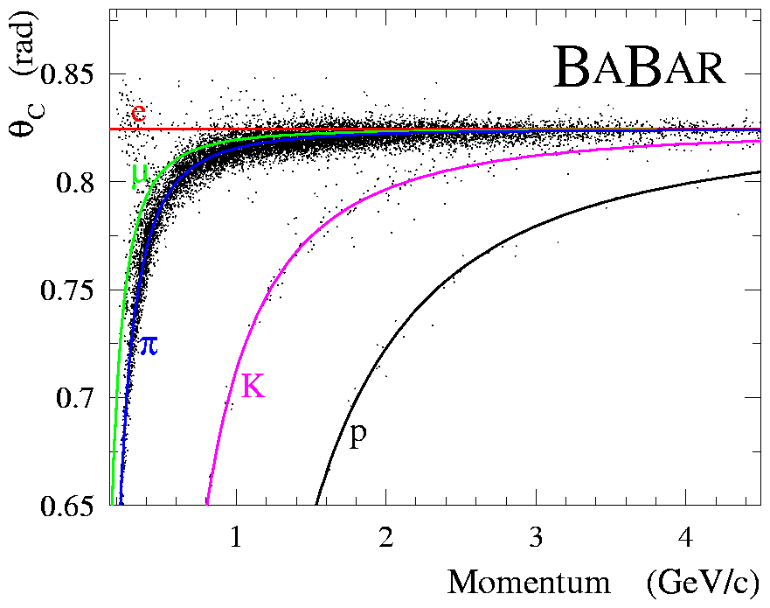
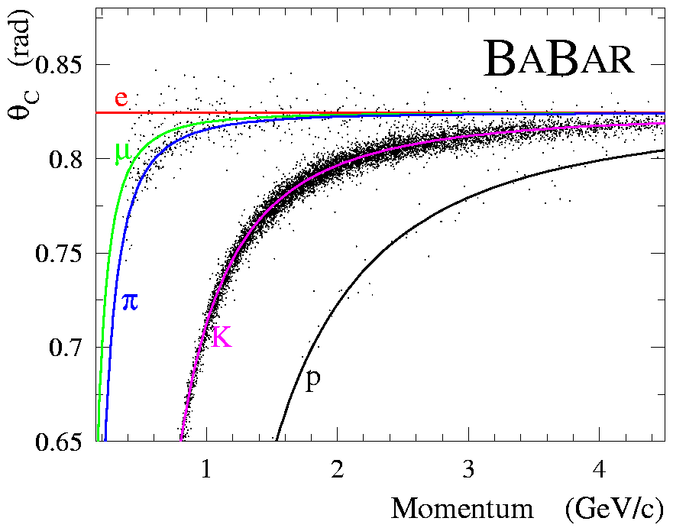
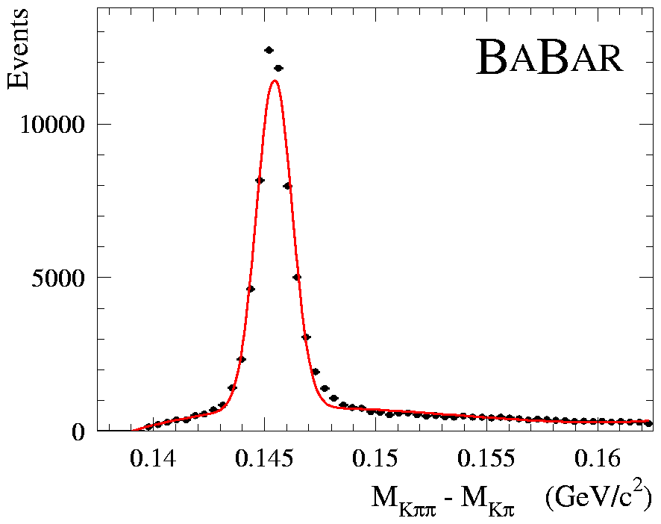
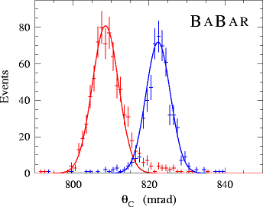
BABAR DIRC PERFORMANCE EXAMPLE
D∗ – → D⁰ π –
K– π ⁺
kinematically identified
π and K
Select D⁰ candidate control sample with mass cut (±0.5 MeV/c²)
• π and K are kinematically identified
calculate selection efficiency and mis-id
Correct for combinatorial background (avg. 6%) with sideband method.
example: 2.5<|p|≤3GeV/c
K
π

Slide 10
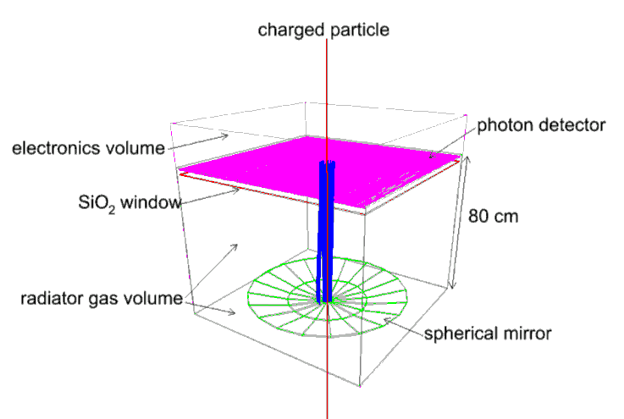
ALICE HMPID R&D
Focusing RICH, C₄F₁₀ gas radiator L~ 80 cm
Photon detector a la HMPID, baseline option: MWPC with CsI pad (8x8 mm) segmented photocathode; alternative: CsI-TGEM or GEM
Spherical (or parabolic) mirror, composite substrate, Al/MgF2 coating
FEE based on HMPID Gassiplex chip, analogue readout for localization via centroid measurement
CaF₂
Windowless designs also use C₄F₁₀ or CF₄ as both Cerenkov and amplifier medium.
07/05/2010
A. Di Mauro – RICH2010, Cassis
10

Slide 11
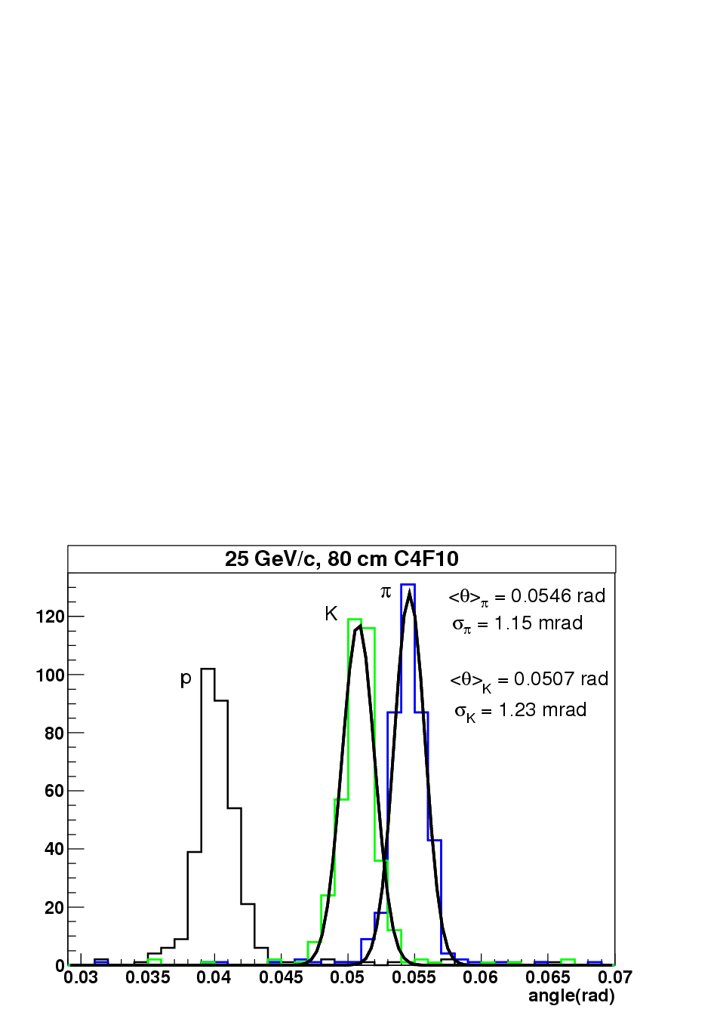
PID performance: ID range
 | Signal (GeV/c) | Absence of signal (GeV/c)
π | 4-24
K | 11-24
p | 18-38 | 11-18
Lower limit: Cherenkov threshold
Upper limit: 3σ separation
TestBeam and AliROOT simulation
19/10/09
ALICE Upgrade Forum
11

Slide 12
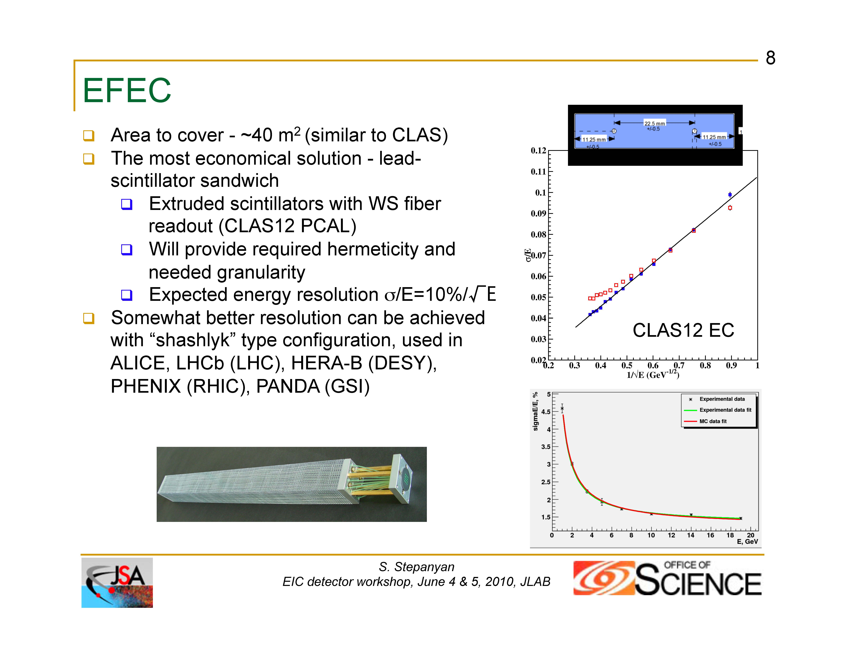

Slide 13
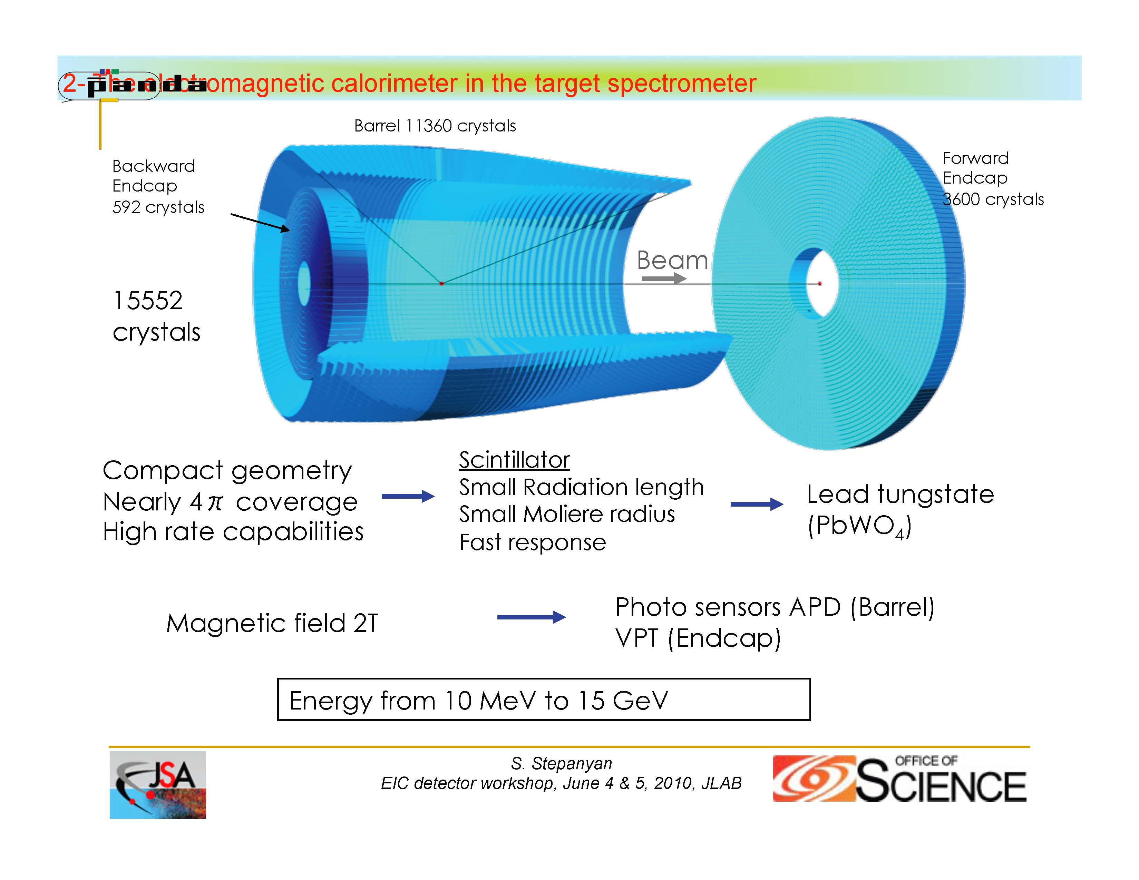

Slide 14
Tracking/ Triggering / Simulations
Tracking: F. Klein (CUA)
Pattern recognition
Technologies for EIC:
Central tracking, three stage Si + TPC + micro-pattern
Endcap tracking (Si) + Drift Chambers or micro-pattern
Triggering : B. Raydo (JLab)
Challenge of asynchronous triggering with 1.5 GHz beam structure
JLab 6 GeV : analog
Pipeline DAQ/Triggering
CLAS12, HallD
Simulations: T. Horn (CUA)
Event Generators, simulations

Slide 15
Activities of the Simulation Working Group
Event Generators (standardized format)
Rate predictions including simulations of the detector restrictions
Input for detector design
Momentum and angular distributions for various particles
Fast MC
Input: resolution function
GEANT MC
Based on the CLAS12 simulation package GEMC
Event Reconstruction/Tracking (for GEANT data)
Semi weekly meetings with Physics+Accelerator EIC group

Slide 16
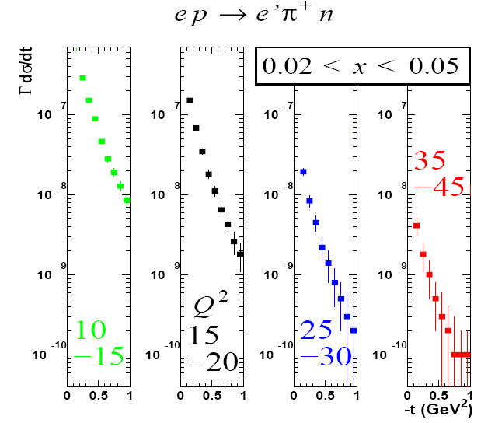
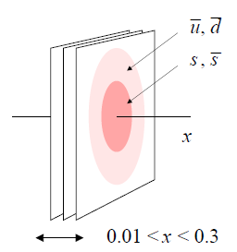
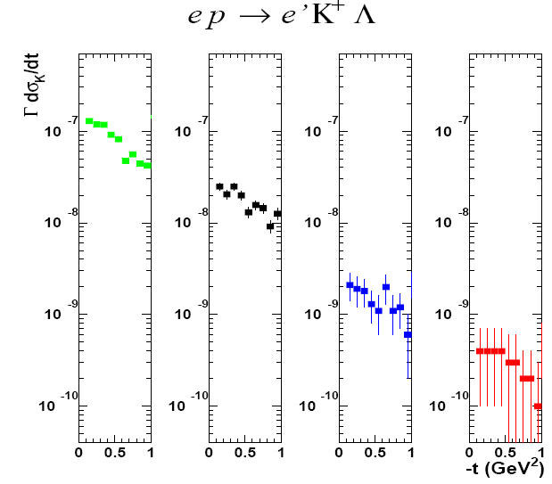
Exclusive Generators: π⁺/K⁺
e p π⁺ n
[T. Horn with summer student: D. Cooper ’08]
Do strange and non-strange sea quarks have the same spatial distribution?
Simulation for charged π⁺ production, assuming 100 days at a luminosity of 10³⁴, with 5 on 50 GeV (s = 1000)
e p K⁺ Λ
Pion cross section models:
Ch. Weiss: Regge model
T. Horn: π⁺ empirical parameterization
Kaon cross section model:
T. Horn: K⁺ empirical parameterization based on DESY, Cornell, JLab data
Pushes for high luminosity ~10³⁴ and lower and more symmetric energies

Slide 17
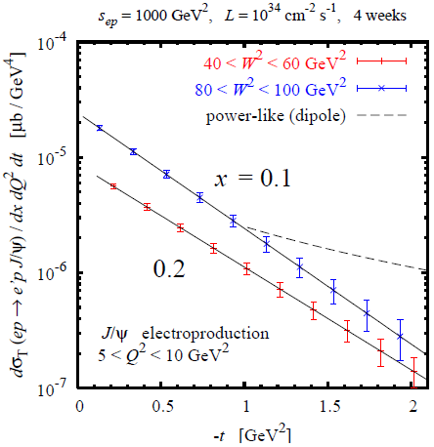
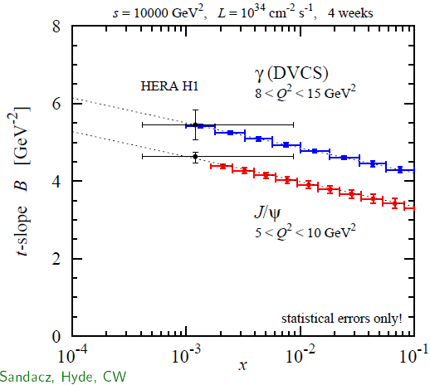
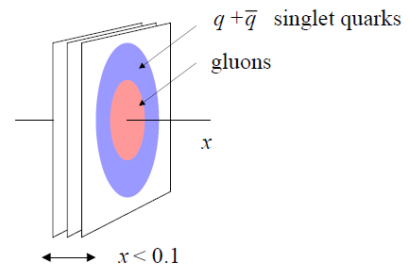
Models and rate estimates: J/Ψ and DVCS
[Sandacz, Hyde, Weiss ’06/07+]
Gluon size directly probed by J/Ψ and φ production (Q²>10 GeV²)
Require full t-distribution Fourier
Powerlike at |t|>1GeV²?
J/Ψ rate estimate uses a model based on a photoproduction parameterization
Branching ratio of 0.06 into e⁺e⁻ (or μ⁺μ⁻) has been included in rate estimates
Do singlet quarks and gluons have the same transverse distribution?
Gluon size from J/Ψ, singlet quark size from DVCS

Slide 18
Summary - main detector challenges (P. Nadel-Turonski)
1. Central Detector
Particle ID (e/π/K/p)
Momentum resolution (tracker radius / layout)
Electron beam on Solenoid Axis
Ion beam crossing angle 50 – 100 mrad.
2. Forward hadron detection
Acceptance (3 stages needed)
0 to 10 mr, 10 mr to 5°, >5°
Momentum resolution at intermediate angles (0.5-5°)
3. Low-Q² electron tagging
Endcap design (DIRC readout?)
Common dipole for both beams?
4. Integration with accelerator

Slide 19
Central detector and End caps
TOF
Crossing angle: 3-5°
Magnet apertures for small-angle ion and electron detection not shown
Solenoid yoke + Muon Detector
Solenoid yoke + Hadronic Calorimeter
EM Calorimeter
Tagger
LTCC / RICH
ions
Forward hadrons
Tracking
Muon Detector
HTCC
RICH
EM Calorimeter
EM Calorimeter
Hadron Calorimeter
electrons
TOF (5 cm)
DIRC (10 cm)
EmCal (20 cm)
Low Threshold Cer 65cm
5 m
The IP the IP is offset within the solenoid towards the electron endcap to provide more tracking space
Barrel has ~1 m radial tracking + ~1 m [Cerenkov+DIRC+TOF+EMCal]
Only active elements are shown. Detector can be “closed” magnetically

Slide 20
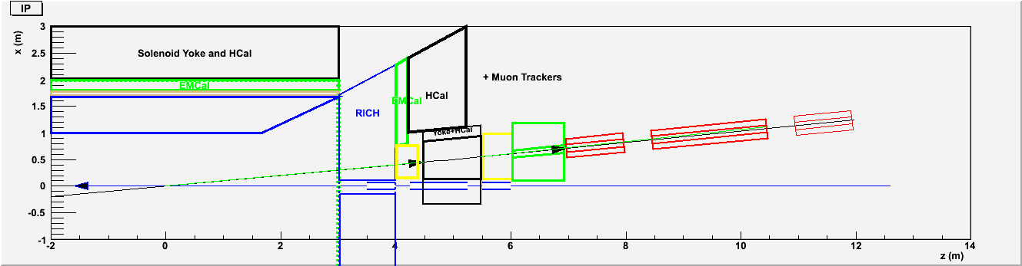
Forward Tracking
1.2 Tm vertical bend Dipole
Cancels ⊥ B-field of Solenoid
Tracking + EMCal + NeutronCal between dipole and Q1
Trajectories in shadow of Q1 are tracked
12 GeV/c for < 10mr
Wide angle neutrons detected by annular forward nCal.
0° neutrons and Charged particles aligned through Q1-Q5
20 Tm Dipole at 20 m : ZDC for neutrons, Tracking for P’<0.995P

Slide 21
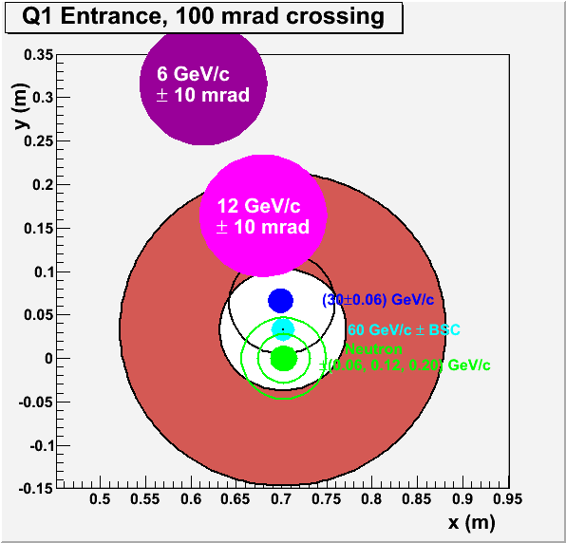
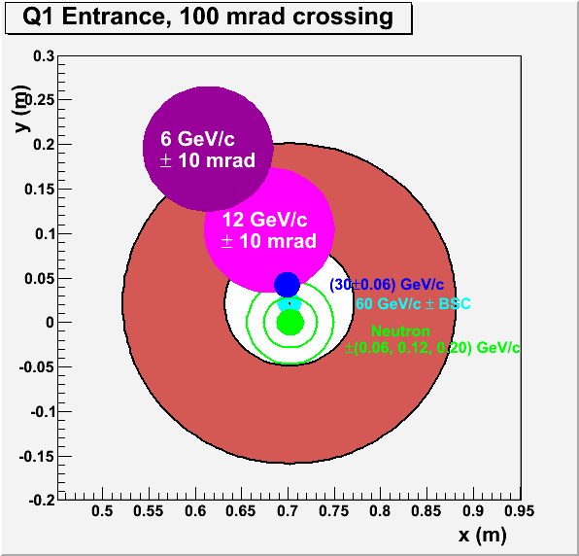
Precession of Trajectories in Solenoid
Solenoid
4 Tesla x 3m at 100 mrad
Q1-Q3
G ~10 T/m
Oversized quad 7 T max. field
Primary N=Z beam, proton and neutron spectators in Q1 acceptance
Need B_{x}dl=−1.2 Tm from Dipole to align charged and neutral trajectories through Q1-Q3
10 GeV/c forward hadrons tracking dp/p ~1%
Detect n,p Spectators after 20 Tm dipole at 20 m
Tracking acceptance P’<0.995 P
Resolution dP/P <3•10⁻⁴.

Slide 22
Conclusion
Informative workshop
Significant progress in detector design
Active detector design effort
Need lots of input from users on requirements for individual physics processes
Detect both “current jet” and “Projectile jet”
Dynamic interaction with accelerator group
Close to a “Zero Design Concept”
Next project, a “Fast Monte Carlo”
Analytic, not GEANT, easy to analyse output
Happy to hear proposals for a more specialized second detector
Join us !

Slide 23
Momentum Resolution of Forward Tracker
Measure points to 100μ over 0.5 m length before and after dipole
δθ ~0.3 mrad.
Dipole Bdl = −1.2 Tm
Bending angle
θ = (ecBdl)/(pc) = (0.3GeV)/(pc)
Momentum Resolution
δp/p = δθ/θ = pc/(1000 GeV)
1% at 10 GeV/c
0.5% at 5 GeV/c

Slide 24
Ion Ring – Beam envelopes
FF Quads @ about 10 m, σ_{x,y} = 2-3 mm
Very forward tagging?
~ 20 meters
σ_{x,y} = 0.2 mm
IP
Beam-stay-clear area near IP, before Q1: 10-12 σ → 2.5 cm @ 7 m = 0.2 deg
Beam-stay-clear area away from IP: 8-10 σ → 2 mm @ 20 m = 0.1 mr

Slide 25
Forward Particles of a 6x60 GeV collider
“Forward” is defined relative to ion beam
Important issues also for low Q2 tagging on electron side, not addressed here.
SIDIS and exclusive processes produce “jet” fragmentation particles (γ, π, K, etc).
These particles fill the full 4π laboratory detector space,
Exclusive, DIS, Rapidity gap events produce ultra forward baryons, and forward mesons from dissociation.
Exclusive: ep → epγ
SIDIS or RapGap: ep → e’K…Λ…
Deep Exclusive or SIDIS production of forward Δ, Λ will produce forward mesons and nucleons
mesons: momenta ~(m/M)P ~8 GeV/c θ ~ (0.2 GeV/c) / (8 GeV/c) ~25 mrad
nucleons: P~50 GeV/c, θ ~4 mrad
Photoproduction can produce forward mesons [nearly] up to beam momentum

Slide 26
Far Forward Tracking
20-40 Tm Dipole at 20m
Need 1-2 m drift space :
Dispersion ~ 1 m /100%
Not [anti-symmetric] Lattice dispersion: Dispersion of a 0° particle at IP
β ~ D
Lattice Admittance ΔP/P ~0.003 = 10 δP/P
“Recoil” ion with (P’-P)/P > 0.005
x> 5 mm
BSC ~ 10 [εβ/γ]^{1/2} ~1 mm
δx = 100 μ → dp||/p =10⁻⁴ → better than intrinsic beam spread
Neutron Detection in ZDC
Neutron P⊥<60 MeV/c cone is 20 mm radius
Separated from Beam by 200 mm after 2m drift
10 mm resolution at 25 m → δθ = 0.4 mr → δp⊥= 12 MeV/c

