Slide 1
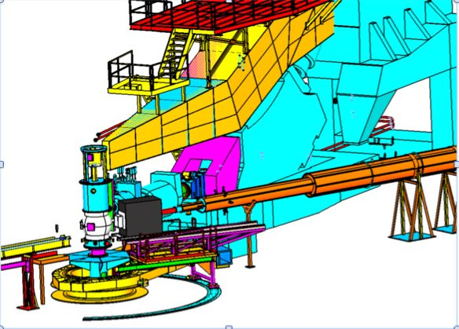
DVCS at 12 GeV: E12-06-114
“Measurements of the electron-helicity dependent cross-sections of deeply virtual Compton scattering in Hall A at 11 GeV”
C. Hyde
C. Muñoz Camacho
A.Camsonne
J. Roche
Hall A Collaboration Meeting
14-16 December 2011

Slide 2
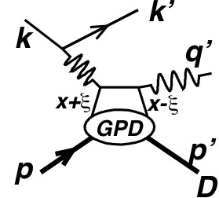
Generalized Parton Distributions (GPDs)
  GPD(x,ξ,t)
  ξ ≈ x_{B}/(2-x_{B})
    x = average momentum fraction
    2ξ = skewness
Correlation of longitudinal momentum fraction x± ξ with transverse spatial distributions
  Impact parameter b Fourier congugate Δ, with Δ² = t
GPD DIS Elastic ElectroWeak
Η(x,ξ,t): H(x,0,0)=q(x) →
E(x,ξ,t) : No forward link to DIS

Slide 3
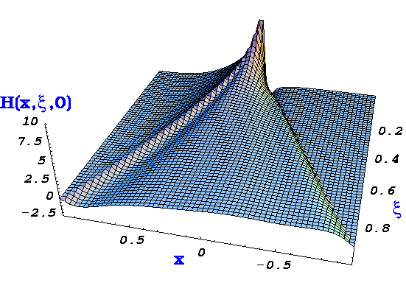
γ∗
t
ξ∼x_{Β}
γ,Μ,...
x
~
~
H,E,H,E
p
p’
Cross-section measurement
and beam charge asymmetry (ReT)
integrate GPDs over x
Beam or target spin-dependent dσ
contain only ImT,
GPDs at x = ξ and −ξ
(M. Vanderhaeghen)
Notes:
Intro

Slide 4
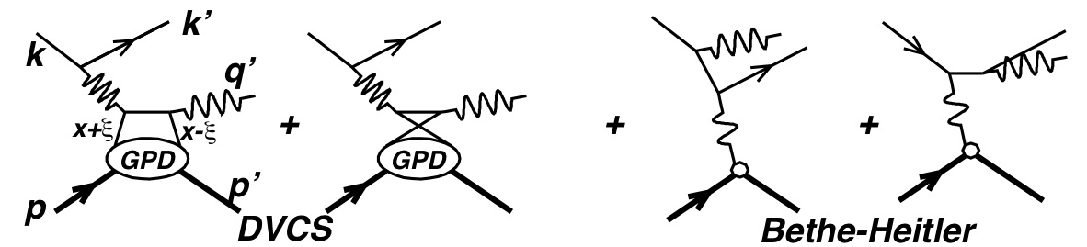
GPDs and ep→epγ
Compton amplitude is integral over average momentum fraction x
The real part can also be expressed as a dispersion integral
Correlations

Slide 5
Precision Cross Sections
GPDs are the leading twist amplitude in the ep→ epγ amplitude.
Measuring the Q² dependence at fixed x_{B}, t is essential to separate GPDs from higher twist terms
  Asymmetries cannot do this
  Spectrometers have a distinct advantage for precision

Slide 6
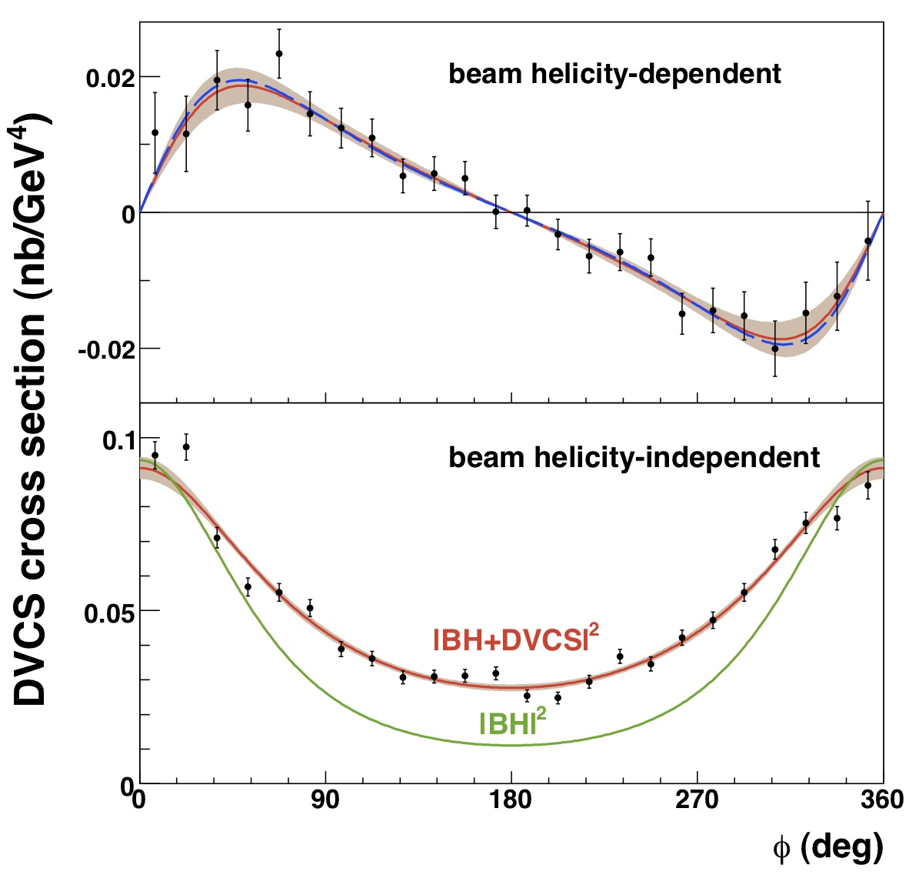
Hall A E00-110 H(e,e’γ)p
C. Muñoz et al.
Azimuthal dependence in one bin in Q², x_{B}, t
Δσ ~ Im[DVCS*BH]
~ GPD(ξ,ξ,t)
dσ ∼ |BH|²+
Re[DVCS*BH]
+|DVCS|²
  Separation à la “Rosenbluth” in E07-007 (2010)

Slide 7
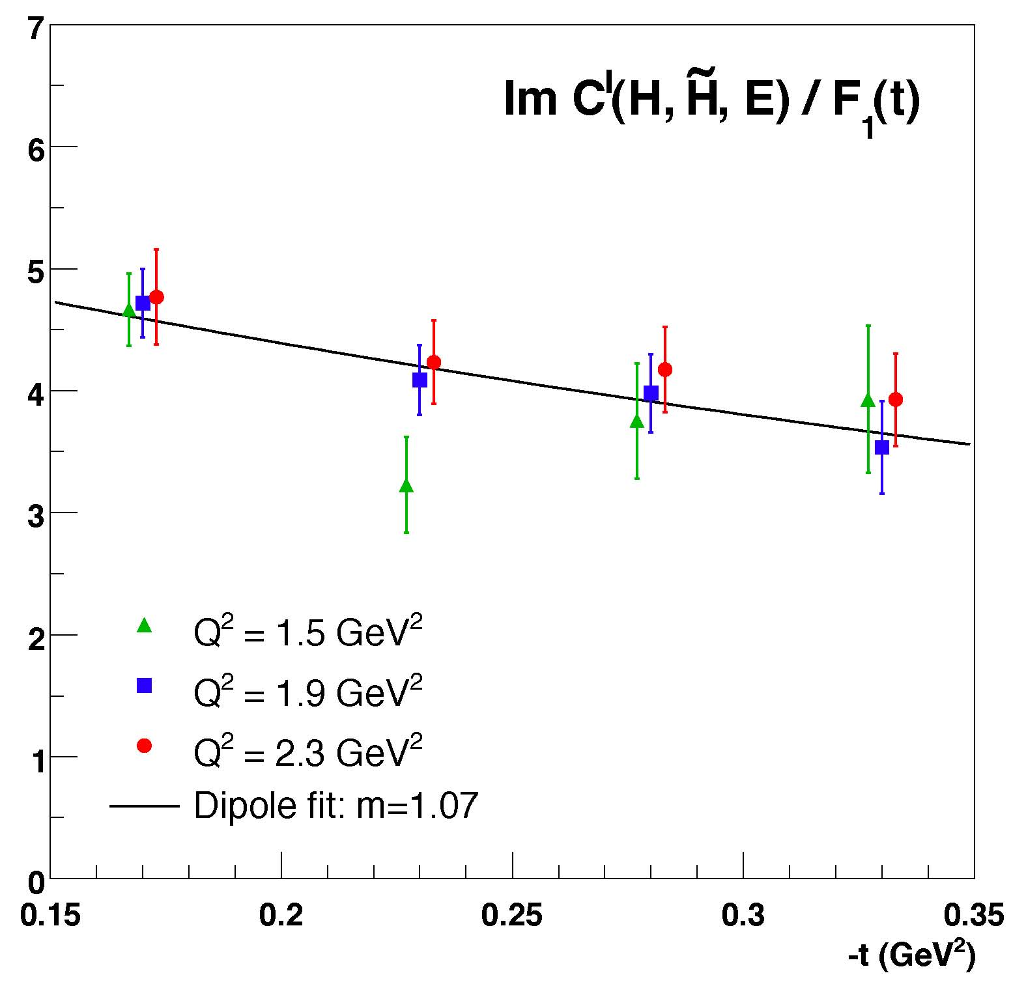
Test of Scaling Im[DVCS†BH]
E00-110
(C.Muñoz Camacho, PRL 97:262002)
Compatible
with leading twist dominance for Q² > 2 GeV²

Slide 8
DVCS at 12 GeV
Notes:
Cross section on unpolarized proton vs Q² to isolate Leading-Twist amplitude
Factor of 2 dynamic range in Q²
Almost full coverage of accessible 11 GeV kinematics

Slide 10
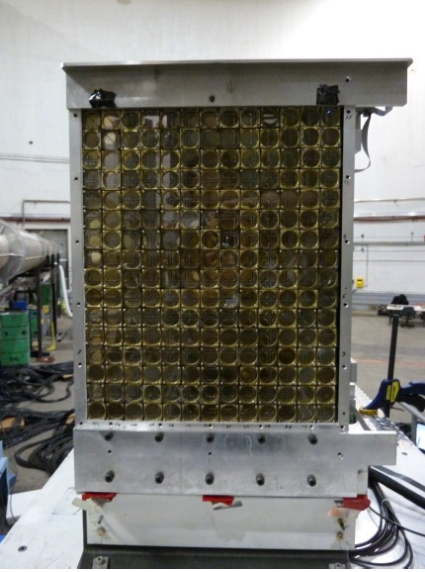
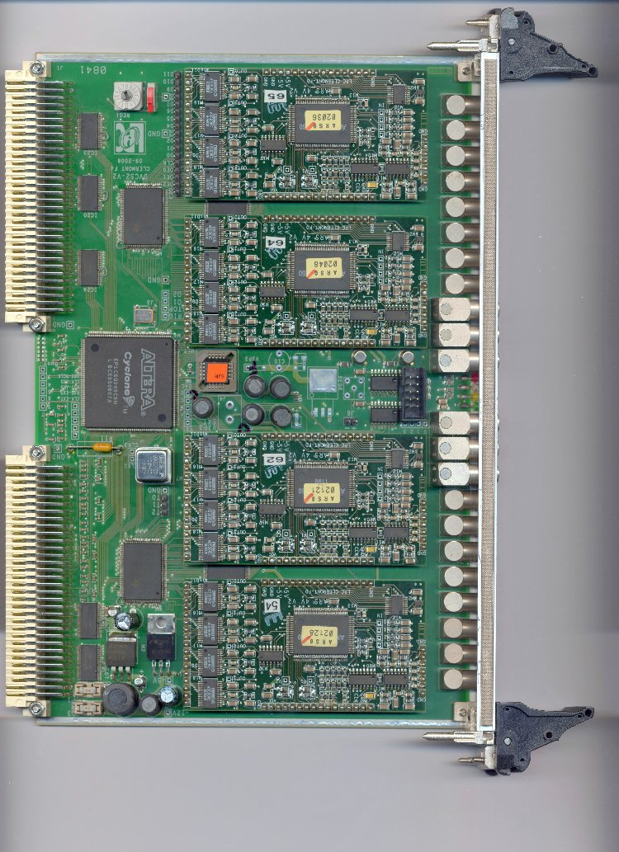
Technical Upgrades
Expanded PbF₂ Calorimeter to 16x13 crystals
  Improved π⁰ detection
Converted 1GHz ARS digitizer to VME160SST with data buffering
Upgraded (e,e’γ) trigger

Slide 11
Conclusions
PAC 38 Charge
  “…top half of the priority list to be established for the first 5 years of 12 GeV operations.”
PAC 38 approved E12-06-114 for 100 days with A rating.
  This is a large fraction of available beam in first 5 years.
  The PAC understood this when they approved th exp.
These data are crucial for the GPD program
  Establish precision of Leading twist separation vs Q²
  Early running will strongly influence the entire GPD program
Minimal resources required
  Equipment is ready
Large investment already made in France and US.
Beam requirements are modest
  ≤ 20 microA
  Energies flexible, ½ of beam request is < 11 GeV
Join us!

