Slide 1
Three Dimensional Imaging of the Proton
Graduate Seminar
19 January 2012
Prof. Charles Hyde
The Problem
The Data
The Solution
The Future

Slide 2
The Challenge
The construction of an image implies that the object being observed is unaffected by the measurement
The proton rms charge radius ~ 10^{–15} m (1 fm)
To image something this small requires that it absorb momenta of the order pc = ħc/(1 fm) = 200 MeV
But the proton mass Mc² = 938 MeV
Imaging the proton requires disturbing the proton
Is it even physically sensible to talk about imaging the proton?

Slide 3
Elastic Electron Scattering on the proton, 1950s – 2010s
Wave equation ☐A^{μ} = J^{μ}
Interaction
An electron makes a transition from momentum state k to k’:
Current j^{μ}(q) generates a vector potential A^{μ}(x) ~ e^{–iq•x}j^{μ}(q)/q²
This vector potential then interacts with the current density J^{μ}(x) of the proton.
k
k’
p
p’

Slide 4
From Interactions to Cross Sections
Number of scattering events into a solid angle ΔΩ:
Fermi Golden Rule (1st order interaction)
Cross section is proportional to interaction squared:
ΔΩ
ΔN_{Scatt}
X
N_{Inc}

Slide 5
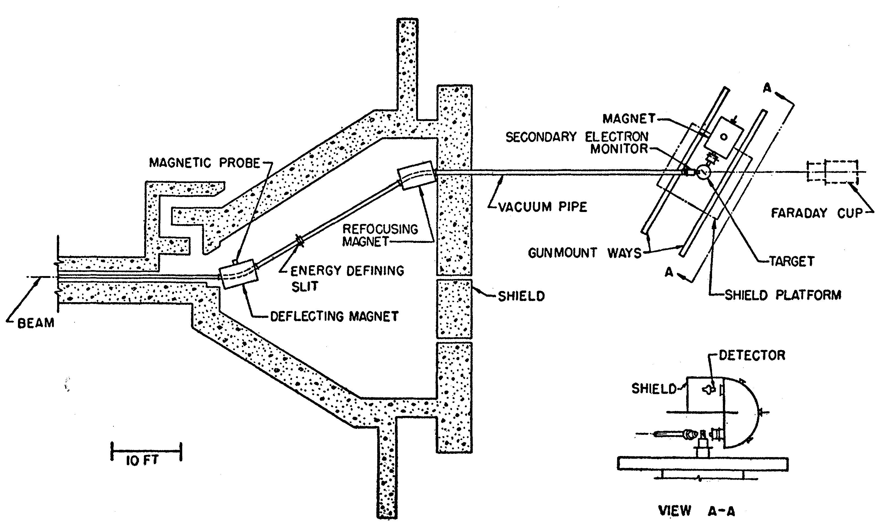
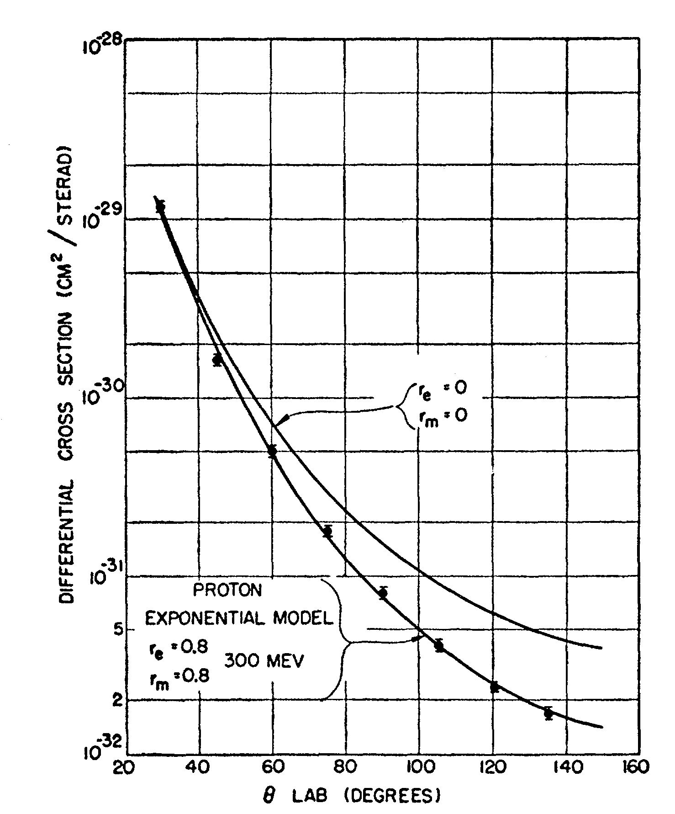
R. Hofstadter, et al., Phys Rev 1956
Nobel Prize, 1961

Slide 6
The Proton is not an Elementary Particle:
Anomalous Magnetic moment, Charge and Current Densities,
General EM current for a Dirac spin-1/2 nucleon to make a transition from a state (p,s) to (p’,s’) with q = p’-p (Q²=-q²>0):
Macroscopic Limits
F₁(0) = 1 F₂(0) = κ
O.Stern 1933: κ_{p}=1.5±0.2
2006 PDG review κ_{p}= 1.792847351(028)
G_{M}(Q²) = F₁+F₂
G_{E}(Q²) = F₁–Q²/(4M²)F₂
k
k’
p
p’

Slide 7
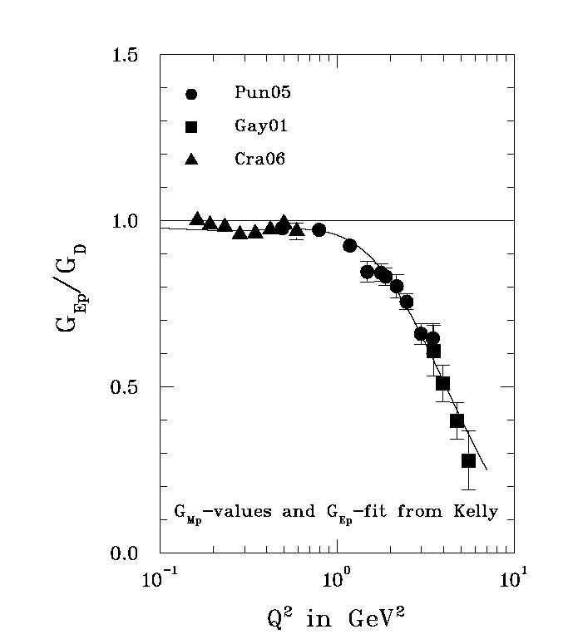
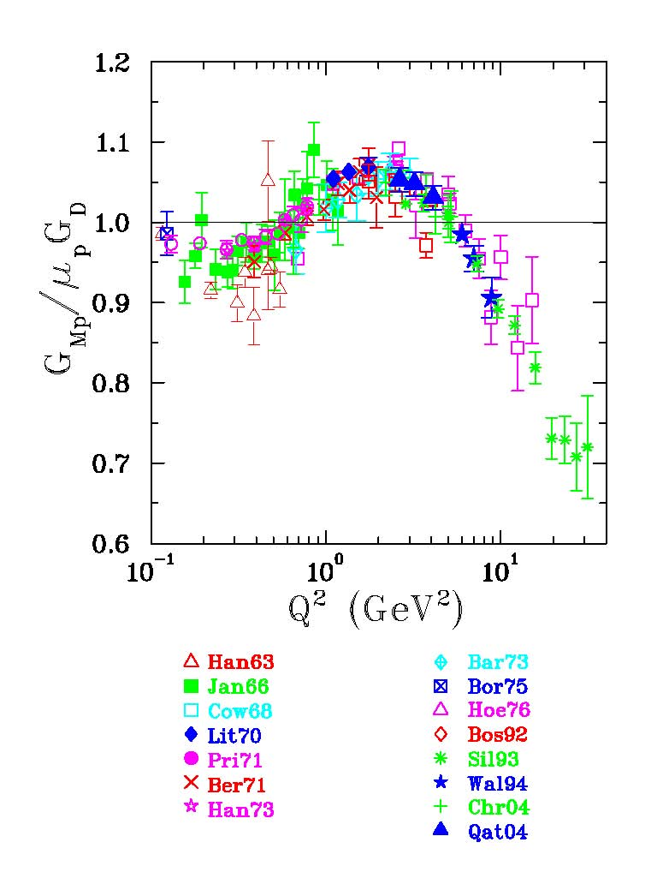
Elastic Electron Scattering Today
Ratios to `Dipole’ G_{D} =[1+Q²/Λ²]^{–2}, Λ² = 0.71 GeV²
JLab
Experiments at JLab 12 GeV (2014+) looking for zero crossing in G_{E}.

Slide 8
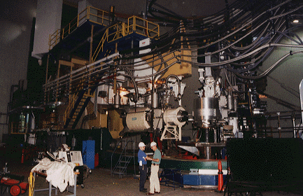
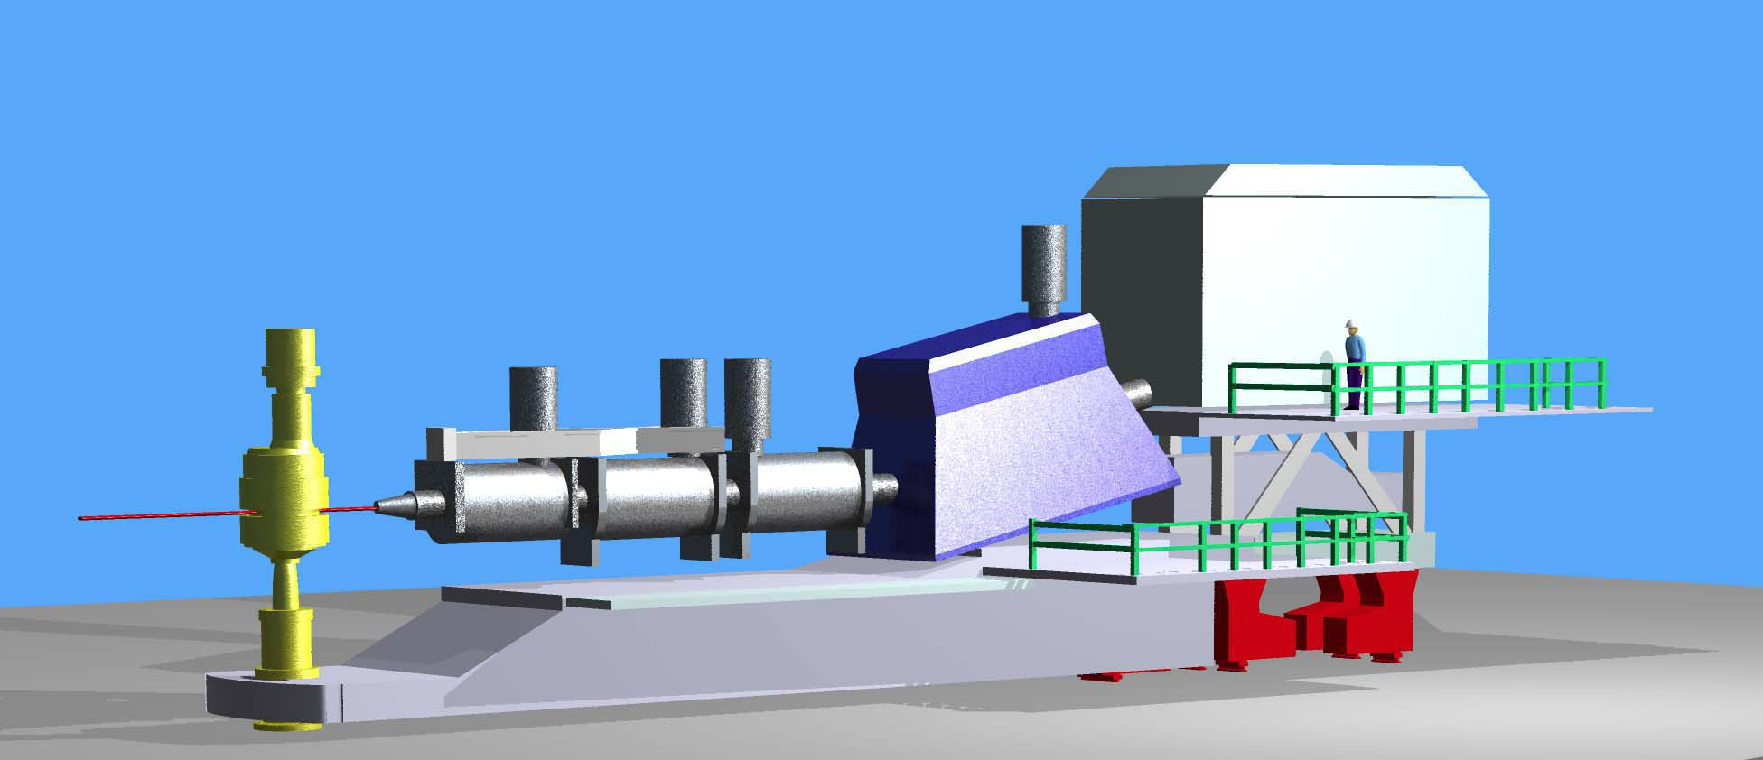
Jefferson Lab Spectrometers
Hall A High Resolution Spectrometer (HRS) pair
Hall C High Momentum Spectrometer (HMS), to be supplemented with SHMS

Slide 9
Form Factors and Densities
Naively, G_{E}(Q²) is the Fourier transform of the charge density. But this only works for Q²<<M_{p}²
Consider H(e,e)p in the `Breit’ Frame: P=–q/2, P’=+q/2 (zero energy transfer)
At each |q|=[Q²]^{1/2}, G_{E}(Q²) samples the charge distribution of a differently boosted proton.
Lorentz contracted proton:
γ
–q/2
q
+q/2

Slide 10
Protons are made of Quarks and Gluons, described by QCD.
ep→e’X (at large Q² and M_{X} >>M_{p}) measures 1-D momentum distributions of quarks in the proton
Deep Inelastic Scattering (DIS), Friedman, Kendal, Taylor, Nobel Prize 1990
Discovery of ‘partons’: quarks and gluons as elementary fermions and bosons.
ep→epγ can measure the tomographic image of the distribution of quark momenta along one axis and the spatial density in the plane transverse to this axis [Generalized Parton Distributions = GPDs]
J. Xi (UMd), A.Radyushkin 1997 ….
JLab experiments (ODU…)

Slide 11
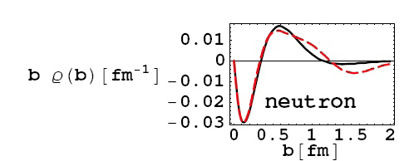
Form Factors and Charge Distributions, revisited
The Dirac Form Factor F₁(Q²) is the 2-dim Fourier transform of the charge distribution of the nucleon (proton or neutron), after integrating over the third (momentum) axis. (M. Burkardt 2000, NMSU)
γ
q
P–q/2
P+q/2
Charge Distribution in the Neutron (G.Miller 2007, UWa)
more than 2x as many fast d-quarks at center of neutron than fast u-quarks
n→pπ–

Slide 12
Conclusions
Relativity and Quantum Field Theory are not closed subjects, we still have a lot to learn
New experimental and theoretical tools are helping us to understand how QCD generates
The mass of ordinary matter
The spin of the hadrons
proton, neutron, vector mesons, etc.
Spatial distribution of charge and matter in hadrons.
Nuclear Binding
Why is the deuteron (np) bound but nn not?
Why are ⁴He, ⁶He(β– 1sec), ⁸He(β– 0.1sec) bound, but ⁵He is not bound?
Spatial correlations in the vacuum fluctuations of quarks and gluons.
ODU Faculty and Graduate Students are working on all of these questions.

Slide 13
Backup Slides
Higher order corrections and DIS

Slide 14
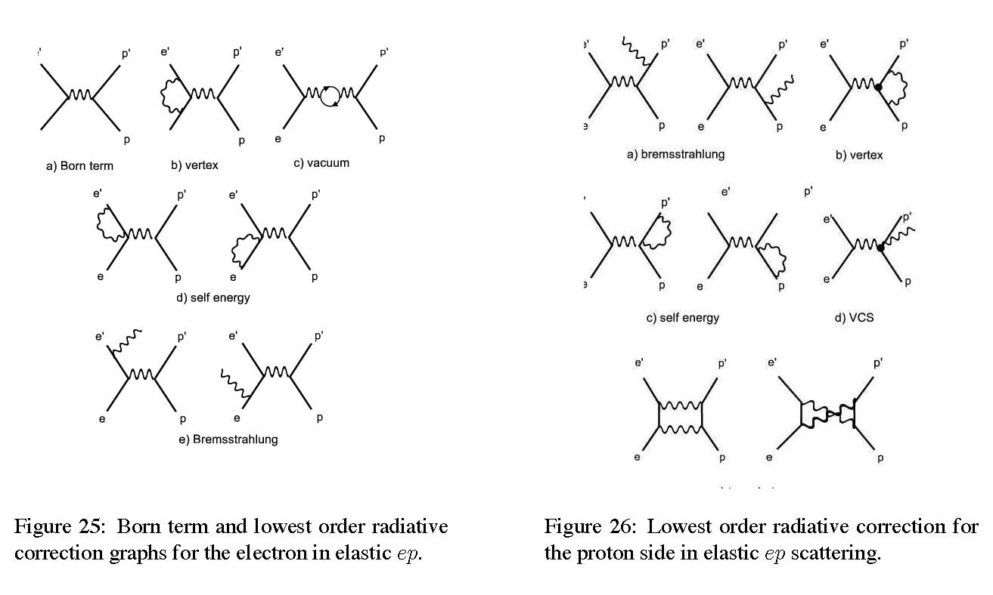
Radiative Corrections
Born*(1+20%±1%)
Proton
Electron
Dispersion
3%±2%

Slide 15
Lepton Scattering
Deep Inelastic Scattering
Q²=-q²=(k-k’)²
x_{Bj} = Q²/(2p⋅q)
k
k
2
k
k
dσ =
=
X
p
p
p

Slide 16
Deep Inelastic Scattering: Scaling
Q², (or p⊥² , M²(pair) for hadron reactions)
k
k
p
p
Non-local, forward matrix elements

Slide 17
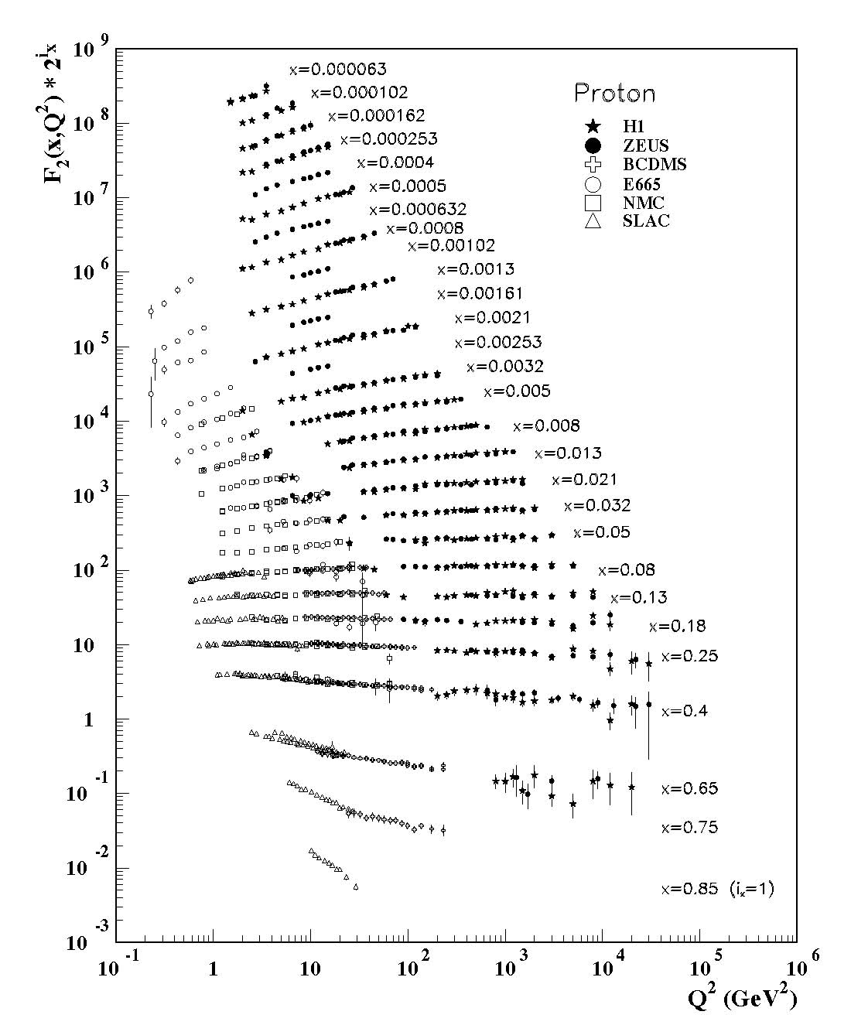
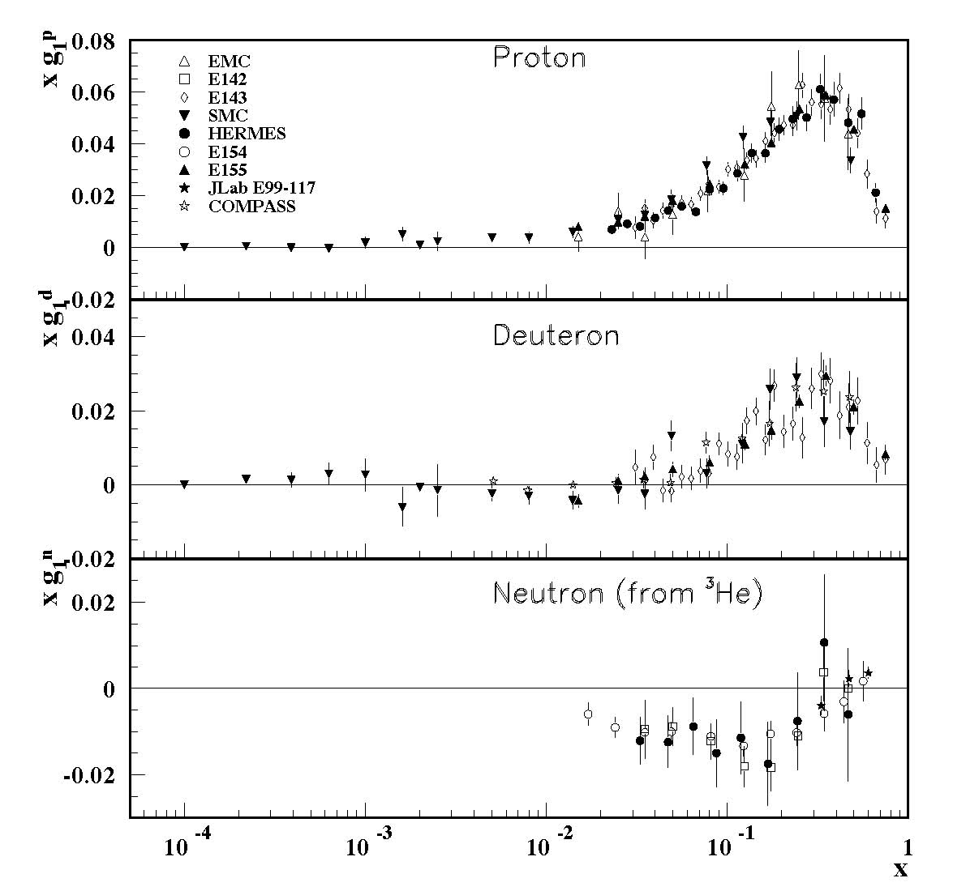
Structure Functions
polarized

Slide 18
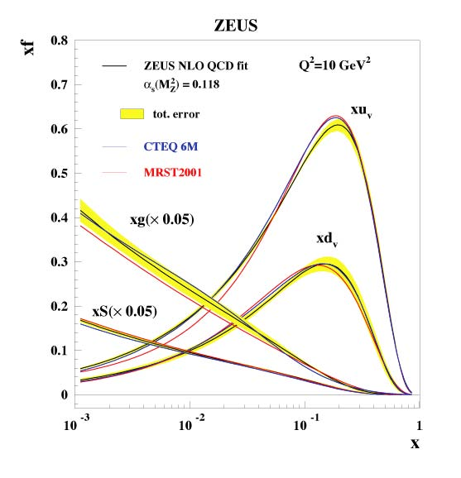
Unpolarized Parton Distributions
40 years of effort
Large relative uncertainties for x>0.5
Glue ≈ down for x > 0.2
(note factor 0.05)

