Slide 1
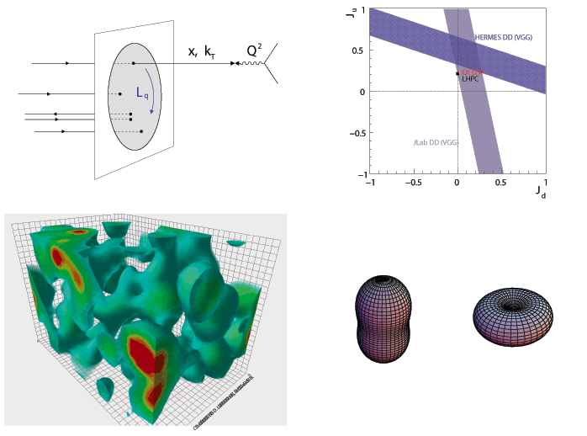

Experimental Overview of Deeply Virtual Exclusive Reactions
INT-12-49W: Orbital Angular Momentum in QCD
February 6 - 17, 2012
Charles Hyde
Old Dominion University
Norfolk VA
J. Phys. Conf. Ser. 299:012006, 2011, arXiv:1101.2482
A universally correct statement for the nucleon spin
Nucleon spin comes from
the spin and orbital motion
of quarks and gluons
--- Chairman Mao

Slide 2
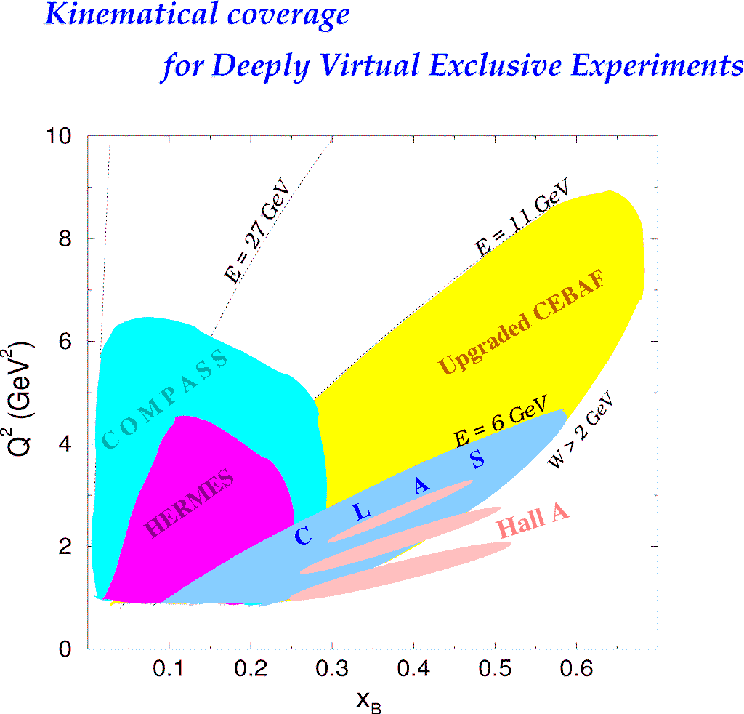
Deeply Virtual Exclusive Processes -
Kinematic Coverages
H1, ZEUS
H1, ZEUS
27 GeV
200 GeV
JLab Upgrade
JLab @ 12 GeV
COMPASS
W = 2 GeV
HERMES
Study of high x_{B} domain requires high luminosity
0.7
Notes:
The kinematics range that can be covered in exclusive processes with high precision data is shown with this yellow area. This will be the only accelerator where the valence quark regime can be fully covered with high precision data.

Slide 3
Bethe-Heitler and Virtual Compton Scattering (VCS)
e p→e p γ
k
k'
=
Δ
+
q'
p
p'
Bethe-Heitler (BH)
+
q
VCS
BH-DVCS interference
Access to DVCS amplitude, linear in GPDs

Slide 4
Leading Order (LO) QCD Factorization of DVCS
e p→e p γ
P+Δ/2
P−Δ/2
+
+
(x+ξ)P⁺
(x−ξ)P⁺
(x+ξ)P⁺
(x−ξ)P⁺
P+Δ/2
P−Δ/2
GPD_{f}(x,ξ ,t=Δ²)
GPD_{g}(x,ξ ,t=Δ²)
GPD_{f}(x,ξ ,t=Δ²)
Symmetrized Bjorken variable:
SCHC
Tranversely polarized virtual photons dominate to O(1/Q)

Slide 5
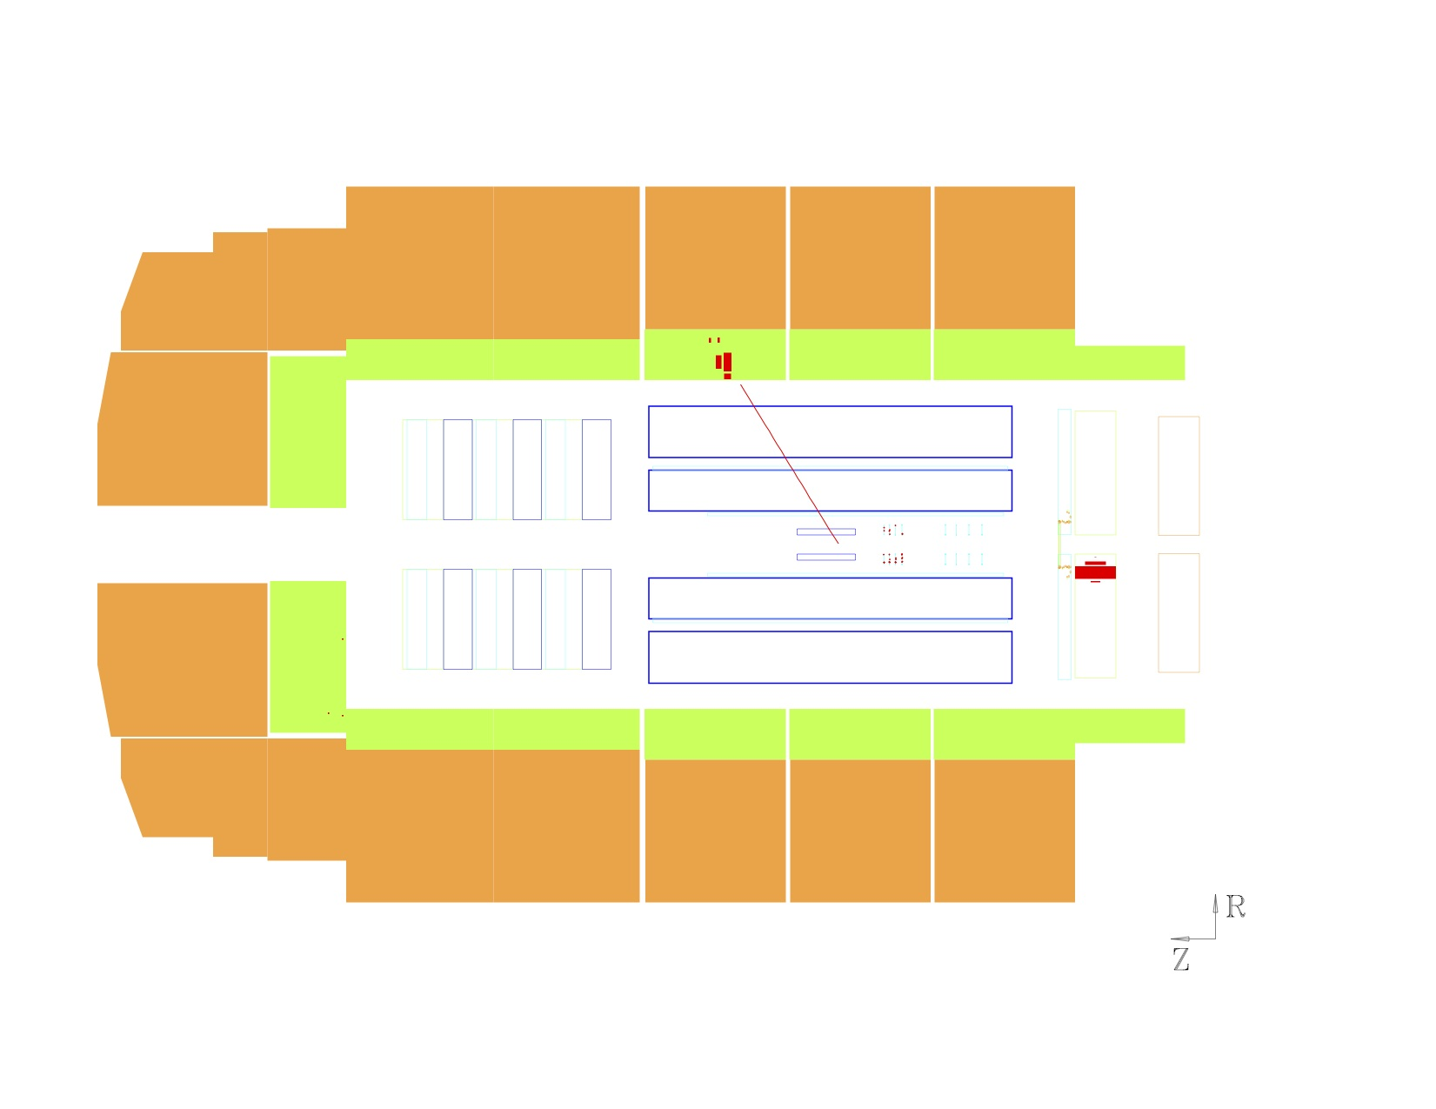
HERA-H1 DVCS-dominated and BH-dominated events
ep→eγX X is ultra-forward, no visible energy → dominated by exclusive
e⁺
p

Slide 6
HERA DVCS, fits by D.Müller et al., 2012 for EIC whitepaper

Slide 7
What do DVCS experiments measure?
dσ(ep→epγ) = twist-2 (GPD) terms + Σ_{n} [twist-n]/Q^{n-2}
Isolate twist-2 terms → cross sections vs Q² at fixed (x_{Bj}, t).
GPD terms are `Compton Form Factors’
Re and Im parts (accessible via interference with BH):

Slide 8
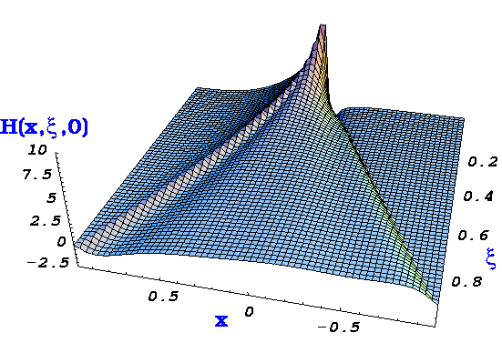
DVCS, GPDs, Compton Form Factors(CFF), and Lattice QCD
(at leading order:)
Cross-section (σ) measurement
and beam charge difference (ReT)
integrate GPDs with 1/(x±ξ) weight
Beam or target spin Δσ
contain only ImT,
therefore GPDs at x = ξ and −ξ
D.R.
Notes:
Intro

Slide 9
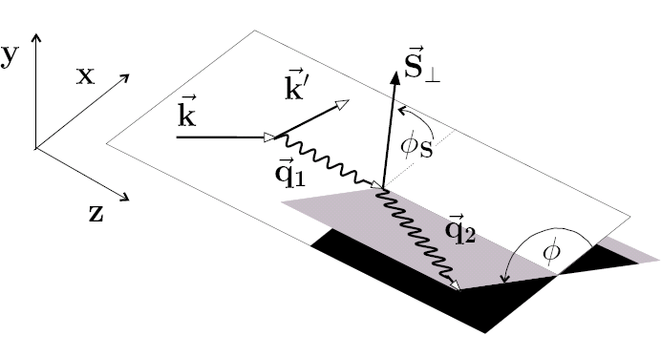
Exploiting the harmonic structure of DVCS with polarization
The difference of cross-sections is a key
observable to extract GPDs
With polarized beam and unpolarized target:
With unpolarized beam and Long. polarized target:
With unpolarized beam and Transversely polarized target:
~
~
~
Separations of CFFs H(±ξ,ξ,t), E(±ξ,ξ,t),…
Notes:
9

Slide 10
HERMES overview

Slide 11
HERMES-Transversely Polarized H(e,e’γ)X, SSA
Azimuthal moments
Differential in x_{Bj}, Q², or t, integrated over other 2 variables.
sinφ moments
Sensitive to E(ξ,ξ,t)
sin2φ moments ≈ 0
≈ Twist 3
sin3φ moments
≈Gluon Transversity

Slide 12
HERMES Recoil Detector

Slide 13
HERMES Recoil Exclusivity

Slide 14
HERMES Recoil Detector Results

Slide 15
HERMES summary 2011
DVCS Asymmetries
e⁺e–
Beam Spin Asymmetry
Transverse target Single Spin Beam & Transverse Target Double Spin
Longitudinal Target
next to final
averaged over Q² and t
Transversely polarized H-target → sensitivity to E(ξ,ξ,Δ²), ξ≈0.1

Slide 16
DVCS in CLAS @ 6 GeV

Slide 17
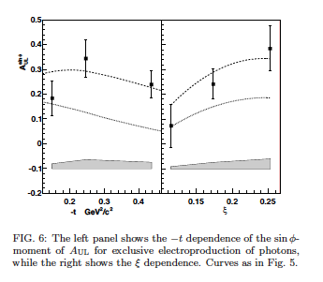
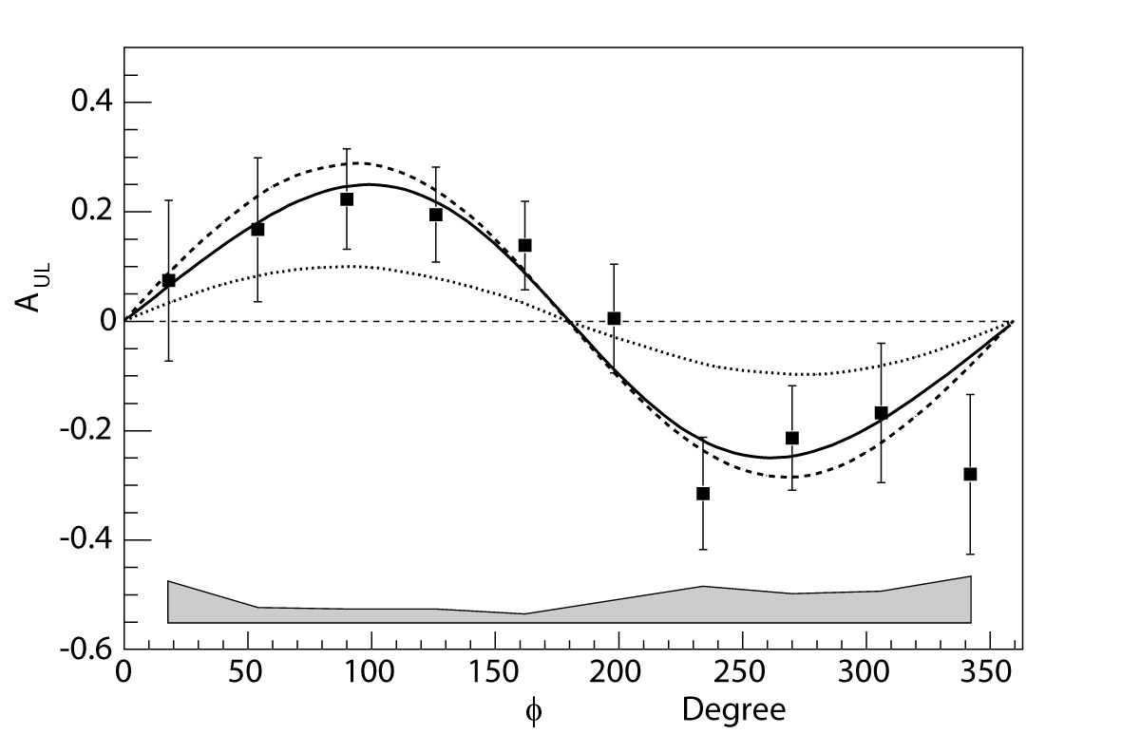
CLAS: Longitudinally Polarized Protons
A_{UL}
JLab/Hall B – Eg1 Non-dedicated experiment(no inner calorimeter), but H(e,e’γp) fully exclusive.
fit
GPD
Fig. 5.
fully exclusive
S.Chen, et al, PRL 97, 072002 (2006)
Higher statistics and larger acceptance (Inner Calorimeter)
run Feb-Sept. 2009

Slide 18
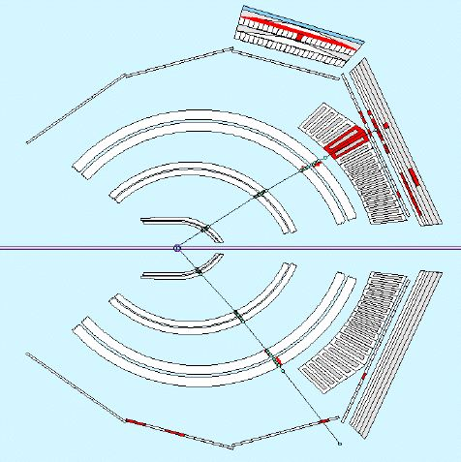
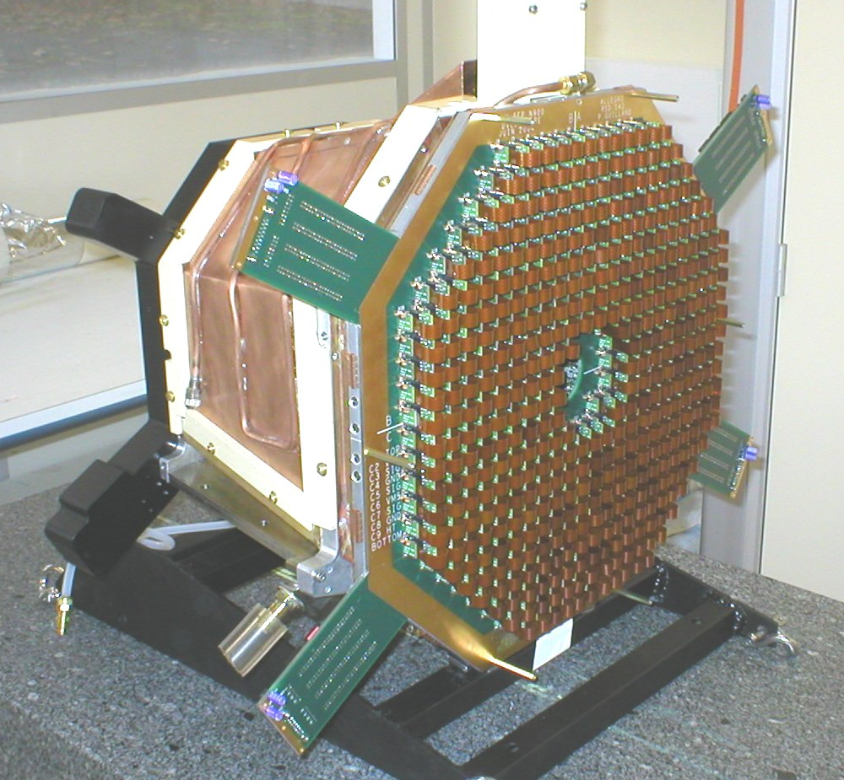
DVCS@Hall B
e’
γ
epa epγ
5 Tesla Solenoid
420 PbWO₄ crystals :
~10x10x160 mm³
APD+preamp readout
Orsay / Saclay / ITEP / Jlab
p

Slide 19
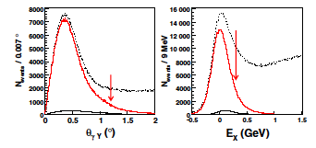
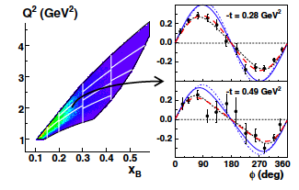
CLAS 6 GeV: Exclusivity and Kinematics
H(e,e’γp’)x
Overcomplete triple coincidence
Co-linearity of γ with q-p’
Missing Energy E_{x}
Example angular distribution of Beam Spin Asymmetry
One (Q²,x_{B}) bin
Two t-bins.

Slide 20
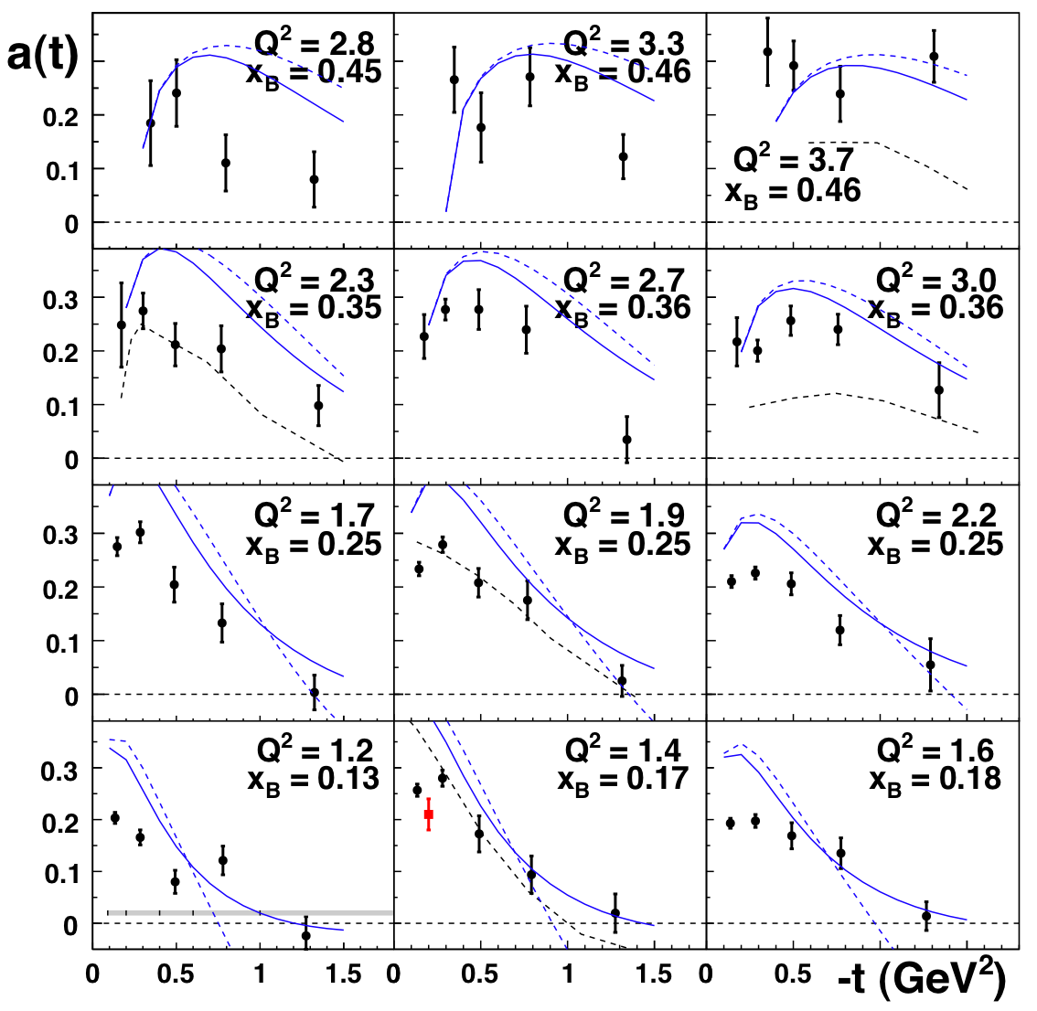
CLAS, 6 GeV Beam Helicity Asymmetry
F.X. Girod et al, Phys.Rev.Lett.100, 162002, 2008
sinφ moments of A_{LU}
Solid blue curves: VGG GPD model
Data set doubled by Fall/Winter 2008/2009 run
x_{B}
Q²

Slide 21
CLAS DVCS Longitudinal Target w/ Inner Calorimeter

Slide 22
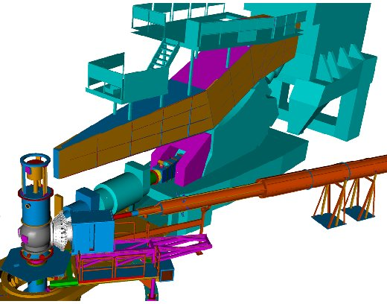
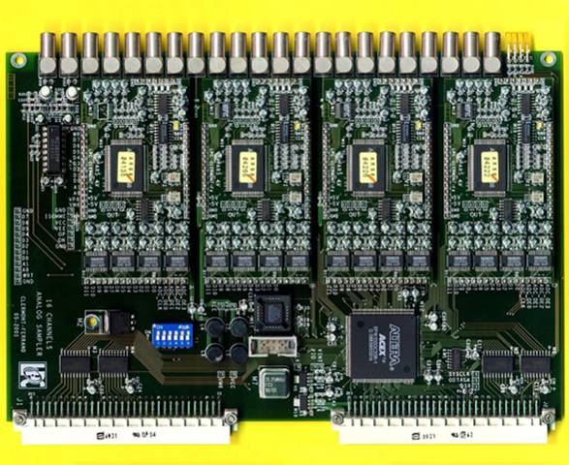
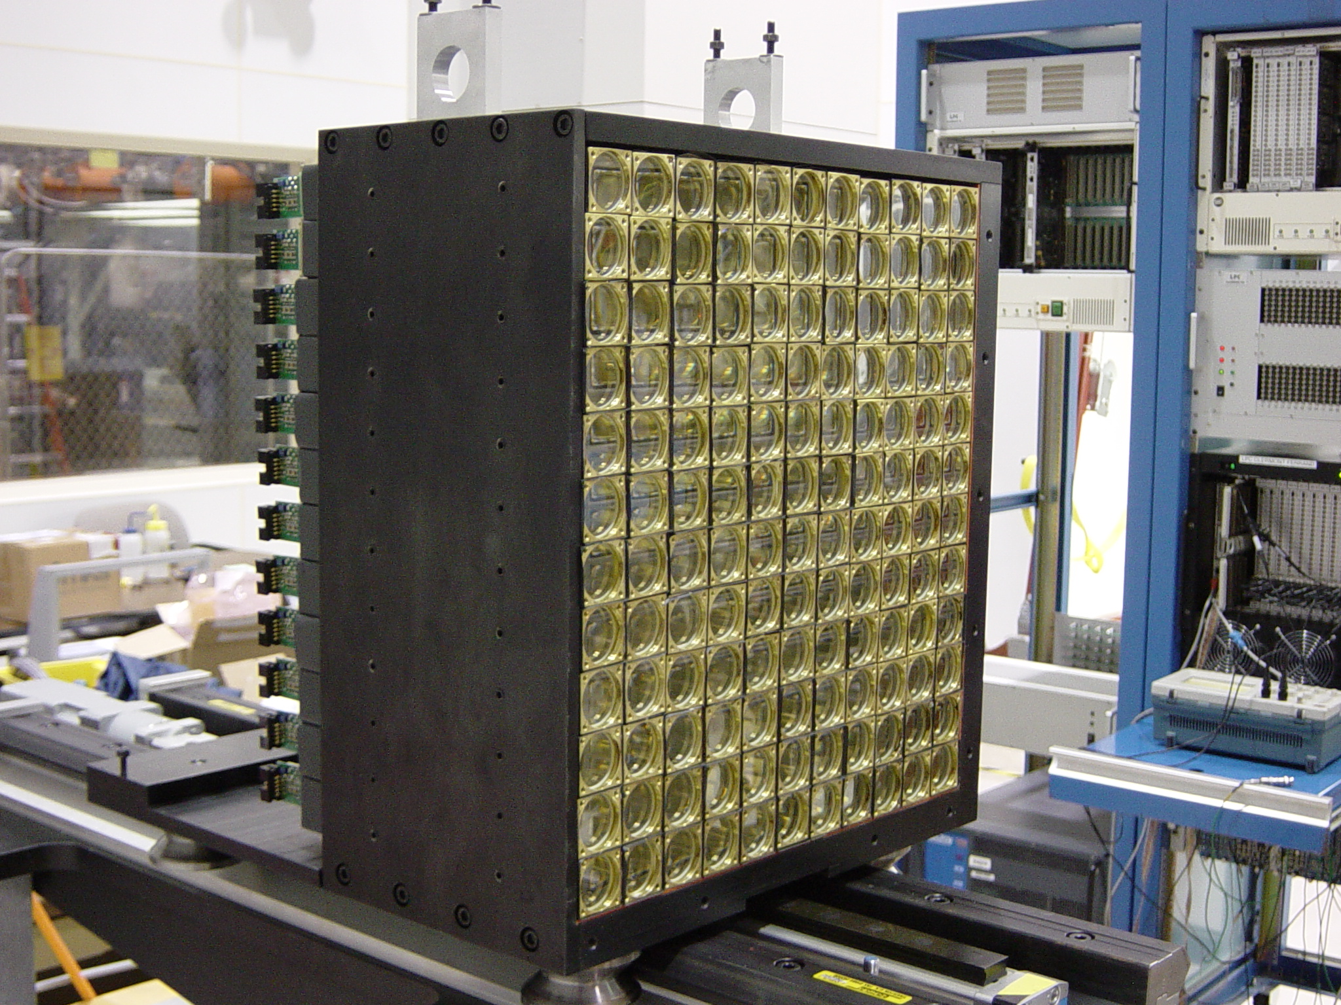
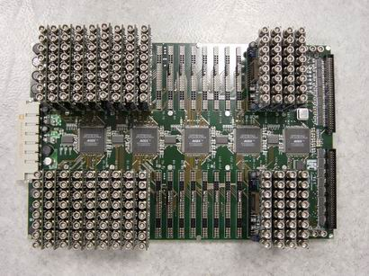
DVCS: JLab Hall A 2004, 2010 L ≥ 10³⁷ cm²/s Precision cross sections •Test factorization •Calibrate Asymmetries
(e,e’)X HRS trigger
→
e⁻
16chan VME6U: ARS
128 samples@1GHz
Digital Trigger Validation
132 PbF₂

Slide 23
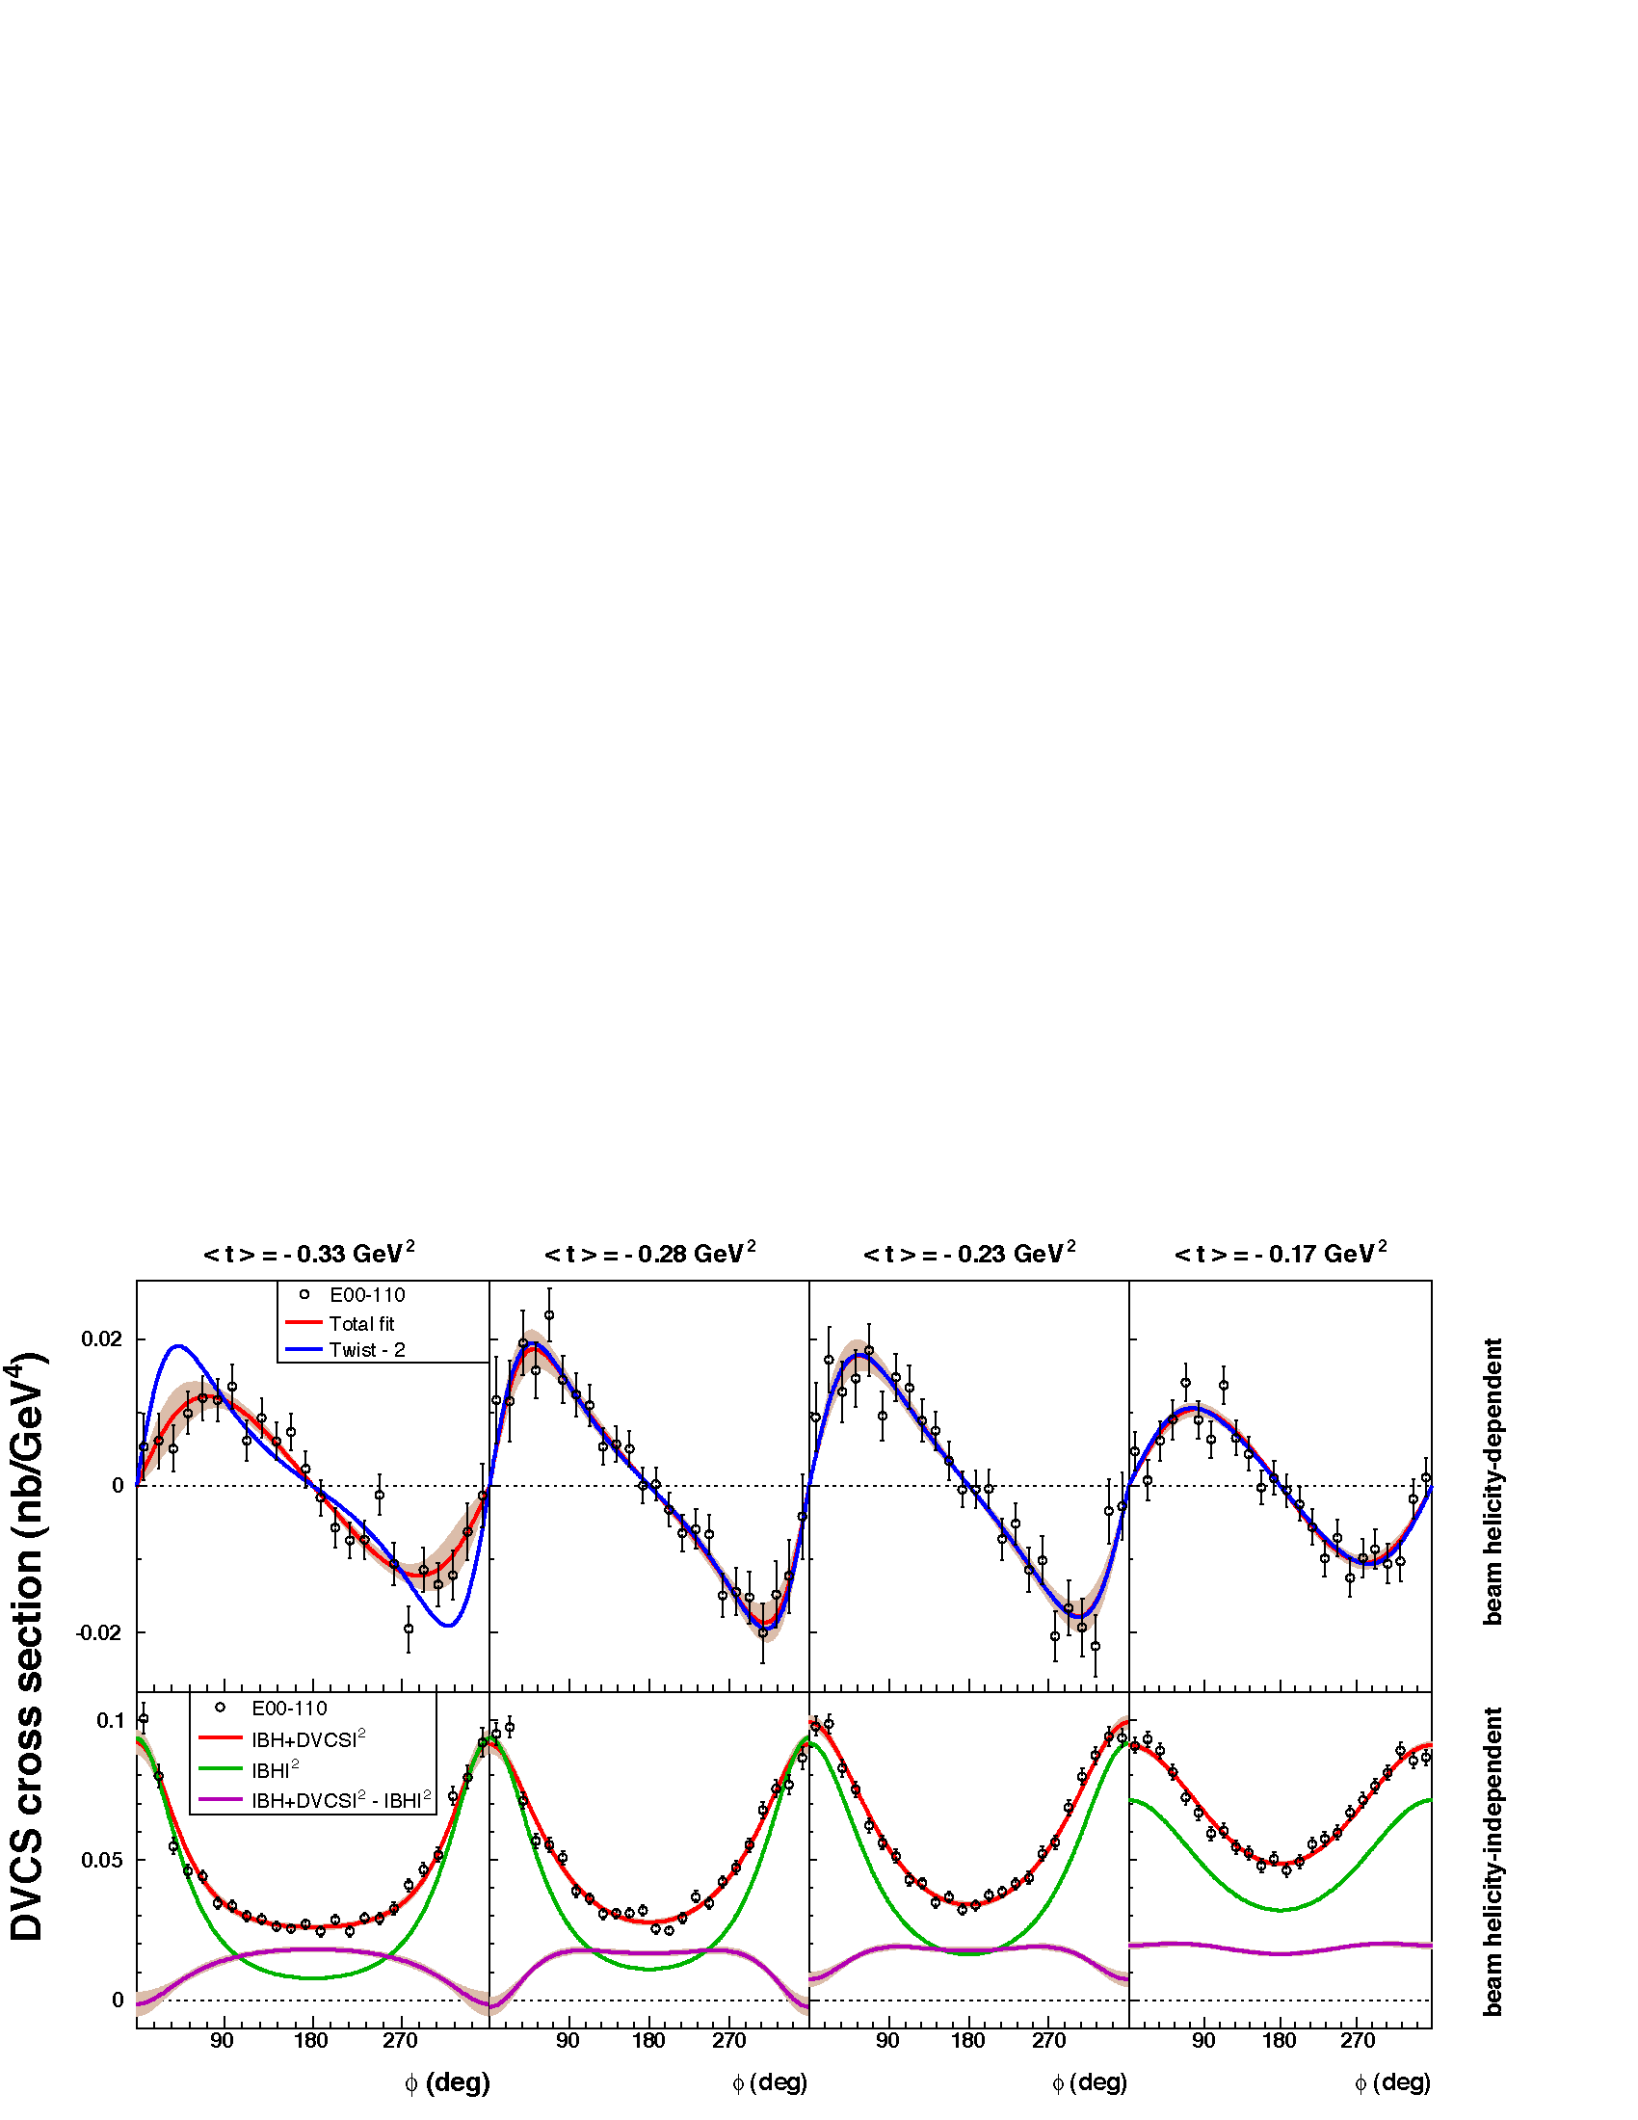
Beam helicity-independent cross sections at Q²=2.3 GeV², x_{B}=0.36
Contribution of Re[DVCS*BH] + |DVCS|² large.
Positron beam or measurements at multiple incident energies to separate these two terms and isolate Twist 2 from Twist-3 contributions
PRL97:262002 (2006) C. MUNOZ CAMACHO, et al.,
d⁴σ (nb/GeV⁴)

Slide 24
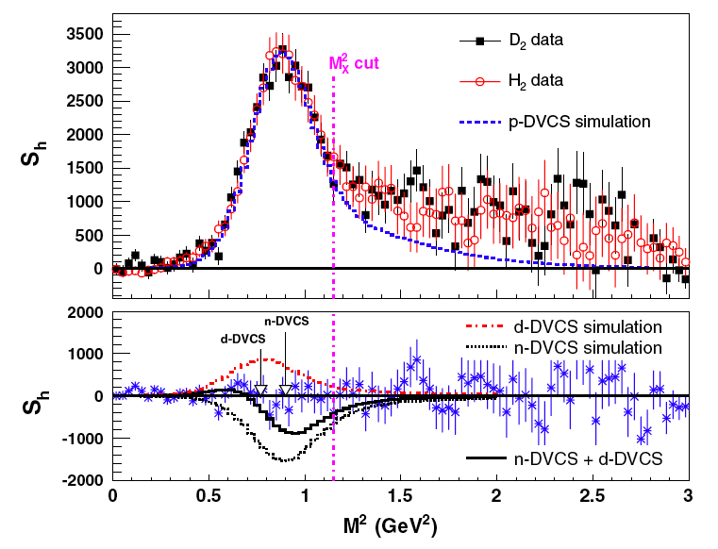
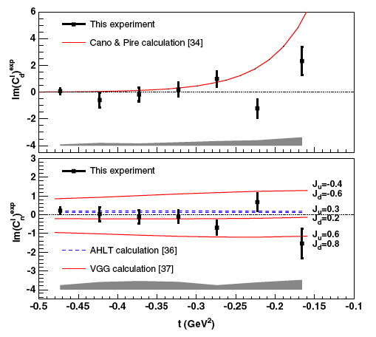
DVCS-Deuteron, Hall A
E03-106:
D(e,e’γ)X ≈ d(e,e’γ)d+n(e,e’γ)n+p(e,e’γ)p
Sensitivity to E_{n}(ξ,ξ,t) in Im[DVCS*BH]
E08-025 (5.5 GeV- 2010)
Reduce the systematic errors
Expanded PbF₂ calorimeter for π⁰ subtraction
Separate the Re[DVCS*BH] and |DVCS|² terms on the neutron via two beam energies.
Q²=2.3 GeV², x_{B}=0.36
neutron

Slide 25
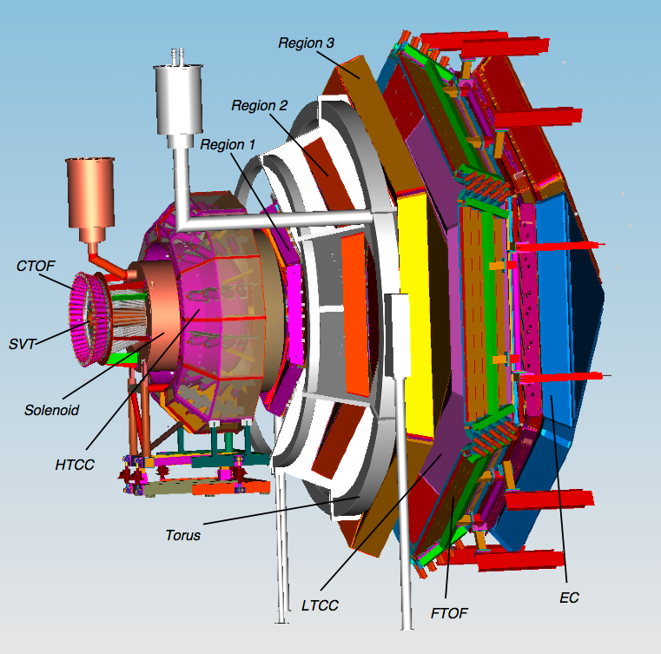
CLAS12
CLAS12
Central
Detector
Forward
Detector
GPDs & TMDs
Nucleon Spin Structure
N* Form Factors
Baryon Spectroscopy
Hadron Formation
2m

Slide 26
DVCS with CLAS at 12 GeV
80 days on H₂ target at ~10³⁵ /cm²/s
120 days on Longitudinally Polarized NH₃ target
Total Luminosity 10³⁵ /cm²/s, dilution factor ~1/10
D(e,e’γn)p_{S}
Ambitions/options for Transversely polarized targets
NH₃ target has 5 T transverse field
need to shield detectors from “sheet of flame”
Reduce (Luminosity)(Acceptance) by factor of 10 (my guess)
HD-ice target (weak holding field, less dilution)
Currently taking data with photon beam
Polarization measurements incomplete
Test with electron beam in 1-2 months.

Slide 27
DVCS at 12 GeV in Hall A: 100 days HRS ×PbF₂
All equipment in-hand. Ready for beam !
Notes:
Cross section on unpolarized proton vs Q² to isolate Leading-Twist amplitude
Factor of 2 dynamic range in Q²
Almost full coverage of accessible 11 GeV kinematics

Slide 28
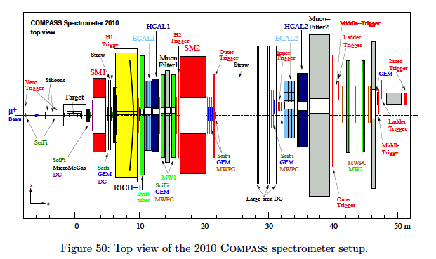
COMPASS 2014+ DVCS & DVES

Slide 29
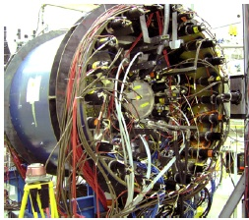
COMPASS Recoil Proton Detector + ECAL0

Slide 30
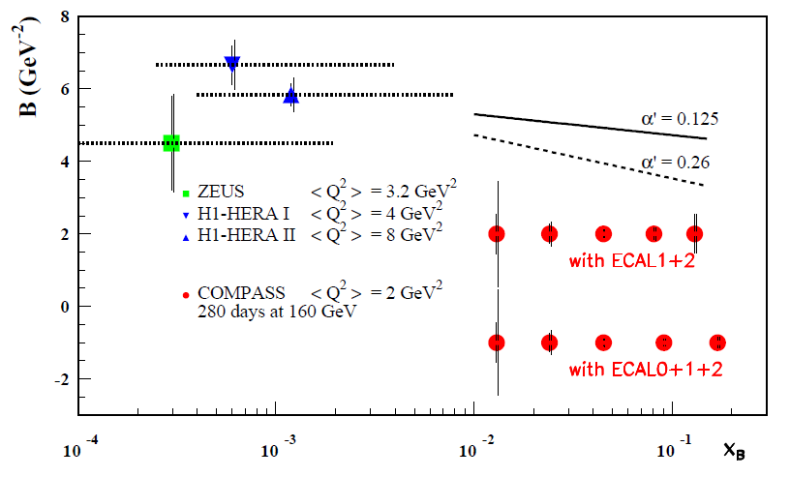
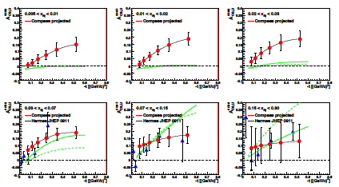
COMPASS DVCS Projections
160 GeV
Spin×Charge averaged
Spin×Charge difference
Spin×Charge difference

Slide 31
Leading Order (LO) QCD Factorization of DVES
Δ_{μ}
z
γ*
z
DA(z)
DA(z)
+
x+ξ
x-ξ
x+ξ
x-ξ
P +Δ/2
GPD(x,ξ ,t=Δ²)
P-Δ/2
GPD(x,ξ ,t=Δ²)
z
DA(z)
+
x+ξ
x-ξ
Gluon and quark GPDs enter to same order in α_{S}.
SCHC: σ_{L}~ [Q²]⁻³ σ_{T}~ [Q²]⁻⁴
Spin/Flavor selectivity
GPD(x,ξ ,t=Δ²)
[Diffractive channels only]

Slide 32
Semi Universal behavior of exclusive reactions at high W²
Two views:
Extracting leading twist information is hopeless for Q²+q’²<10 GeV²
Perturbative t-channel exchange even for modest Q², but convolution of finite size of nucleon and probe.
Fitting data (cf C.Weiss) requires setting scale of gluon pdf μ² <<Q²
Finite transverse spatial size b≈1/μ of γ→V amplitude
GWolf 0907.1217

Slide 33
σ_{L}/σ_{T} in vector meson production at HERA
SCHC: ρ→ππ, ω→πππ, φ→ KK
Validate SCHC from decay angular distribution (Schilling & Wolf)
Extract dσ_{L} from
Rapid rise in r⁰⁴ vs Q²:
Validation of perturbative exchange in t-channel.
Sub-asymptotic saturation of dσ_{L}/dσ_{T}
Extra mechanism for dσ_{T}?

Slide 34
Vector Mesons at JLab
Deep ρ
SCHC observed at 20% level
Anomalous rise in dσ_{L} at low W
Deep ω
SCHC strongly violated in CLAS data
No (??) SCHC tests from HERMES or HERA.
Deep φ
SHCH validated
Model of P. Kroll consistent with world data set
Perturbative t-channel exchange (2g), but factor of 10 suppression relative to colinear factorization from Sudakov effects in γ→φ

Slide 35
CLAS Deep rho

Slide 36
Deep φ
Q²≈2 GeV²
CLAS, HERMES, HERA
Model of S.Goloskokov and P. Kroll
Proposals/LOI in Hall B and Hall A
LOI for J/Ψ in Halls B and C.

Slide 37
The next 20 years of DVCS experiments
First 5 years
Precision tests of factorization with Q² range ≥ 2:1 for
x_{B}∈[0.25,0.6]. t_{min}-t < 1 GeV² + COMPASS : x_{B}∈[0.01,0.1]
Proton unpolarized target observables
Im[DVCS*BH], Re [DVCS*BH], |DVCS|².
Longitudinal, target spin observables
Primary sensitivity to H, ˜H, at x = ±ξ = ±x_{B}/(2−x_{B}) point.
Partial u,d flavor separations from quasi-free neutron.
Coherent Nuclear DVCS on D, He
5-10 years
Transversely Polarized H, D, ³He in JLab Halls A,B,C
Optimize targets
Improved recoil/spectator detection?
Polarized targets at COMPASS
10-15 years: Build electron ion collider with s≥1000 GeV² and L > 2•10³⁴ /cm²/s.

Slide 38
Back-up Slides

Slide 39
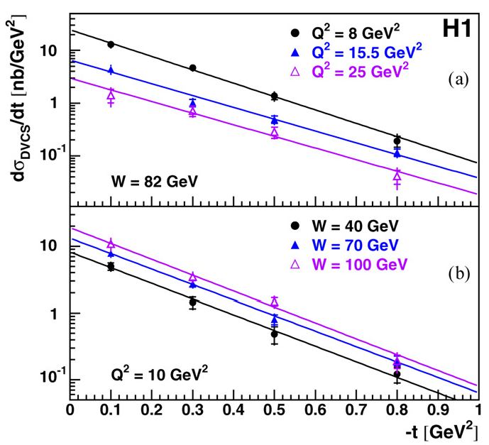
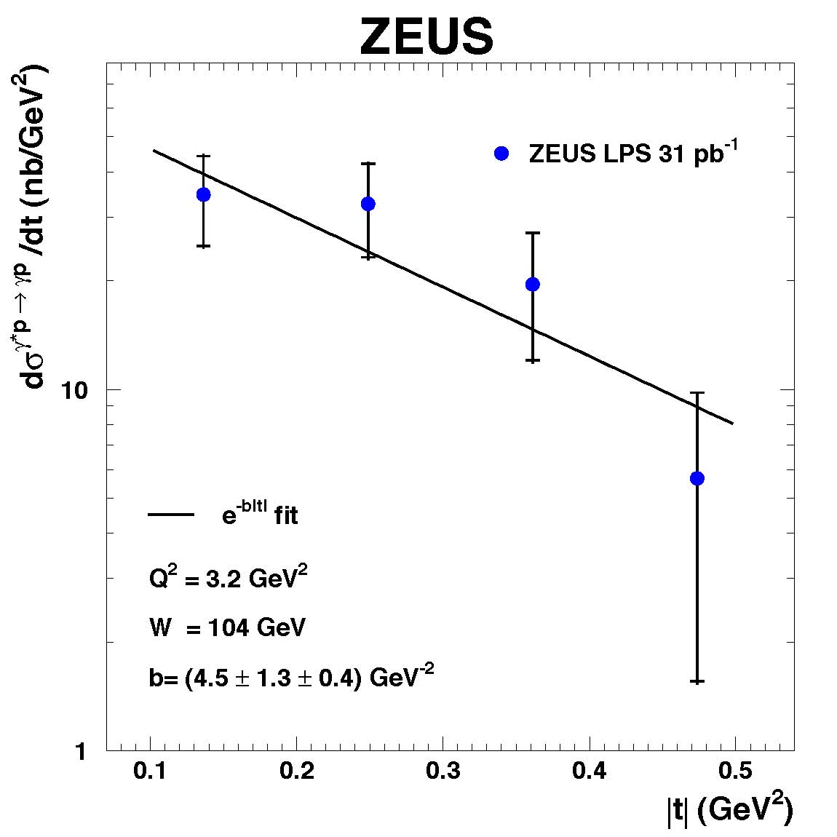
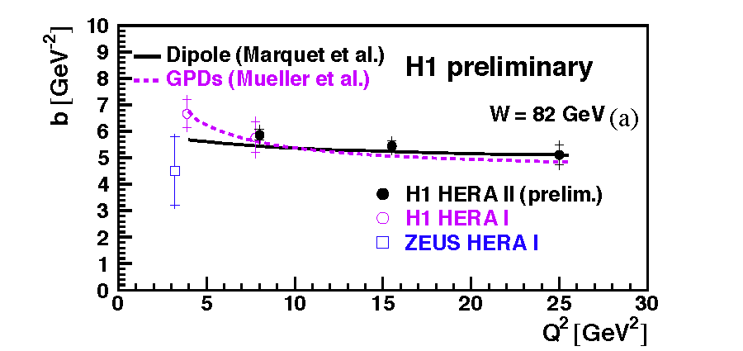
HERA DVCS
Spatial imaging of gluons at small x_{B}

Slide 40
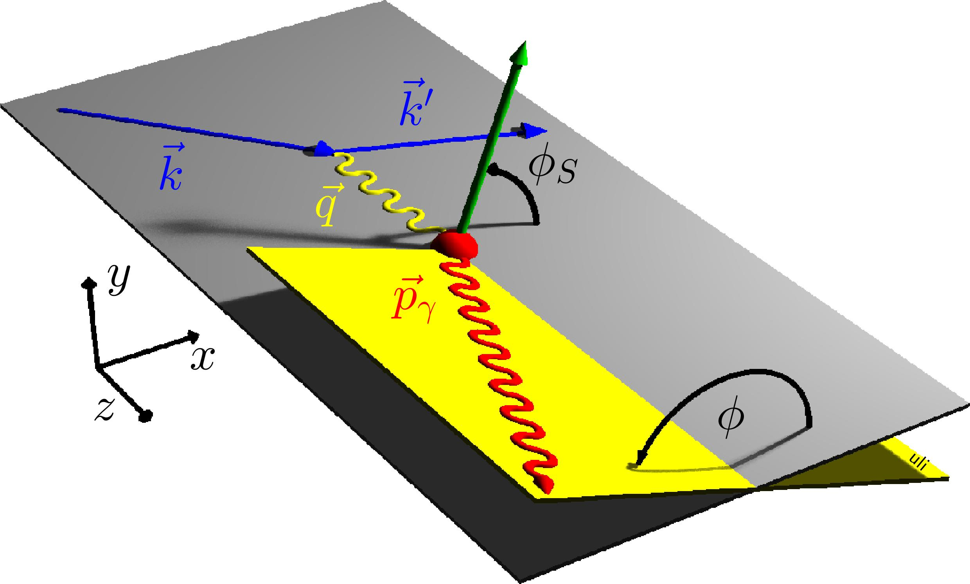
Unraveling DVCS observables
Twist-2 terms ≈ 1, cosφ, sinφ
Twist-2 terms ≈ sin2φ
Not a pure Fourier series: 1/[A + Bcosφ + Ccos2φ] from BH propagators.
GPDs enter with different weights for each azimuthal term for different polarization (lepton helicity, target-longitudinal or –transverse) observables
Single and Double spin observables
Beam charge difference (e⁺e– HERMES, JLab????; μ⁺μ– COMPASS)
Energy dependence (JLab)
Complete separation of Re and Im parts of CFF of E, H,… in-principle possible ( D.Mueller, next)
u, d flavor separations require neutron targets (or deep meson electroproduction)

Slide 41
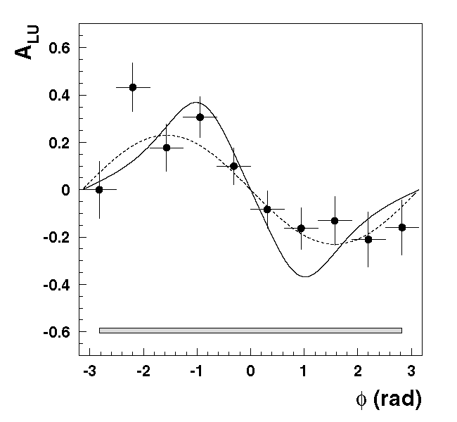
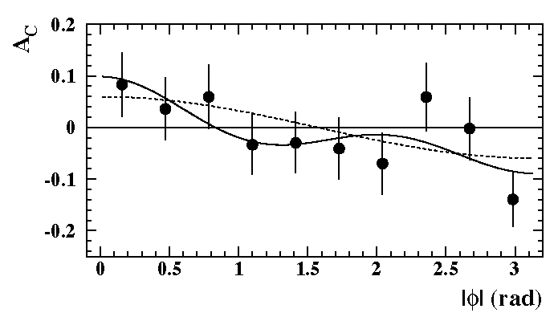
HERMES DVCS p(e,e’γ)X
2001 BSA
27 GeV polarized e± on Internal Gas Jet / Atomic Beam Source targets
2006 BCA

Slide 42
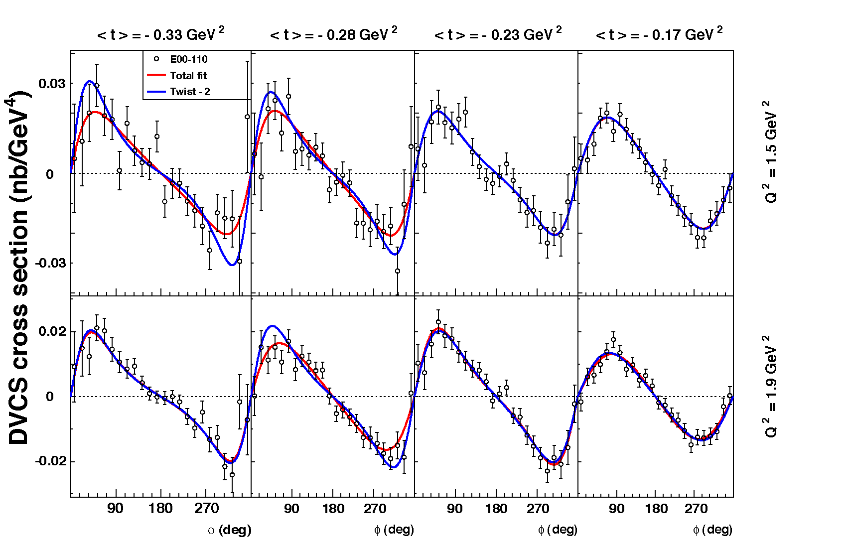
Hall A Helicity Dependent Cross Sections E00-110
Q² = 2.3 GeV²
4 bins, Δt = 0.055 GeV²
PRL97:262002 (2006) C. MUNOZ CAMACHO, et al.,
Q²=2.3 GeV²
Twist-2(GPD)+…
Twist-3(qGq)+…
Γ_{s1,2} = kinematic factors

Slide 43
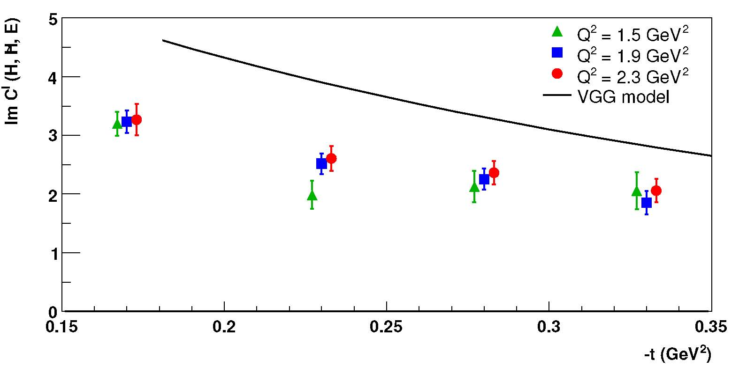
GPD results from JLab Hall A (E00-110) (C.MUNOZ CAMACHO et al PRL 97:262002)
Q²-independance of Im[DVCS*BH]
Twist-2 Dominance (GPD)
Model « Vanderhaeghen-Guichon-Guidal (VGG) » accurate to ≈30%
Compensate the small lever-arm in Q² with precision in dσ.

Slide 44
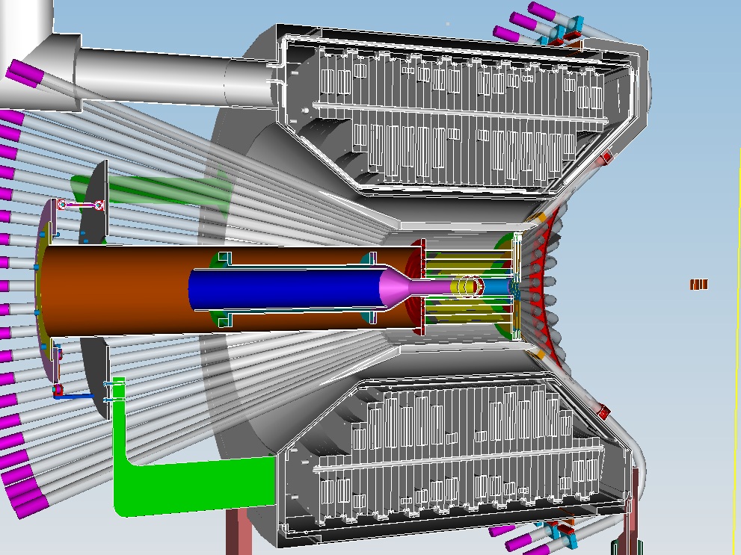
CLAS12 – Central Detector SVT, CTOF
Charged particle
tracking in 5T field
ΔT < 60psec in for
particle id
Moller electron shield
Polarized target
operation ΔB/B<10⁻⁴

Slide 45
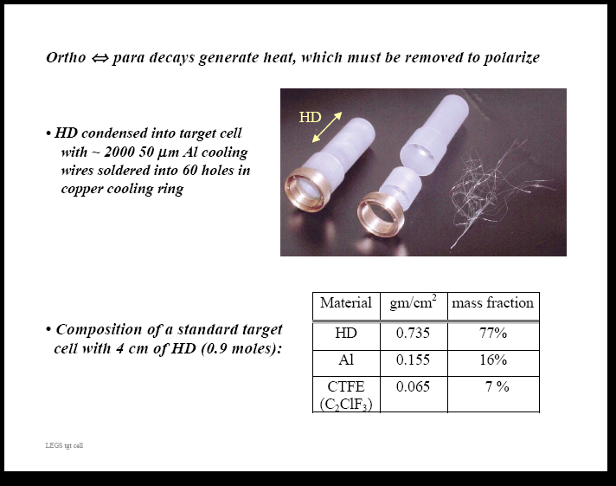
HD ice : a transversely polarized target for CLAS
Operates at T~500-750mK
Long spin relaxation times (months)
Weak transverse magnetic field
25+ years of development…
Successful operation at LEGS photon beam
Just in time for DVCS!!!!
Test in 2010 with electron beam, Experiment conditionally scheduled in 2011
Heat extraction is accomplished with thin aluminum wires running through the target

Slide 46
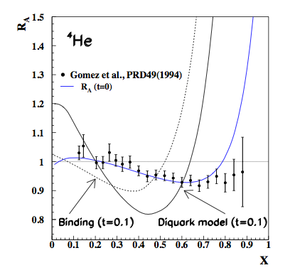
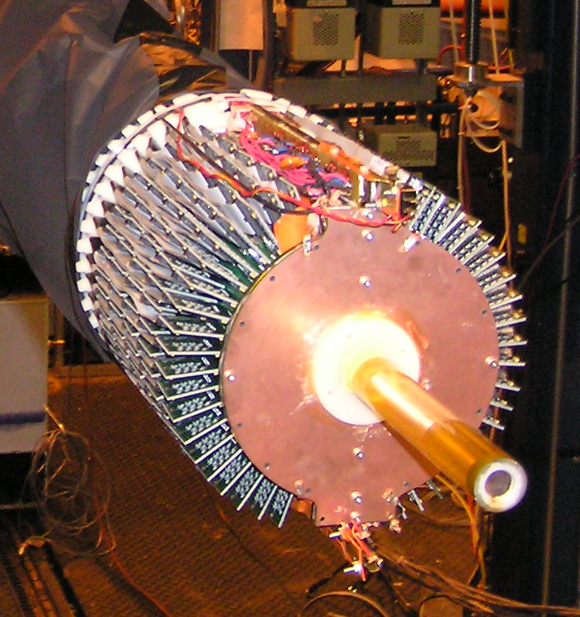
CLAS: Coherent ⁴He(e,e’γα)
A single GPD
H(ξ,ξ,t)=(4/9)H_{u}+(1/9) H_{u}.
G_{E}=∫dx[(2/9)H_{u}-(1/9)H_{u}].
E08-024, Autumn 2009
BoNuS GEM radial TPC
[t=0.0] →EMC effect,
[t=-0.1]→ GPD
(Liuti & Taneja, Guzey & Strickman)

Slide 47
DVCS in Hall A
Elastic form factors, Real Compton Scattering: Correlated two-body final state,
Spectrometers have the advantage over large acceptance:
product of (Luminosity)(Acceptance)
Precision of absolute cross sections
DVCS is a 3-body final state
For –t/Q²<<1, final photon close to q-direction.
Quasi two-body final state for limited t coverage

