Slide 1
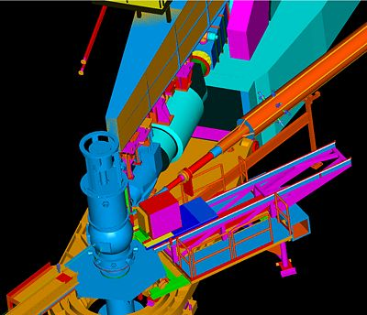
Deeply Virtual Compton Scattering in Hall C at 11 GeV
DVCS Hall C Workshop 11 Nov 2012, Orsay France
Charles Hyde
Old Dominion University

Slide 2
Why Use Spectrometers for DVCS?
Precision cross sections are key to extracting physics
dσ(ep→epγ) = twist-2 (GPD) terms + Σ_{n} [twist-n]/Q^{n-2}
Isolate twist-2 terms → cross sections vs Q² at fixed (x_{Bj}, t); or
→ Multiple beam energies at fixed (Q², x_{Bj}, t)
Two beam energies at fixed (Q², x_{Bj}, t) to isolate [DVCS†BH] from |DVCS|²
Three beam energies at fixed (Q², x_{Bj}, t) to isolate all twist-2 and twist-3 terms in unpolarized cross section.
H(e,e’γ)p at low Δ², electron and photon are highly correlated
For a single kinematic setting, Luminosity×Acceptance with spectrometers roughly 10× CLAS12
CLAS12 has greater reach to larger values of –t and smaller x_{Bj}

Slide 3
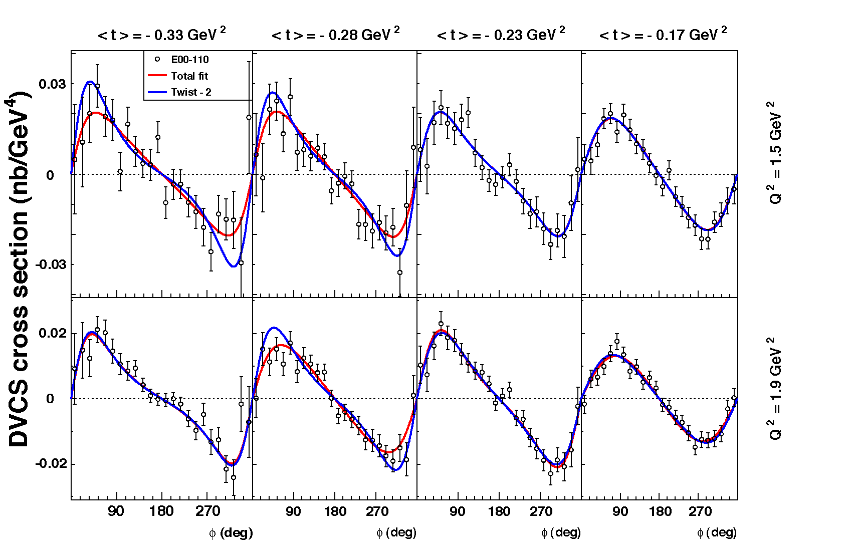
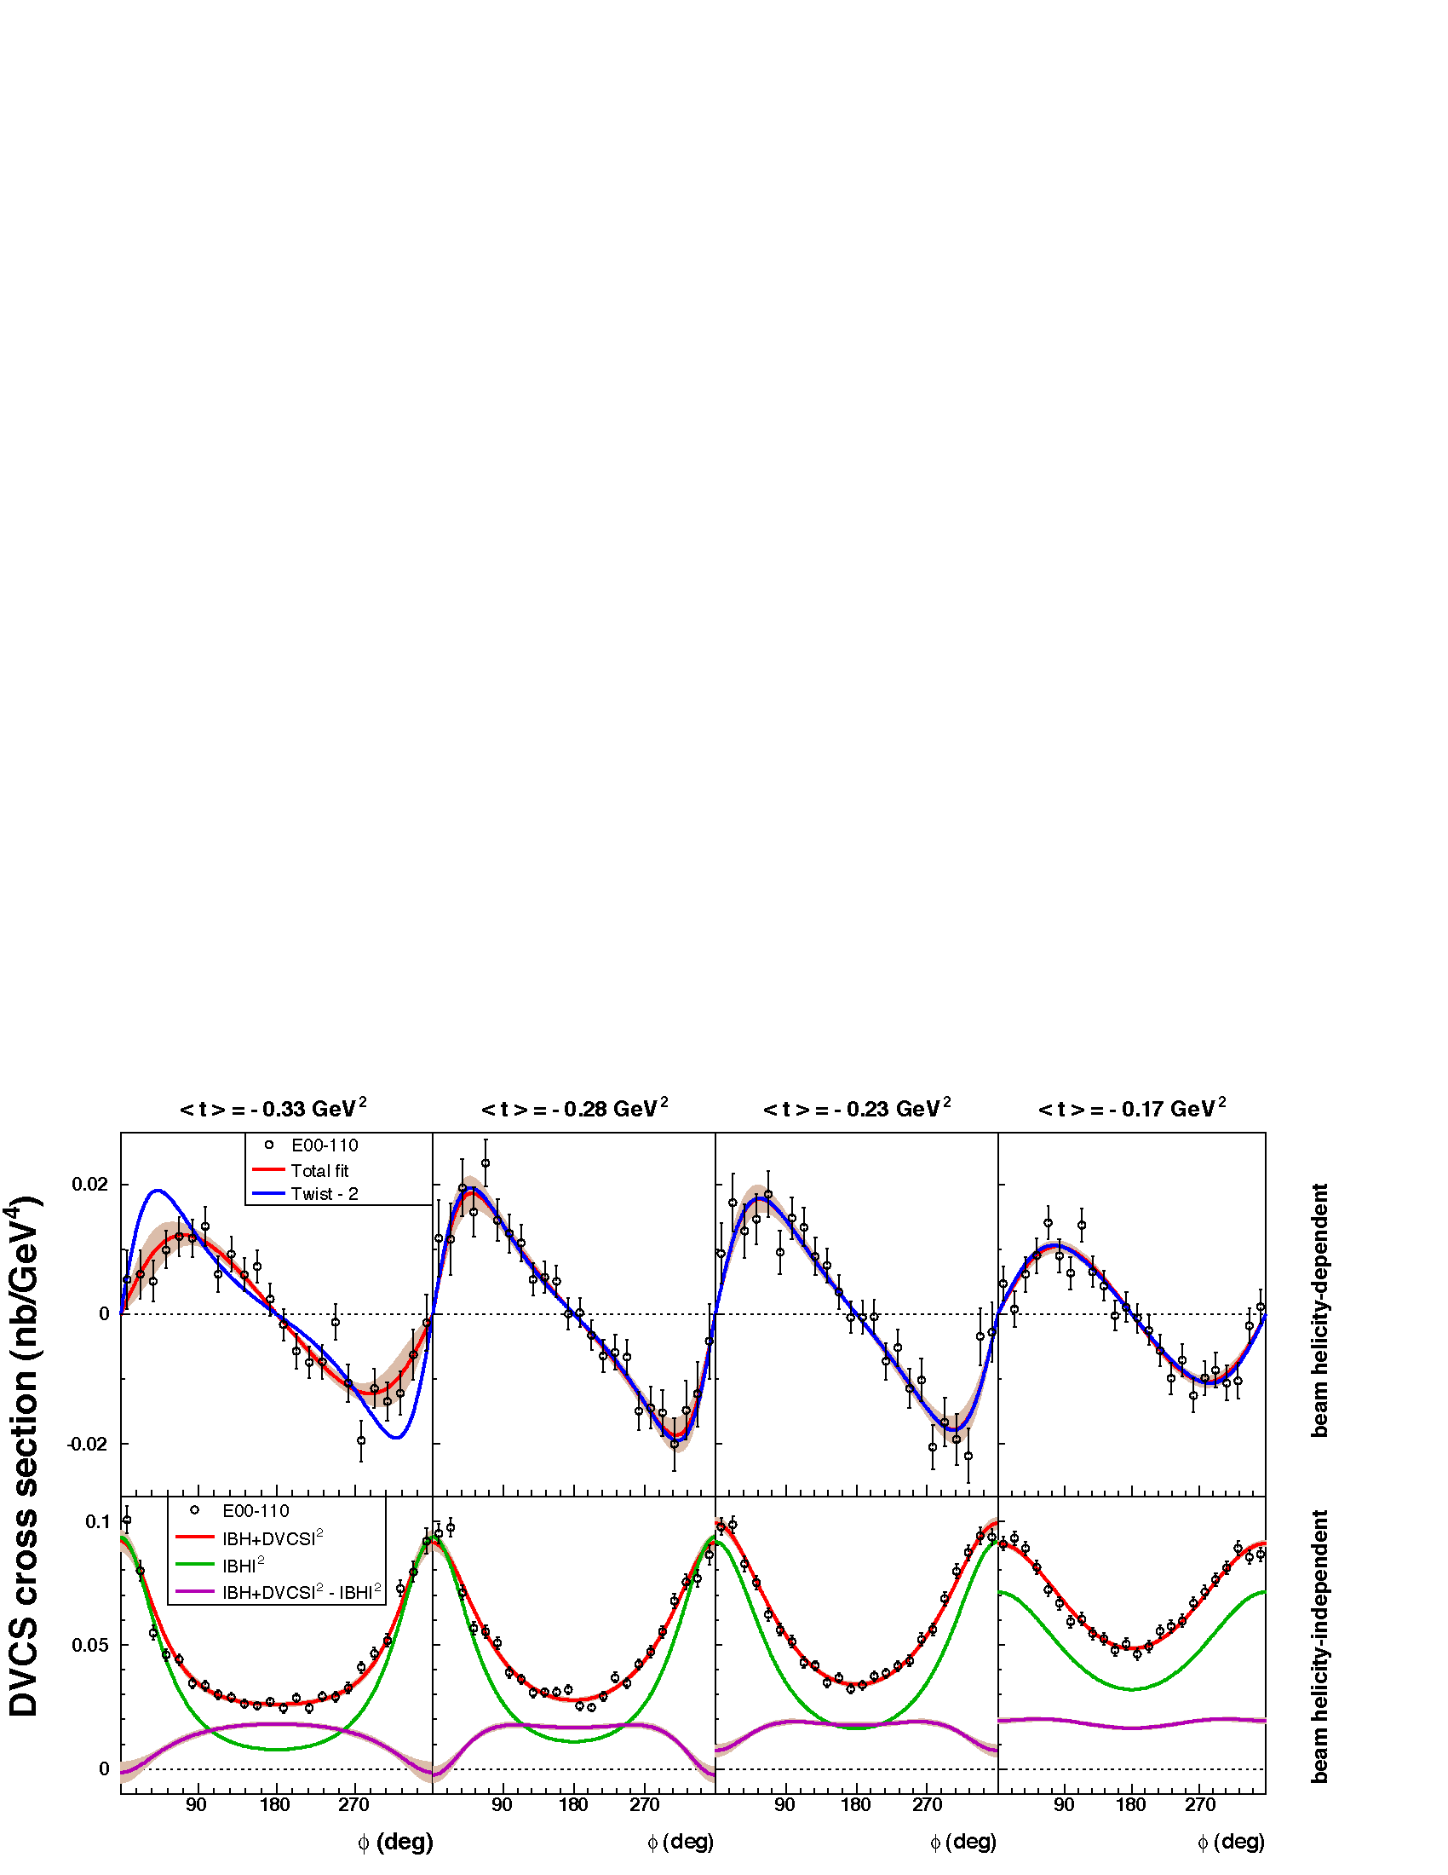
Hall A Helicity Dependent Cross Sections E00-110
Q² = 2.3 GeV²
4 bins, Δt = 0.055 GeV²
PRL97:262002 (2006) C. MUNOZ CAMACHO, et al.,
Q²=2.3 GeV²
Twist-2(GPD)+…
Twist-3(qGq)+…
Γ_{s1,2} = kinematic factors

Slide 4
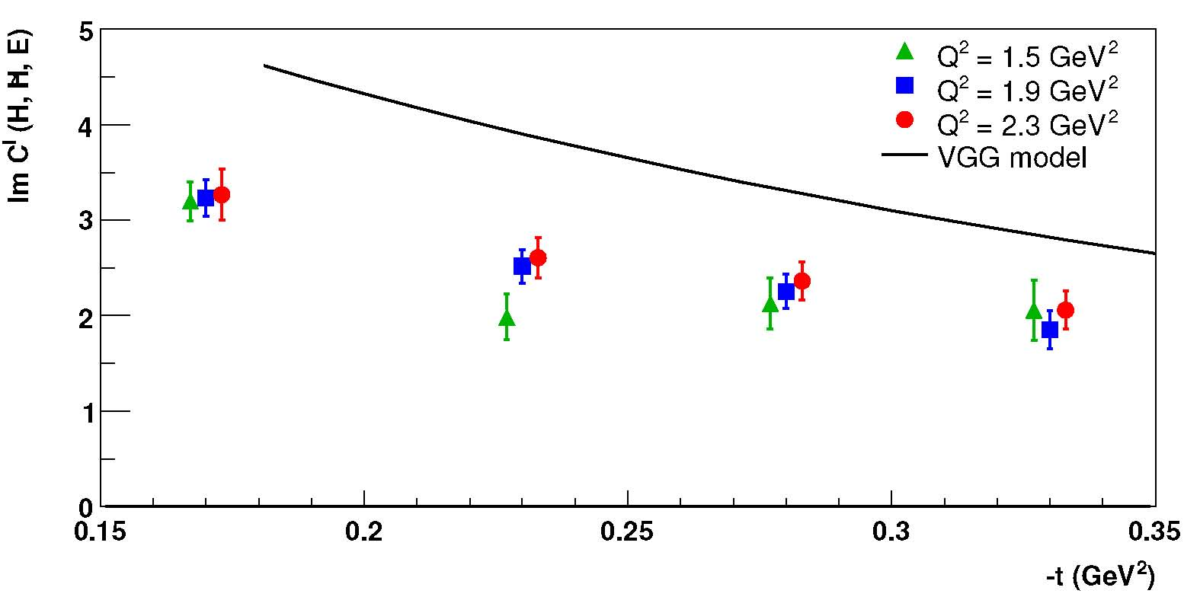
GPD results from JLab Hall A (E00-110) (C.MUNOZ CAMACHO et al PRL 97:262002)
Q²-independance of Im[DVCS*BH]
Twist-2 Dominance (GPD)
Model « Vanderhaeghen-Guichon-Guidal(VGG) » (based on Double Dist. of A.Radyushkin) accurate to ≈30%
Extend to Q² = 4.5 GeV² @11GeV
Compensate the small lever-arm in Q² with precision in dσ.

Slide 5
Beam helicity-independent cross sections at Q²=2.3 GeV², x_{B}=0.36
Contribution of Re[DVCS*BH] + |DVCS|² large.
Positron beam or measurements at multiple incident energies to separate these two terms and isolate Twist 2 from Twist-3 contributions
PRL97:262002 (2006) C. MUNOZ CAMACHO, et al.,
d⁴σ (nb/GeV⁴)

Slide 6
Projections for E07-007 (2010), Q²=1.9 GeV²
Different dependence on incident energy for |BH|², [DVCS†BH] (C^{I} twist-2), and |DVCS|²(C^{DVCS} twist-3) terms
k = 6 GeV
k = 4.8 GeV

Slide 7
E07-007 Projected Extractions:
Re[DVCS†BH],
Twist-2
Re[DVCS†BH],
Twist-2
green bands are systematic errors.
Four different contributions to unpolarized cross sections
constant terms
cosφ_{γγ} terms
cos2φ_{γγ} terms
Re[DVCS†BH],
Twist-3
Re[DVCS_{L}†DVCS_{T}],
Twist-3

Slide 8
Hall A E12-06-116, approved for 100 days
Multiple beam energies at fixed Q², x_{Bj} requires spectrometer momenta > k_{HRS}=4.3 GeV/c

Slide 9
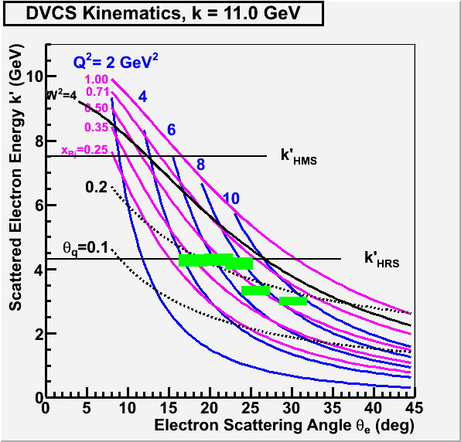
DVCS Kinematics, Hall A & C
Green rectangles are Hall A kinematics.
Calorimeter centered at θ_{q}.
Require θ_{q} ≥ 0.2 rad to avoid small-angle background

Slide 10
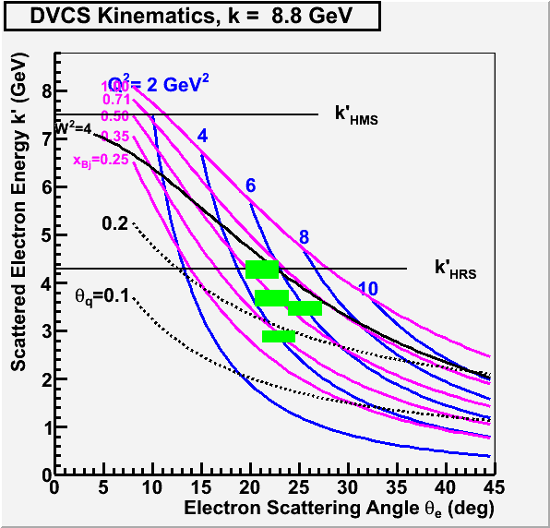
DVCS Kinematics, Hall A & C
Green rectangles are Hall A kinematics.
Calorimeter centered at θ_{q}.
Require θ_{q} ≥ 0.2 rad to avoid small-angle background

Slide 11
Kinematics Table Hall A E12-06-114
 |  | Hall A E12-06-114 |  |  | Hall C complement at fixed (Q², x_{Bj})
Q² | x_{Bj} | k | k' | θ_{q} | k | k' | θ_{e} | θ_{q} | k | k' | θ_{e} | θ_{q} | Days HallC
3.00 | 0.36 | 6.60 | 2.16 | 11.7 | 8.80 | 4.36 | 16.08 | 14.7 | 11.00 | 6.56 | 11.70 | 16.2 | 6
4.00 | 0.36 | 8.80 | 2.88 | 10.3 |  |  |  |  | 11.00 | 5.08 | 15.38 | 12.4 | 3
4.55 | 0.36 | 11.00 | 4.26 | 10.7
3.10 | 0.50 | 6.60 | 3.30 | 19.0 | 8.80 | 5.50 | 14.55 | 21.6 | 11.00 | 7.70 | 10.98 | 23.0 | 10
4.80 | 0.50 | 8.80 | 3.68 | 14.5 |  |  |  |  | 11.00 | 5.88 | 15.65 | 16.6 | 4
6.30 | 0.50 | 11.00 | 4.28 | 12.4
7.20 | 0.50 | 11.00 | 3.32 | 10.2
5.10 | 0.60 | 8.80 | 4.27 | 17.8 |  |  |  |  | 11.00 | 6.47 | 15.38 | 19.8 | 13
6.00 | 0.60 | 8.80 | 3.47 | 14.8 |  |  |  |  | 11.00 | 5.67 | 17.84 | 17.2 | 16
7.70 | 0.60 | 11.00 | 4.16 | 13.0
9.00 | 0.60 | 11.00 | 3.00 | 10.2
 |  | Total Days |  | 88 |  |  |  |  |  |  |  |  | 52

Slide 12
Conclusions
Precision cross section measurements with spectrometers are essential to extracting the leading twist amplitudes from the ep→epγ cross section
The Hall C HMS paired with the DVCS PbF₂ calorimeter (or alternate PbWO₄) will allow an extension to measure two or three energy points for each x_{Bj} value at one or two Q² values
Separation of all twist-2 and twist-3 contributions to cross sections, without positrons.

Slide 13
Missing Mass Resolution
Spectrometer resolution required
δp/p ≤ 10^{–3}
δθ ∼ 10^{–3}

Slide 14
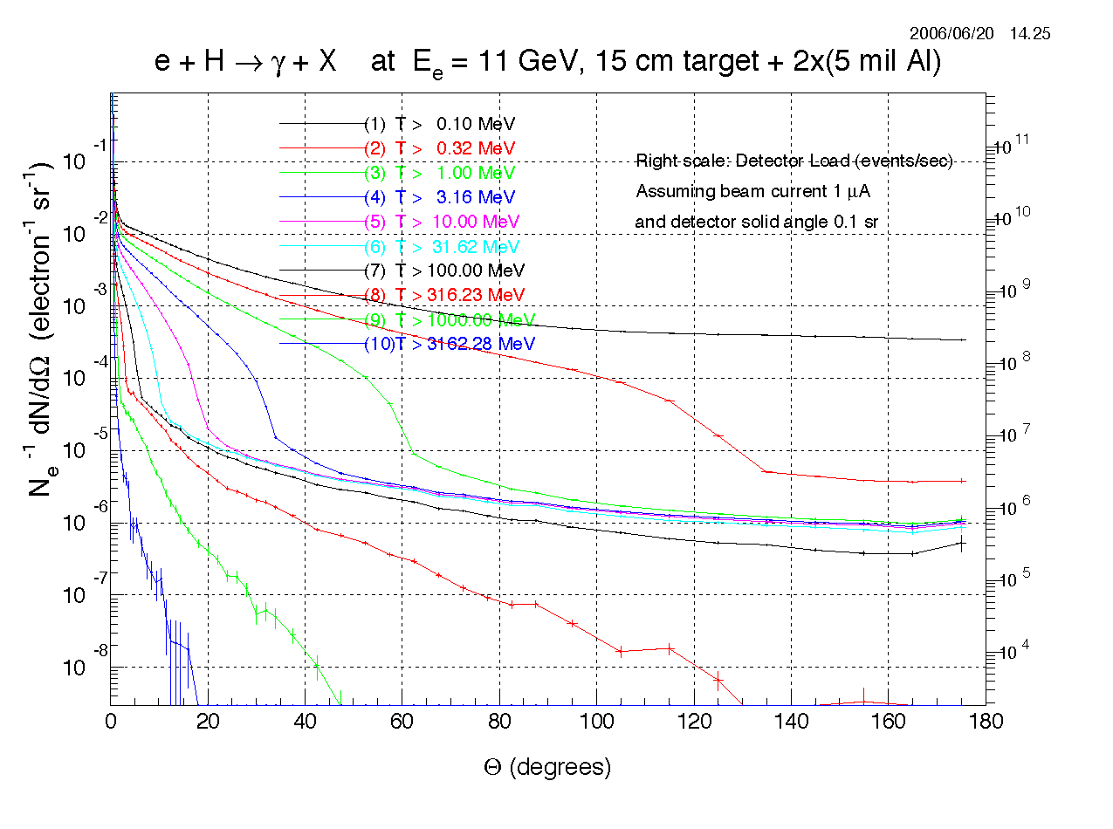
Electron and Gamma-ray Backgrounds dominate
Target dominates background

Slide 15
Electron and Gamma-ray Backgrounds dominate
Target dominates background

