Slide 1
2014 DVCS Run Preparations
Hall A Collaboration Meeting
11-13 December 2012
Jefferson Lab
Charles Hyde
Carlos Muñoz Camacho
Alex Camsonne
Julie Roche

Slide 2
88 days, 100K events/setting

Slide 3
Three models:
DVCS-GMP Symbiosis
Independence
  GMp installs and runs first ~1 PAC month
    Full operation of both HRS for GMp, no Luminosity limits from DVCS
  One month shutdown for DVCS installation
  DVCS runs ~3 PAC months
  No modification to scattering chamber needed
Cooperation
  GMp and DVCS install together (except DVCS Calo.)
  GMp runs independently
    Restrictions on HRS angles from vacuum chamber and DVCS stand
    Restrictions on HRS movement from DVCS cables and stand,
    HRS movement needs manual assistance
  One week shutdown to install DVCS Calo.
  DVCS runs ~3 PAC months
    GMp acquires parasitic data in HRS-R at large angles.
Symbiosis
  GMp and DVCS fully install together
  GMp and DVCS running is interlaced (circa weekly)
    Maximum luminosity is 25μA × 15 cm LH₂ (radiation limit for DVCS Calo.)
    Beam in Compton Chicane
    Restrictions on HRS angles and movement
    GMp acquires “unlimited” parasitic data in wide angle HRS-R
      Luminosity is correlated with beam energy: 10³⁷ @ 6.6 GeV, of 10•10³⁷ @ 11 GeV
    GMp angles < 49° only accessible with HRS-L
      DVCS Calo parked in “safe mode” at 5.5 m from target at 14°
No 11 GeV beam before Autumn 2014
Must have DVCS
DAQ operational Jan 2014
Too many restrictions on G_{M}^{p}

Slide 4
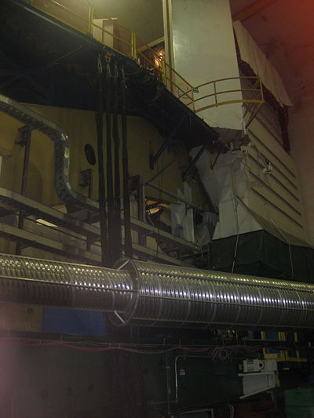
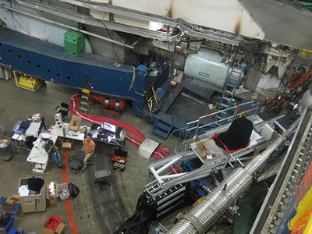
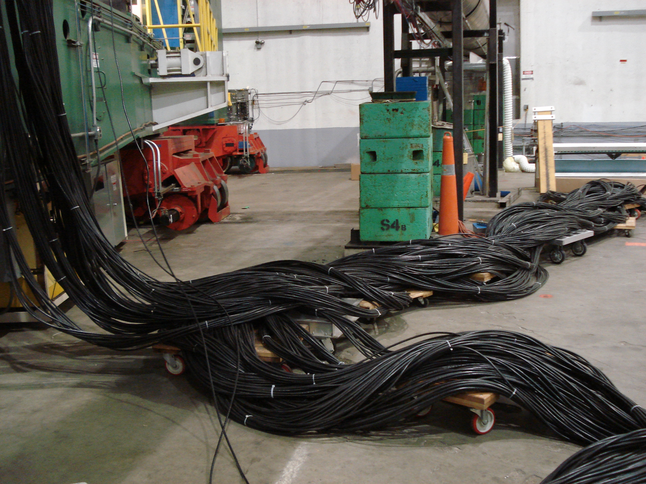
DVCS Cabling
Spectrometers movement must be monitored
in the Hall
220 RG-213 cables
DVCS cables must be moved by hand with HRS-L movement
(multi-person effort)

Slide 5
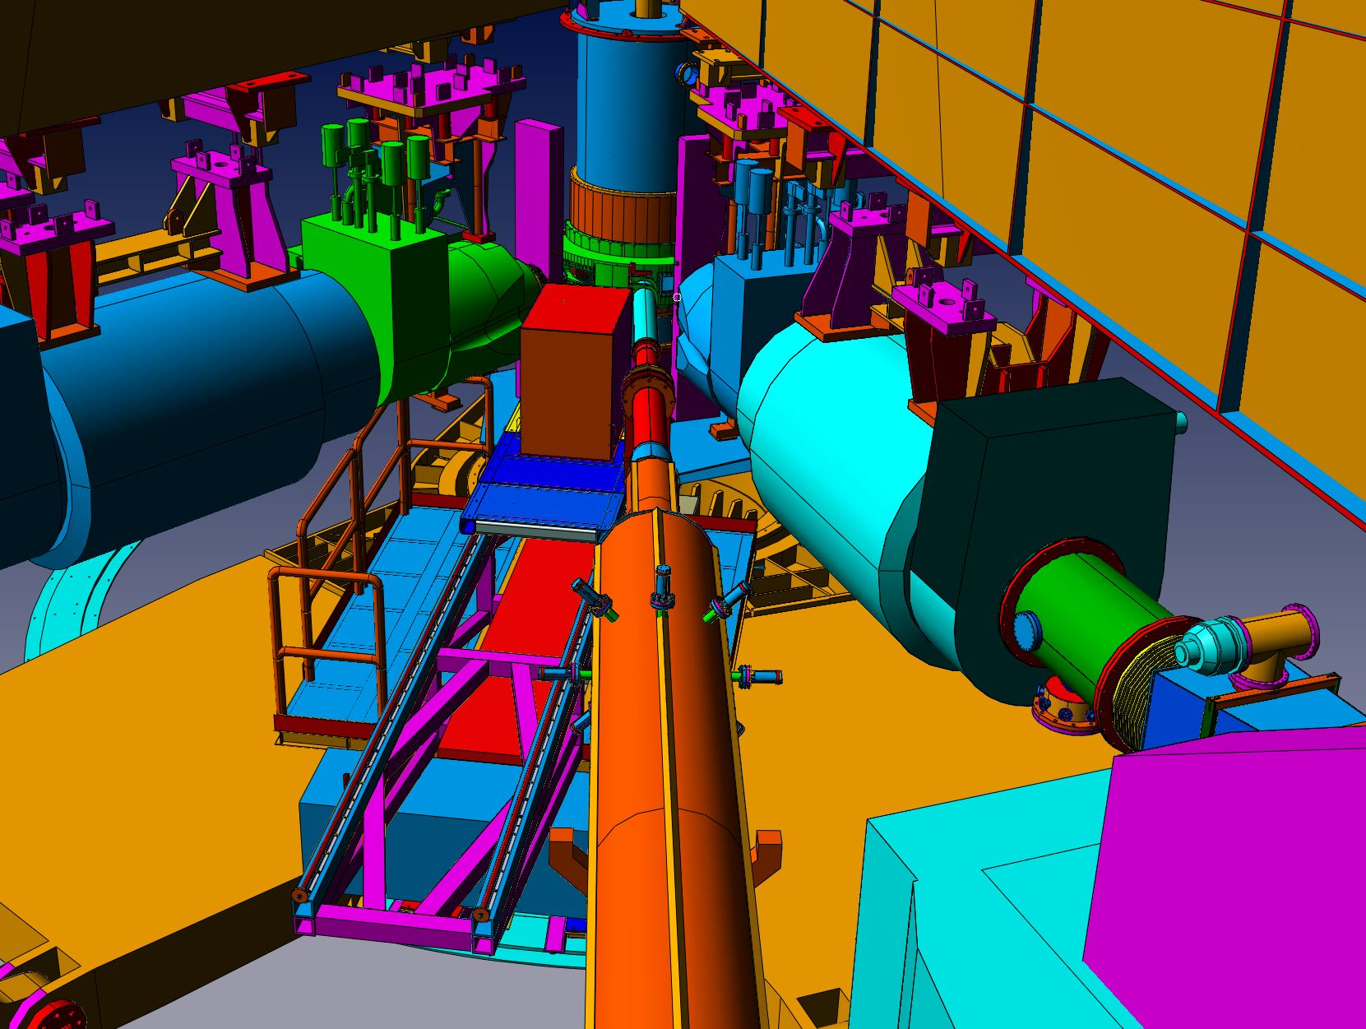
New (skinny) support for DVCS Stand
HRS-L: 20.2°; HRS-R: –43°; DVCS:–8.5°

Slide 6
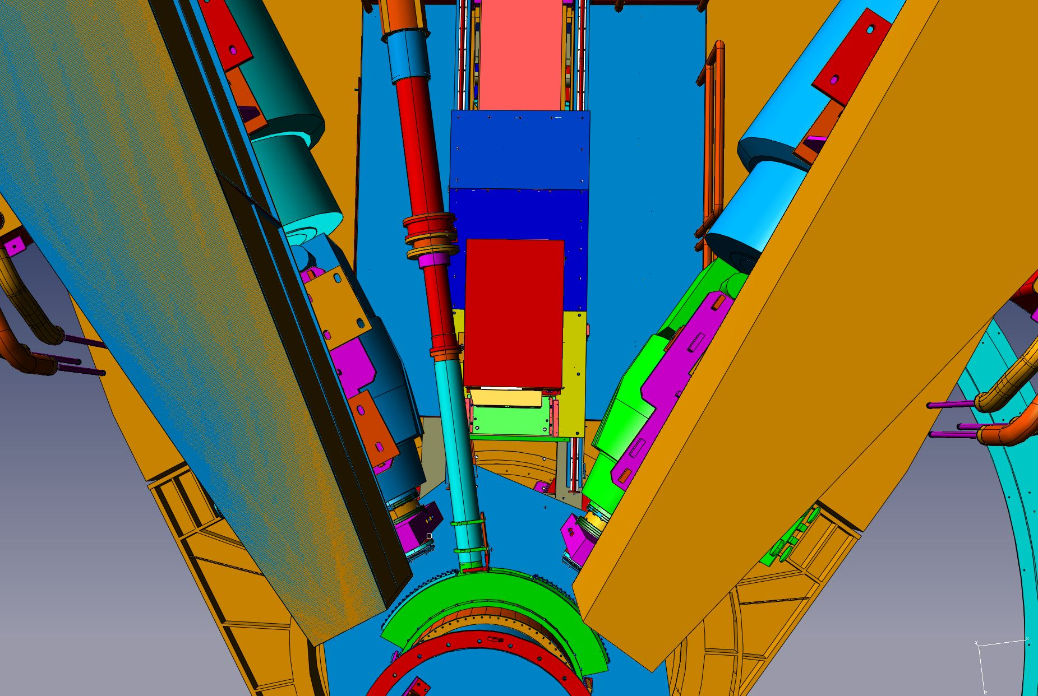
DVCS: –8.5° and 2.0 m from target center
HRS-L: 20.2° HRS-R: -43.0°

Slide 7
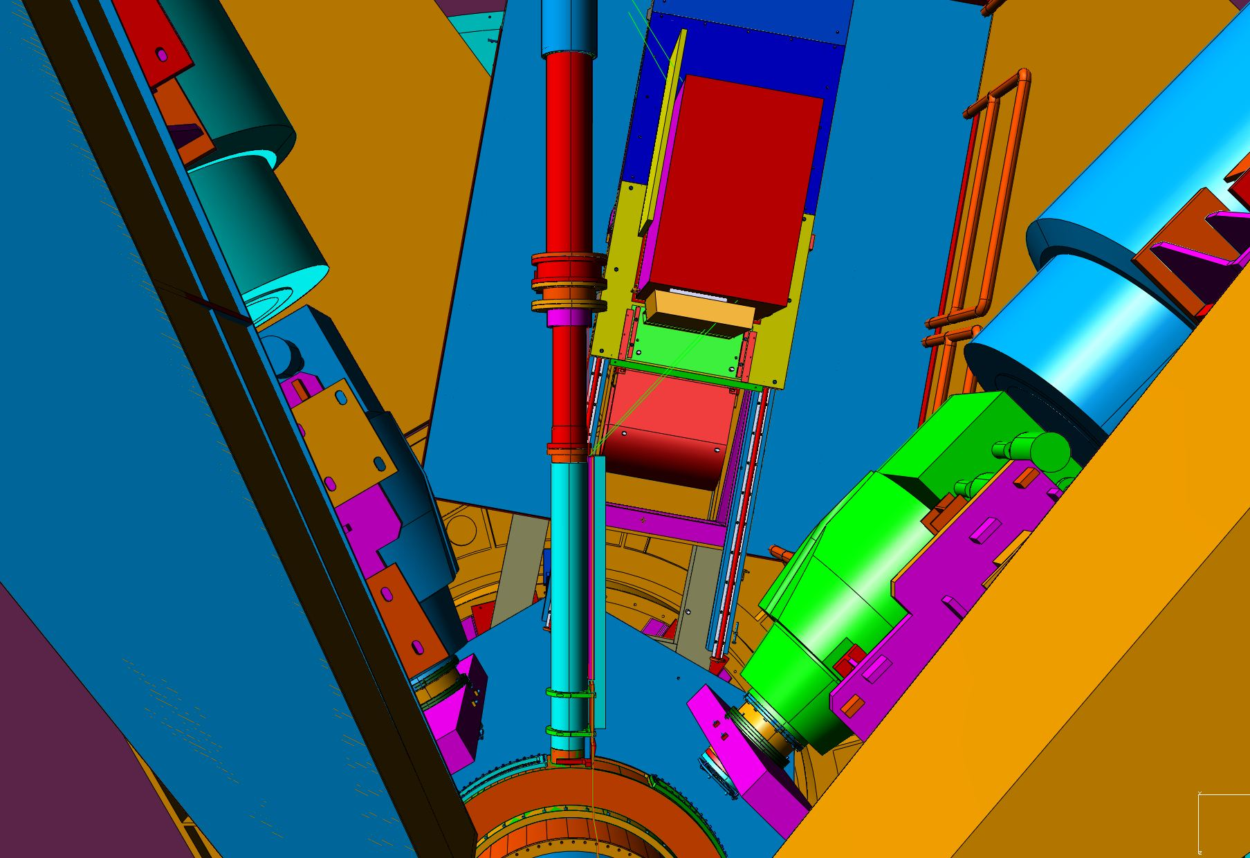
DVCS: –10.2° and 3.0 m from target center
(minimum distance 1.5 m)

Slide 8
Angle Restrictions
Minimum (central) HRS—DVCS-Calo opening angles: (limited by DVCS-Calo stand)
  θ(HRS-L)–θ(DVCS-Calo) ≥ 28.7°
    HRS-L ≥ 19° with DVCS-Calo @ –9.7°
  θ(DVCS-Calo)–θ(HRS-R) ≥ 34.5°
    |HRS-R| ≥ 49° with DVCS-Calo @ –14.5°
Restrictions of the common Scattering Chamber design
  HRS-L ≤ 46°
  HRS-R: 33°—80°

Slide 9
Scattering Chamber
  HRS-R (central angles)
  49°—80° w/ DVCS Calo @ 14.5°
DVCS
Calo
HRS-L
  12.5°—46° (central angles)
    14.5° min w/ Calo @ 14.5°

Slide 10
E12-04-114 DVCS Kinematics: nucl-ex/0609015
Beam (GeV) | k’ (GeV) | θ (HRS-L) | Q² (GeV²) | x_{Bj} | Beam (μA) | θ(Calo) | d(Calo) (m) | Time (days)
6.6 | 2.15 | 26.5° | 3.0 | 0.36 | 5.0 | –11.7° | 1.5 | 3
6.6 | 3.20 | 22.5 | 3.1 | 0.50 | 5.0 | –18.5 | 1.5 | 5
Subtotal days @ 6.6 GeV |  |  |  |  |  |  |  |  | 8
8.8 | 2.88 | 22.9 | 4.0 | 0.36 | 8.5 | –10.3 | 2.0 | 2
8.8 | 3.68 | 22.2 | 4.8 | 0.50 | 8.5 | –14.5 | 2.0 | 4
8.8 | 4.27 | 21.2 | 5.1 | 0.60 | 5.0 | –17.8 | 1.5 | 13
8.8 | 3.47 | 25.6 | 6.0 | 0.60 | 5.0 | –14.1 | 1.5 | 16
Subtotal days @ 8.8 GeV |  |  |  |  |  |  |  |  | 35
11.0 | 4.26 | 17.9 | 4.5 | 0.36 | 13. | –10.8 | 2.5 | 1
11.0 | 4.29 | 21.1 | 6.3 | 0.50 | 13. | –12.4 | 2.5 | 4
11.0 | 3.32 | 25.6 | 7.2 | 0.50 | 13. | –10.2 | 2.5 | 7
11.0 | 4.16 | 23.6 | 7.7 | 0.60 | 13. | –13.1 | 2.5 | 13
11.0 | 3.00 | 30.2 | 9.0 | 0.60 | 20. | –10.2 | 3.0 | 20
Subtotal days @ 11 GeV |  |  |  |  |  |  |  |  | 45

Slide 11
Detector Configuration
Cerenkov mirrors need re-coating.
Full Cerenkov
  Revised mounting for GMp FPP chamber
Trigger options:
  S0
  Cerenkov
  Pb-Glass (PR)

Slide 12
2013 – DVCS Collaboration Work
Reconstruct the Calorimeter
  Return PMT to JLab from Clermont-Ferrand
  re-wrap crystals
Remount calorimeter
  Space in TEDF building?
  Small stand for Calo
  Space to organize cables?
Re-commission ARS/Trigger/CODA
  Calo Trigger module under test at Clermont w/ CODA
Ready for Jan 2014.

Slide 13
2013 w/ Hall A staff
Construct/modify DVCS support and stand.
Design/construct beam shielding (& support)
cryo target
  Beer can
  (vertical flow target requires 5cm vertical height)
Work space
Revise/improve cable carts?
‘Standard Equipment’
  Scattering Chamber
  HRS:
    Space for DVCS electronics in shielding hut
    Full size Cerenkov
  Moeller, Compton polarimeters
  Arc Energy measurement.
Install one month before expected beam
  Nov 2013 for Jan 2014??

Slide 14
G_{M}^{p} Proposal
Last two kinematic points rejected by PAC
Possible parasitic points in
blue

