Slide 1
Polarized Targets for DVCS at 11 GeV: Required for separation of H, E, ˜H, Ẽ GPDs on x=ξ line.
Workshop on DVCS and other opportunities in Hall C
11 Nov 2012, Orsay, France
Charles Hyde
Old Dominion University

Slide 2
Polarized Protons, Neutrons in CLAS12
Longitudinally polarized NH₃ target
100 days approved
polarized proton luminosity ~ 10³⁴ ?
Extensive data taken already at 6 GeV
Transversely polarized protons in HDice
C2 approval from PAC, pending luminosity and polarization milestones
Longitudinal ND₃ or LiD likely (proposals?)
Unpolarized D₂ program with Orsay neutron detector in central barrel
No active program for transversely polarized neutrons

Slide 3
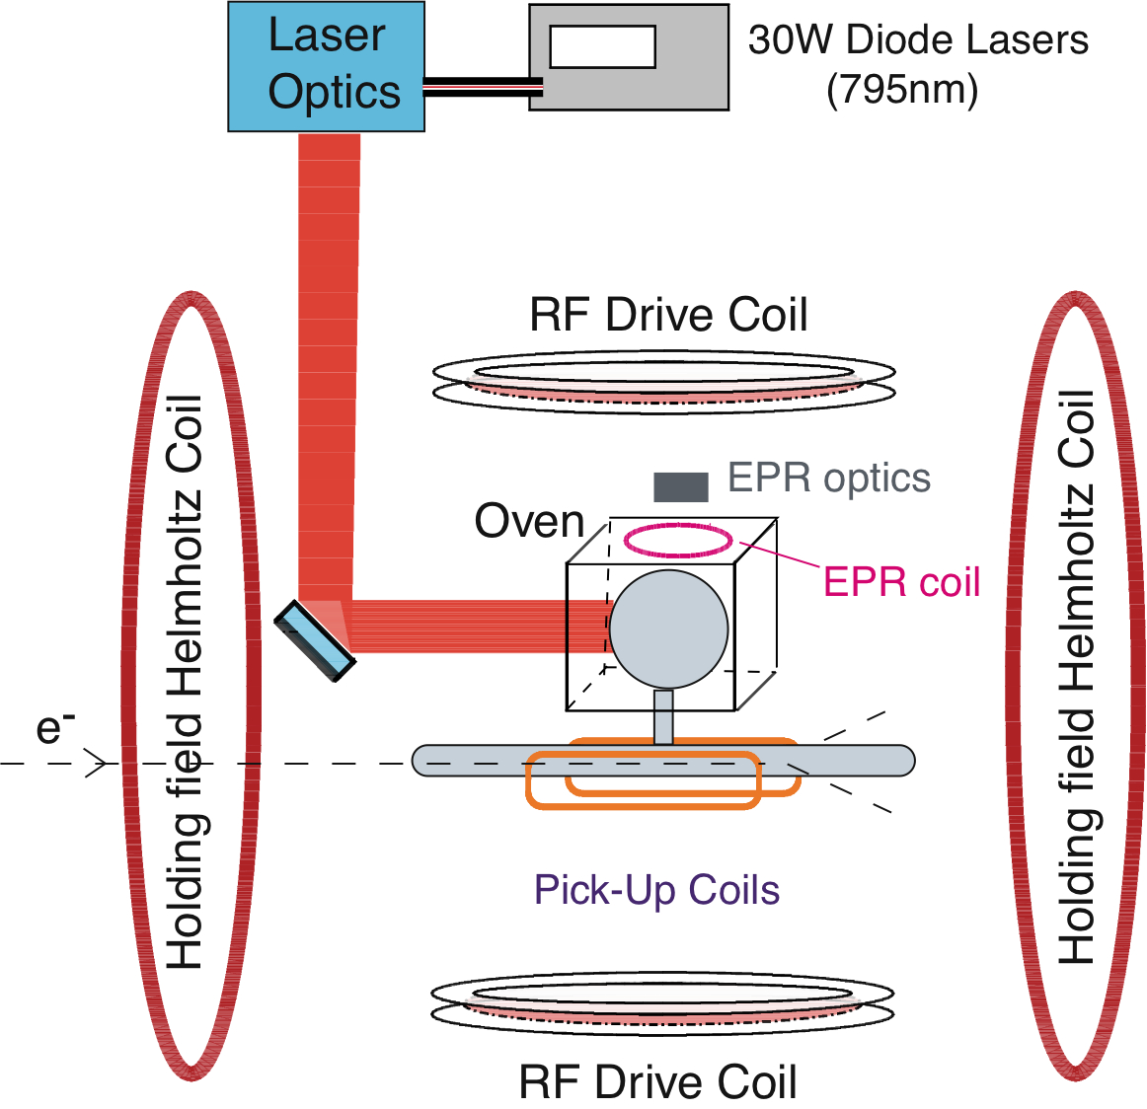
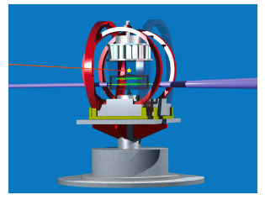
Hall A Polarized ³He Target
Maximum neutron luminosity 10³⁶
14 atm × 40 cm
“Background” Luminosity
Protons in ³He + entrance and exit windows
10³⁷/cm²/s total luminosity
Polarization 50% > 60%
Nuclear Physics dilution factor 0.86 (d-state)
-2.8% proton polarization
Longitudinal and Transverse (relative to q)
Large secondary background
BigBite suggests equivalent to 3• 10³⁷/cm²/s

Slide 4
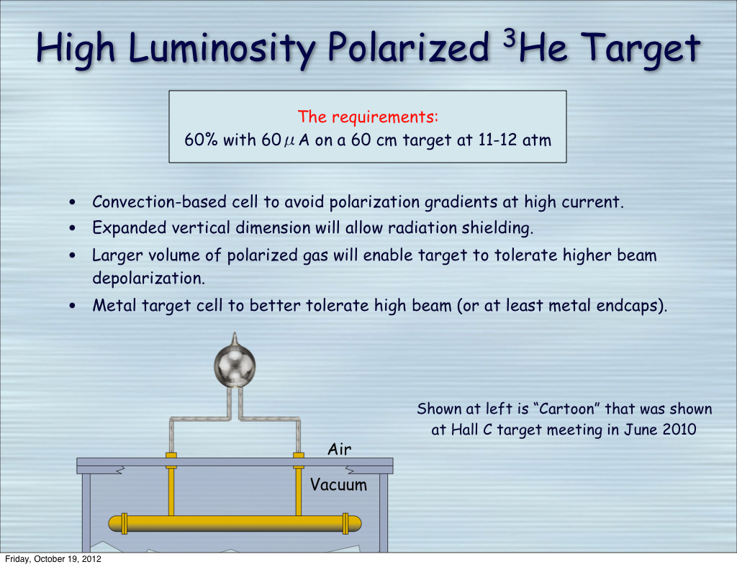
11 GeV Hall A/C 3He target
Neutron lumi
Neutron
L = 3•10³⁶
30 cm
Need thin metal walls, or 6 cm ϕ cell, to eliminate secondary background in DVCS Calorimeter

Slide 5
Hall A Figure of Merit
Typical bins (Hall A or CLAS)
[ΔQ², Δx_{B}]=[1.0 GeV²,0.1]
For t-range of DVCS calorimeter
HRS vertical angle acceptance Δθ_{v}= ±60 mr
Azimuthal acceptance (Δφ_{e}/2π) = 120mr/sinθ_{e} ≈ 1/20
Figure of merit ³He target
( Luminosity)(acceptance)(Polarization)²
FOM = (3•10³⁶)(1/20)(0.6*0.86)² ≈ 4•10³⁴
Competetive with NH3, HD targets in CLAS12
Cool target cell to LN₂ temperature to reach neutron Luminosity of 10³⁷ ???

Slide 6
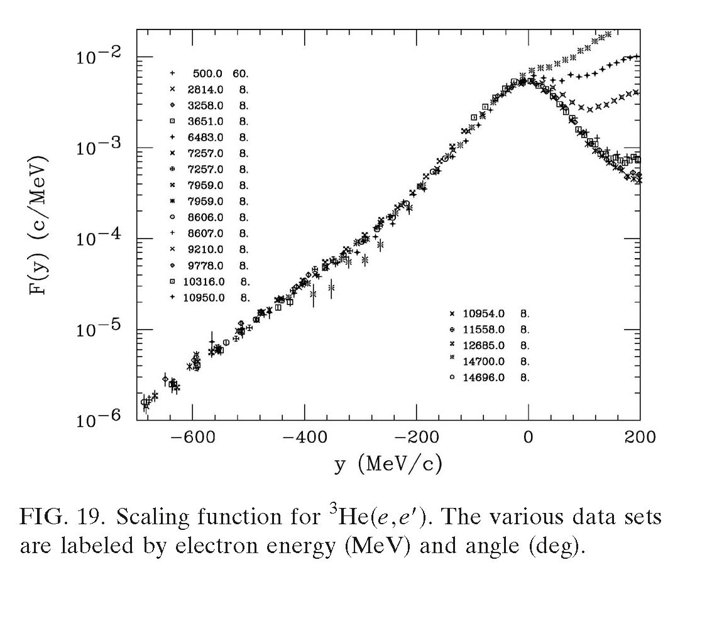
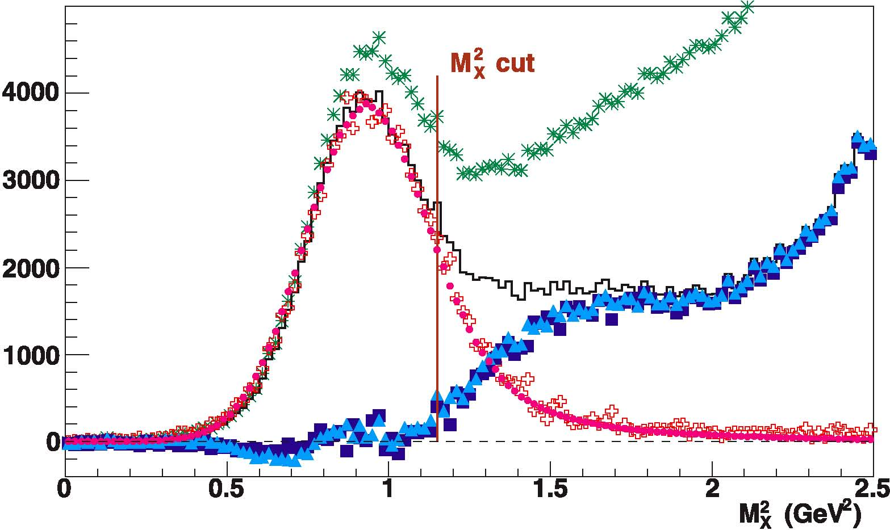
Neutron DVCS in ³He Target:
Target spin-dependent cross sections
0.86”n”-0.028”p” from ³He wave-function
Fermi-motion of neutron in ³He
Smearing of QF neutron contribution with pion-production channels N(e,e’γ)Nπ
H(e,e’γ)X: M_{X}² resolution σ(M_{X}²) ≈ 0.22 GeV².
For −t < 0.4 GeV² and p_{N} <250 MeV/c, QF smearing contributes ≤0.1 GeV² to σ(M_{X}²) .
Benhar, Day, Sick, RMP80 (2008)

Slide 7
Neutron DVCS Observables
λ, Λ = electron, ³He Polarization
Long or Transverse Normal Polarization
Target Single Spin Cross Sections
dσ_{LSS} = Σ_{λΛ} Λdσ(λ,Λ)/4 ~ sinφ_{γγ} Im[BH*DVCS] (Twist-2) Unpolarized Protons in ³He cancel
Target Double Spin
dσ_{LDS} = Σ_{λΛ} Λλdσ(λ,Λ)/4 ~ c₀ + c₁cosφ_{γγ} Re[BH² + (BH*DVCS) + DVCS²] Unpolarized protons cancel
Transverse Sideways: sinφ_{γγ} ⇔ cosφ_{γγ}
All other “neutron” observables (dσ, Beam-spin) have large incoherent proton contributions

Slide 8
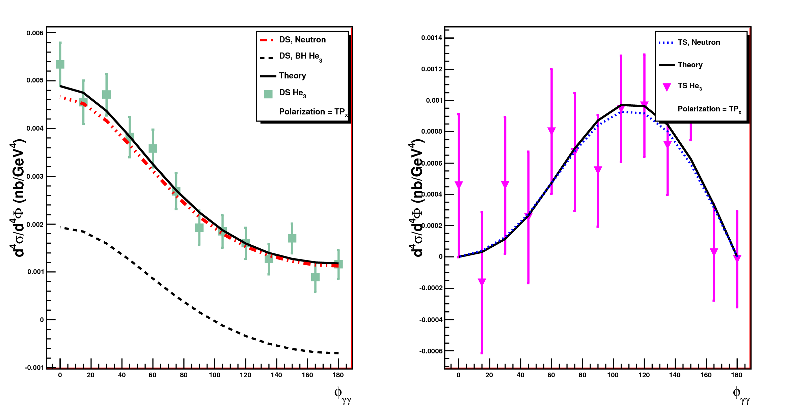
Q² = 3.05 GeV², x_{Bj}=0.36, t_{Min}–t=0.05 GeV² Δt=0.10GeV², 16 days @ 3•10³⁶×60%×80%
Double spin
Target single spin
Pol=X (Transverse in-plane)

Slide 9
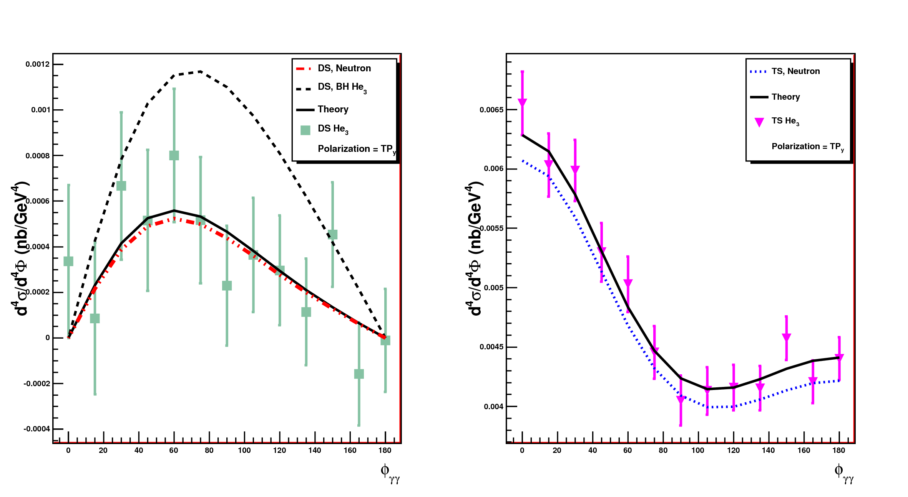
Q² = 3.05 GeV², x_{Bj}=0.36, t_{Min}–t=0.05 GeV² Δt=0.10GeV², 16 days @ 3•10³⁶×60%×80%
Pol=Y (Transverse normal)

Slide 10
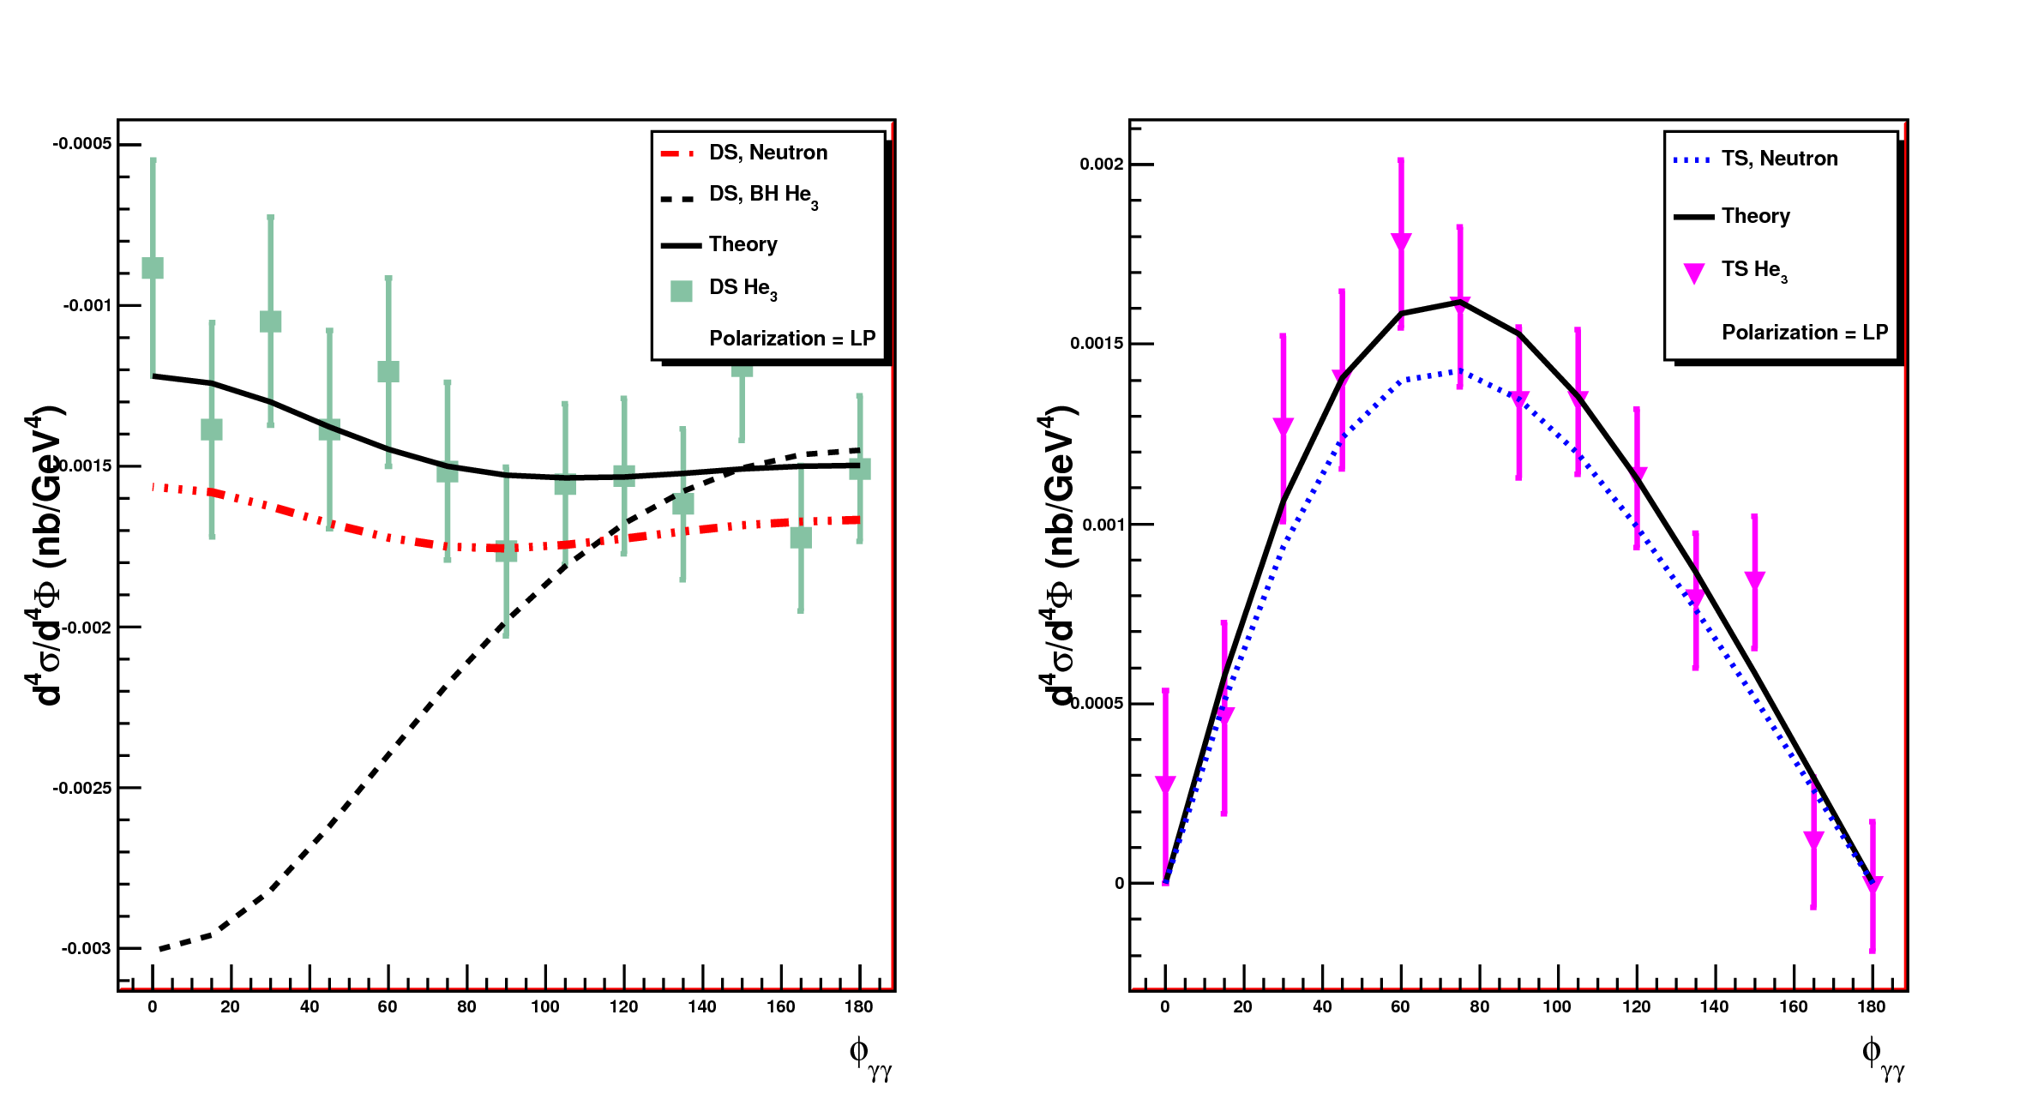
Q² = 3.05 GeV², x_{Bj}=0.36, t_{Min}–t=0.05 GeV² Δt=0.10GeV², 16 days @ 3•10³⁶×60%×80%
Double spin
Target single spin
Pol=Z (Longitudinal)

Slide 11
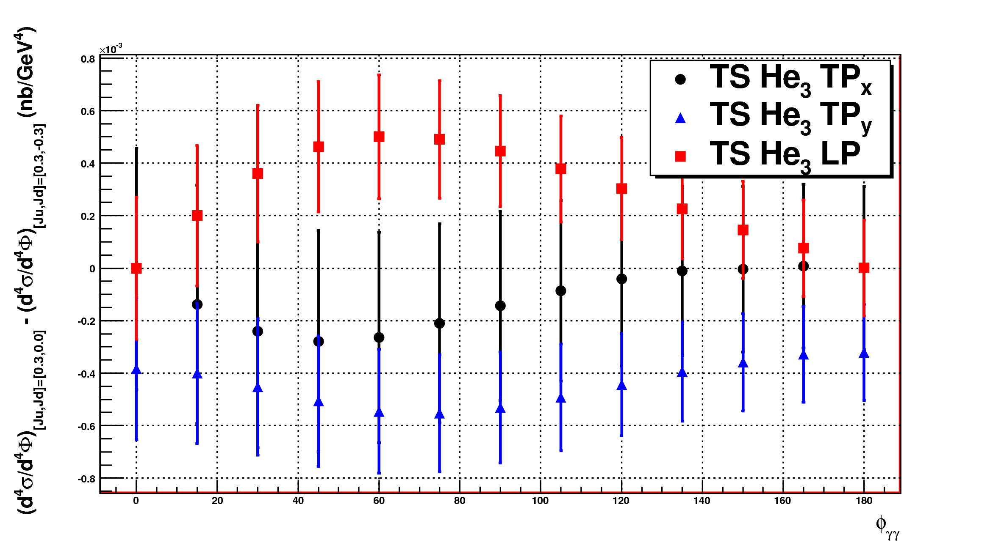
Q² = 3.05 GeV², x_{Bj}=0.36, t_{Min}–t=0.05 GeV² Δt=0.10GeV², 16 days @ 3•10³⁶×60%×80%
One-σ sensitivity Δ(J_{u},J_{d}) = 0.06 (parameters of E in VGG model)

