Slide 1
Exclusive Neutral Pion Production at JLab Hall A
INT Workshop on Orbital Angular Momentum
6-17 February 2012
Seattle, WA
Charles Earl Hyde
Old Dominion University
Norfolk VA
E. Fuchey et al,
Phys Rev C83:025201,2011
arXiv:1003.2938v3

Slide 2
Why Measure π⁰ Production?
π⁰ production is an important background to DVCS via asymmetric p(e,e’γ)γp decays, with the unobserved photon at low energies in backwards direction.
Co-linear factorization predictiions:
dσ_{L}/dσ_{Τ} ∼ Q²
Amplitude ~ Axial Generalized Parton Distributions ˜H and ˜E
Transversity GPDs?
Talks of P. Kroll, S. Liuti

Slide 3
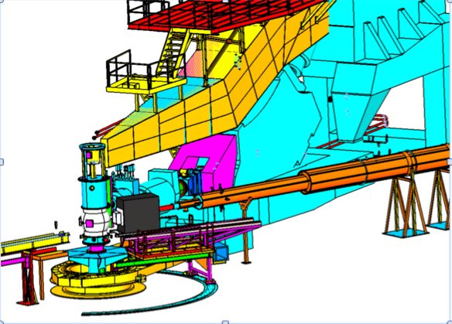
H(e,e’γγ)p in Hall A
5.75 GeV beam incident on 15 cm Liquid H₂ target
L = 10³⁷ /cm²/s
Electron in HRS defines q-direction to ~ 1mr
70 msr PbF₂ calorimeter centered on q
Two photon clusters

Slide 4
Exclusivity in H(e,e’γγ)X Reaction
Exclusive H(e,e’γγ)p peak
Yield is stable with respect to efficiency corrections of 1 GeV threshold in Calorimeter

Slide 5
Electroproduction
Hall A E00-110
Polarized Electron beam
Full azimuthal decomposition,
no dσ_{L}, dσ_{T} separation.

Slide 6
Kinematics k = 5.75 GeV
Label | Q² (GeV²) | x_{Bj} | W² (GeV²)
Kin2 | 2.3 | 0.36 | 5.0
Kin3 | 1.9 | 0.36 | 4.3

Slide 7
Cross Sections, Kin3 (Fitted with full Monte-Carlo)
Kin3

Slide 8
Helicity Dependent Cross Sections, Kin3 (Fitted with full Monte-Carlo)
Kin3

Slide 9
φ-Averaged cross section
~Q^{–5} slower than Q^{–8}
GPD model prediction is 10x too small.
Not leading twist
Probably mostly σ_{T}

Slide 10
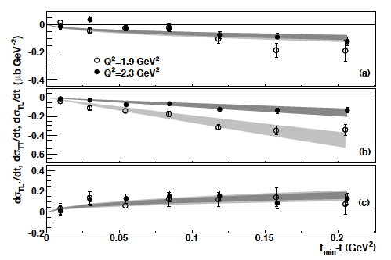
Separated Cross Sections
Bands are fits:
sinθ_{π}
sin2θ_{π}
sinθ_{π}

Slide 11
Regge inspired model of J.-M. Laget
Magnitude ~OK
σ_{TT} too small
Wrong sign to σ_{TL}

Slide 12
Hall C π⁺ data
T. Horn et al, Phys. Rev. Lett. 97, 192001 (2006).
Model of M.Kaskulov, U. Mosel PRC81 045202 for σ_{T}

Slide 13
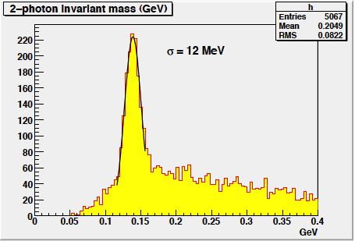
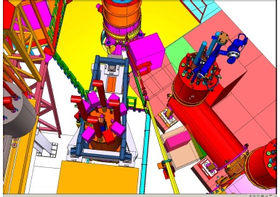
Future π⁰ L/T Separations at JLab
E07-007 Data in Hall A, 2010
4.4 and 5.5 GeV
Hall C 12 GeV C12-11-102 (T.Horn et al)
Please approve our NSF-MRI

Slide 14
Backup Slides

Slide 15
Resolution and t-binning
Kin3
Resolution allows fine t-binning

