Slide 1
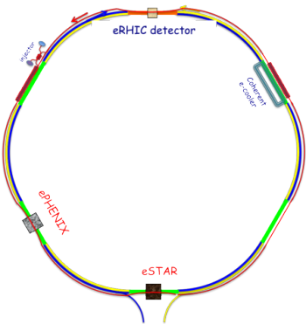
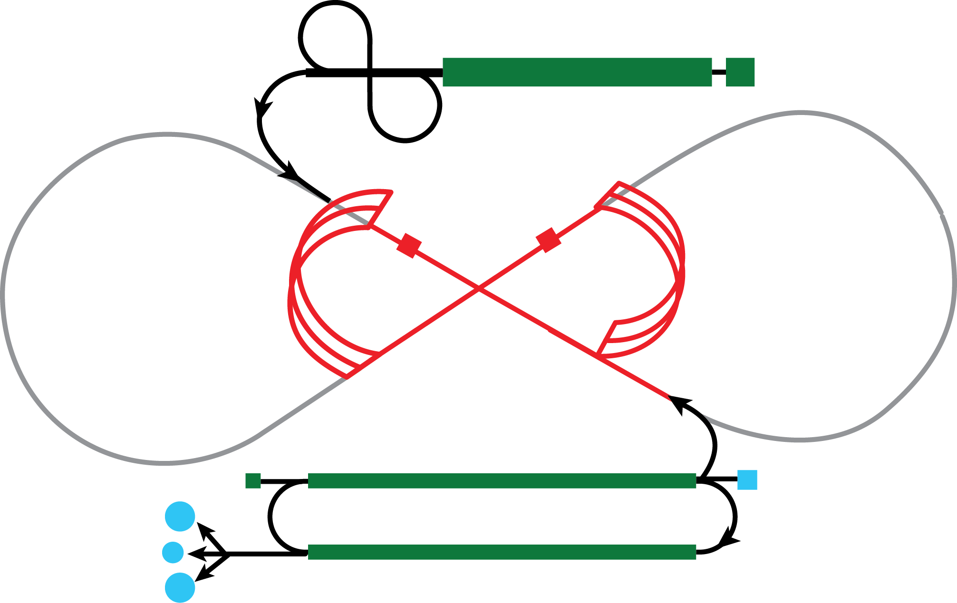
Electron-Ion Collider Polarized Light Ions
Exploring QCD with Next Generation Facilities
21—22 October 2013
Christopher Newport University
C. Hyde
Old Dominion University, Norfolk, VA
recent EIC white papers: arXiv:1212.1701 arXiv:1209.0757

Slide 2
Why a Polarized Electron-Ion Collider?
Longitudinal & Transverse Ion polarization at IP
No intense transverse B-field at IP to disrupt electron beam
Forward boost (incident ion species P(A) = ZP₀)
Target fragmentation region is boosted/easier to detect
Rapidity gap events can be identified
Spectator fragments are boosted forward
Incident ion species total momentum P(A) = ZP₀
Spectator fragment momenta P(A’) ≈ A’(Z/A)P₀
Spectator nucleon p’ = ZP₀/A
Tag the initial momentum of the struck nucleon in DIS, SIDIS, DVES reactions on light nuclei.

Slide 3
Polarized Ion Species Longitudinal and Transverse at IP
Species | (g–2)/2 | MEIC/JLab | eRHIC/BNL
p | 1.79 | ✔ | ✔
Deuteron | –0.14 | ✔+tensor?
Helium-3 | –4.18 | ✔ | ✔
Lithium-7 |  | ? | ?
¹H⁺:
DIS
SIDIS→ transverse momentum imaging,
DVES→ transverse spatial imaging.
²H⁺, ³He⁺⁺:
DIS, SIDIS, DVES… on weakly bound neutron
Polarized & Unpolarized nuclear structure effects in exactly solvable systems
Notes:
Lithium 7, spin 3/2, magnetic moment = 3.2564 mu_N kappa = 15.2?
anomalous magnetic moment = (g-2)/2
Magnetic moment = J g eh-bar/(2M_A c)
Lithium 6, spin 1 magnetic moment = 0.85 mu_N

Slide 4
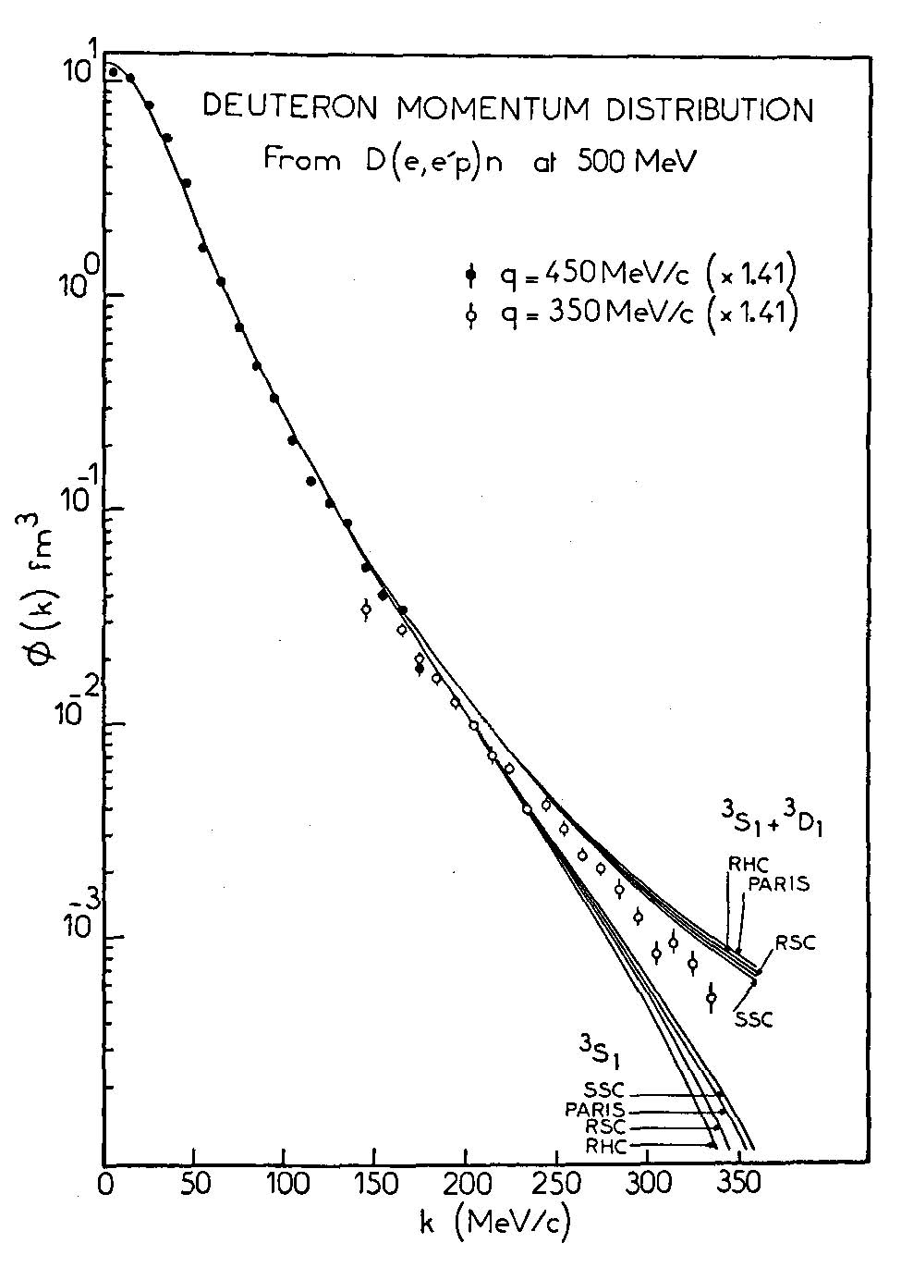
Neutron structure through spectator tagging
Scattering on bound neutrons
Fermi motion,
NN correlations
Depolarization
Solution is Spectator Tagging
Fixed target:
Low-momentum spectators
Thick Targets
Electron-Ion Collider
Spectator fragments are ultra-forward.
The MEIC is designed from the outset to tag spectators, and other nuclear fragments.
α≈ k/Μ
EIC
CLAS + BoNuS
CLAS
Notes:
DIS, SIDIS, DVES on bound neutron
‘Fermi’-smearing
Shift in x
Quark structure modified by NN-correlations
Solution is Spectator Tagging!
S. Kuhn

Slide 5
Nuclear Spectral Functions
²H and ³He
‘Neutron’ targets
Mean field ≈ 80%
Correlations
EMC Effect
Modified quark-gluon structure
M Alvioli, et al., PRC 87 (2013) 034603
Mean Field
Independent Nucleons
NN-Correlations
Notes:
²H and ³He are ‘neutron’ targets
Universal nuclear phenomena:
Independent nucleons moving in mean field~ 80%
Strong 2-body correlations generate high momentum tails to nucleon momentum distributions
Magnitude of EMC effect proportional to magnitude of NN correlations

Slide 6
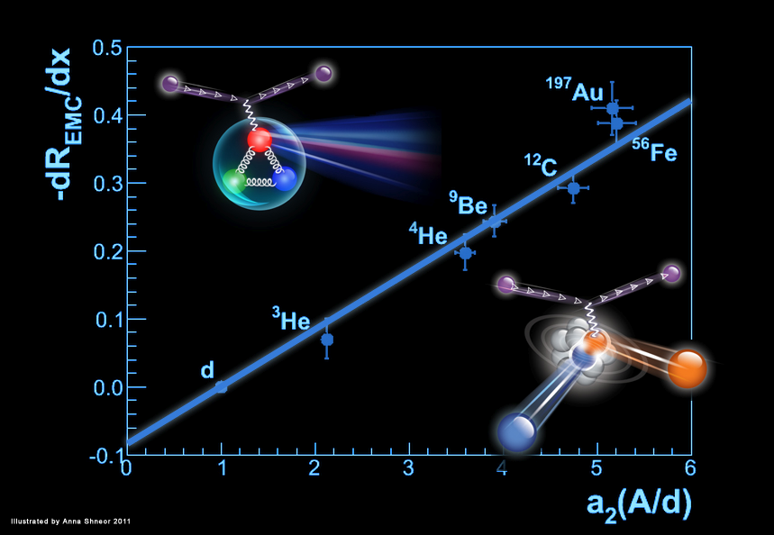
The EMC Effect and NN Correlations
EMC Effect:
J. Aubert et al., Phys. Lett. B 123, 275 (1983).
Recent ¹²C JLab ‘EMC’ data
J. Seely PRL 103 (2009) 202301
N. Fomin et al, PRL 108 (2012) 092502
L. Weinstein, PRL 106 (2011) 052301

Slide 7
MEIC-EIC(Jlab) and eRHIC Performance
revised Oct 2013 CEH
EIC
CLAS12
eRHIC
10³⁴

Slide 8
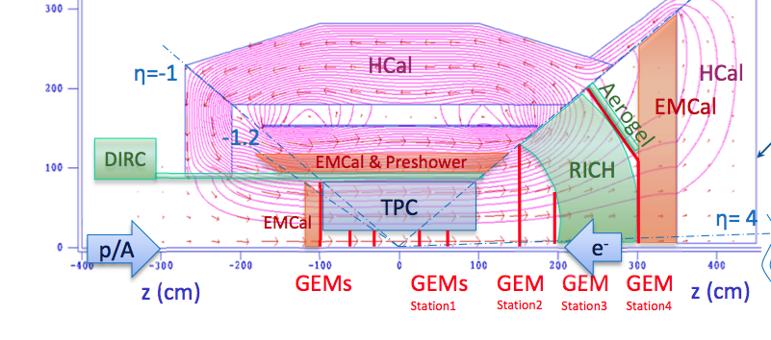
ePHENIX (fsPHENIX) Detector Concept
TK Hemmick, Future Trends in High Energy Nuclear Collisions, Beijing 2013
BaBAR Solenoid
Spectators
fsPHENIX definition:
sPHENIX with hadron endcap
Adds GEM-tracking, RICH, Aerogel, addn’l ecal & hcal.
Leaves sPHENIX barrel unchanged.
ePHENIX definition:
fsPHENIX with electron endcap
Removes silicon tracking
Adds crystal emcal, TPC, DIRC.
Discussing ePHENIX covers all of fsPHENIX

Slide 9
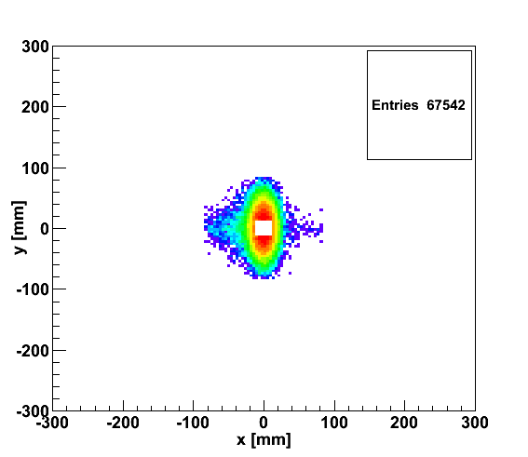
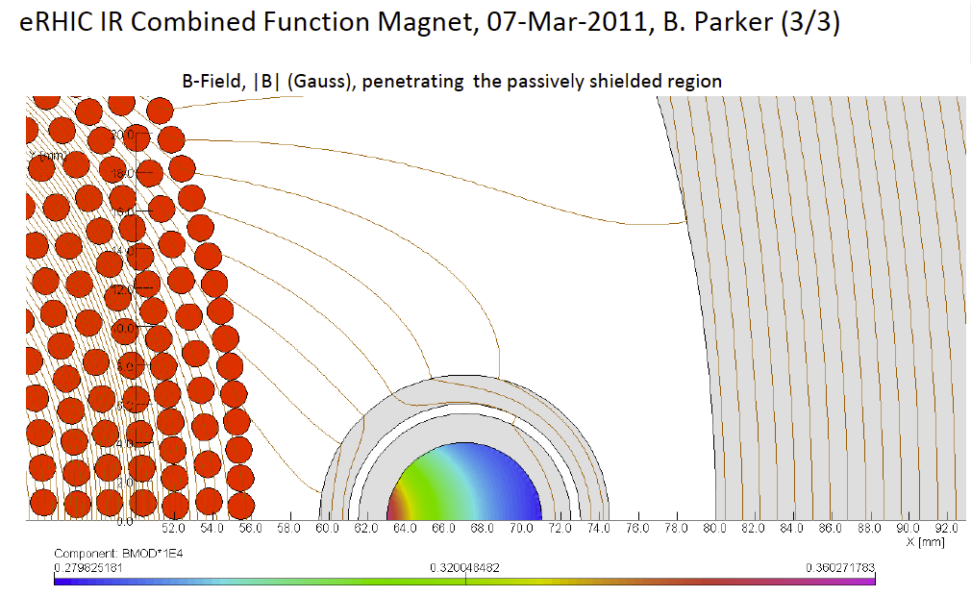
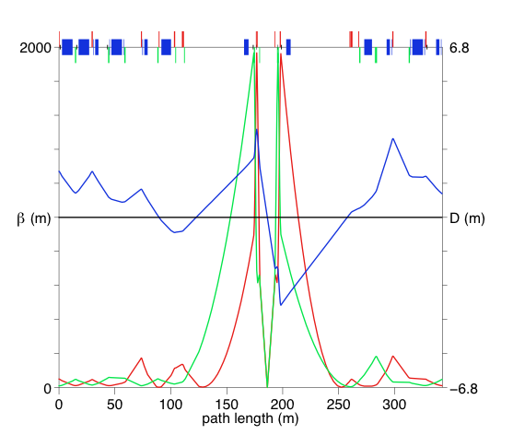
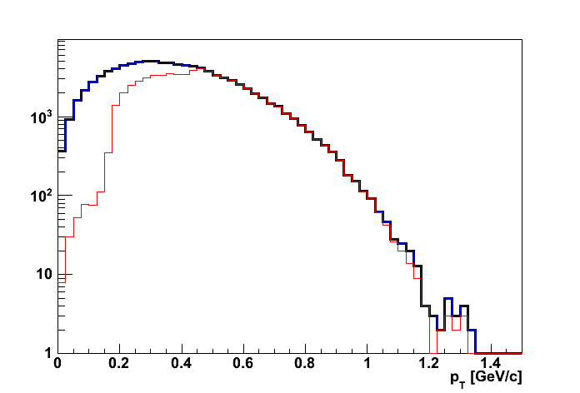
eRHIC: high-luminosity IR
20x250
p
Proton beam lattice
DVCS: Q²>1 GeV, 0.01<y<0.95, E_{γ}>1 GeV
e
20x250
eRHIC - High-lumi IR with β*=5 cm, l*=4.5 m → 10³⁴ cm⁻² s⁻¹
Generated
Quad aperture limited
RP (at 20m) accepted
10 mrad crossing angle and crab-crossing
High gradient (200 T/m) large aperture Nb₃Sn focusing magnets
Arranged free-field electron pass through the hadron quad-triplet
Integration with the detector: efficient separation and registration of low angle collision products
© D.Trbojevic, B.Parker, S. Tepikian, J. Beebe-Wang

Slide 10
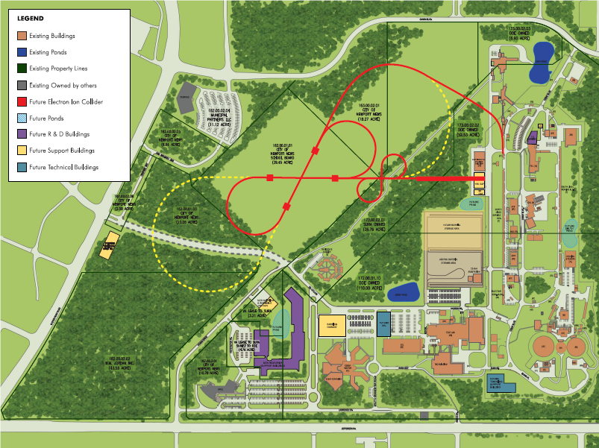

EIC – accelerator layout at JLab
e injection
MEIC
(Stage-I EIC)
IP
Ion linac
IP
Pre-booster
CEBAF
High-Energy Ring (Stage-II EIC)
The MEIC has the same circumference as CEBAF or about 1/3 of RHIC

Slide 11
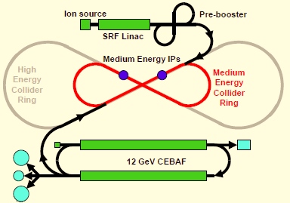
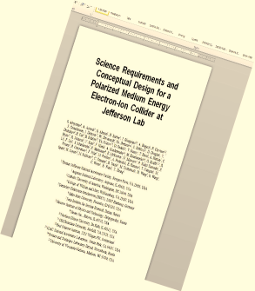
MEIC – design goals
EIC
MEIC
MEIC
Spin control for all light ions
(arXiv:1209.0757)
Figure-8 layout
Full-acceptance detector
Stable concept – detailed design report released August 2012
Ring designed around detector requirements
Minimized technical risk

Slide 12
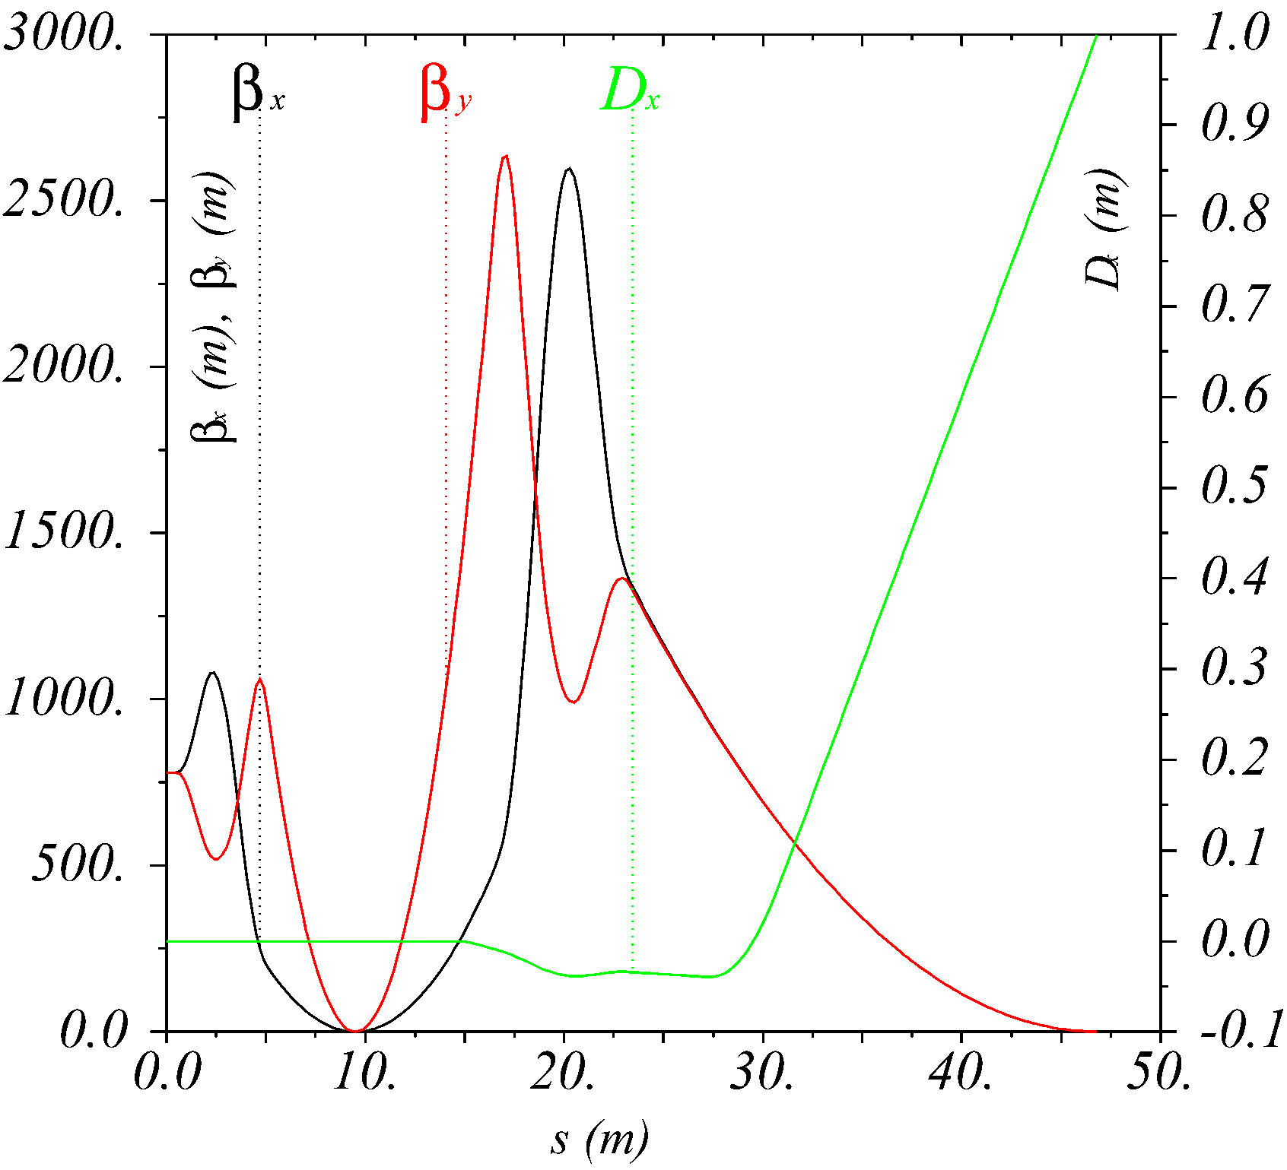
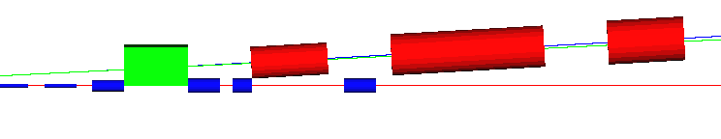
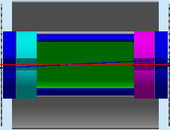
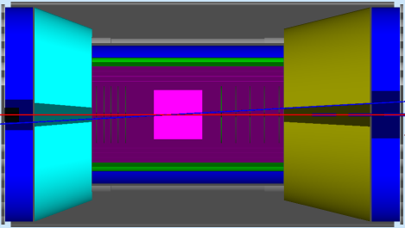
The full-acceptance detector concept
(G4BeamLine)
No other magnets or apertures between IP and FP!
Endcap
1 m
1 m
Ion quadrupoles
2 Tm dipole
Electron quadrupoles
‘Forward’ Trackers (~1% δp/p) and “donut” calorimeter
small angle
hadron detection
IP
FP
Far-Forward
hadron detection
low-Q²
electron detection
n, γ
large aperture
electron quads
ion quads
~60 mrad bend
p
small diameter
electron quads
e
p
50 mrad beam
(crab) crossing angle
Thin exit windows
Fixed trackers in vacuum?
Roman pots
(GEANT4)
central detector
with endcaps
Forward hadron detection in three stages:
1. Endcap with 50 mrad crossing angle
2. Forward 2 T•m dipole covering angles up to a few degrees
3. Far-forward, up to 1° (neutrals) and 0.5° charged particles
Notes:
No additional apertures or beamline elements between IP and Secondary Focus

Slide 13
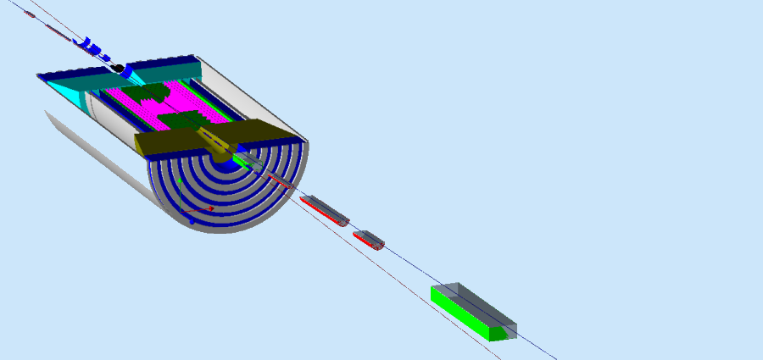
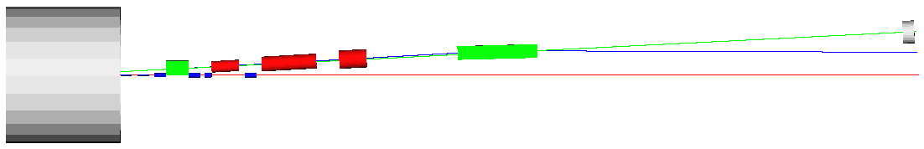
Far-Forward hadron detection
G4BeamLine → GEANT4
Neutron detection in a 20 mrad cone down to 0°
DREAM HCAL: σ(θ) = 1cm/40m=2.5•10^{–4} rad σ(E)/E = 30%(1GeV/E)^{1/2}
Excellent acceptance for all ion fragments
Recoil proton acceptance:
0 <θ<10 mrad for |P’–P₀| > (0.05%) P₀ 100% DVES acceptance for x_{B} > 0.005
2 < θ <10 mrad for all P’
0.3 P₀ < (Z/Z’) P₀ < ∞
Far-Forward Detection JLab LDRD proposal pending FY2014
Momentum resolution < 3•10⁻⁴ Beam energy spread
n
2 Tm dipole
20 Tm dipole
p
solenoid
e

Slide 14
The Deuteron
Rest Frame
Lightcone: p⊥ ,

Slide 15
Proton Spectator Tagging in the Deuteron
MEIC: Polarized DIS, SIDIS, DVES… on bound Neutron
eRHIC: Unpolarized
MEIC Resolution
Notes:
Remove fermi-momentum smearing (S. Kuhn)
Study transition from quasi-free neutron at (P_perp=0, alpha=M/M_D)
to highly correlated NN pairs (EMC effect of the Deuteron) at pmiss> 400 MeV/c
MEIC acceptance = 10 mrad → 500 MeV/c
theta>10mrad tagged with 6 mrad bend before FFQ → 1% momentum resolution
eRHIC Unpolarized acceptance 5mrad → 250 MeV/c

Slide 16
Neutron Spectator Tagging in the Deuteron
MEIC Polarized DIS, SIDIS, DVES… on bound proton
eRHIC unpolarized
MEIC Resolution

Slide 17
³He(e,e’N_{S}N_{S})X
PWIA `measurement’ of active nucleon momentum:
Active Neutron ➔
Tagging of the two spectator protons
Active Proton ➔
Tagging of spectator proton and neutron.
Tag spectator deuteron
Polarized ³He: Neutron: +86% polarized. Each Proton: –2.8% polarized.
M Alvioli, et al., PRC 87 (2013) 034603
Far-Forward
Forward
MEIC tagging resolution (3-σ)
k⊥ (proton)
k||
k⊥ (neutron)
k||
Notes:
alt 8869
Unicode F05E

Slide 18
How to Tell the Spectator Nucleons from the Active Nucleon?
DIS, SIDIS
Target fragmentation produces a forward nucleon
Fragmentation increases p⊥, decreases p||
DVES:
p_{z}’ ≈ p_{z}(1–x_{B}) ➔ p’⁺/P⁺ ≈ α – x_{B}
–t = –Δ² ≈ (x_{B}²M²+ Δ⊥²)/(1-x_{B})
D, ³He, Momentum densities fall by ~1/1000 for x_{B} > 0.1, or Δ⊥ = p⊥’ > 300 MeV/c ➔ –t>0.1 GeV² Antisymmetrization < 3%
At smaller x_{B} and smaller p⊥’ , sum over all nucleons as active or spectator, w/ anti-symmetrization

Slide 19
A high-luminosity Electron-Ion Collider
Unprecedented capabilities to study the QCD structure of matter
Polarized Light Ions:
Precision study of neutron structure
Spectator proton tagging
Quark-gluon structure of nuclear binding
Bound proton structure via neutron tagging
DIS, SIDIS, DVES processes identified in mean-field and NN-correlations regions

Slide 20
Back-up Slides

Slide 21
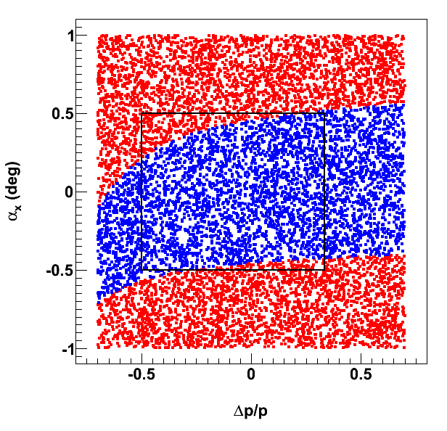
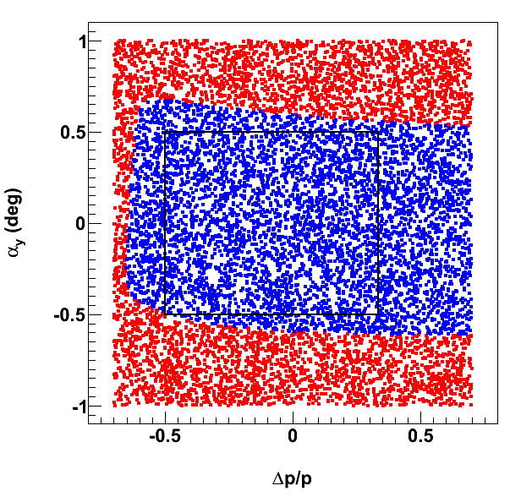
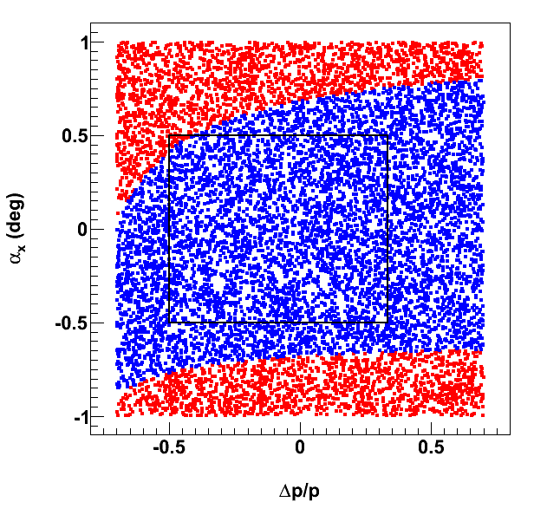
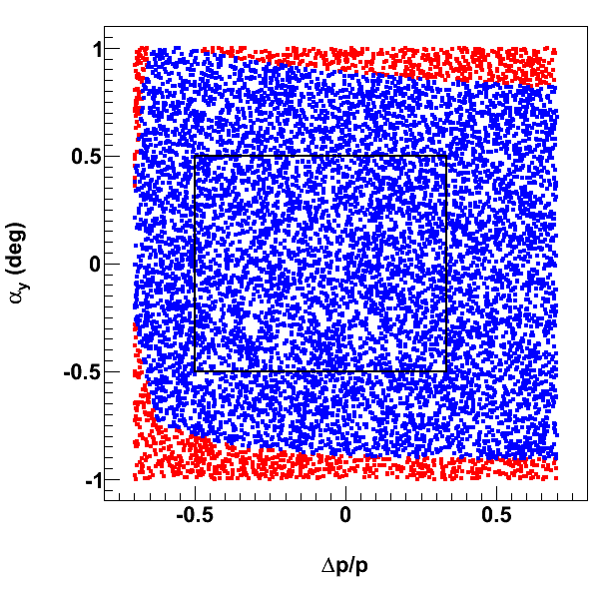
Ultra-forward charged-hadron acceptance
Forward acceptance vs.magnetic rigidity
horizontal plane
vertical plane
50 mr crossing angle in ion beam
6 T max
Red: Detection before ion quadrupoles
Blue: Detection after ion quadrupoles
9 T max
Tagged d beam: dp/p = -0.5
Tagged ³He beam: dp/p = +0.33

Slide 22
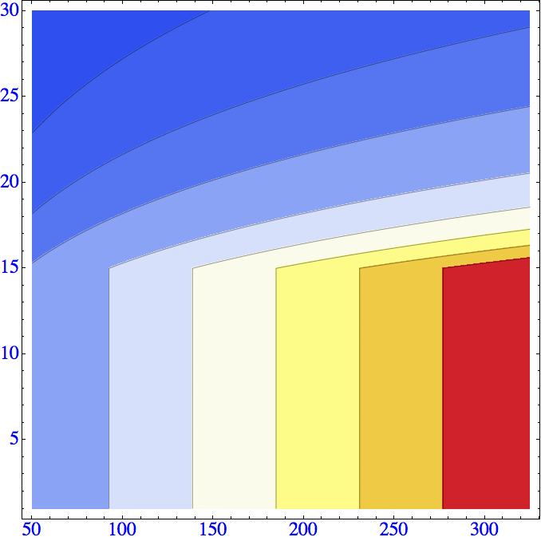

eRHIC: design luminosity
E_{e}, GeV
L., cm⁻² sec⁻¹
>3.10³⁴
0.1.10³⁴
3.10³⁴
0.25.10³⁴
2.5.10³⁴
0.5.10³⁴
2.10³⁴
1.5.10³⁴
1.10³⁴
1.10³⁴
1.5.10³⁴
2.10³⁴
2.5.10³⁴
3.10³⁴
0.5.10³⁴
0.25.10³⁴
0.1.10³⁴
E_{p}, GeV

Slide 23
eRHIC: design luminosity
 | e | p | ²He³ | ⁷⁹Au¹⁹⁷ | ⁹²U²³⁸
Energy, GeV | 20 | 250 | 167 | 100 | 100
CM energy, GeV |  | 100 | 82 | 63 | 63
Number of bunches/distance between bunches | 107 nsec | 111 | 111 | 111 | 111
Bunch intensity (nucleons) ,10¹¹ | 0.36 | 4 | 6 | 6 | 6
Bunch charge, nC | 5.8 | 64 | 60 | 39 | 40
Beam current, mA | 50 | 556 | 556 | 335 | 338
Normalized emittance of hadrons , 95% , mm mrad |  | 1.2 | 1.2 | 1.2 | 1.2
Normalized emittance of electrons, rms, mm mrad |  | 16 | 24 | 40 | 40
Polarization, % | 80 | 70 | 70 | none | none
rms bunch length, cm | 0.2 | 5 | 5 | 5 | 5
β*, cm | 5 | 5 | 5 | 5 | 5
Luminosity per nucleon, x 10³⁴ cm⁻²s⁻¹ |  | 2.7 | 2.7 | 1.6 | 1.7
Hourglass the pinch effects are included. Space charge effects are compensated.
Energy of electrons can be selected at any desirable value at or below 30 GeV
The luminosity does not depend on the electron beam energy below or at 20 GeV
The luminosity falls as E_{e}⁻⁴ at energies above 20 GeV
The luminosity is proportional to the hadron beam energy: L ~ E_{h}/E_{top}

Slide 24
Parameters for Full Acceptance Interaction Point
 |  | Proton | Electron
Beam energy | GeV | 60 | 5
Collision frequency | MHz | 750 | 750
Particles per bunch | 10¹⁰ | 0.416 | 2.5
Beam Current | A | 0.5 | 3
Polarization | % | > 70 | ~ 80
Energy spread | 10⁻⁴ | ~ 3 | 7.1
RMS bunch length | mm | 10 | 7.5
Horizontal emittance, normalized | µm rad | 0.35 | 54
Vertical emittance, normalized | µm rad | 0.07 | 11
Horizontal β* | cm | 10 | 10
Vertical β* | cm | 2 | 2
Vertical beam-beam tune shift |  | 0.014 | 0.03
Laslett tune shift |  | 0.06 | Very small
Distance from IP to 1st FF quad | m | 7 | 3
Luminosity per IP, 10³³ | cm⁻²s⁻¹ | 5.6

Slide 25
A fully integrated interaction region
IP
(top view)
forward e⁻
detection
forward ion
detection
ions
e⁻ spin rotator
e⁻
final focusing
elements
v-step and 50 mrad crossing
Recoil baryon detection:
IR optics
Small beam size (β) and large dispersion at the secondary focal point give superb resolution and acceptance at very small angles
Focal Point:
D ~ 1 m
β ~ 1 m
Excellent t-coverage for all kinematics!
IP
FP

Slide 26
Spectator tagging in a collider
P_{D} = 100 GeV/c deuteron
p_{p} ≈ (P_{D}/2)(1+α) + p⊥ f
α < 50 MeV/1GeV, θ_{S} =p⊥ /(P_{D}/2) ≤ 1 mrad
p_{n} ≈ (P_{D}/2)(1–α) – p⊥
Measure θ_{n}≈ p⊥ /(P_{D}/2) accurately in Forward Hadronic Calorimeter (integrate over α). δθ_{n} ≈ (1 cm)/(40 m) = 0.25 mrad
P(⁴He) = 200 GeV/c = ZP₀
Magnetic rigidity K(⁴He) = P/(ZB) = (100 GeV/c)/B = K₀
P(Spectator ³He) ≈ (3/4)P(³He) ➔ K(³He) = (3/4) K₀
P(Spectator ³H) ≈ (3/4)P(³H) ➔ K(³H) = (3/2) K₀ > K₀

Slide 27
Nuclear Spectral Functions
C. Ciofi degli Atti, S. Simula PRC 53 (1996)
A=2
A=∞
Mean Field
Independent Nucleons
NN-Correlations

