Slide 1
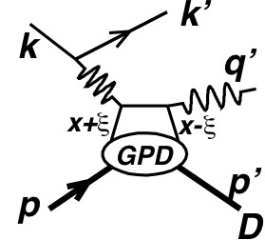
DVCS on the Proton and Nuclei in an Electron-Ion Collider Recent EIC white papers: arXiv:1212.1701 arXiv:1209.0757
C. Hyde
Old Dominion University
APS April Meeting
13-16 April 2013
Denver CO
e+p→e+p+γ

Slide 2
Generalized Parton Distributions (GPDs)
GPD(x,ξ,t)
ξ ≈ x_{B}/(2-x_{B})
x = average momentum fraction
2ξ = skewness
Correlation of longitudinal momentum fraction x± ξ with transverse spatial distributions
Impact parameter b Fourier congugate Δ, with Δ² = t = (q-q’)²
GPD DIS Elastic ElectroWeak
Η(x,ξ,t): H(x,0,0)=q(x) →
E(x,ξ,t) : No forward link to DIS

Slide 3
DVCS in an Electron Ion Collider
Higher CM Energy than JLab fixed target
Larger Q², x_{Bj} range
Higher Luminosity (and CM Energy) than COMPASS
Longitudinally and Transversely polarized beams without dilution
Roughly equivalent to factor of 10 in luminosity
Spectator tagging to zero relative momentum
Neutron structure from D, ³He beams
Calibration check of bound proton structure via tagging of spectator neutrons.
Tagging of far-forward coherent nuclear recoil
e + ^{A}Z → e + ^{A}Z + γ
Extensions to ρ, ω, φ, J/ψ

Slide 4
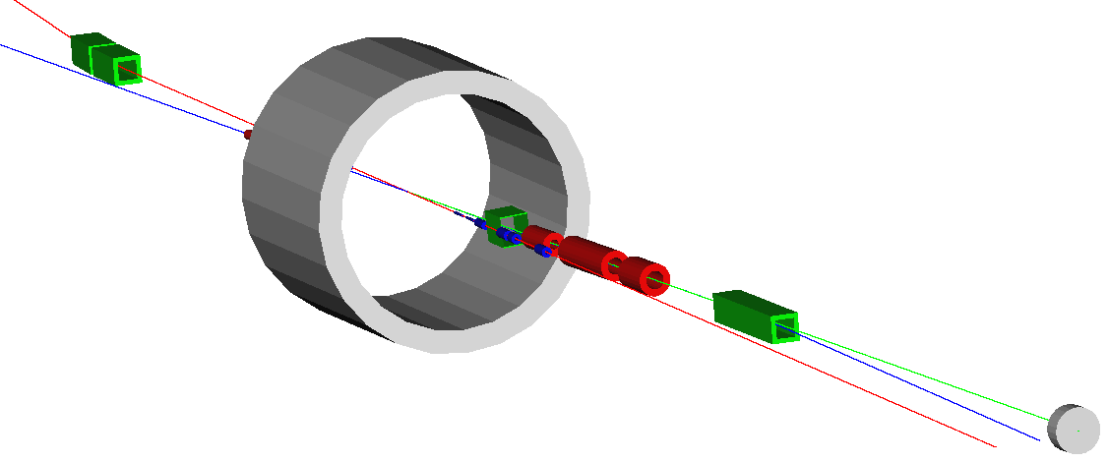
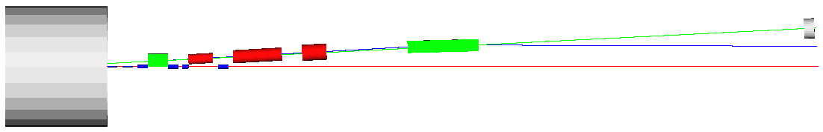
Ultra-forward hadron detection – summary
Neutron detection in a 25 mrad cone down to zero degrees
Excellent acceptance for all ion fragments
Recoil baryon acceptance:
up to 99.5% of beam energy for all angles
down to 2-3 mrad for all momenta
Momentum resolution < 3x10⁻⁴
limited by intrinsic beam momentum spread
100 GeV maximum ion energy allows using large-aperture magnets with achievable field strengths
n
e
p
n
2 Tm dipole
20 Tm dipole
p
solenoid
e

Slide 5
DVCS & Spatial imaging with EIC
arXiv:1212.1701
DVCS cross section
Transverse spatial image
10 days
MEIC Phase I

Slide 6
Coherent Nuclear DVCS in JLab MEIC design
Luminosity L_{A} ∼ L_{p}/Z
Coherent peak: dσ_{Α}(t=0) ∼ Z²dσ_{p}
Counting rate in coherent peak : L_{A}dσ_{Α}(t=0) ∼ ZL_{p}dσ_{p}
Coherent peak drops very rapidly with t
What is our resolution for resolving the diffractive shape of nuclei?
Ion Beam, P_{A} = Z P₀
rms beam spread at IP:
δP||/P = 3•10^{–4}
δP_{perp} /P = 2•10^{–4}

Slide 7
Coherent DVCS scaling to Charge Form Factors
dσ_{DVCS} ~ |F(Δ²)|²
Δ² = (q-q’)² = (P’-P)²
Constrain Δ² from both (k-k’-q’)² and (P’-P)²
Resolution from ion tagging alone:
Dominated by beam angular spread at IP
δΔ ∼ δP ~ 2•10^{–4} P
±1σ resolution bands for ¹²C @ P_{C}= 6•60 GeV/c

Slide 8
Outlook
Resolving the diffraction pattern of coherent DVCS on light nuclei is possible.
More refined studies of dual constraint of momentum transfer resolution from both (k-k’-q’)² and (P’-P)² in progress.
Short runs at relaxed β∗ ∼ Ζβ₀∗ can improve resolution of momentum transfer by factor Z
This also reduces luminosity by factor of Z,
At coherent peak, counting rate on nucleus ^{A}Z still ~ rate on proton (at full luminosity).

Slide 9
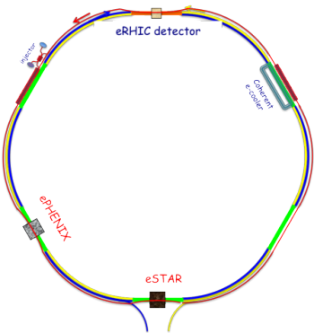
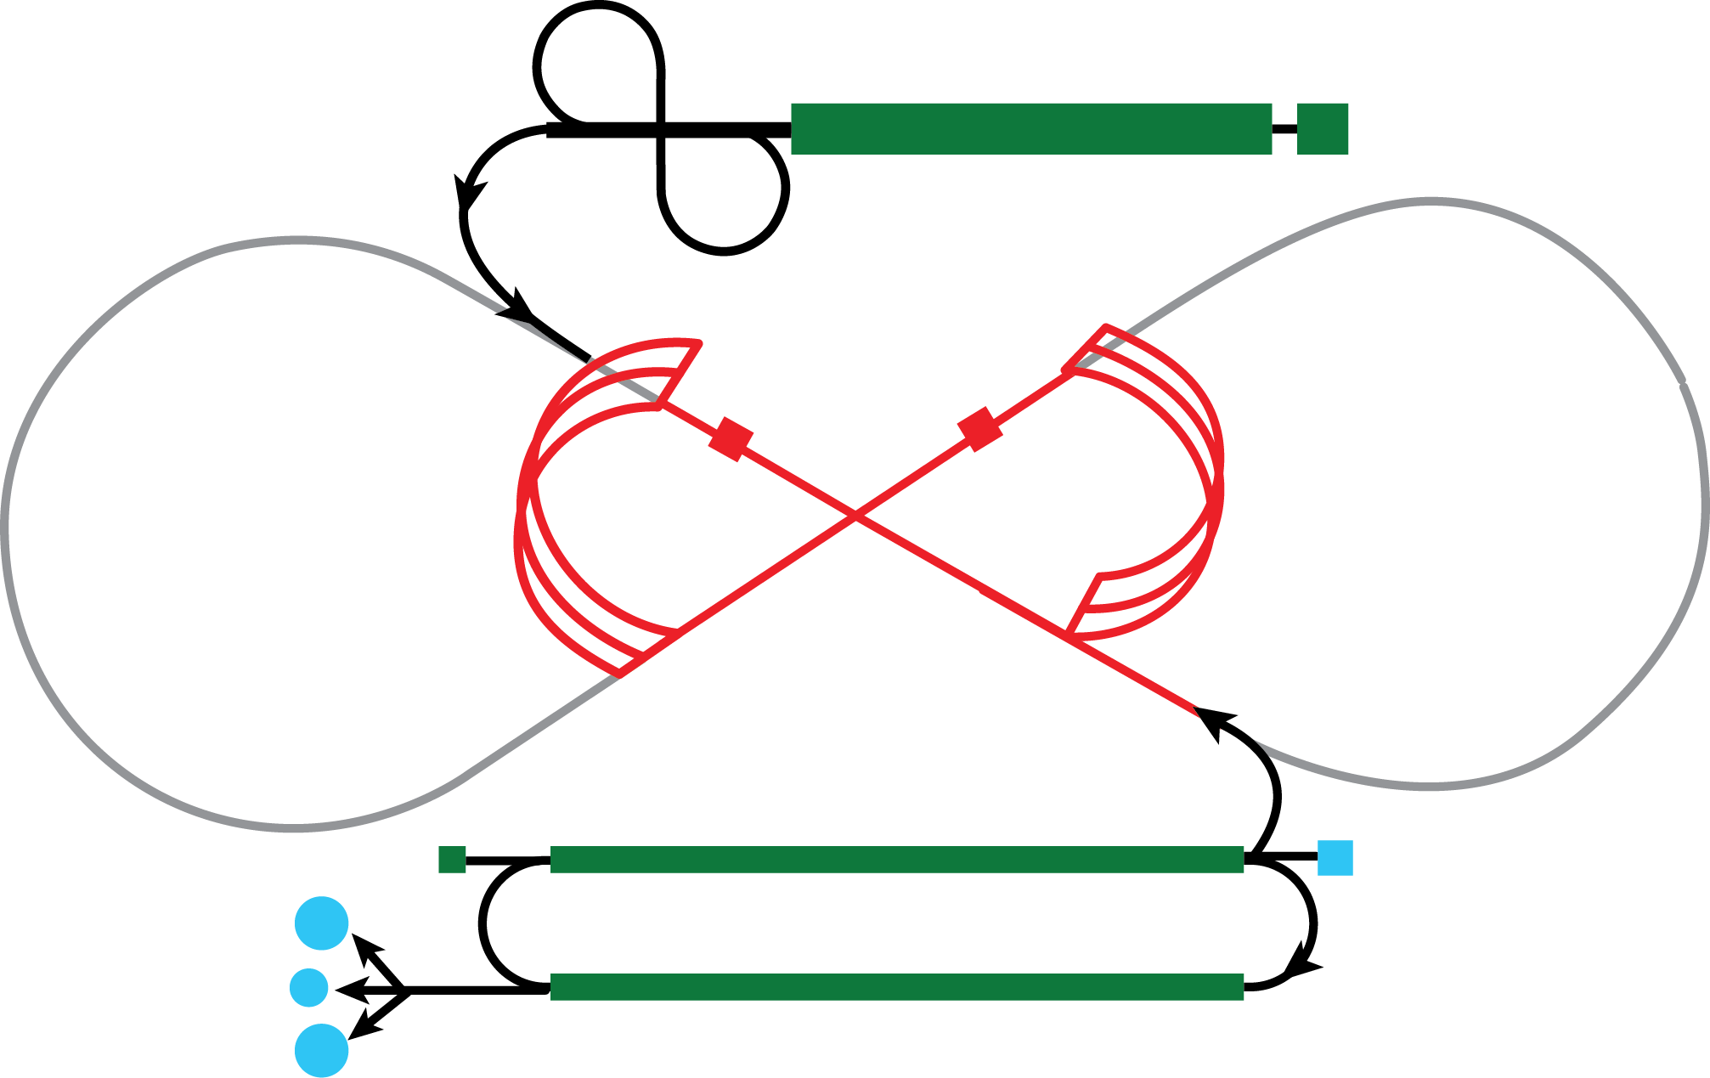
EIC – staging at BNL and JLab
Stage I
Stage II
eRHIC @ BNL
√s = 34 – 71 GeV
E_{e} = 3 – 5 (10 ?) GeV
E_{p} = 100 – 255 GeV
E_{Pb} = up to 100 GeV/A
√s = up to ~180 GeV
E_{e} = up to ~30 GeV
E_{p} = up to 275 GeV
E_{Pb} = up to 110 GeV/A
MEIC / EIC @ JLab
√s = 13 – 70 GeV
E_{e} = 3 – 12 GeV
E_{p} = 15 – 100 GeV
E_{Pb} = up to 40 GeV/A
√s = up to ~140 GeV
E_{e} = up to 20 GeV
E_{p} = up to at least 250 GeV
E_{Pb} = up to at least 100 GeV/A
(MEIC)
(EIC)

Slide 10
Basic MEIC & EIC Performance
EIC
CLAS12
10³⁴

Slide 11
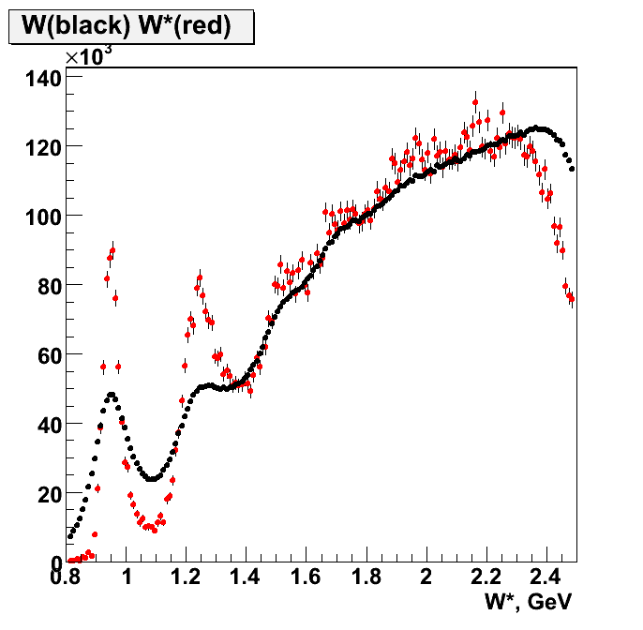
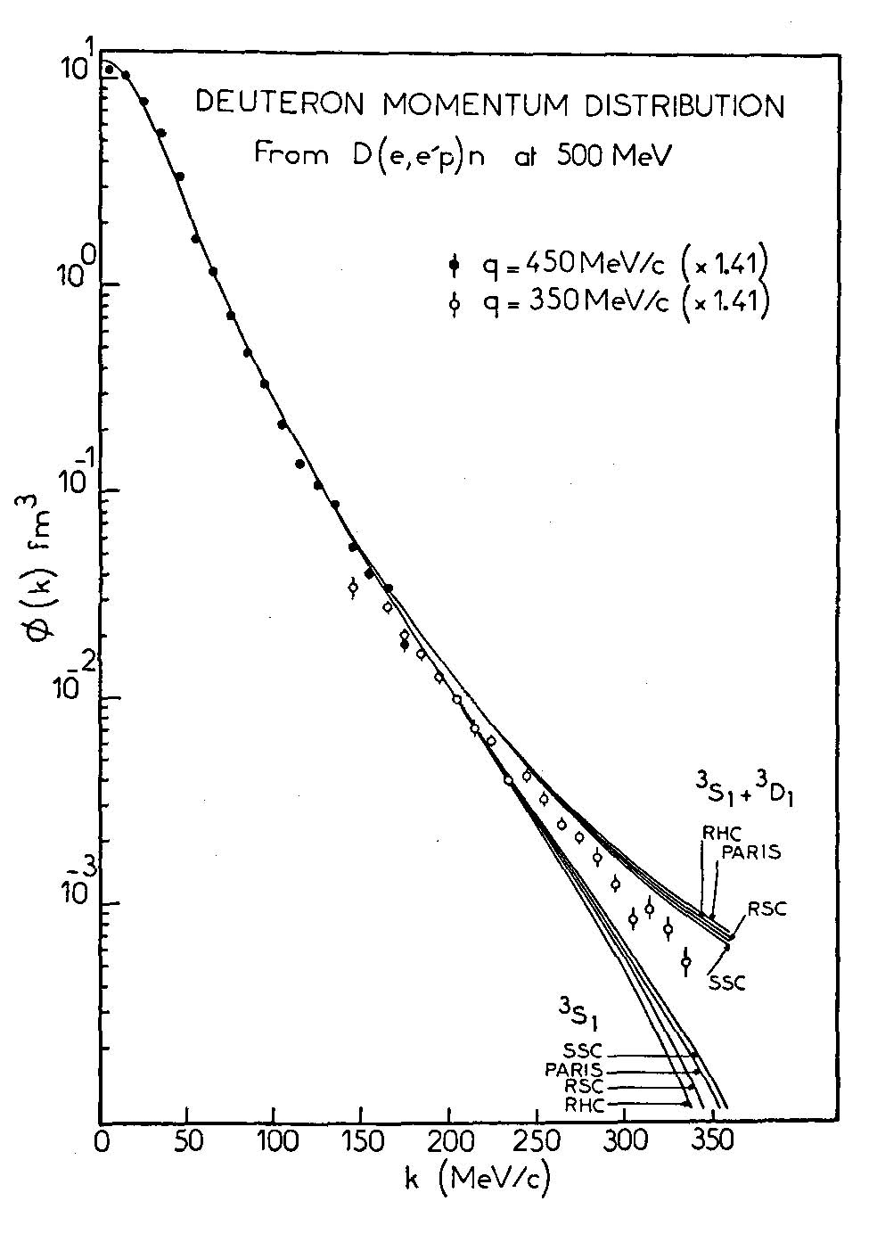
Neutron structure through spectator tagging
kinematically corrected W spectrum on n in D
smeared W spectrum on D
CLAS BoNuS data with tagged spectators
In fixed-target experiments, scattering on bound neutrons is complicated
Fermi motion, nuclear effects
Low-momentum spectators
No polarization
The MEIC is designed from the outset to tag spectators, and all nuclear fragments.
α≈ k/Μ
MEIC
CLAS + BoNuS
CLAS

Slide 12
Spectator tagging in a collider
P_{D} = 100 GeV/c deuteron
p_{p} ≈ (P_{D}/2)(1+α) + p⊥
α < 50 MeV/1GeV, θ_{S} =p⊥ /(P_{D}/2) ≤ 1 mrad
p_{n} ≈ (P_{D}/2)(1–α) – p⊥
Measure θ_{n}≈ p⊥ /(P_{D}/2) accurately in Forward Hadronic Calorimeter. δθ_{n} ≈ (1 cm)/(40 m) = 0.25 mrad
P(⁴He) = 200 GeV/c = ZP₀
Magnetic rigidity K(⁴He) = P/(ZB) = (100 GeV/c)/B = K₀
P(Spectator ³He) ≈ (3/4)P(³He) ➔ K(³He) = (3/4) K₀
P(Spectator ³H) ≈ (3/4)P(³H) ➔ K(³H) = (3/2) K₀ > K₀

Slide 13
DVCS examples Recent white papers: arXiv:1212.1701 arXiv:1209.0757
k = 3 GeV, P = 100 GeV/c, s–M² = 1200 GeV²
x_{Bj} = 0.0021, y = 0.8, Q² = x_{Bj}y(s–M²) = 2.0 GeV²
θ_{e} = 56°, k’ = 0.77 GeV
Tag final state protons for all –t>0.04 GeV²
x_{Bj} = 0.01, y = 0.8, Q² = 10. GeV²
θ_{e} = 99°, k’ = 1.4 GeV
Tag final state protons for all t
x_{Bj} = 0.03, y = 0.28, Q² = 10. GeV²
θ_{e} = 64°, k’ = 3 GeV
Tag final state protons for all t
Collider kinematics are different!!
k’ > k for x_{Bj} > k/P
Boosts and rotations do not commute!
Boost from Target rest frame to Collider frame induces mass-dependent rotations about beam axis.
M_{p}² = 0.88 GeV² >> m_{π}² ≈ m_{e}²≈0 >> q²= –Q²

Slide 14
Parameters for Full Acceptance Interaction Point
 |  | Proton | Electron
Beam energy | GeV | 60 | 5
Collision frequency | MHz | 750 | 750
Particles per bunch | 10¹⁰ | 0.416 | 2.5
Beam Current | A | 0.5 | 3
Polarization | % | > 70 | ~ 80
Energy spread | 10⁻⁴ | ~ 3 | 7.1
RMS bunch length | mm | 10 | 7.5
Horizontal emittance, normalized | µm rad | 0.35 | 54
Vertical emittance, normalized | µm rad | 0.07 | 11
Horizontal β* | cm | 10 | 10
Vertical β* | cm | 2 | 2
Vertical beam-beam tune shift |  | 0.014 | 0.03
Laslett tune shift |  | 0.06 | Very small
Distance from IP to 1st FF quad | m | 7 | 3
Luminosity per IP, 10³³ | cm⁻²s⁻¹ | 5.6

Slide 15
EIC timeline
 | 2010 | 2011 | 2012 | 2013 | 2014 | 2015 | 2016 | 2017 | 2018 | 2019 | 2020 | 2021 | 2022 | 2023 | 2024 | 2025
12 GeV Upgrade
FRIB
EIC Physics Case
NSAC LRP
EIC CD0¹
EIC Machine Design/R&D
EIC CD1 Downselelect²
EIC CD2/CD3
EIC Construction
1) Assumes endorsement for an EIC at the next NSAC Long Range Plan
2) Assumes relevant accelerator R&D for down-select process done around 2016

