Slide 1
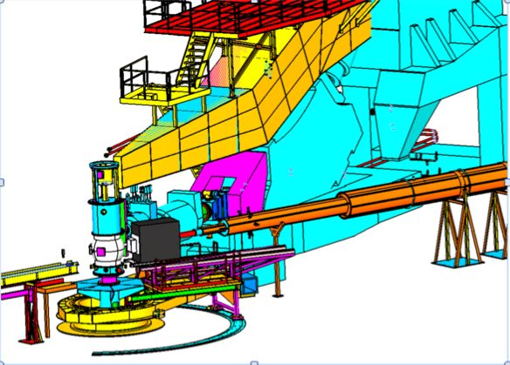
An Electron Ion Collider: What, Why, Where, When?
C. Hyde
Nuclear Physics Seminar
ODU
28 Feb 2013

Slide 2
JLab MEIC (Medium energy Electron Ion Collider)
Electron beam k = 3—12 GeV/c
Longitudinally polarized
Ion Beams
Proton: P₀ = 30—100 GeV/c
Ions D to Pb: P_{A} = Z P₀ ➔ P_{A}/A = (Z/A) P₀
Polarized p, D, ³He, … (Li?)
Longitudinal or transverse at Intersection Point (IP)

Slide 3
Collider Kinematics
s = (k+P)² Q² = x_{Bj} y s
Q²=–q²= –(k-k’)² x_{Bj} = Q²/(2q•P) y = q•P/(k•P)
0 ≤ x_{Bj} ≤ 1 0 < y <1
Fixed target: s–M² = 2k^{Lab}M
Collider: s–M² = 2k(P+E) ≈ 4kP
JLab MEIC, peak luminosity at k × P = 3×100 (GeV/c)²
s – M² = 1200 GeV²
Equivalent lab energy k^{Lab} = 640 GeV/c

Slide 4
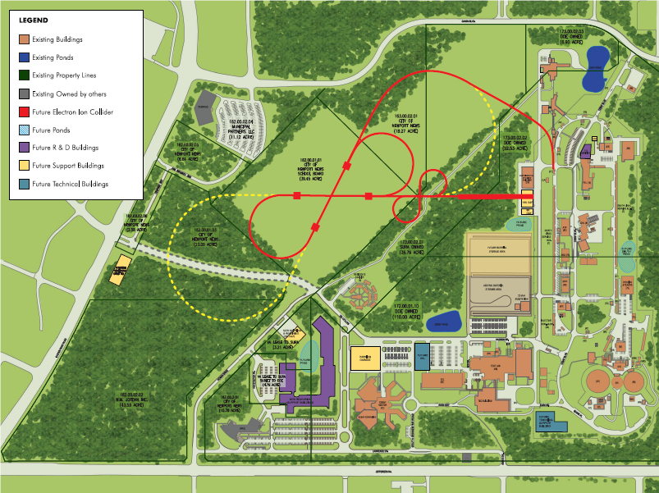

EIC – accelerator layout at JLab
e injection
MEIC
(Stage-I EIC)
IP
Ion linac
IP
Pre-booster
CEBAF
High-Energy Ring (Stage-II EIC)
The MEIC has the same circumference as CEBAF or about 1/3 of RHIC

Slide 5
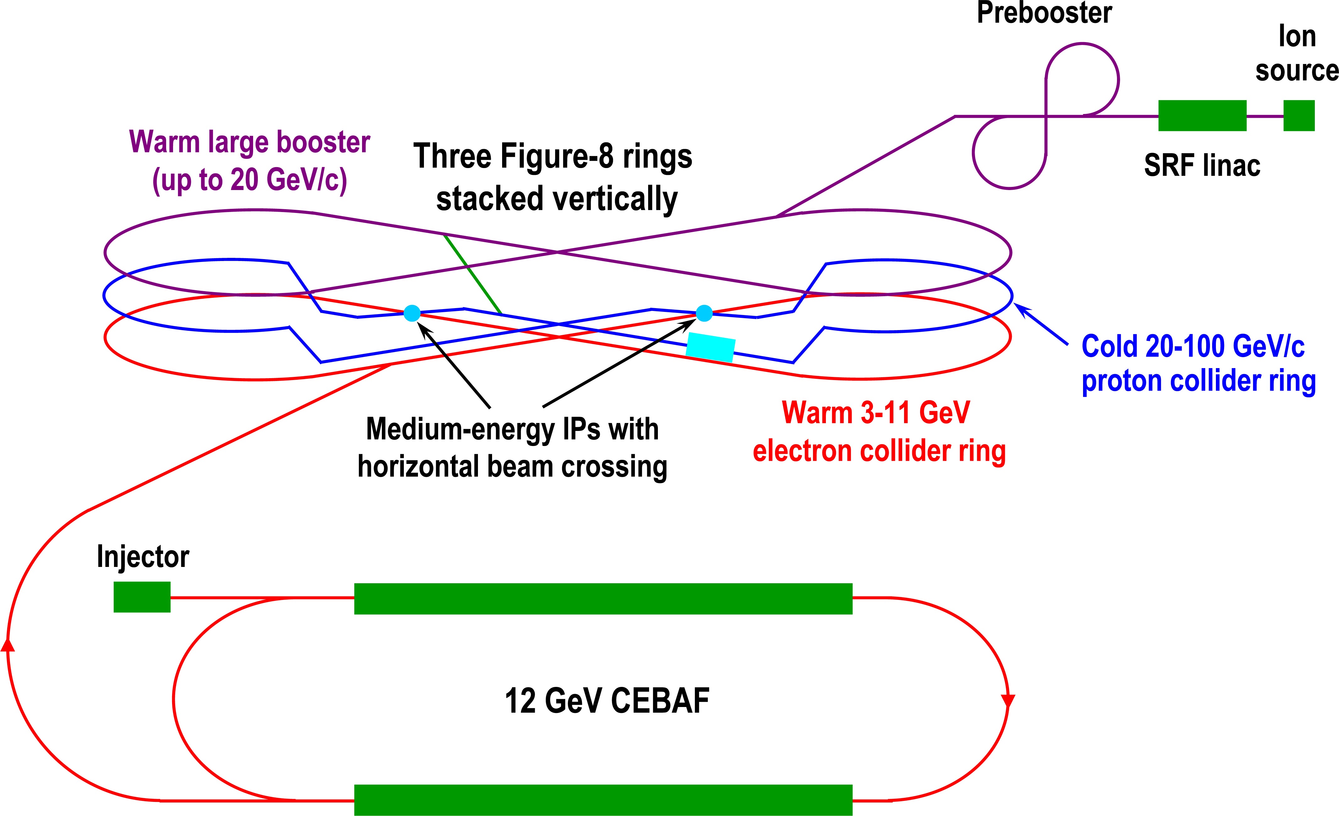
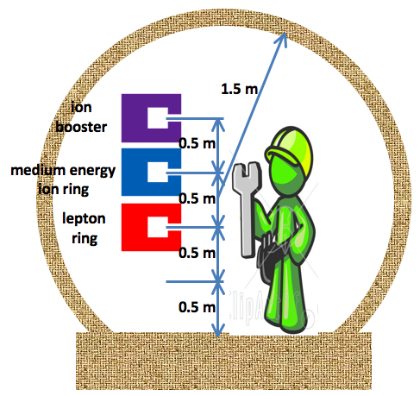
MEIC Schematic Layout
Cross sections of MEIC tunnels
Figure-8 for better control of polarized ion spin-precession
Only solution for polarized d⬅ μ_{d} = 0.86 μ_{N} << μ_{p,n}

Slide 6
Collider Luminosity
N_{e,i} = number of electron, ions / bunch
eNf = stored beam current ~ Amp
f = collision frequency
σ_{x,y} = r.m.s. beam size at IP
σ = [β∗ε]^{1/2}
Flat beams σ_{y} ≈ σ_{x} /10
ε = Emittance (invariant in ring) ~ `Temperature’
ε=ε_{N} (m/p) ➔ Luminosity increases as energy increases
For electrons, emittance decrease as m/p eventually destroyed by emittance growth by stochastic synchrotron radiation
CEBAF ε_{N} ≈ 10⁻⁶ m
For ions, emittance is large at low energy from space-charge effects (minimize with small N, large f)
Ions favor smaller ring, electrons favor larger ring
Notes:
beta* and epsilon different for different ion species, x, and y

Slide 7
Beam Phase Space (Gaussian Beams)
Phase ellipse rotates with position s around ring
ε is invariant around ring
Notes:
Tune = # of rotations of phase ellipse per pass around ring

Slide 8
Violating Liouville’s Theorem
Beam Phase Space ∼ (x,x’), (y,y’), (E,t)
coupling [transverse(x ⊗ y) ⊗ longitudinal] can be [partially] controlled by lattice
In a conservative system, Phase space density is conserved ( ε=constant)
Shrink phase space by coupling beam to a cold thermal bath.
Electron cooling of proton beam
Co-propagate a very cold electron beam of the same velocity
R&D to develop efficient acceleration of intense cold 50 MeV electron beam ➔ Energy Recovery Linac (ERL)

Slide 9
Basic MEIC & EIC Performance
EIC
CLAS12
10³⁴

Slide 10
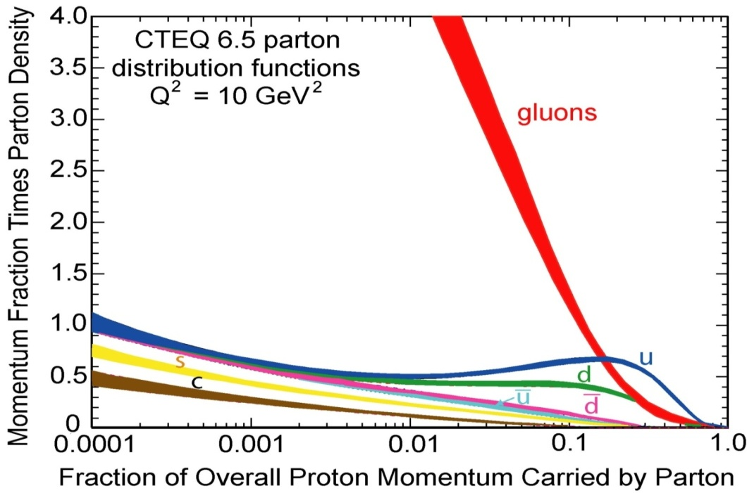
What is the Physics?
Chiral Symmetry Breaking (χSB) in the vacuum generates constituent quark masses ~ 300 MeV
Mechanism is similar to Higgs
Non trivial structure of quark distribution functions for 0.005 ≤ x ≤ 0.2
u ≠ d
u-bar ≠ d-bar
δu ≠ δu-bar ≠ δu

Slide 11
Why an EIC (besides large √s)?
Polarized ions without dilution factor
Transversely polarized ions without B⊥ at IP
Spectator tagging down to p_{S} = 0
Tagging of spectator neutron allows the study of bound protons
Detection of exclusive ions at very low (P’–P)²
Spatial imaging of quarks and gluons in nuclei
More favorable separation of `current-jet’ and `target-jet’
SIDIS Flavor tagging,
quark—quark, quark—anti-quark correlations
Forward boost of short lived secondaries
PID via vertex reconstruction of K_{S} , Λ, D(charm)…
Notes:
Cumulative factors of 10 in luminosity
Physics that cannot be done with fixed target experiments

Slide 12
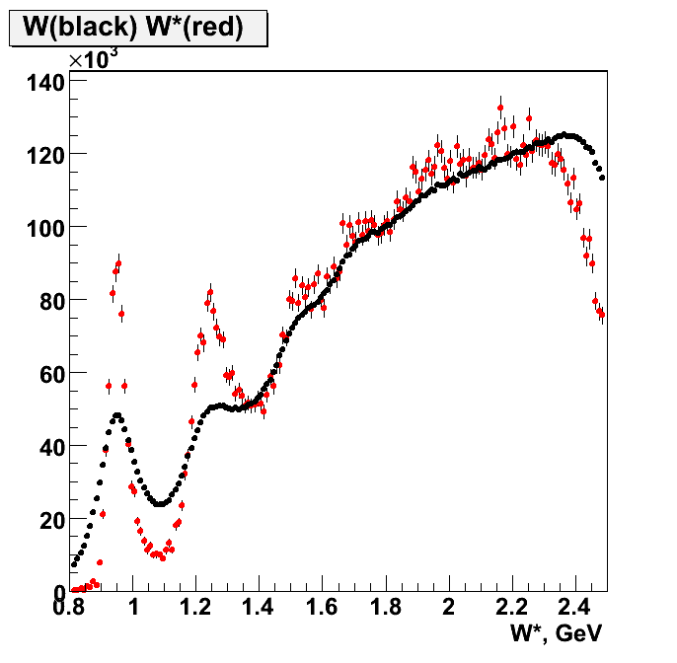
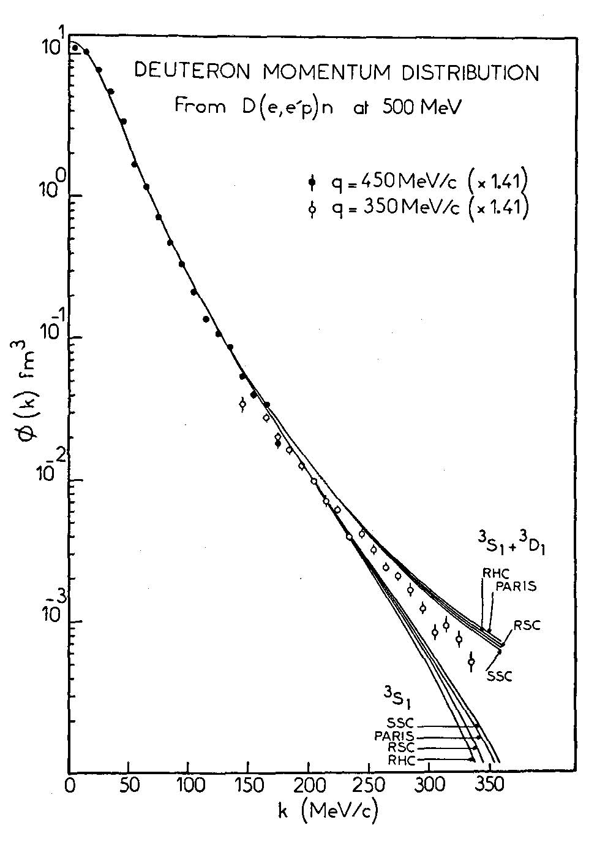
Neutron structure through spectator tagging
kinematically corrected W spectrum on n in D
smeared W spectrum on D
CLAS BoNuS data with tagged spectators
In fixed-target experiments, scattering on bound neutrons is complicated
Fermi motion, nuclear effects
Low-momentum spectators
No polarization
The MEIC is designed from the outset to tag spectators, and all nuclear fragments.
α≈ k/Μ
MEIC
CLAS + BoNuS
CLAS

Slide 13
Spectator tagging in a collider
P_{D} = 100 GeV/c deuteron
p_{p} ≈ (P_{D}/2)(1+α) + p⊥ f
α < 50 MeV/1GeV, θ_{S} =p⊥ /(P_{D}/2) ≤ 1 mrad
p_{n} ≈ (P_{D}/2)(1–α) – p⊥
Measure θ_{n}≈ p⊥ /(P_{D}/2) accurately in Forward Hadronic Calorimeter (integrate over α). δθ_{n} ≈ (1 cm)/(40 m) = 0.25 mrad
P(⁴He) = 200 GeV/c = ZP₀
Magnetic rigidity K(⁴He) = P/(ZB) = (100 GeV/c)/B = K₀
P(Spectator ³He) ≈ (3/4)P(³He) ➔ K(³He) = (3/4) K₀
P(Spectator ³H) ≈ (3/4)P(³H) ➔ K(³H) = (3/2) K₀ > K₀

Slide 14
Detector concept (iron-free design in development)
Ions incident from left
Electrons incident from right
Detector regions
Far forward quasi-real photon tagging
Electron EndCap
Central
Ion Endcap
Ion Forward Tracker
Ion Far-Forward tagger
@25—40 m,
after 20 T·m dipole @25m
Fe/muons
EM Cal
2 T·m dipole
Ion FF-quads
Fe
Cer
Central Tracking
Cer
HCal
DIRC+TOF

Slide 15
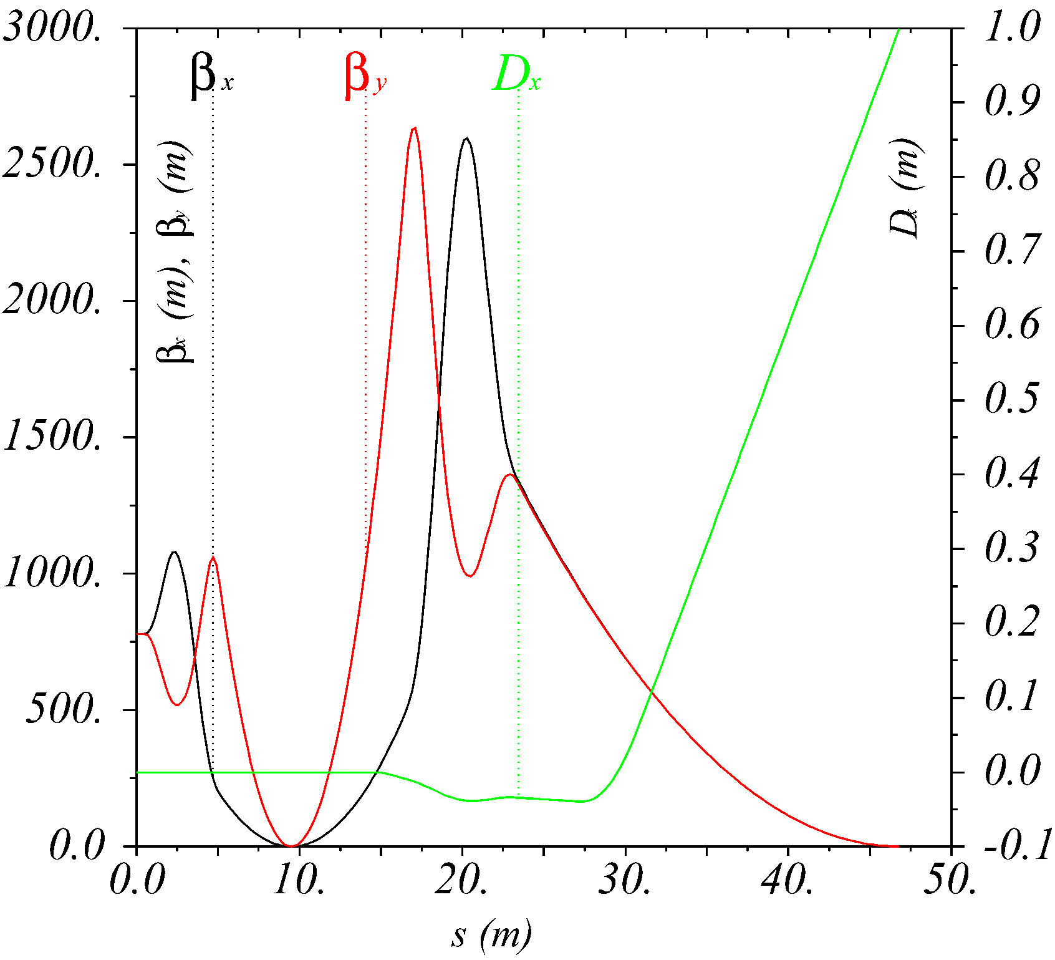
Accelerator optics – fully integrated interaction region
No other magnets or apertures between IP and FP!
central detector
with endcaps
small angle
hadron detection
ultra forward
hadron detection
low-Q²
electron detection
n, γ
large aperture
electron quads
ion quads
60 mrad bend
p
small diameter
electron quads
p
50 mrad beam
(crab) crossing angle
Focal Point:
D ~ 1 m
β ~ 1 m
IP
FP

Slide 16
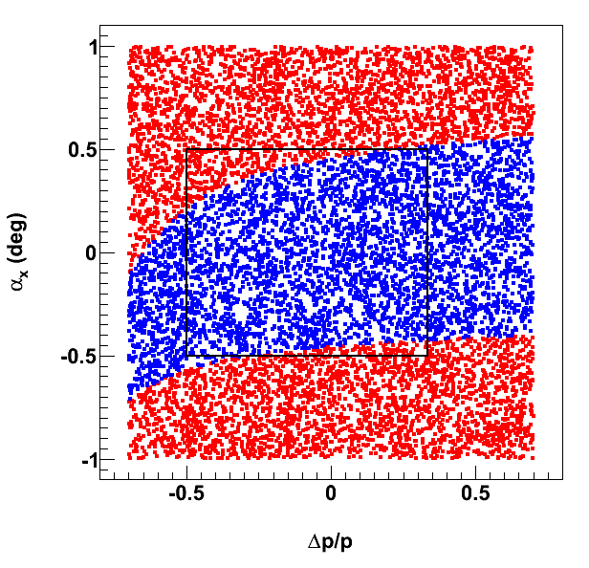
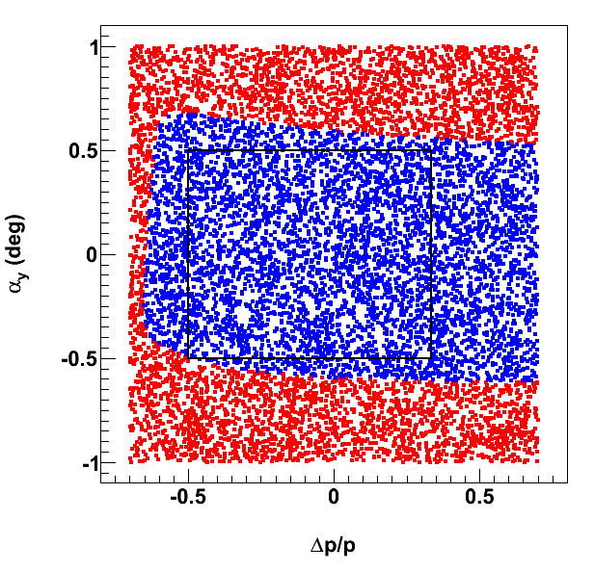
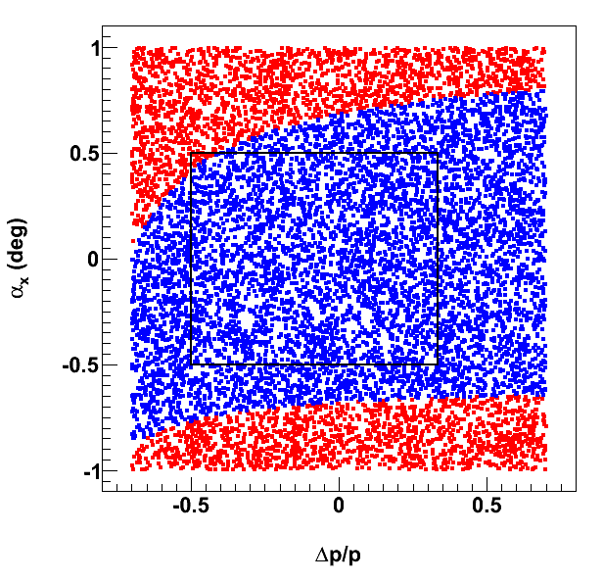
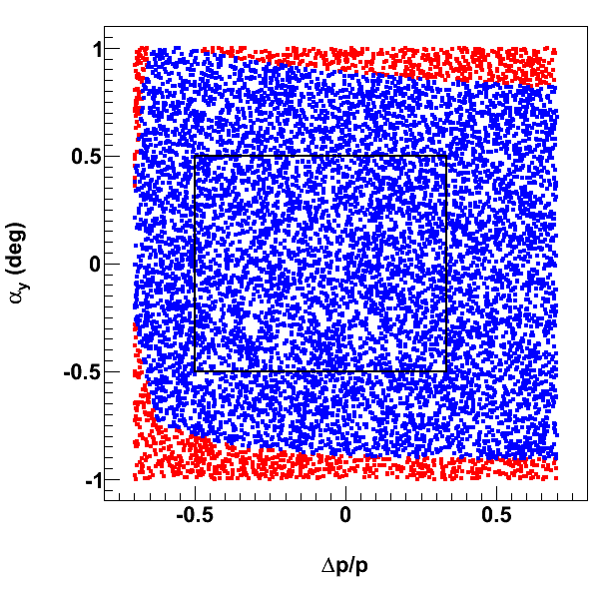
Ultra-forward charged-hadron acceptance
Forward acceptance vs.magnetic rigidity
horizontal plane
vertical plane
50 mr crossing angle in ion beam
6 T max
Red: Detection before ion quadrupoles
Blue: Detection after ion quadrupoles
9 T max
Tagged d beam: dp/p = -0.5
Tagged ³He beam: dp/p = +0.33

Slide 17
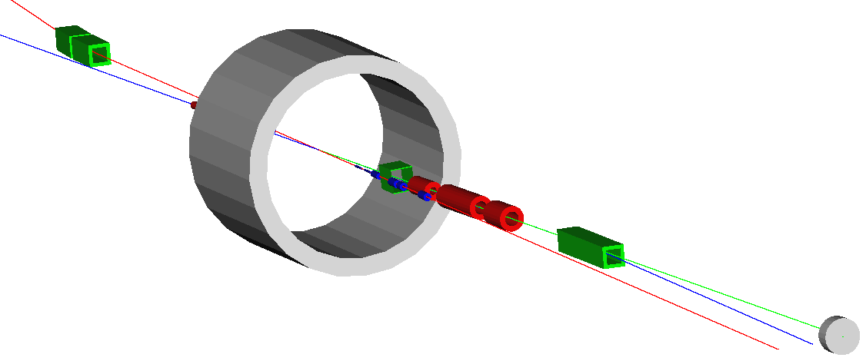
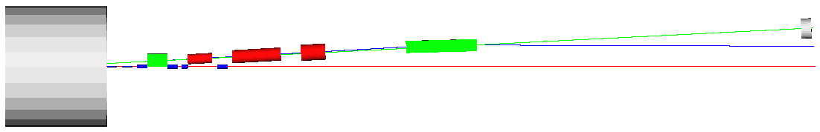
Ultra-forward hadron detection – summary
Neutron detection in a 25 mrad cone down to zero degrees
Excellent acceptance for all ion fragments
Recoil baryon acceptance:
up to 99.5% of beam energy for all angles
down to 2-3 mrad for all momenta
Momentum resolution < 3x10⁻⁴
limited by intrinsic beam momentum spread
100 GeV maximum ion energy allows using large-aperture magnets with achievable field strengths
n
e
p
n
2 Tm dipole
20 Tm dipole
p
solenoid
e

Slide 18
DVCS examples Recent white papers: arXiv:1212.1701 arXiv:1209.0757
k = 3 GeV, P = 100 GeV/c, s–M² = 1200 GeV²
x_{Bj} = 0.002, y = 0.8, Q² = xy(s–M²) = 2.0 GeV²
Tag final state protons for all –t>0.04 GeV²
x_{Bj} = 0.01, y = 0.8, Q² = xy(s–M²) = 10.0 GeV²
θ_{e} = 75°, k’ = 2.2 GeV
Tag final state protons for all t
x_{Bj} = 0.03, y = 0.27, Q² = xy(s–M²) = 10.0 GeV²
θ_{e} = 75°, k’ = 3 GeV
Tag final state protons for all t
Collider kinematics are different!!
k’ > k for x_{Bj} > k/P
Boosts and rotations do not commute!
Boost from Target rest frame to Collider frame induces mass-dependent rotations about beam axis.
M_{p}² = 0.88 GeV² >> m_{e}²≈0 >> q²= –Q²

Slide 19
Parameters for Full Acceptance Interaction Point
 |  | Proton | Electron
Beam energy | GeV | 60 | 5
Collision frequency | MHz | 750 | 750
Particles per bunch | 10¹⁰ | 0.416 | 2.5
Beam Current | A | 0.5 | 3
Polarization | % | > 70 | ~ 80
Energy spread | 10⁻⁴ | ~ 3 | 7.1
RMS bunch length | mm | 10 | 7.5
Horizontal emittance, normalized | µm rad | 0.35 | 54
Vertical emittance, normalized | µm rad | 0.07 | 11
Horizontal β* | cm | 10 | 10
Vertical β* | cm | 2 | 2
Vertical beam-beam tune shift |  | 0.014 | 0.03
Laslett tune shift |  | 0.06 | Very small
Distance from IP to 1st FF quad | m | 7 | 3
Luminosity per IP, 10³³ | cm⁻²s⁻¹ | 5.6

Slide 20
Central Detector Concepts

