Slide 1
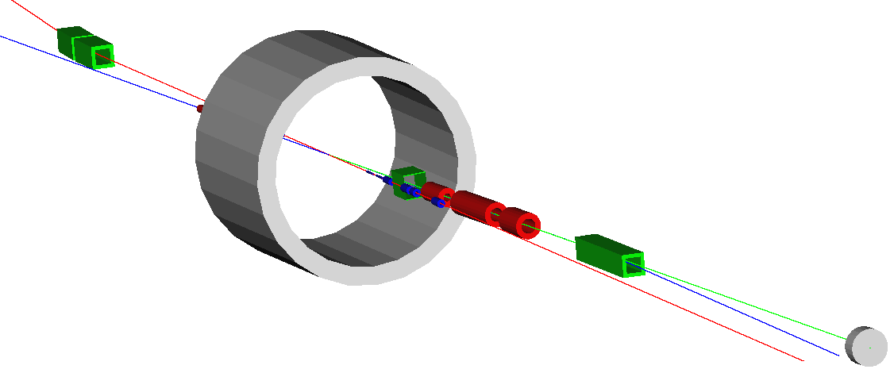
Neutron Spin Structure via Spectator Tagging at the EIC
Charles Hyde
W.Cosyn, V.Guzey, D.Higinbotham, S.Kuhn, W. Melnichouk, P.Nadel-Turonski, KJ.Park, M. Sargsian, C.Weiss
e–
Low Q²
e-tagger
APS-DNP Long Range Plan
QCD Town Hall Meeting
13–15 September 2014
Temple University
6mrad out-bend
Central
Solenoid 50 mr ion crossing
60 mrad in-bend
Full acceptance for spectators from longitudinally and transversely polarized light ion beams
n
Neutron detection in a 25 mrad cone around 0°
e
p
Secondary high dispersive ion focus ~40 m downstream of IP

Slide 2
Longitudinal Double-Spin Asymmetry D(e,e’p_{S})X
t = (P_{D}-p_{S})² t ∼ Μ² –|p_{S}^{Rest}|² – 2MB_{D}
On-shell neutron: t = M²
A|| insensitive to D-state, FSI for M²–t < 0.04 GeV²
High Resolution and High Luminosity for fine binning
α_{S}(Q²) from Bjorken sum Rule.
ΔG from Evolution
Extensions to e.g. D(e,e’γpn)

Slide 3
The importance of Variable Beam Energies
D(e,e’p_{S})X
FOM x 100
Optimal to run at lowest practical beam energy
FOM ~ L (P_{e}P_{D} A||)²
• Proceedings: www.lions.odu.edu/~chyde/Research/Talks/Talks2014/neutron.pdf

