Slide 1
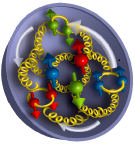
Experimental Study of Generalized Parton Distributions at Jefferson Lab
Charles E. Hyde
Old Dominion University
Norfolk VA
C. Hyde, M. Guidal, A. Radyushkin,
J. Phys. Conf. Ser. 299:012006, 2011,
arXiv:1101.2482

Slide 2
Partonic Structure of the Nucleon
Studying matter as it is illuminated by a light-front
y
DIS: H(e,e’)X
  Longitudinal (light-cone) Momentum distributions
Elastic Electro-Weak Form Factors:
H(e,e’)p
  Fourier Transform of spatial impact-parameter distributions
  2-D formalism fully compatible with Q.M. and Relativity
Generalized Parton Distributions
Deeply Virtual Exclusive Scattering
  eN→ eNγ, eN→ eN(π, ρ, φ), etc
  Correlations of longitudinal momentum fraction with transverse spatial position
xP⁺
x
z
P
y
b
x
z
P
y
xP⁺
b
x
z
P

Slide 3
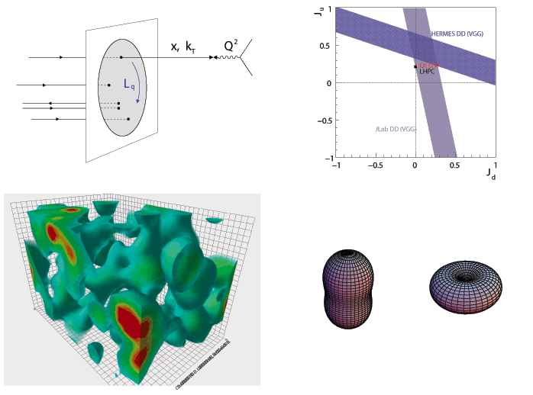
Spatial Structure and Spatial Correlations
Angular Momentum
Space-Spin,
Momentum-Spin,
or Space-Space Correlations in the Proton
Spatial Correlations in the Vacuum

Slide 4
Bethe-Heitler (BH) and Virtual Compton Scattering (VCS)
e p→ e p γ
k
k'
=
Δ
+
q'
p
p’=p-Δ
Bethe-Heitler (BH)
+
q
VCS
BH-DVCS interference
  Access to DVCS amplitude, linear in GPDs

Slide 5
QCD Factorization of DVCS (Co-Linear)
e p→e p γ
q
q’
P+Δ/2
P−Δ/2
+
+
(x+ξ)P⁺
(x−ξ)P⁺
(x+ξ)P⁺
(x−ξ)P⁺
(1+ξ)P⁺
(1–ξ)P⁺
P+Δ/2
P−Δ/2
GPD_{f}(x,ξ,t=Δ²)
GPD_{g}(x,ξ,t=Δ²)
GPD_{f}(x,ξ,t=Δ²)
Symmetrized Bjorken variable:
SCHC
  Transversely polarized virtual photons dominate to O(1/Q)

Slide 6
GPDs: Correlations of Transverse Spatial and Longitudinal Momentum. M. Diehl, M. Burkardt…
Non-Local, Off-Diagonal one-body quark and gluon currents of the Nucleon
P = (p+p’)/2 p⁺ = (1+ξ)P⁺ p’⁺ = (1–ξ)P⁺
  Remove a parton of momentum fraction x+ξ at impact parameter b/(1+ξ) relative to initial proton center-of-momentum.
  Replace it at b/(1–ξ) with momentum fraction x–ξ
  Integrate over x.
Fourier Transform b←→Δ⊥ Δ⊥² = –(1−ξ)²Δ²−4ξ²Μ²

Slide 7
Physical Interpretation of GPDs: Two Limits
ξ=0: Probability densities of impact parameter b relative to Center-of-Momentum of proton:
x=ξ: H(ξ, ξ,Δ²)–Η(–ξ,ξ,Δ²), Ε, etcetera
  2-d Fourier-transform Δ⊥←→r
  Transition amplitude from longitudinal momentum
  0 to 2ξ/(1+ξ) at fixed impact parameter r relative to CM of spectators.
    Not a positive definite density, but still an image of the proton.
  Directly measurable
  Expect size shrinks as ξ ➔1
  Different profiles for u, d, glue,…

Slide 8
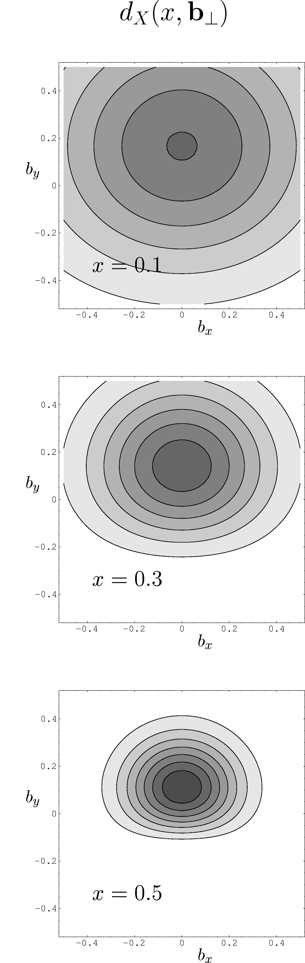
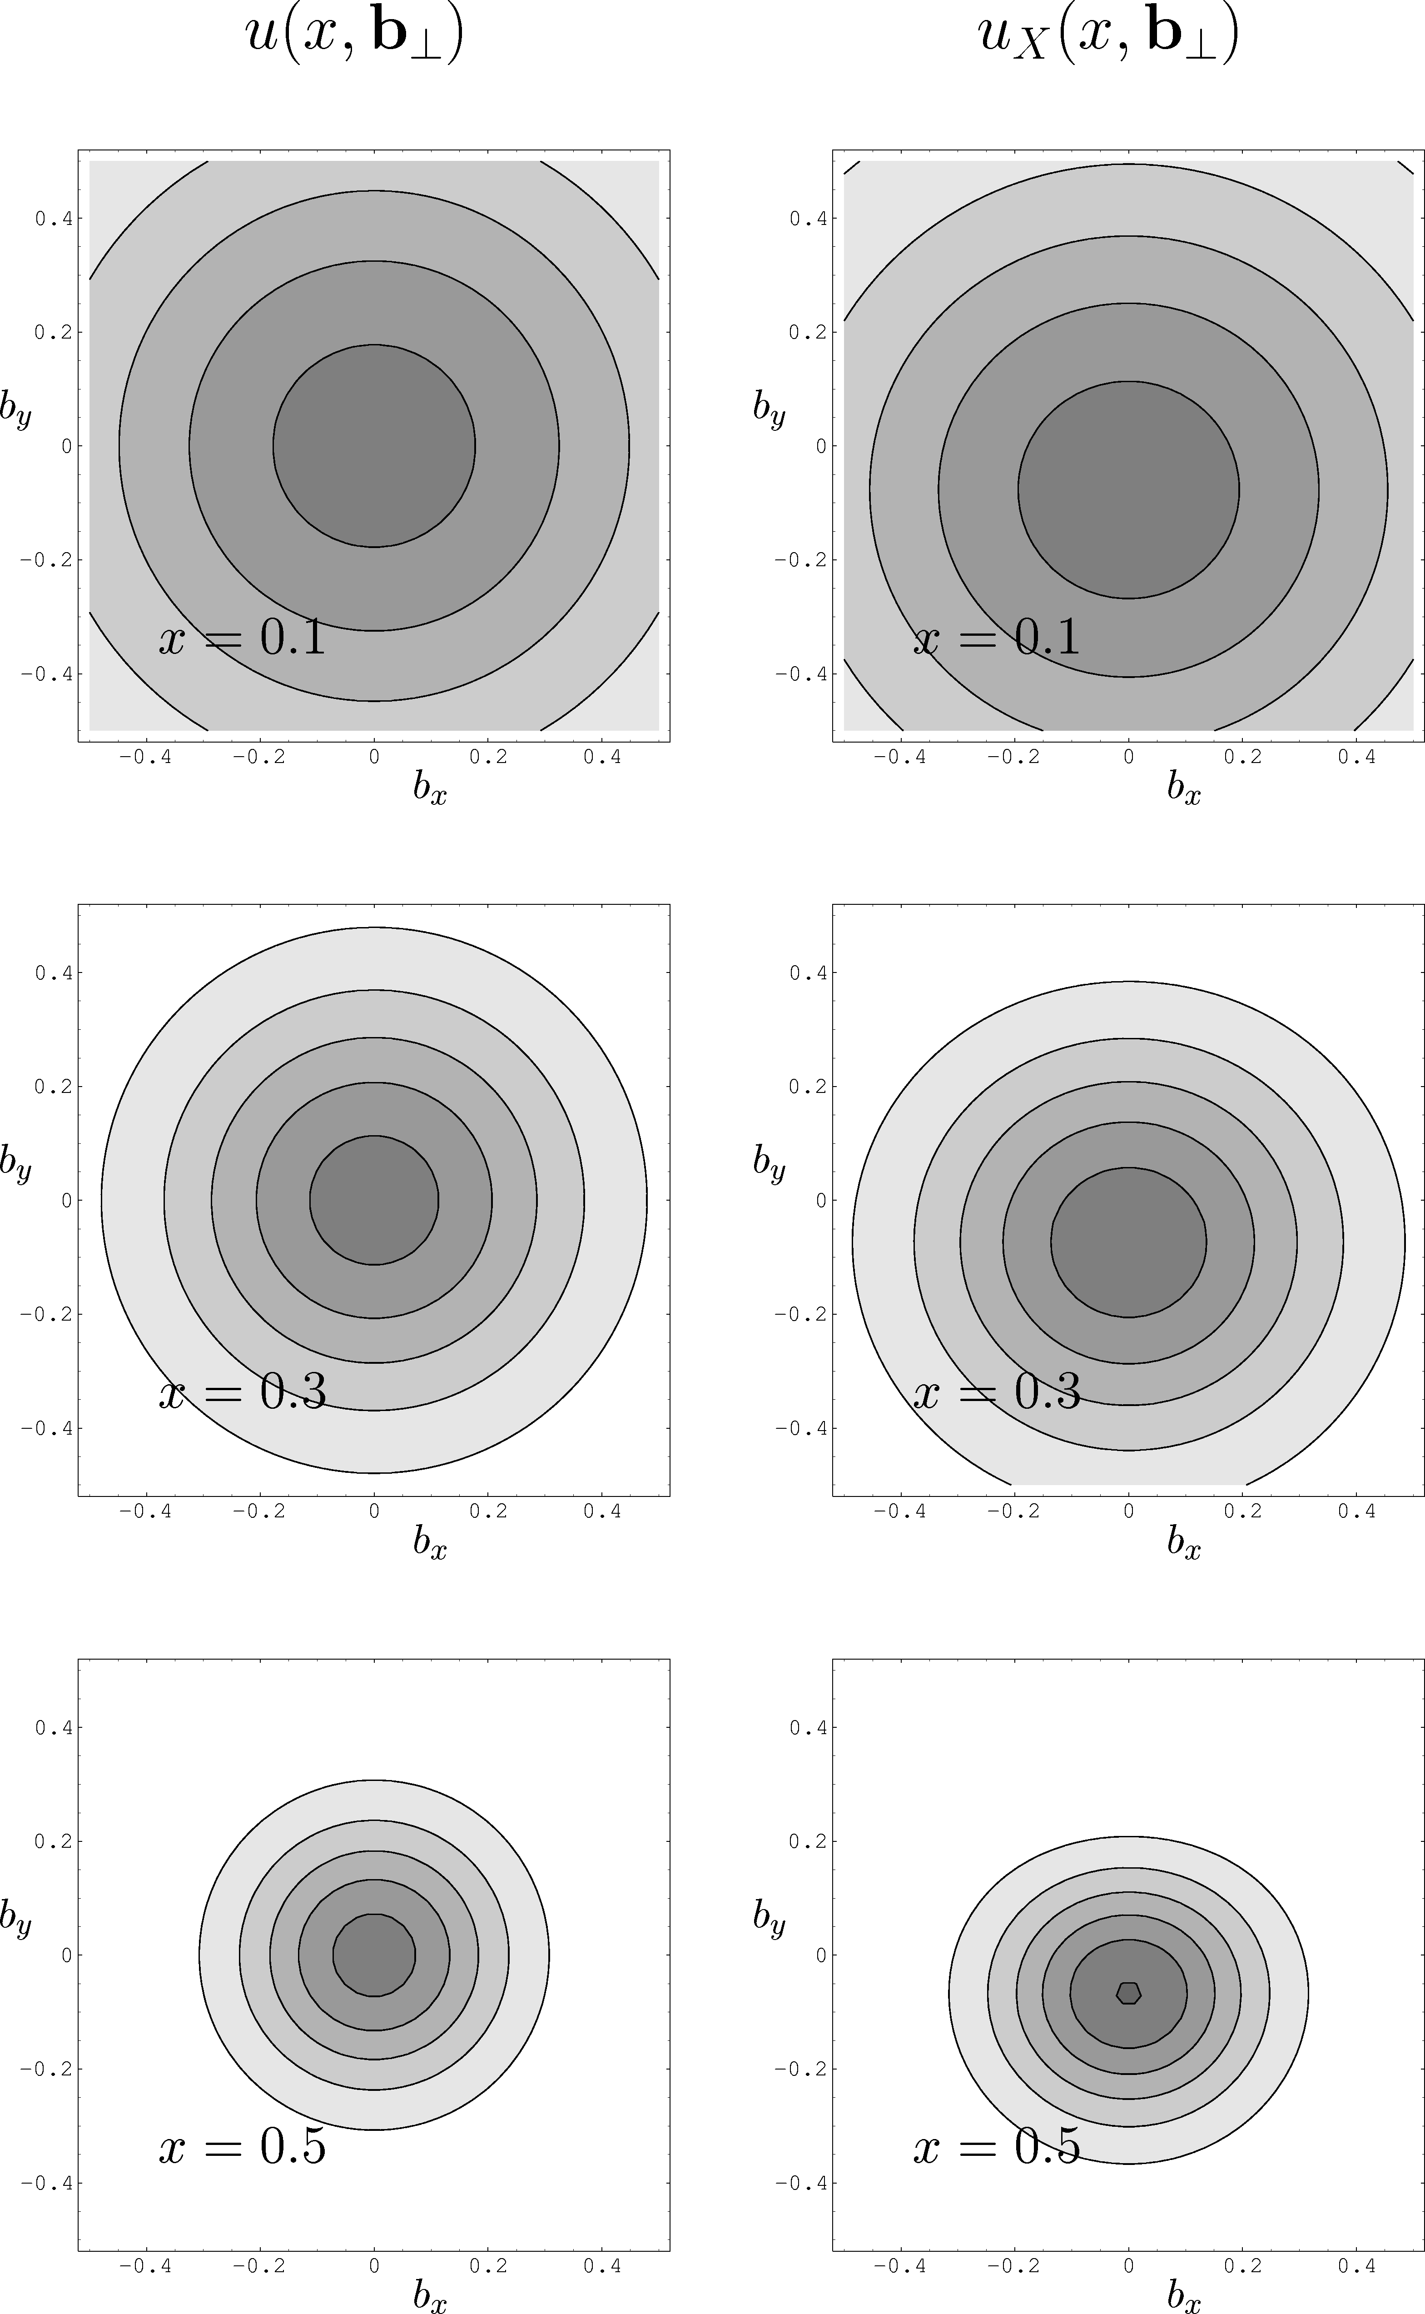
Tomography with Generalized Parton Distributions (M. Burkardt)
Target polarization
H(x,t)γ^{μ} + E(x,t)σ^{μν}Δ_{ν}
  Proton size shrinks as x→ 1.
  Spatial separation of up-
  and down-quarks in a
  transversely polarized proton
Spin-Flavor dependence to Proton size & profile.
  M. Burkardt
  up and down quarks separate in transversely polarized proton
d_{X}(x,b )
u_{X}(x,b )
T
T
y
x
Flavor dipole

Slide 9
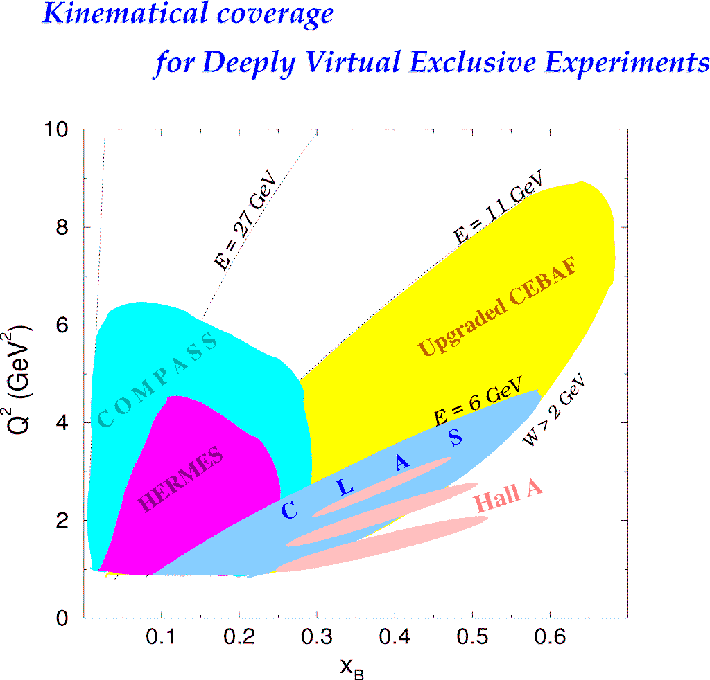
Deeply Virtual Exclusive Processes -
Kinematic Coverage
H1, ZEUS
H1, ZEUS
200 GeV
JLab Upgrade
JLab @ 12 GeV
COMPASS
HERMES
Study of high x_{B} domain requires high luminosity
0.7
Notes:
The kinematics range that can be covered in exclusive processes with high precision data is shown with this yellow area. This will be the only accelerator where the valence quark regime can be fully covered with high precision data.

Slide 10
What do DVCS experiments measure?
dσ(ep→epγ) = twist-2 (GPD) terms + Σ_{n} [twist-n]/Q^{n-2}
  Isolate twist-2 terms → cross sections vs Q² at fixed (x_{Bj}, t);
  Multiple beam energies at fixed (Q², x_{Bj}, t)
GPD terms are `Compton Form Factors’
  Re and Im parts (accessible via interference with BH):

Slide 11
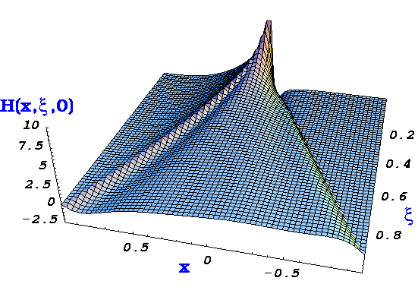
DVCS, GPDs, Compton Form Factors(CFF), and Lattice QCD
(at leading order:)
Cross-section (σ), Beam-charge-difference, and Double-spin (ReT)
integrate GPDs with 1/(x±ξ) weight
Beam or target spin Δσ
contain only ImT,
therefore GPDs at x = ξ and −ξ
D.R.
Notes:
Intro

Slide 12
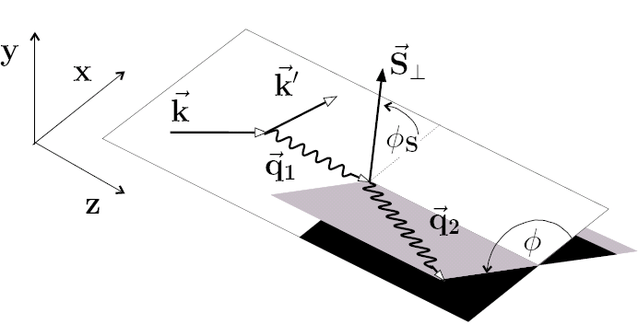
Exploiting the harmonic structure of DVCS with polarization
The spin-dependence of cross-sections
are key observables to extract GPDs
With polarized beam and unpolarized target:
With unpolarized beam and Long. polarized target:
With unpolarized beam and Transversely polarized target:
~
~
~
Separations of CFFs H(±ξ,ξ,t), E(±ξ,ξ,t),…
Notes:
12

Slide 13
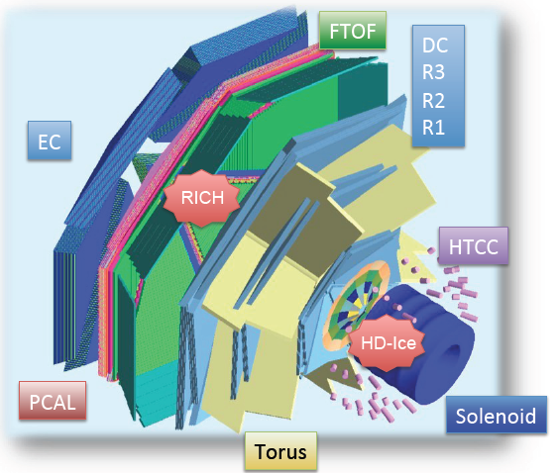
GPDs at JLab: Hall B
CLAS, CLAS12
  Wide kinematic coverage
  Over-complete exclusivity
  High multiplicity mesonic final states
    ρ ➔ππ, ω ➔ πππ, φ ➔ KK
  Timelike Compton Scattering (TCS)
    γ p → p e⁺ e–, (Quasi-real Photons)
    γ p → p J/Ψ
  Cross section systematic errors 5-10%
  Longitudinally polarized NH₃, ND₃
  Transversely polarized HD
  target in development

Slide 14
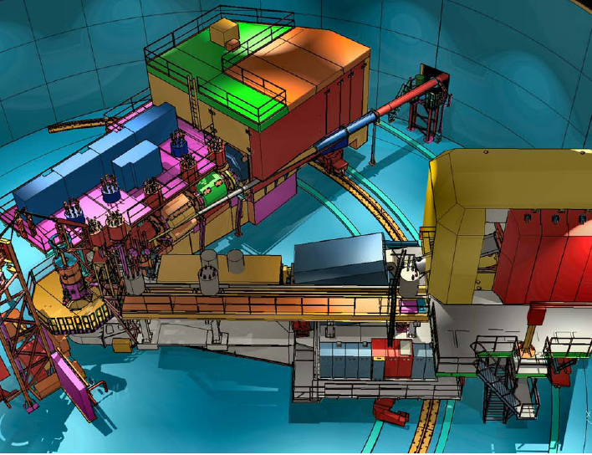
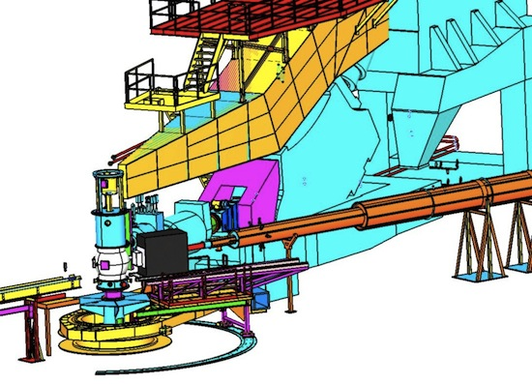
GPDs at JLab: Halls A & C
SHMS
Hall C: 12 GeV: HMS x SHMS
  L/T separations:
  H(e,e’π⁺)n, H(e,e’K⁺)Λ
Halls A & C:
Spectrometer × Calorimeter
  DVCS & Exclusive π⁰.
  H(e,e’γ)p H(e,e’γγ)p
    Exclusivity by missing mass
  dσ systematic errors ≤ 4%
  Polarized ³He (L & T) possible
HMS

Slide 15
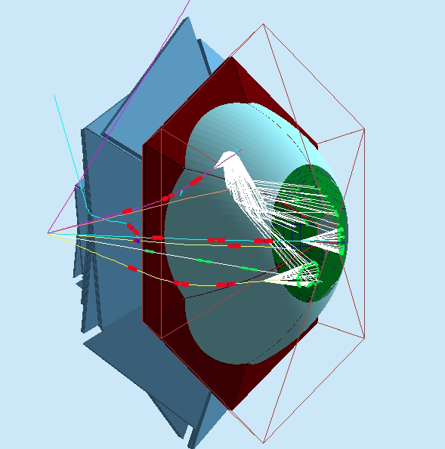
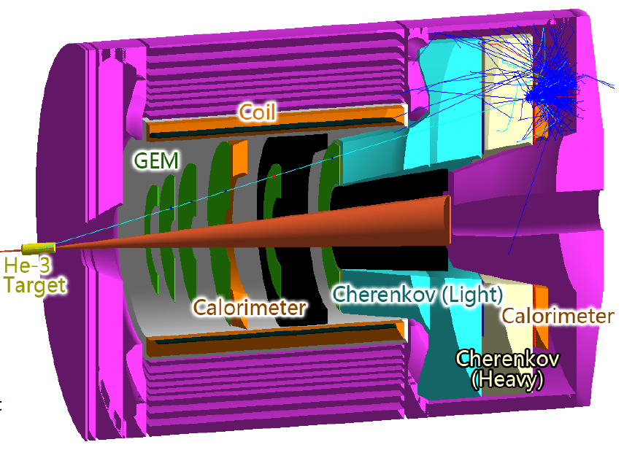
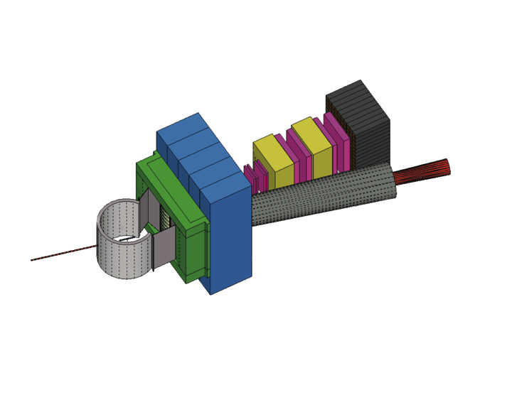
GPDs at JLab: Future Upgrades
(Mostly motivated by non-GPD topics)
CLAS12 RICH
RICH Detector (partial) in CLAS 12:
π/K id
  INFN participation
Solenoidal Large Intensity Detector
(SoLID) in Hall A (CLEO Solenoid)
  TCS, J/Ψ
  Chinese participation
Super BigBite Spectrometer
  Dipole from BNL
  Funded, under construction
  GEM trackers for high rates
SOLID - Hall A
SBS-Hall A
Hadron calorimeter
Tracker
Scattering chamber
CH2 analyzer
Beam line Pb shield

Slide 16
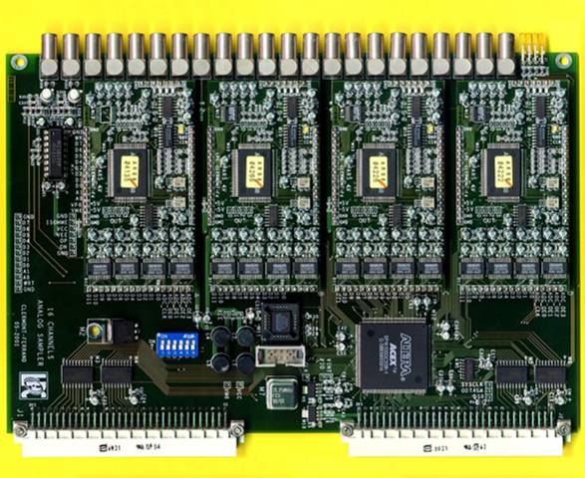
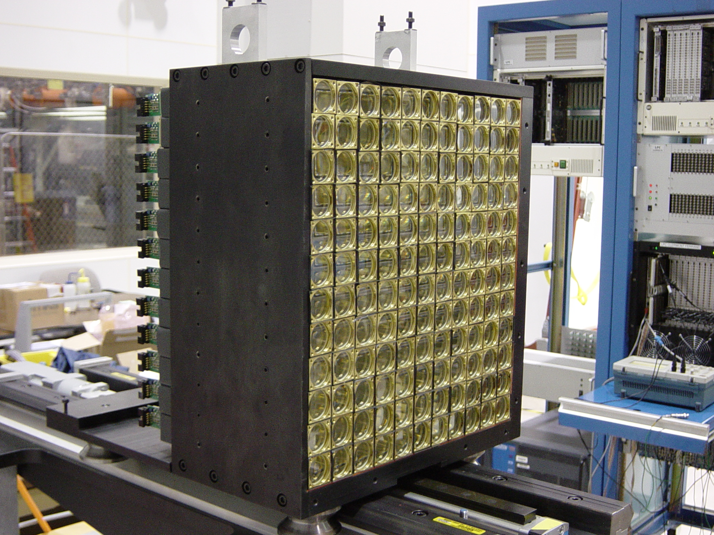
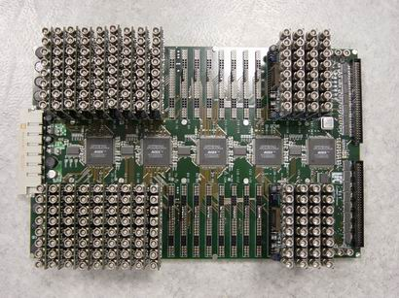
DVCS: JLab Hall A 2004, 2010, 2014-2015
L ≥ 10³⁷ cm²/s
Precision cross sections
•Test factorization
•Calibrate Asymmetries
(e,e’)X HRS
trigger
→
e⁻
16chan VME6U: ARS
128 samples@1GHz
Digital Trigger
Validation
208 PbF₂

Slide 17
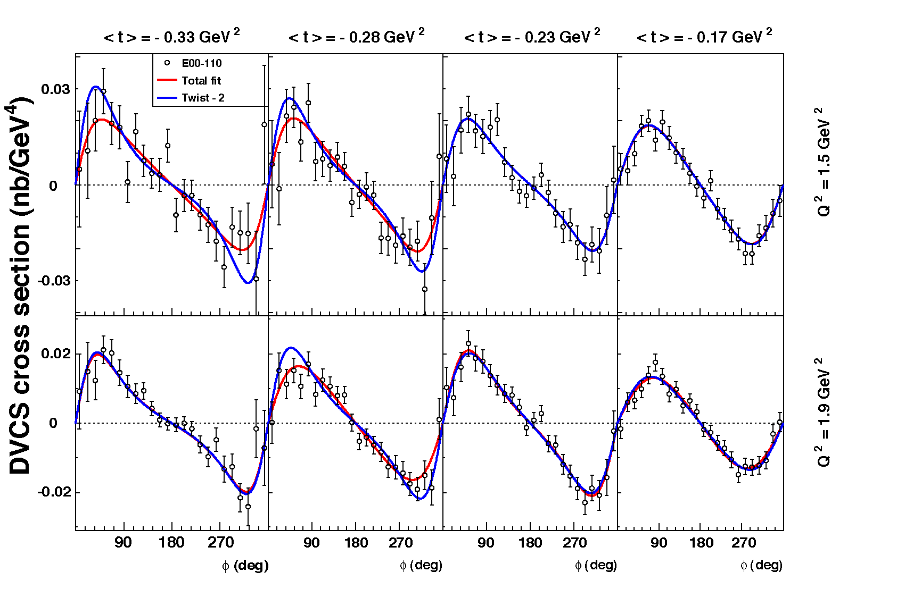
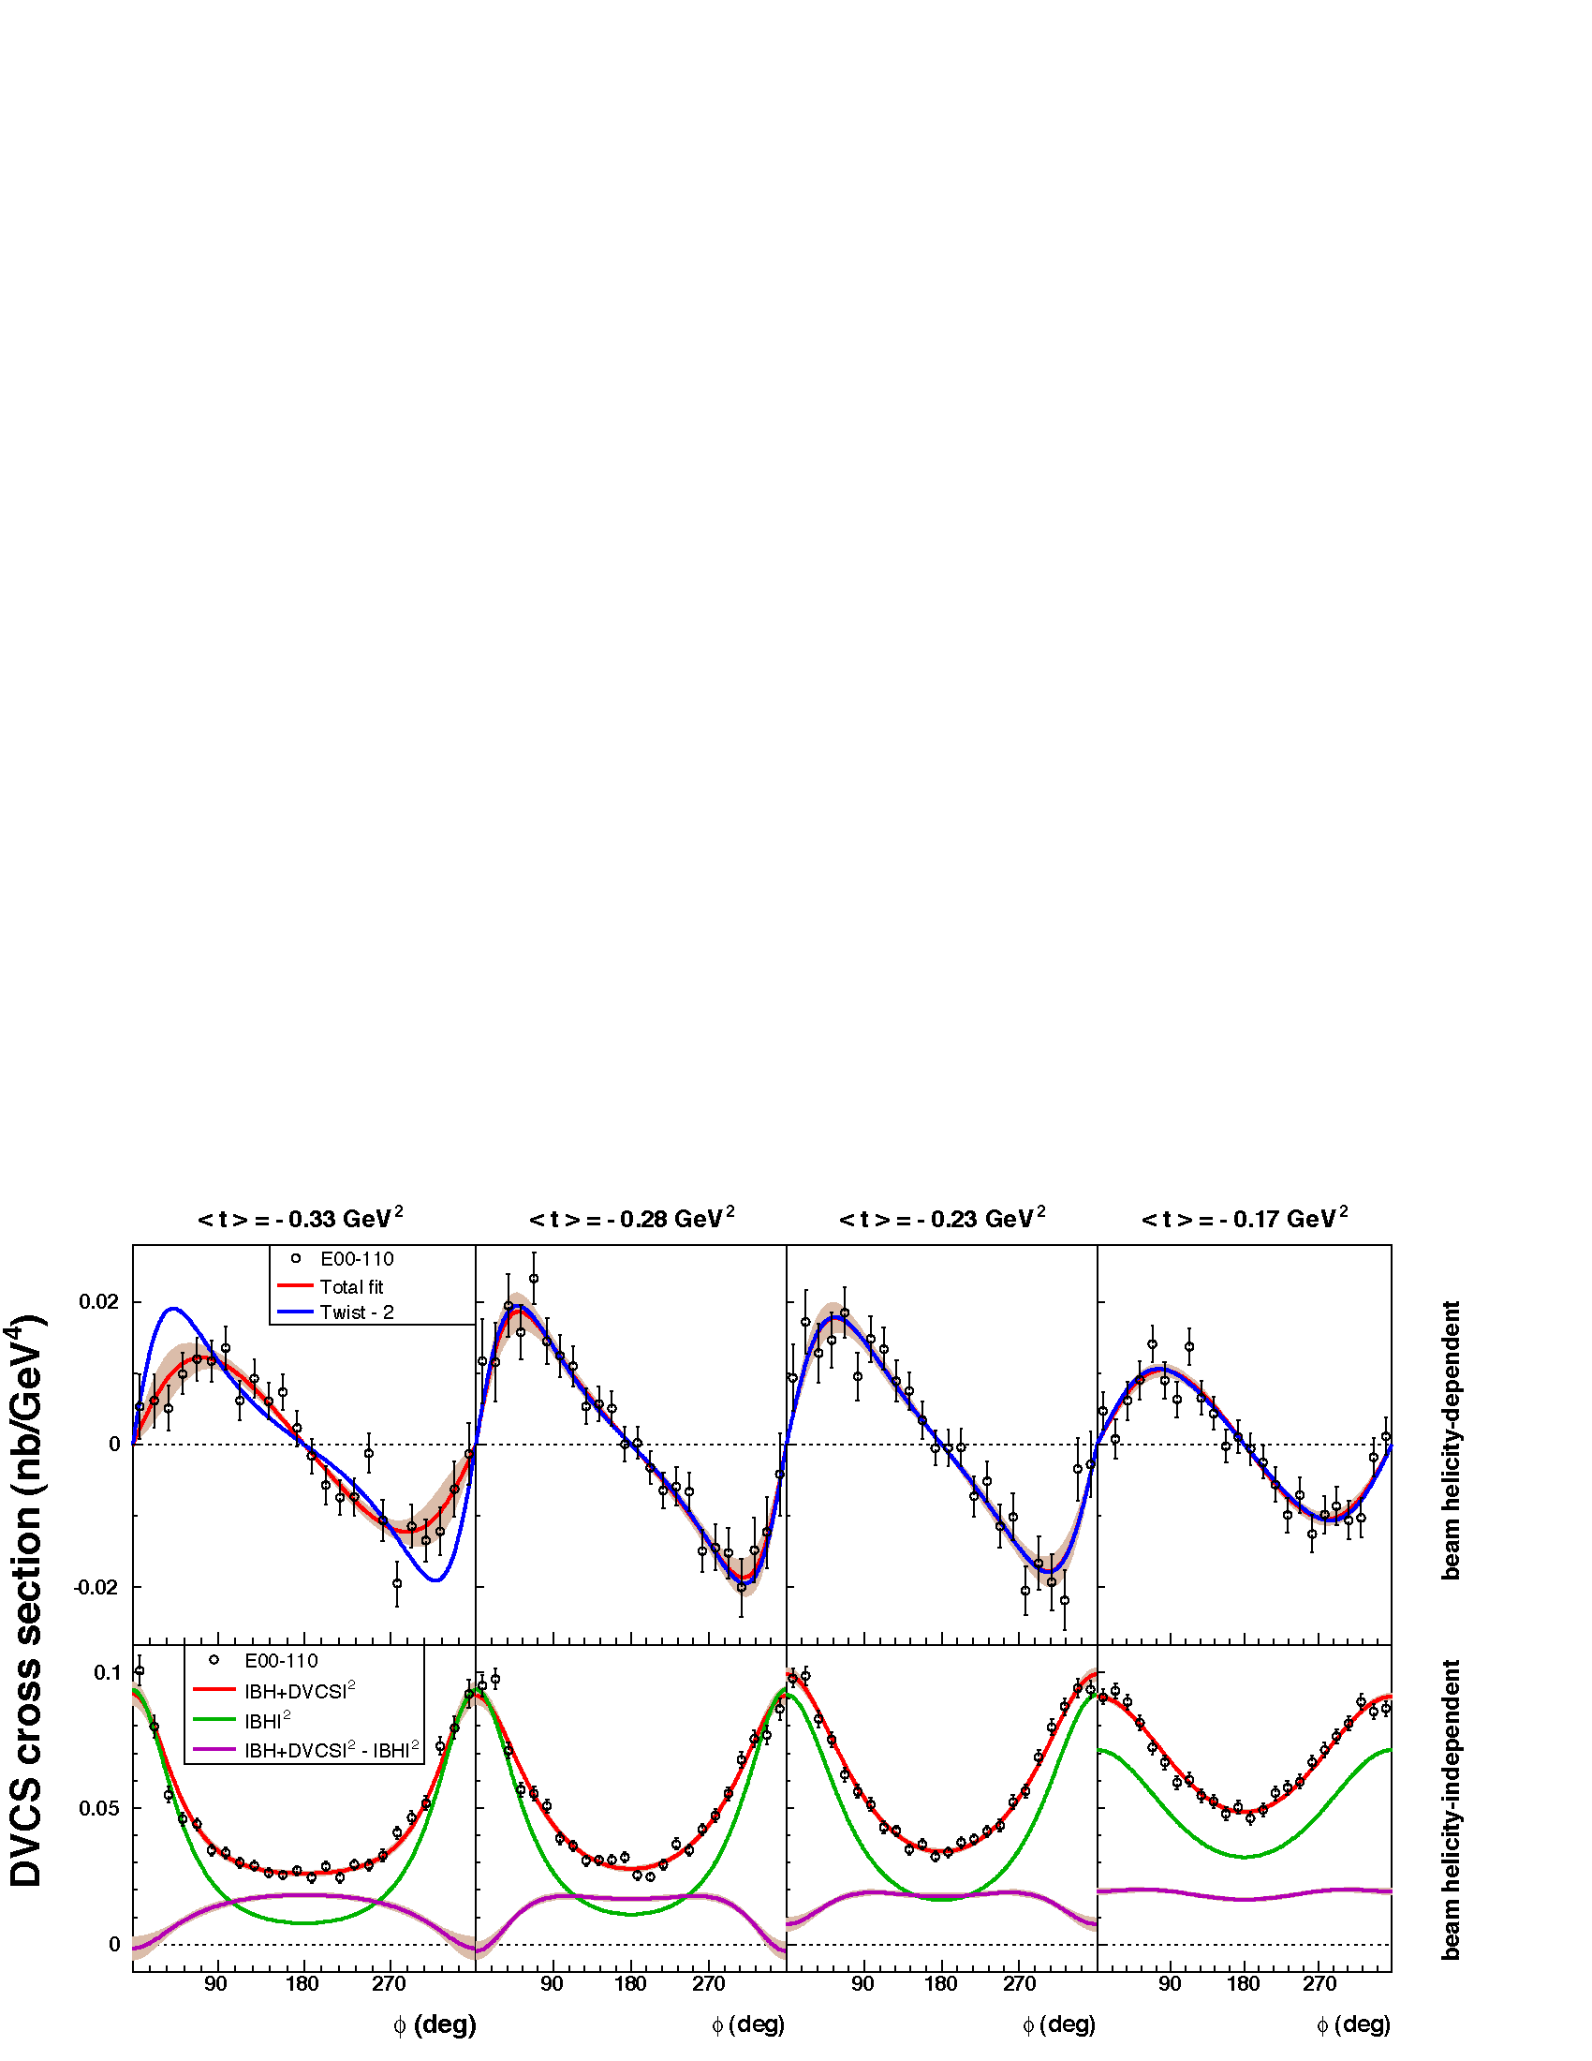
Hall A Helicity Dependent Cross Sections E00-110
Q² = 2.3 GeV²
4 bins, Δt = 0.055 GeV²
PRL97:262002 (2006) C. MUNOZ CAMACHO, et al.,
Q²=2.3 GeV²
Twist-2(GPD)+…
Twist-3(qGq)+…
Γ_{s1,2} = kinematic factors

Slide 18
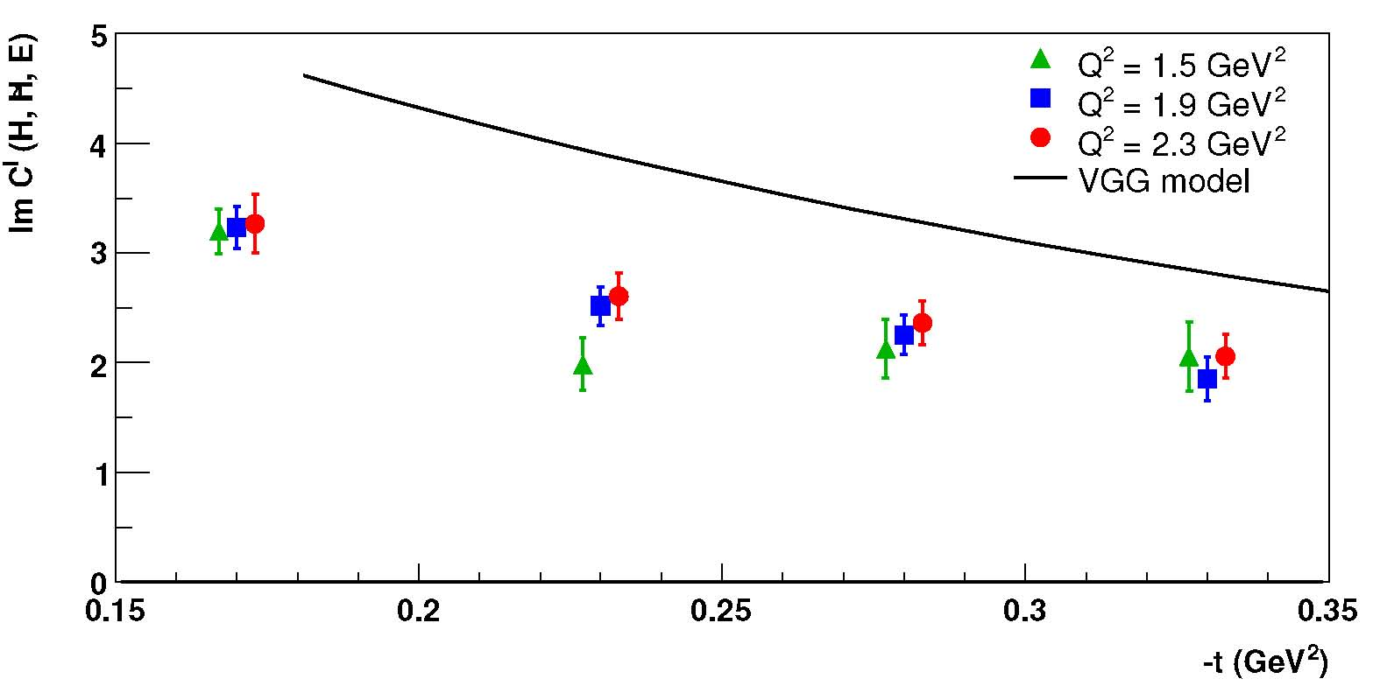
GPD results from JLab Hall A (E00-110) (C.MUNOZ CAMACHO et al PRL 97:262002)
Q²-independance of Im[DVCS*BH]
  Twist-2 Dominance (GPD)
  Model « Vanderhaeghen-Guichon-Guidal (VGG)» accurate to≈30%
2015 run:
Extend to
Q²=4.0 GeV²
Compensate the small lever-arm in Q² with precision in dσ.

Slide 19
Beam helicity-independent cross sections at Q²=2.3 GeV², x_{B}=0.36
Contribution of Re[DVCS*BH] + |DVCS|² large.
Measurements at multiple incident energies to separate these two terms and isolate Twist 2 from Twist-3 contributions
PRL97:262002 (2006) C. MUNOZ CAMACHO, et al.,
d⁴σ (nb/GeV⁴)

Slide 20
Hall A 2010 run

Slide 21
|DVCS|²
contribution is small

Slide 22
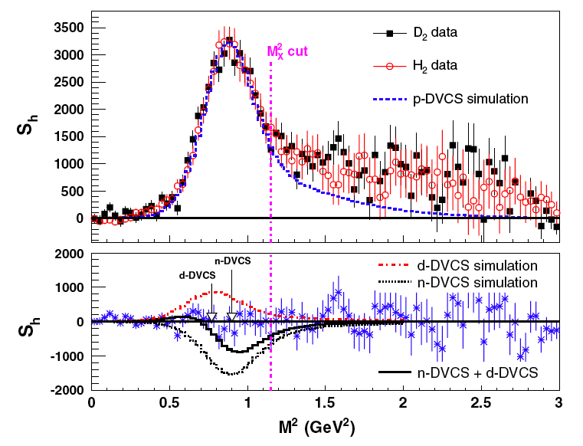
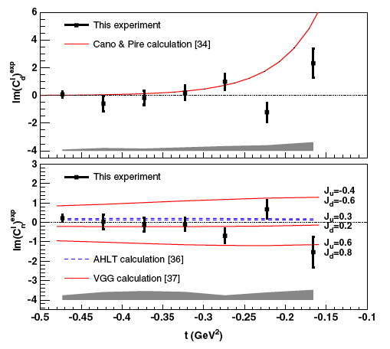
DVCS-Deuteron, Hall A
E03-106:
  D(e,e’γ)X ≈
  d(e,e’γ)d+n(e,e’γ)n+p(e,e’γ)p
  Sensitivity to E_{n}(ξ,ξ,t) in
  Im[DVCS*BH]
E08-025 (5.5 GeV- 2010)
  Reduce the systematic errors
    Expanded PbF₂ calorimeter for π⁰ subtraction
  Separate the Re[DVCS*BH] and
  |DVCS|² terms on the neutron via two beam energies.
Q²=2.3 GeV², x_{B}=0.36
neutron

Slide 23
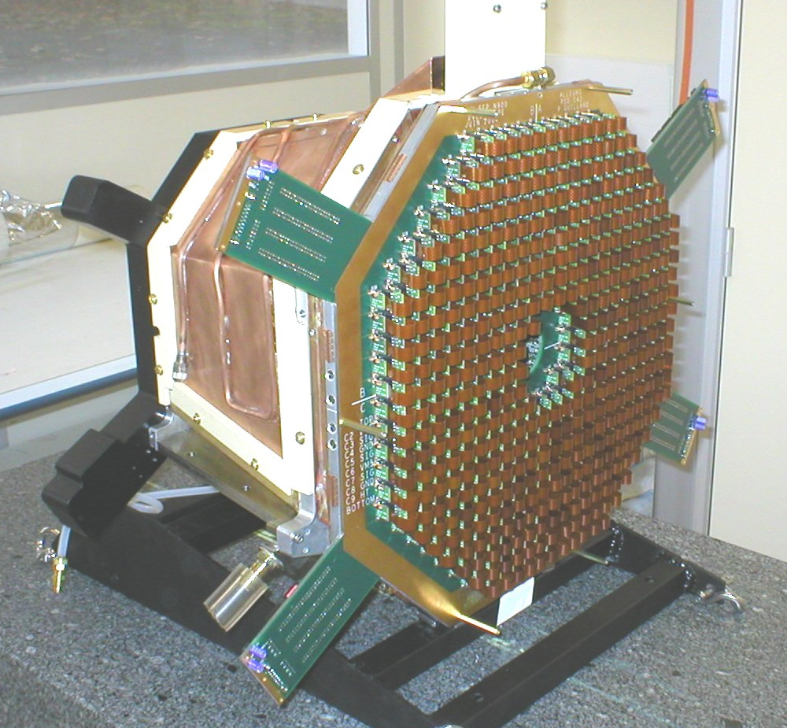
DVCS in CLAS @ 6 GeV
H(e,e’γp)
Longitudinally polarized NH₃ target.
Add:
5 Tesla Solenoid
420 PbWO₄ crystals :
~10x10x160 mm³
  APD+preamp readout
Orsay / Saclay / ITEP / Jlab

Slide 24
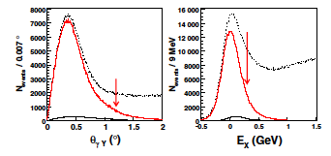
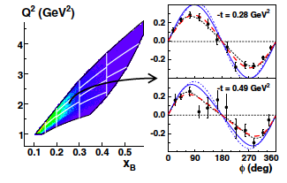
CLAS 6 GeV: Exclusivity and Kinematics
H(e,e’γp’)x
Overcomplete triple coincidence
Co-linearity of γ with q-p’
Missing Energy E_{x}
Example angular distribution of Beam Spin Asymmetry
  One (Q²,x_{B}) bin
  Two t-bins.

Slide 25
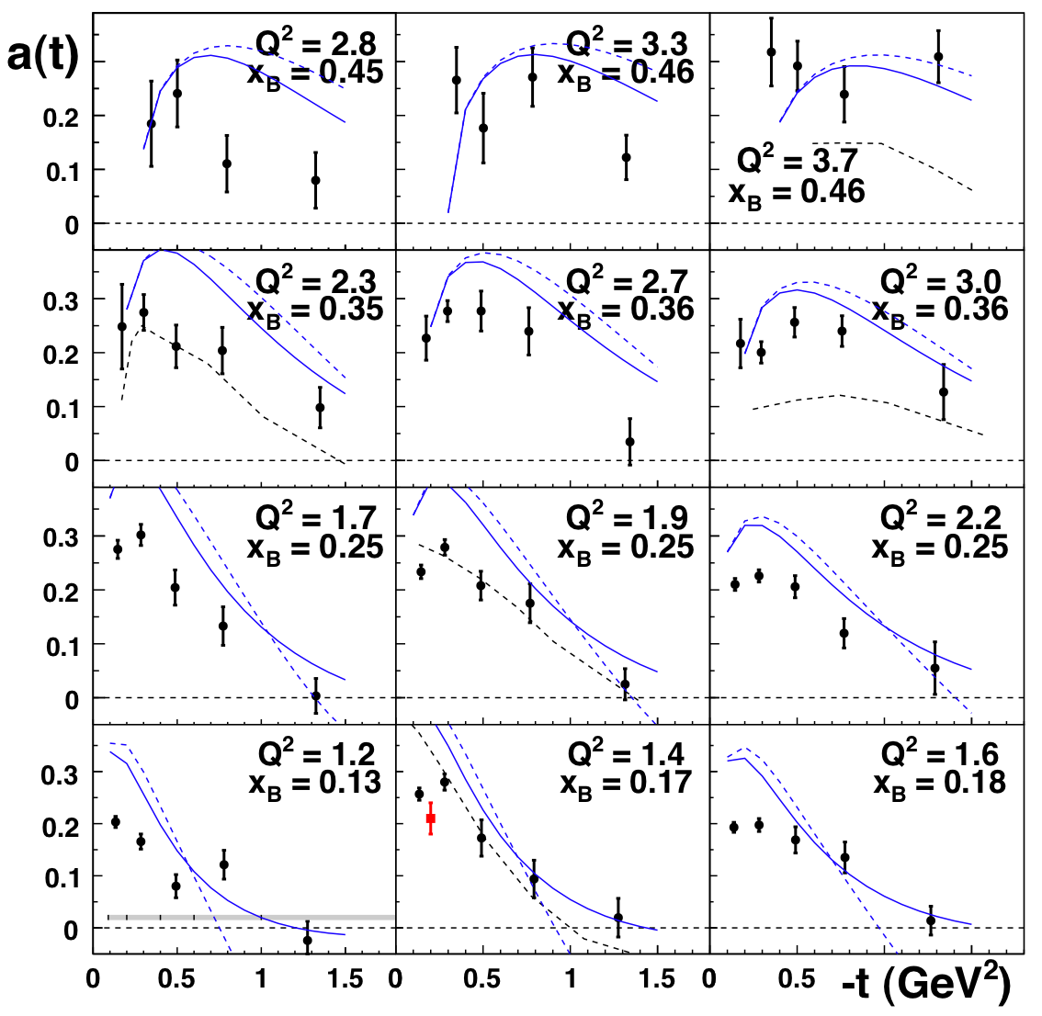
CLAS, 6 GeV Beam Helicity Asymmetry
F.X. Girod et al, Phys.Rev.Lett.100, 162002, 2008
sinφ moments of A_{LU}
  Solid blue curves: VGG GPD model
  Primarily sensitive to H
x_{B}
Q²

Slide 26
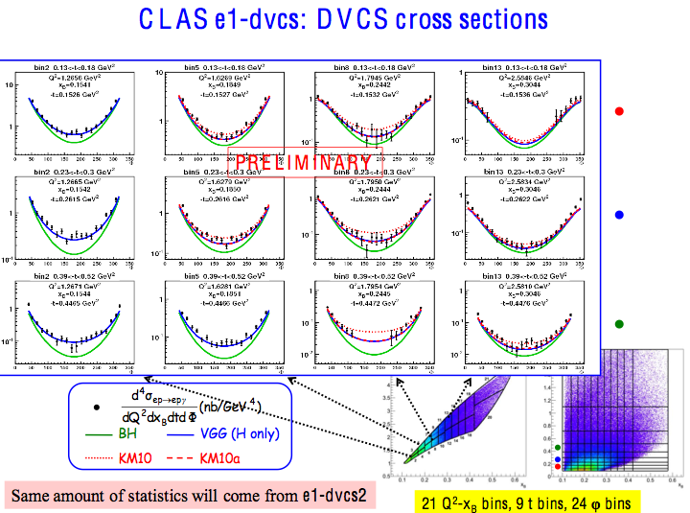
Publication in CLAS review
t

Slide 27
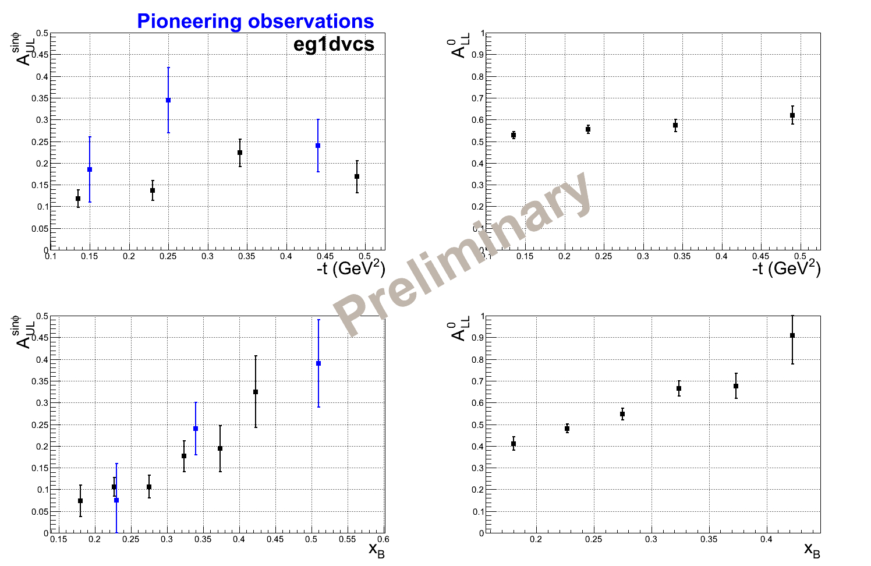
CLAS – Proton Target Spin Asymmetry
S.Chen, et al, PRL 97, 072002 (2006)
Erin Seder, Ph.D U.Conn, (2013)
Primarily sensitive to H-tilde

Slide 28
Global analyses of GPD data
K. Kumericki, D. Mueller, M. Murray,
  arXiv:1301.1230 hep-ph, arXiv:1302.7308 hep-ph
M. Guidal, H.Moutarde,
  EPJA 42 (2009) 71.
P.Kroll,
M. Guidal,
  PLB 689 (2010) 159, PLB 693 (2010) 17.
S. Liutti, G. Goldstein,
  Phys.Rev. D84 (2011) 034007
LO, or NLO implemented
  Finite –t/Q², M²/Q² corrections up to kinematic twist-4.
  V. Braun, et al, Phys.Rev. D89 (2014) 074022.
Dynamic twist-3 formalism known, not implemented in global analysis yet.

Slide 29
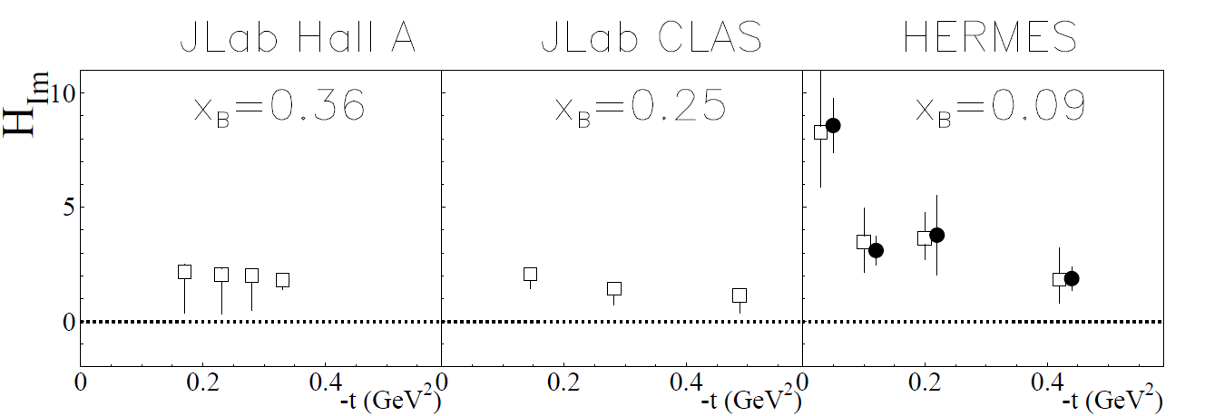
unpol. cross section
+
helicity-dependent cross section
χ² minimization
~
Δσ_{LU} ~ sinφ Im{F₁H + ξ(F₁+F₂)H -kF₂E}dφ

Slide 30
unpol. cross section
+
helicity-dependent cross section
beam spin asym.
+
long. pol. tar. asym
χ² minimization
~
Δσ_{LU} ~ sinφ Im{F₁H + ξ(F₁+F₂)H -kF₂E}dφ
~
~
Δσ_{UL} ~ sinφIm{F₁H+ξ(F₁+F₂)(H + x_{B}/2E) –ξkF₂ E+…}dφ

Slide 31
unpol. cross section
+
helicity-dependent cross section
beam spin asym.
+
long. pol. tar. asym
beam charge asym.
+
beam spin asym
+
…
χ² minimization
linearization
~
Δσ_{LU} ~ sinφ Im{F₁H + ξ(F₁+F₂)H -kF₂E}dφ
~
~
Δσ_{UL} ~ sinφIm{F₁H+ξ(F₁+F₂)(H + x_{B}/2E) –ξkF₂ E+…}dφ

Slide 32
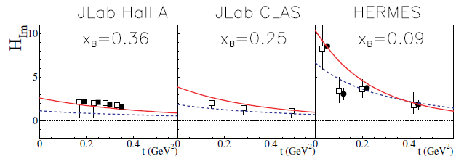
unpol.sec.eff.
+
beam pol.sec.eff.
beam spin asym.
+
long. pol. tar. asym
beam charge asym.
+
beam spin asym
+
…
χ² minimization
linearization
Moutarde10 model/fit
As x_{B} = 0.09 → 0.25 → 0.36
t-slope flattens
Proton shrinks!
VGG model
KM10 model/fit

Slide 33
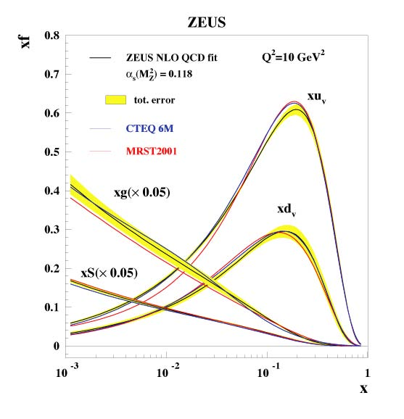
Deep Virtual Meson Production
Spin-flavor sensitivity
Gluons
  Gluons are still important
  at large-x
  Deep φ-production
  J/Ψ photo-production

Slide 34
Leading Order (LO) QCD Factorization of DVES
Δ_{μ}
z
γ*
z
DA(z)
DA(z)
+
x+ξ
x-ξ
x+ξ
x-ξ
P +Δ/2
GPD(x,ξ ,t=Δ²)
P-Δ/2
GPD(x,ξ ,t=Δ²)
z
DA(z)
+
Gluon and quark GPDs enter to same order in α_{S}.
SCHC: σ_{L}~ [Q²]⁻³ σ_{T}~ [Q²]⁻⁴
Spin/Flavor selectivity
x+ξ
x-ξ
GPD(x,ξ ,t=Δ²)
[Diffractive channels only]

Slide 35
Semi Universal behavior of exclusive reactions at high W²
Two views:
  Extracting leading twist information is hopeless for Q²+q’²<10 GeV²
  Perturbative t-channel exchange even for modest Q², but convolution of finite size of nucleon and probe.
HERA data: fitted from gluon pdf at scale μ² <<Q²
  Finite transverse spatial size b≈1/μ of γ→V amplitude
GWolf 0907.1217

Slide 36
Vector Mesons at JLab
Deep ρ
  SCHC observed at 20% level
  Anomalous rise in dσ_{L} at low W
Deep ω
  SCHC strongly violated in CLAS data
  No (??) SCHC tests from HERMES or HERA.
Deep φ
  SHCH validated
  Model of P.Kroll & S.Goloskokov
    (Eur.Phys.J. C53 (2008) 367-384) Consistent with world data set
    Perturbative t-channel exchange (2gluons), but factor of 10 suppression relative to co-linear factorization from finite size (Sudakov) effects in γ→φ transition amplitude

Slide 37
CLAS Deep rho

Slide 38
Deep φ
Q²≈2 GeV²
  CLAS, HERMES, HERA
Model of S.Goloskokov and P. Kroll
  Finite size effects at γ∗→φ vertex
12 GeV Experiment in Hall B
J/Ψ in Halls B and A.

Slide 39
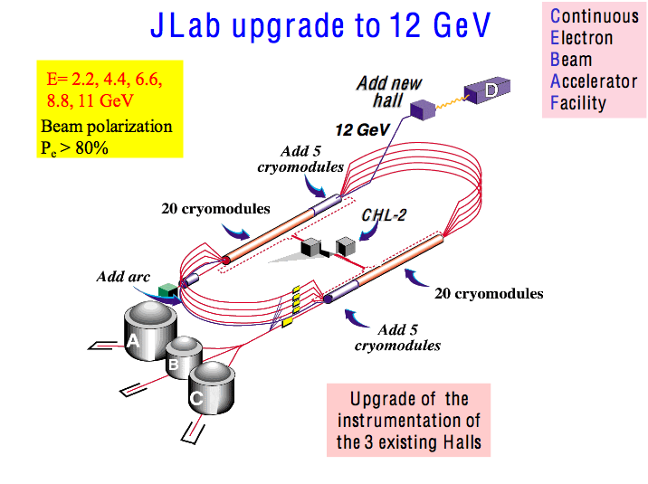
Accelerator
≈ done
≈ operational
CD4A Spring 2014

Slide 40
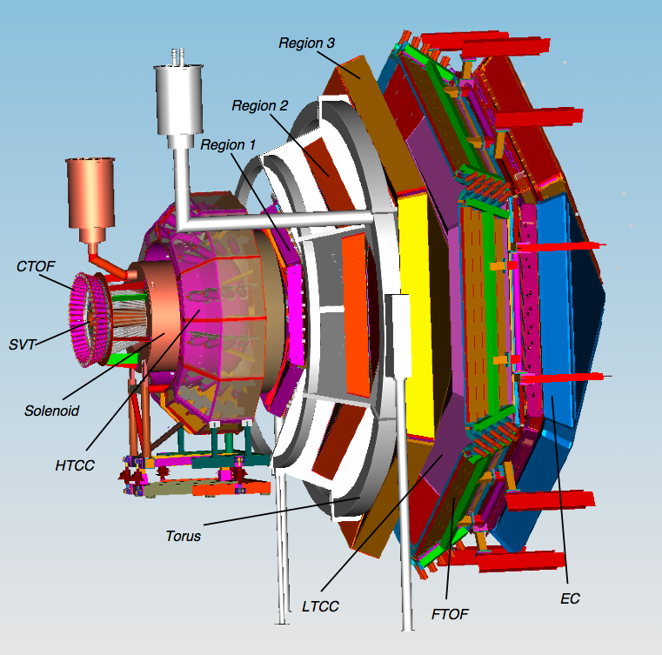
CLAS12
CLAS12
Central
Solenoid
Forward
Torus
GPDs & TMDs
Nucleon Spin Structure
N* Form Factors
Baryon Spectroscopy
Hadron Formation
2m

Slide 41
DVCS/DVMP with CLAS at 12 GeV
80 days on H₂ target at ~10³⁵ /cm²/s
  DVCS/Vector Meson production/ TCS with low-Q² tagger concurrent
120 days on Longitudinally Polarized NH₃ target
  Total Luminosity 10³⁵ /cm²/s, dilution factor ~1/10
90 days: D(e,e’γn)p_{S}
⁴He(e,e’ γα) with upgraded BoNUS detector
  GEM based radial TPC for recoil α-detection
Ambitions/options for Transversely polarized targets
  NH₃ target has 5 T transverse field
    need to shield detectors from “sheet of flame”
    Reduce (Luminosity)•(Acceptance) by factor of 10 (my guess)
  HD-ice target: Transversely polarized H
    110 Days approved
    Luminosity•(polarization)² not yet known

Slide 42
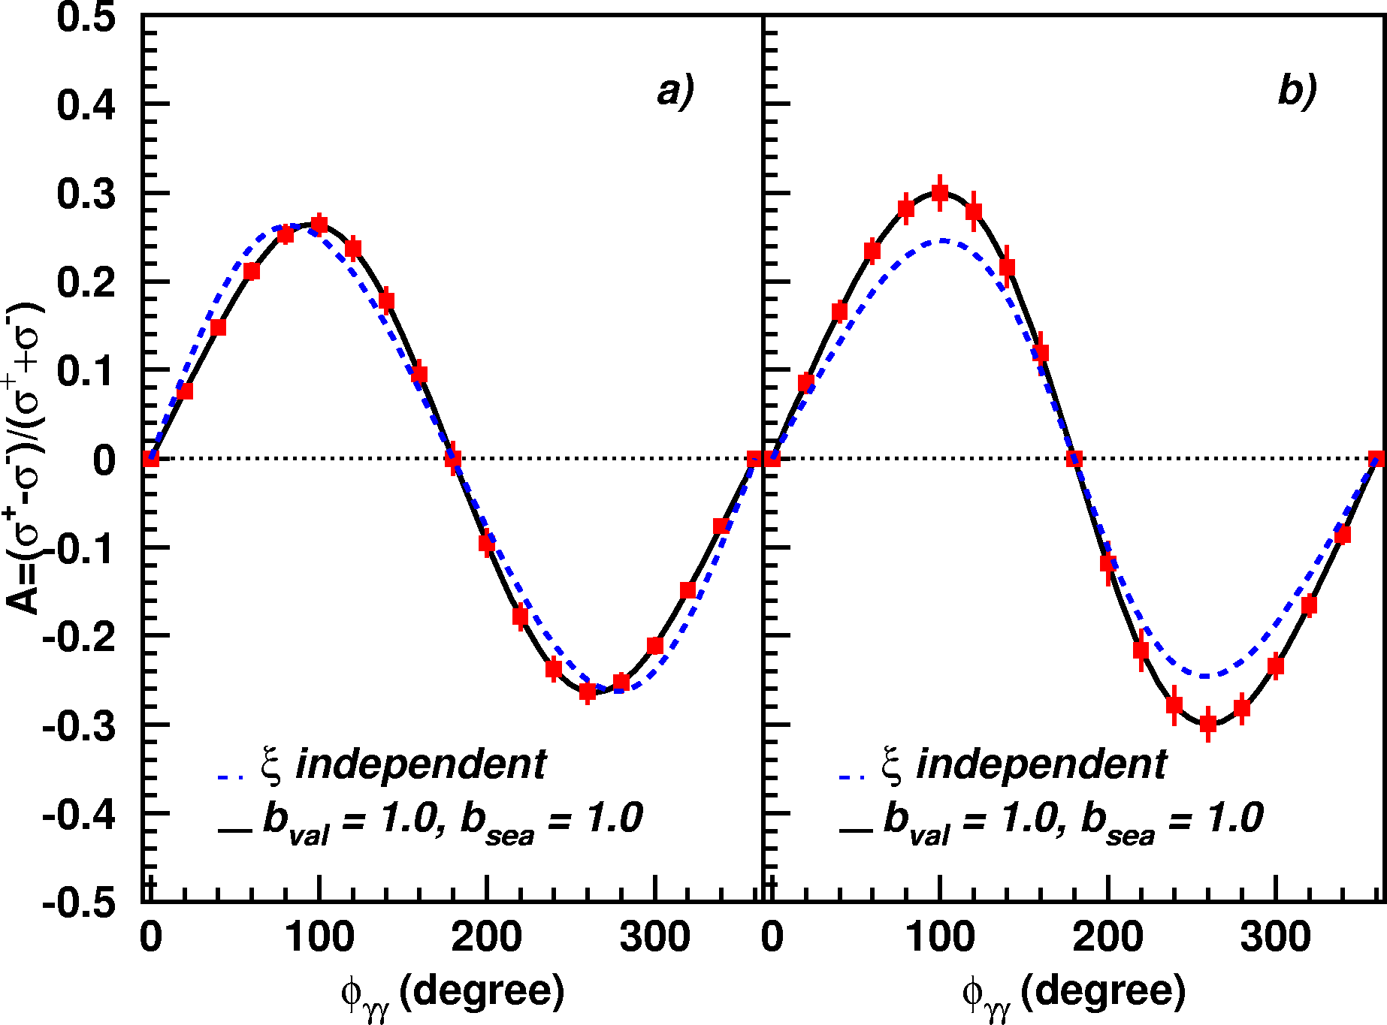
A_{LU} projections for JLab@12GeV
~
Δσ_{LU} ~ sinφ {F₁H + ξ(F₁+F₂)H +kF₂E}dφ
ep → epγ
A_{LU}
E12-06-114
E12-06-119

Slide 43
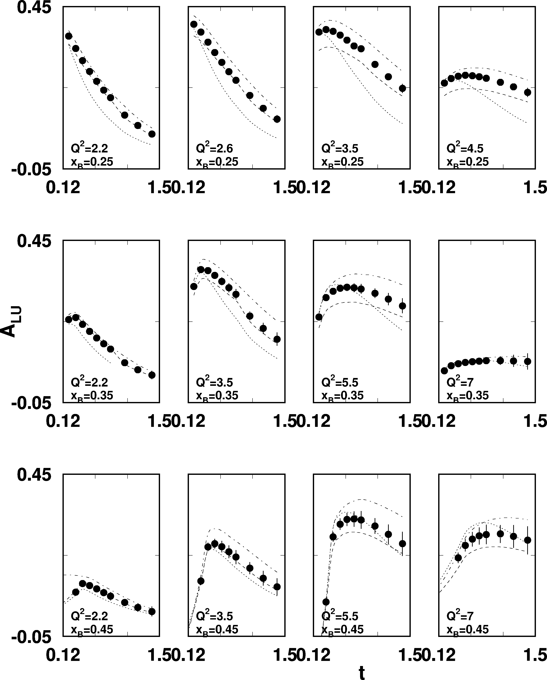
A_{LU} projections for protons
~
Δσ_{LU} ~ sinφ {F₁H + ξ(F₁+F₂)H +kF₂E}dφ
e p epγ
E_{e}=11GeV
sinφ
, GeV²

Slide 44
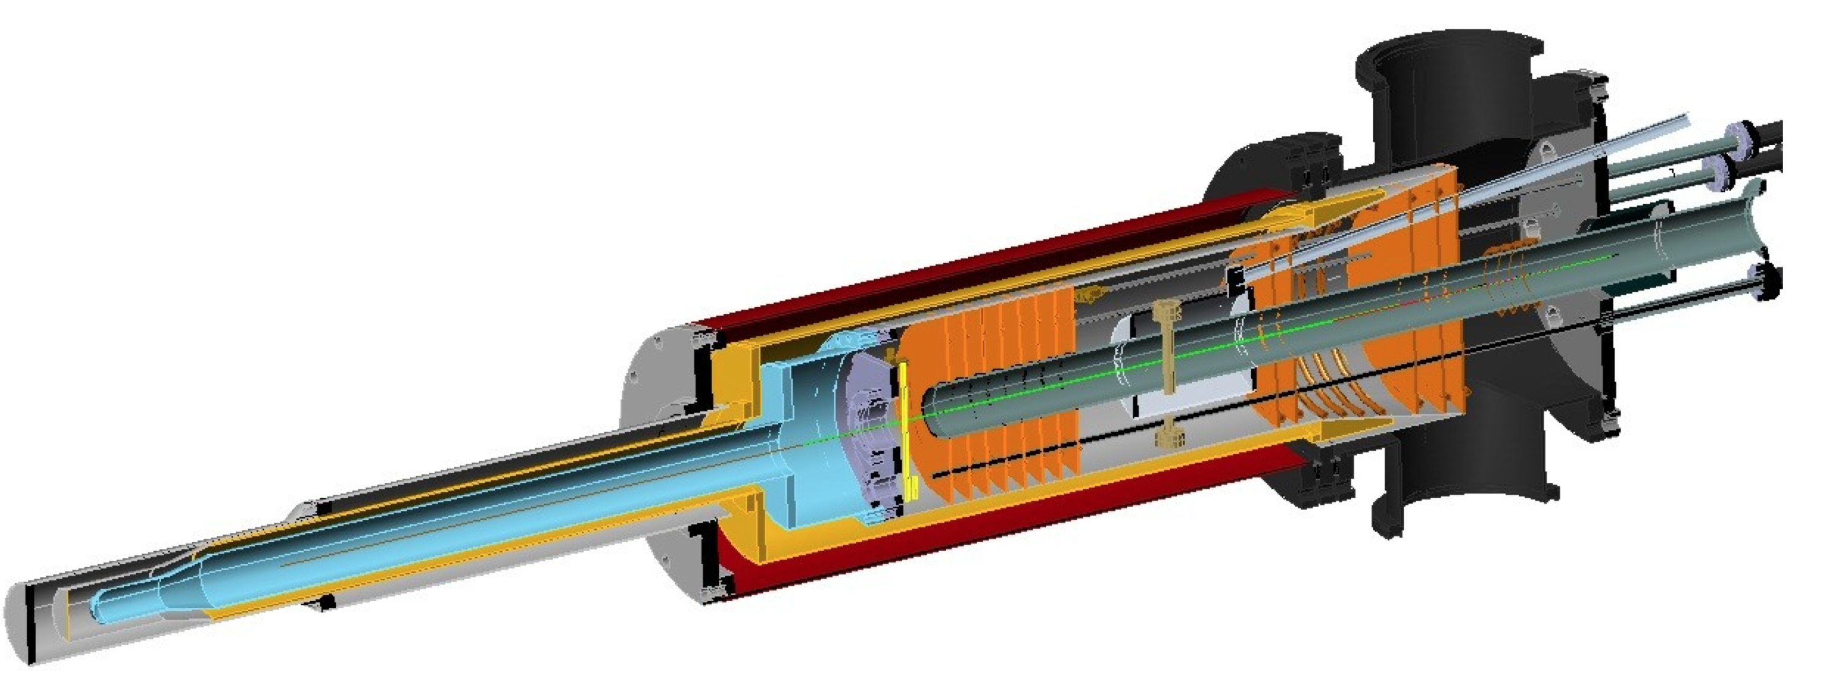
A_{UL} projections for protons
e p epγ
~
Δσ_{UL} ~ sinφ {F₁H+ξ(F₁+F₂)(H +ξ/(1+ξ)E)}dφ
~
Dynamically polarized target NH₃, ND₃
A_{UL}
L = 1x10³⁵ cm⁻²s⁻¹
T = 2000 hrs
Δx = 0.05
E12-06-119

Slide 45
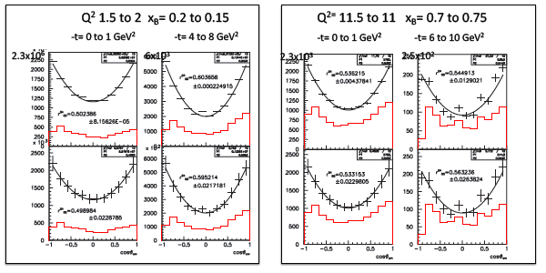
Exclusive ρ⁰→ππ L/T separation from SCHC

Slide 47
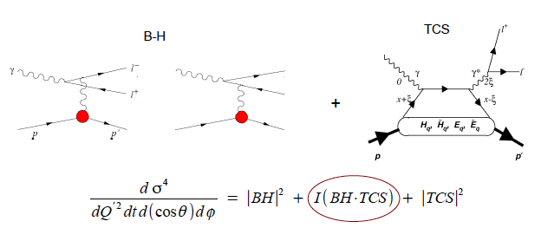
Time-Like Compton Scattering
Lepton Charge Conjugation:
  |TCS|², |BH|² even
  Interference term is odd:
  e⁺e– decay distribution measures Re[TCS*BH]

Slide 48
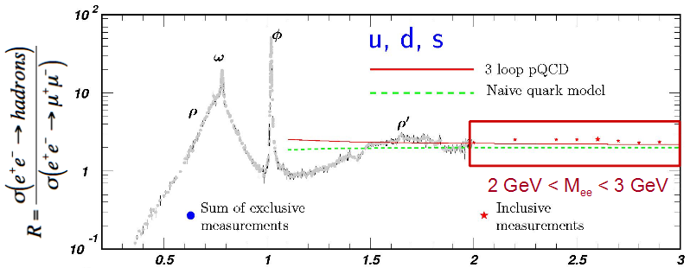
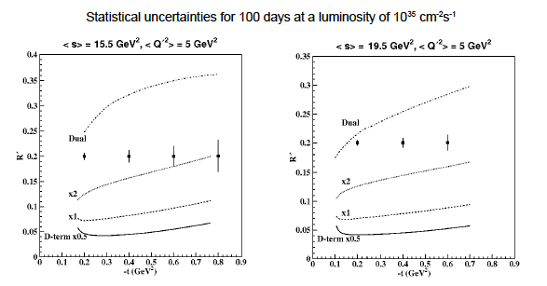
CLAS 12 TCS
Ratio of e⁺e– → Hadrons / di-muons versus e⁺e– mass
Two bins in s
Lowest bin in Q’²
t-dependence of Interference observable
Illustrative GPD models

Slide 49
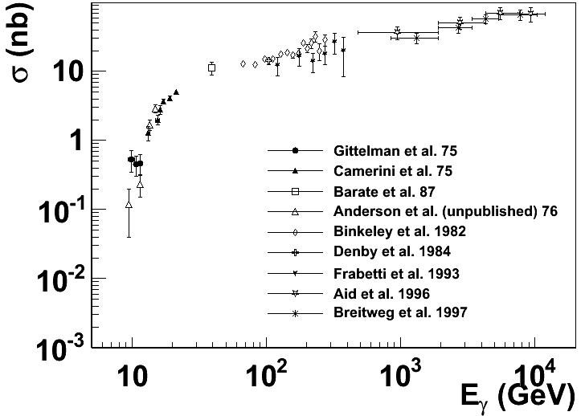
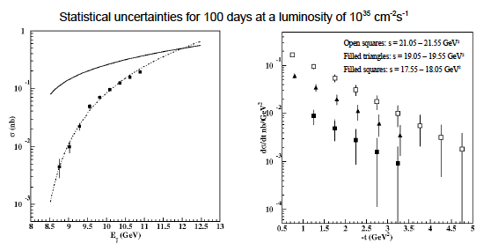
CLAS 12 Exclusive J/Ψ
Threshold region poorly measured
CLAS 12:
  Full t-
  distrbution
  fine bins in
  s at threshold
SoLID,
  Electro-
  production
  Polarized
  Target

Slide 50
GPDs in Halls A & C at 11 GeV
Hall C: HMS + SHMS
  H(e,e’π⁺)n: L/T Separation (E12-06-101)
    Approved for 52 days
    Measurement of the Charged Pion Form Factor to High Q²
    Pion Form Factor ←→ GPD E-tilde
Hall A 2014-2015
  H(e,e’γ)p and H(e,e’π⁰)p
  Subset of 100 days approved
Hall C (53 days approved):
  H(e,e’γ)p and H(e,e’π⁰)p
  Beam energy dependence
  Expanded x_{B}, Q² range
Hall C Real Compton Scattering (large –t) approved by PAC 42

Slide 51
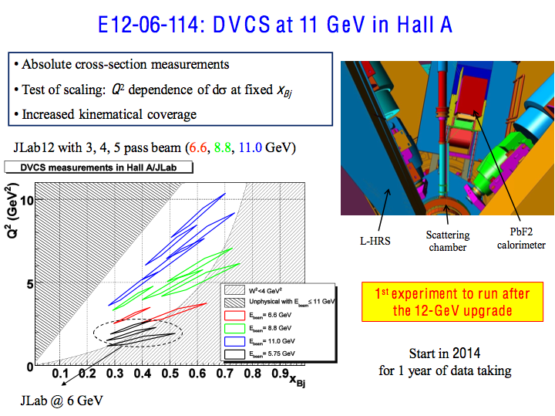

Slide 52
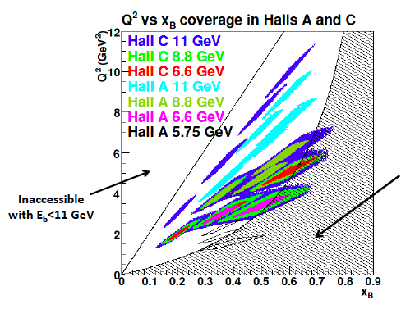
Impact of Hall A+C DVCS Kinematicss
Multiple Energy settings at key
(x_{B}, Q²) settings.
Expanded reach in
x_{B} and Q².
Beam time
adjusted for
≈equal
statistics
in each bin
W<2GeV

Slide 55
The next 20 years of DVCS/DVMP experiments
5 years
  Precision tests of factorization with Q² range ≥ 2:1 for
    x_{B}∈[0.25,0.6]. t_{min}-t < 1 GeV² + COMPASS : x_{B}∈[0.01,0.1]
    Proton unpolarized target observables
    Im[DVCS*BH], Re [DVCS*BH], |DVCS|².
  Longitudinal, target spin observables
    Primary sensitivity to H, ˜H, at x = ±ξ = ±x_{B}/(2−x_{B}) point.
  Partial u,d flavor separations from quasi-free neutron.
  Coherent Nuclear DVCS on D, He
5-10 years
  Transversely Polarized H, D, ³He in JLab Halls A,B,C
    Optimize targets, recoil/spectator detection?
  Polarized targets at COMPASS?
10-15 years:
  Start physics with electron ion collider with s≥1000 GeV² and high Luminosity!

Slide 56
Back-up Slides

Slide 57
Highlights of Generalized Parton Distributions
Spatial imaging of quarks and gluons
  Consistent with Q.M. and Relativity.
Integrals of GPDs are measurable
  DVCS, DVES ➔ GPD(ξ,ξ,Δ²) for Q²>>Λ²_{QCD}
  Extensive program in preparation at JLab
(Positive) Moments are calculable in Lattice QCD
Models are improving in sophistication.
  Data precision already exceeds predictive power of models and flexibility of parameterizations.
DVCS (and related deep exclusive meson production) will be a multi-decade effort
  Each stage can teach us something new and interesting about how QCD generates force, mass, spin, etc.

Slide 58
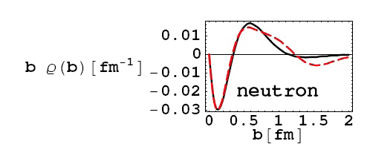
GPDs and the Nucleon Form Factors
F_{1f}(–t) = ∫dx H_{f}(x,0,t) = ∫d²b e^{ib•Δ⊥} ∫dx q_{f}(x,b)
F₁(–Δ²) = ∫d²b e^{ib•Δ⊥} ρ(b)
n→pπ–
G. Miller, 2007
GPD models link negative charge at center of neutron to excess of down-quarks at large-x
(excess of up-quarks in proton at large-x).
u_{p}(x)∼ (1-x)³ d_{p}(x) ∼ (1-x)⁵

Slide 59
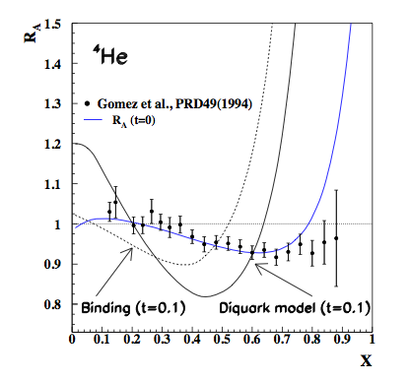
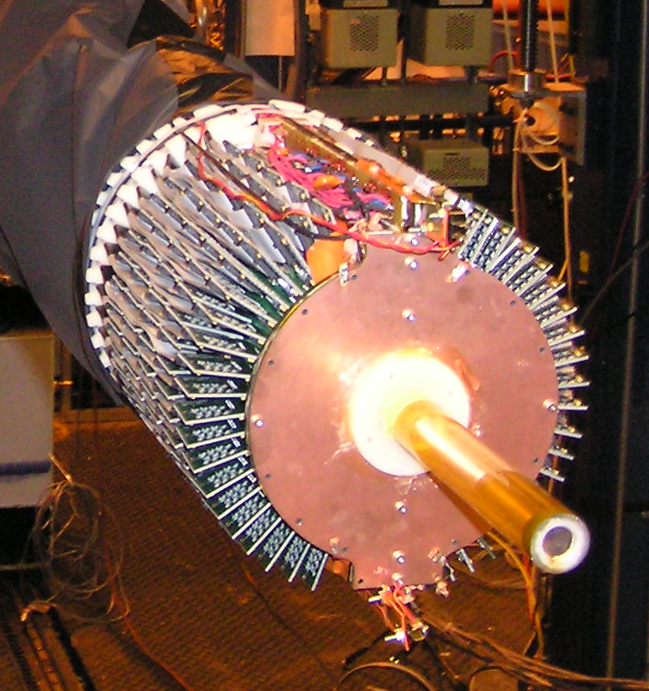
CLAS: Coherent ⁴He(e,e’γα)
A single GPD (H_{u}=H_{d})
  H(ξ,ξ,t)=(4/9)H_{u}+(1/9) H_{u}.
  G_{E}=∫dx[(2/3)H_{u}-(1/3)H_{u}].
E08-024, Autumn 2009
  BoNuS GEM radial TPC
Upgrade planned for 12 GeV
[t=0.0] →EMC effect,
[t=-0.1]→ GPD
(Liuti & Taneja, Guzey & Strickman)

Slide 61
σ_{L}/σ_{T} in vector meson production at HERA
SCHC: ρ→ππ, ω→πππ, φ→ KK
  Validate SCHC from decay angular distribution (Schilling & Wolf)
  Extract dσ_{L} from
Rapid rise in r⁰⁴ vs Q²:
  Validation of
  perturbative
  exchange in
  t-channel.
Sub-asymptotic
saturation
of dσ_{L}/dσ_{T}
  Extra
  mechanism
  for dσ_{T}?

Slide 62
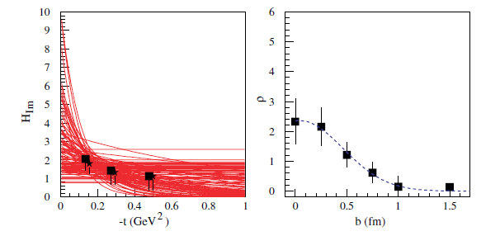
From GPDs to spatial images
Sample exercise with CLAS data (x_{B}=0.25)
1000 Gaussian fits to 1-σ spread of data
x_{B} and Q².
“skewed” H_{Im}
(fits applied to « unskewed » data)
“unskewed” H_{Im}

Slide 63
Spatial Imaging at ξ=0 and at x=ξ
Charles Hyde
Informal Pre-Town Meeting at JLab
August 13 - 15, 2014

Slide 64
Regge-Inspired Model
M.Diehl, P. Kroll, Eur.Phys.J. C73 (2013) 2397.
  Hf(x,0,Δ²) = qf(x)exp[Δ² B1f(x)]
  Ef(x,0,Δ²) = ef(x)exp[Δ² B2f(x)]
    qf(x): ABM2011
    ef(x) = κf Nf x^{–αf} (1-x)^{–βf} (1-γf x^{1/2})
    Bnf(x) =αf’ (1-x)³log(1/x) + Anf x(1-x)² + Bnf (1-x)³
  Fit:
  ∫dx Hf(x,0,Δ²) = F1f(–Δ²)
  ∫dx Ef(x,0,Δ²) = F2f(–Δ²)

Slide 65
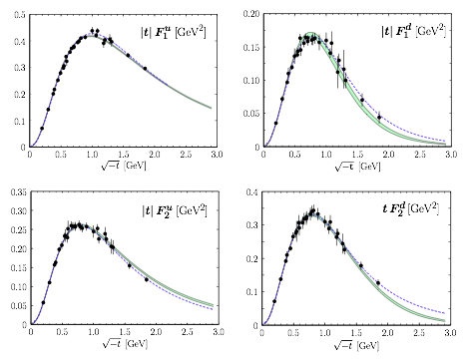

Form Factor Fits
Non-trivial t-dependence from
x-dependent simple Regge slopes
All the funny little wiggles in GE,M(–t) are resolved into a smooth behavior of the flavor separated F1,2

Slide 66
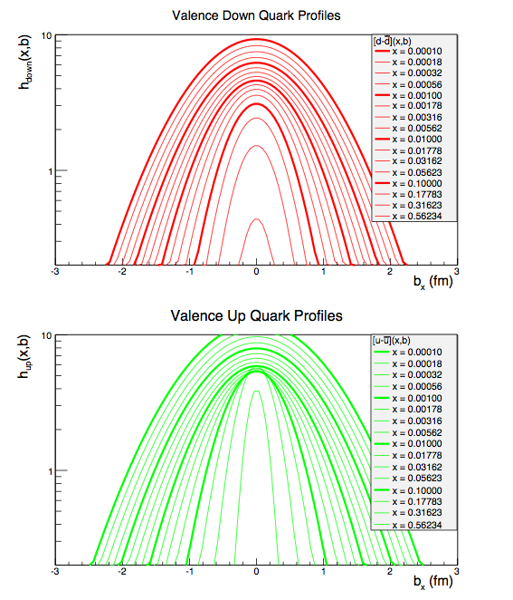
Spatial Densities at ξ=0
x-dependent t-slope B(x)
  Simple Gaussians in impact parameter space (bx, by)
Gaussian width strongly x-dependent
  Negative charge density at center of neutron
Scale: μ² = 2 GeV².

Slide 67
Double-Distribution GPDs at x=±ξ
Compton Form Factor: ξ=xBj/(2–xBj)
Im[Hf(ξ,Δ²)] = π[Hf(ξ, ξ, Δ²)– Hf(–ξ, ξ, Δ²)]
.
Profile functions h(α,β) arbitrary (symmetric in α,β):
  Use:
M. Burkardt, arXiv:0711.1881
Δ⊥: Fourier Conjugate to r⊥, the transverse spatial separation between the active parton and the transverse spatial Center-of-Momentum of the spectator system.

Slide 68
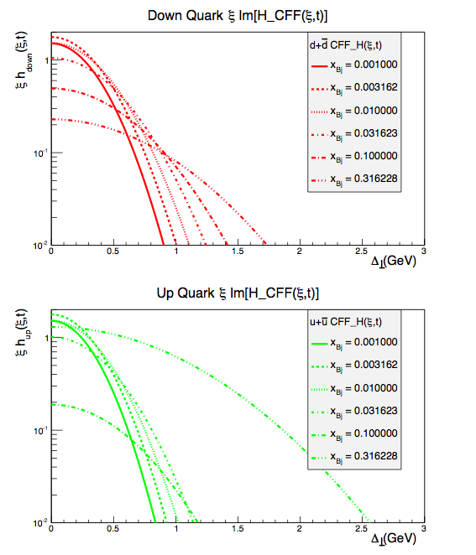
Compton Form Factors on the x=±ξ line
Compton Form Factors:
x = ±ξ profiles of GPDs:
Radial size:
strongly ξ-dependent
Flavor, gluon variation is measureable
  Intriguing insight into dynamics without sum-rules or extrapolation to ξ=0

Slide 69

IMAGING
In the Photoshop era,
you don’t have to be a
Philosopher or a Surrealist
to understand that the
image of an object is
not the object.
[Hf(ξ, ξ, Δ²)– Hf(–ξ, ξ, Δ²)] is an image of the proton.
  It is a non positive-definite quantum transition density,
  but it still can be interpreted physically.

