Slide 1
Hall A DVCS Exp. E12-06-114
DAQ Review: 20 May 2014
Overview and 2010 DAQ: C. Hyde
2014 DAQ Status: C. Muñoz Camacho
DVCS Trigger Module: Magali Magne

Slide 2
Absolute Cross Sections:
H(e,e’γ)p Reaction
Scans in Q² at fixed x_{Bj}
Priority for 2014-2015
x_{Bj} = 0.36 and 0.50
(50% of 100 PAC days approved)

Slide 3
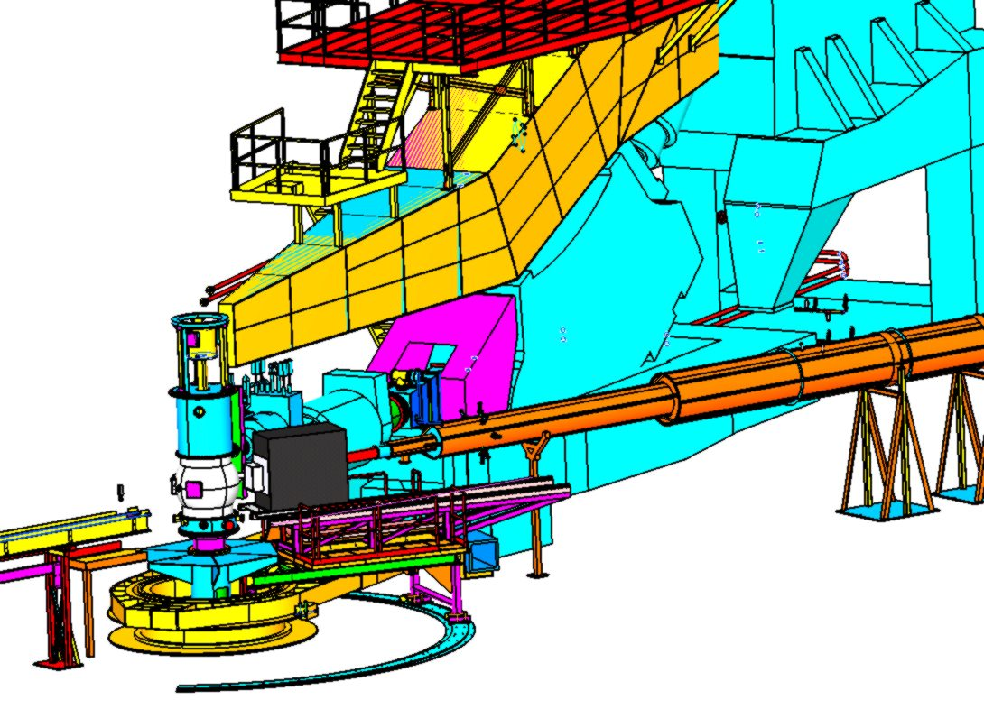
Experimental Configuration
H₂ target
Electron in HRS-L
Photon in 208×PbF₂ Calorimeter
  1.5 to 3 m from target
  Edge at 7° to 15°
PbF₂ electronics
in HRS-L hut
  ARS
  DVCS Trigger

Slide 4
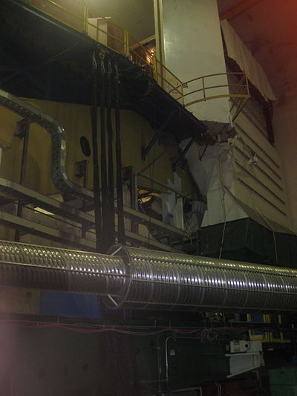
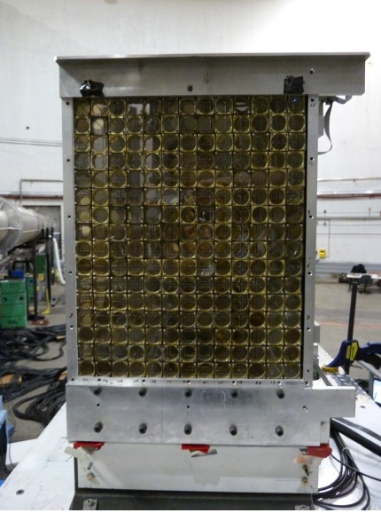
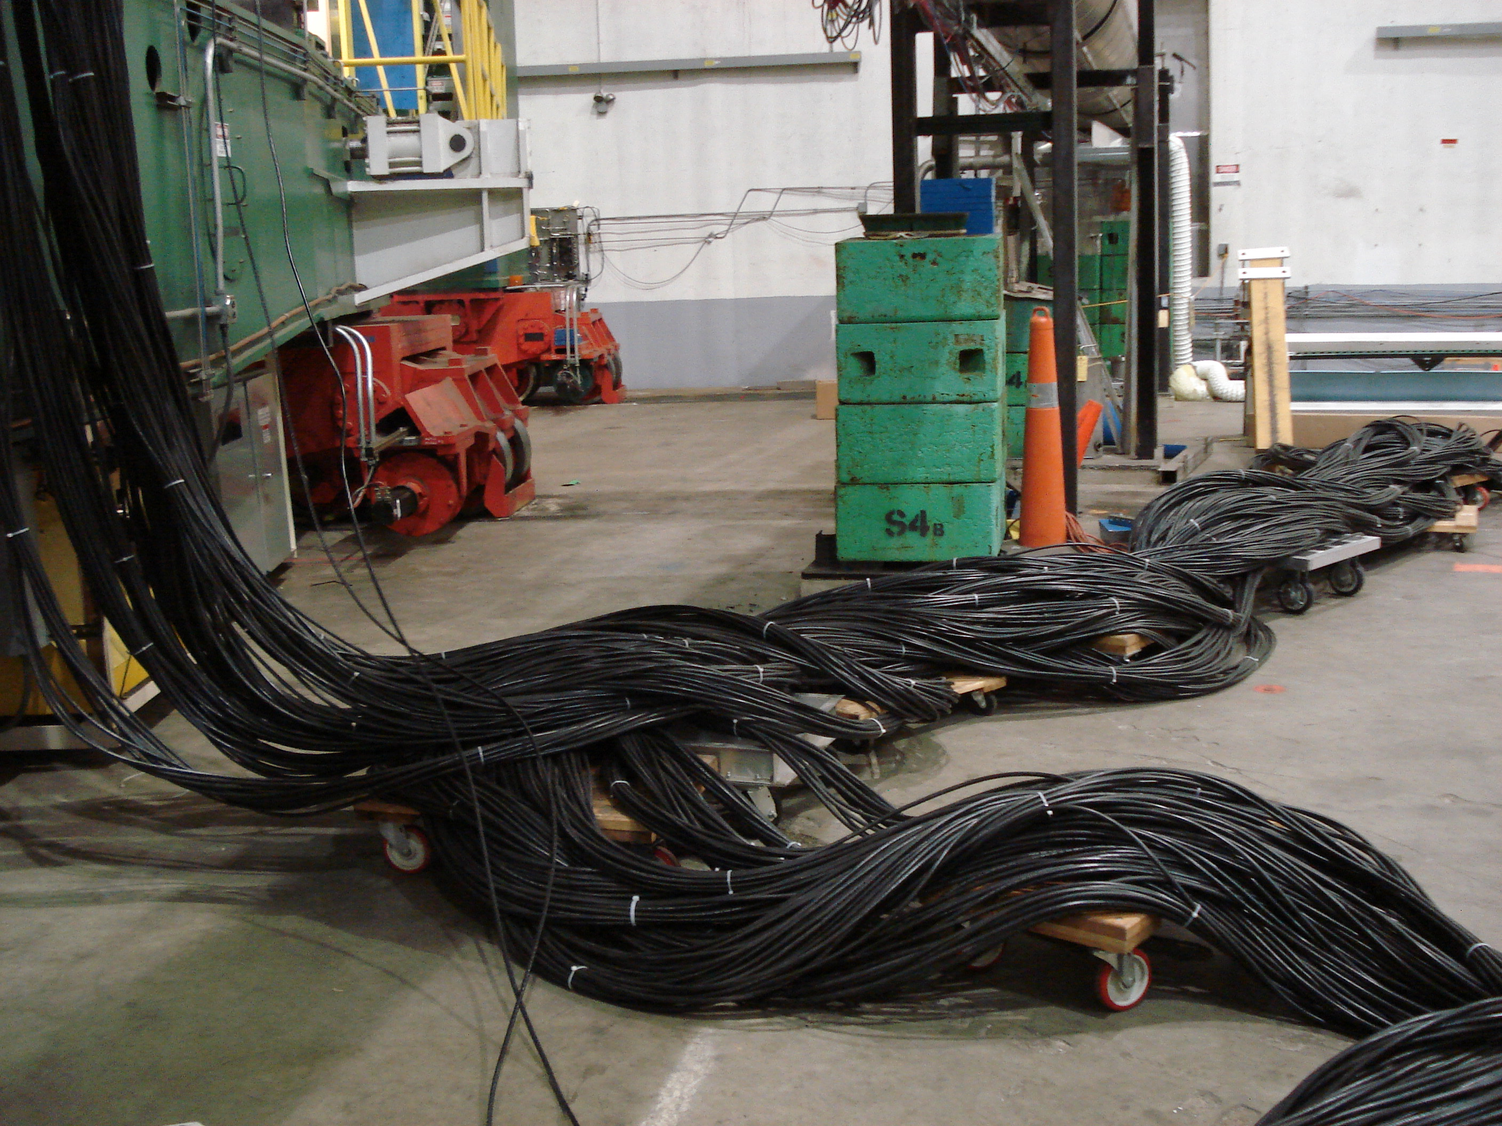
DVCS Calo and Cabling
220 RG-213 cables

Slide 5
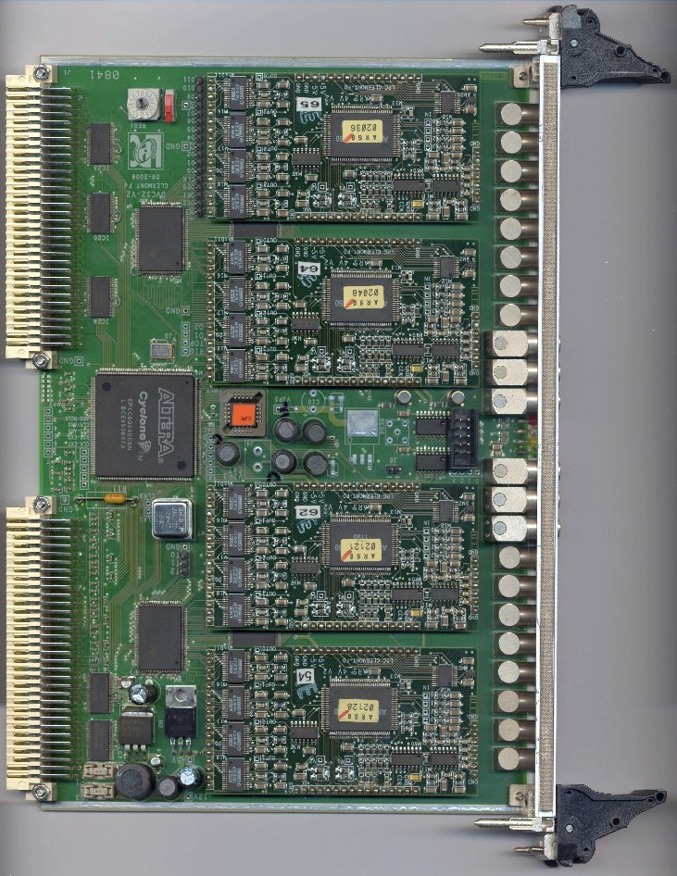
ARS 1-GHz Digitizer
1 GHz analog sampling
  128 samples
Samples frozen on fast (electron trigger)
Digitization
  Initiated on validation signal ~550 ns later
  Fast clear if no validation
  128 μs digitization
    All channels in parallel
    1μs per sample, serial

Slide 6
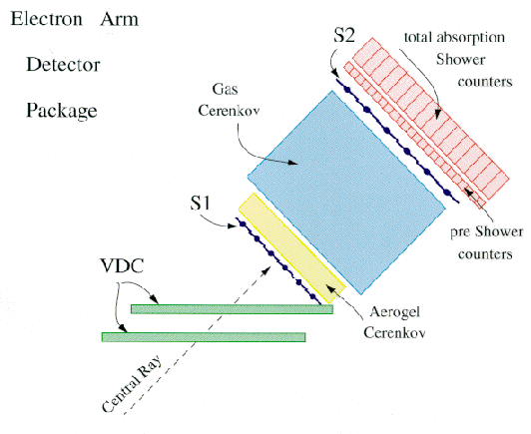
HRS Electron Trigger
Fast coincidence
S2m (or S0) and Cerenkov
S0
Χ

Slide 7
DVCS Trigger
ARS Stop
  Electron Trigger
  Prescaled Clock
Singles mode
  ARS Validation on every trigger
Coincidence Mode:
ARS Validation on
  Prescaled Electrons
  Clock
  (e,e’γ) coincident from ADC Cluster sum in trigger
  (see also Magali Magne presentation)
Signal arrival times

Slide 8
Coincidence Logic Timing
Measured and Calculated delays

Slide 9
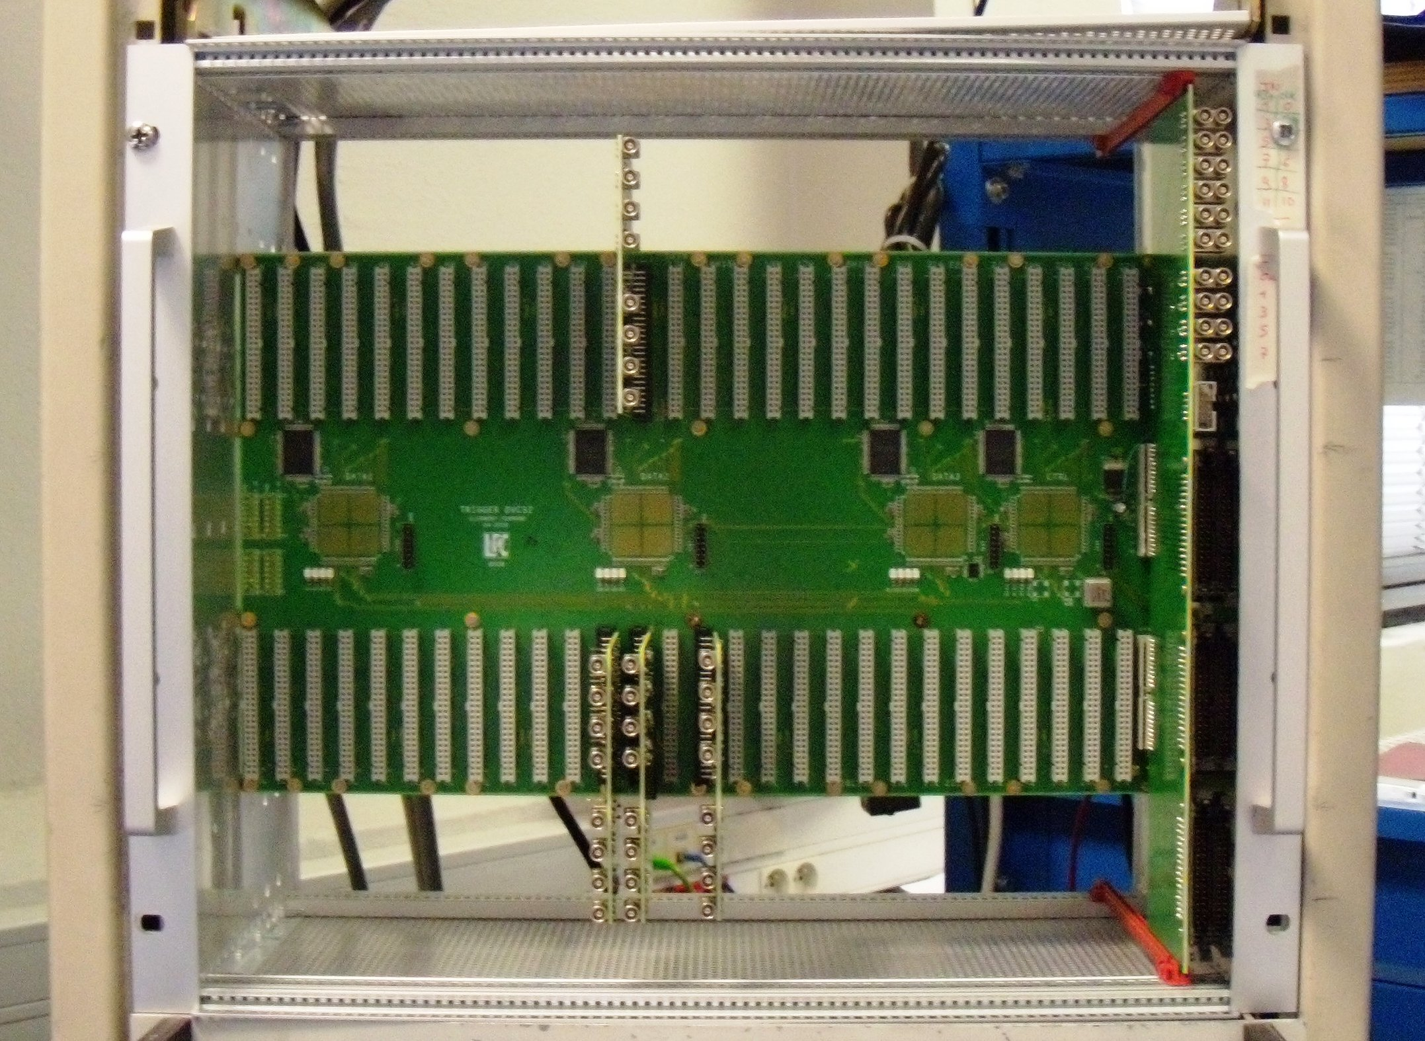
DVCS Trigger Chasis & Motherboard
Mother board
  FPGA
Daughterboards (ADCs)
I/O, control

Slide 10
Sample ARS Waveforms (2010 data)
Single photon signal
Random 2-photon Coincidence
(+ small 3rd photon?)
10%—90% Pulse Rise Time (negative leading edge) ~3ns

Slide 11
DVCS Kinematics & Event Rates

Slide 12
DVCS Trigger and DAQ rate

Slide 13
Conclusions/Questions/Issues
ARS Stop must be formed within 55 ns of arrival of raw HRS signals
DVCS coincidence trigger reduces data rate by factor 100.
  Multiple triggers desirable, not essential
  Singles DAQ mode requires very high data through-put → Requires testing
  Accurate deadtime measurement essential

