Slide 1
Hungarian Optimum Assignment Algorithm with Java Computer Animation
1 April 2016
Ivan Makohon
Graduate Student
Modeling, Simulation & Visualization Engineering (MSVE)
Old Dominion University
Norfolk, Virginia 23529, USA
imako001@odu.edu
Duc T. Nguyen
Professor
Civil & Environmental Engineering (CEE) and MSVE Departments
Old Dominion University
Norfolk, Virginia 23529, USA
Mecit Cetin
Associate Professor
CEE Department
Old Dominion University
Norfolk, Virginia 23529, USA
mcetin@odu.edu
Manwo Ng
Assistant Professor
Department of Information Technology and Decision
Old Dominion University
Norfolk, Virginia 23529, USA
mng@odu.edu

Slide 2
Overview
Java Computer Animations to provide a precise and clear detailed Step-by-Step teachings of the Hungarian Algorithm:
Provides Text-To-Speech (TTS) to animate the voice in several languages (i.e. English, Spanish)
Provides importing/exporting of the Matrix [A] data
Provides a views of the Matrix [A] data being modified
Provides a Step-by-Step logging results (Export Capable)
Provides voice narrative filtering (i.e. None, Terse, Verbose)

Slide 3
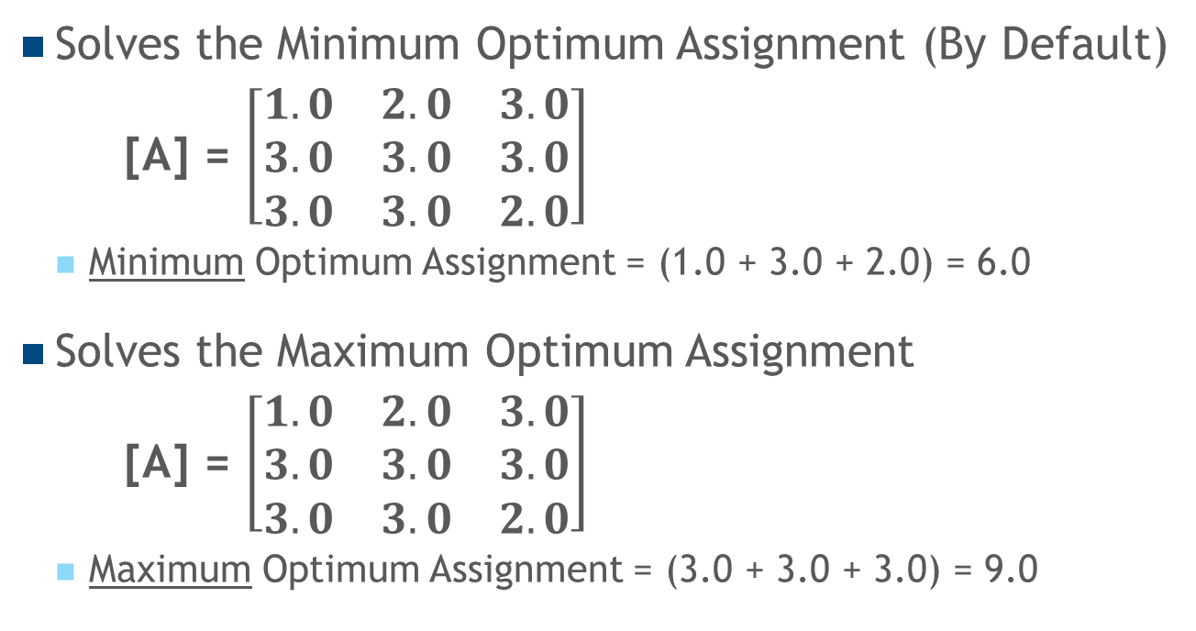
Overview
Solves the Minimum Optimum Assignment (By Default)
[A] = $\left[\begin{matrix}1.0 & 2.0 & 3.0 \\ 3.0 & 3.0 & 3.0 \\ 3.0 & 3.0 & 2.0\end{matrix}\right]$
Minimum Optimum Assignment = (1.0 + 3.0 + 2.0) = 6.0
Solves the Maximum Optimum Assignment
[A] = $\left[\begin{matrix}1.0 & 2.0 & 3.0 \\ 3.0 & 3.0 & 3.0 \\ 3.0 & 3.0 & 2.0\end{matrix}\right]$
Maximum Optimum Assignment = (3.0 + 3.0 + 3.0) = 9.0

Slide 4
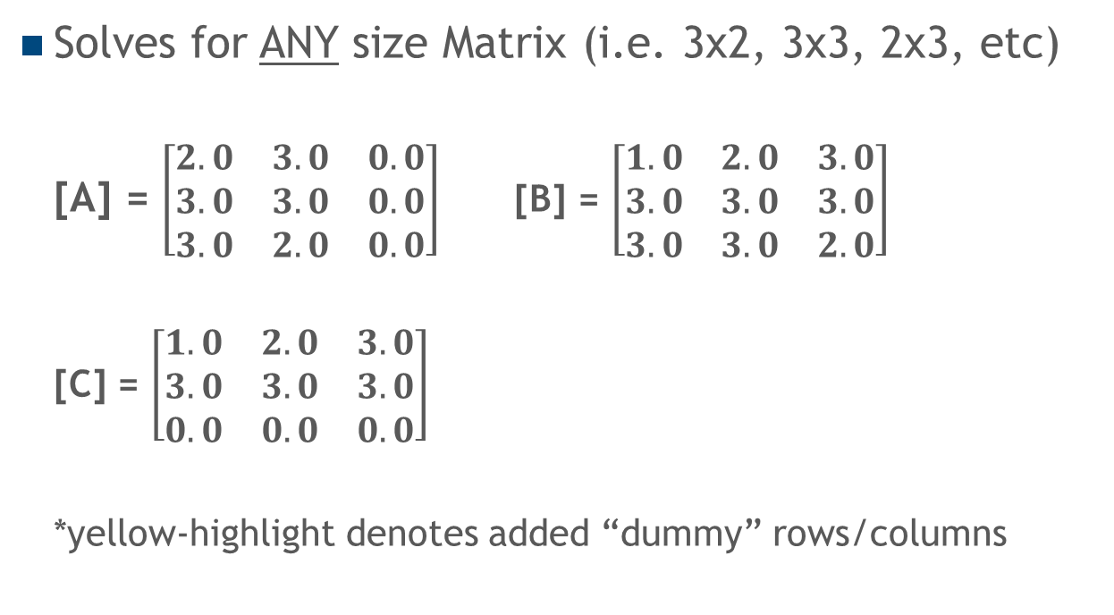
Overview
Solves for ANY size Matrix (i.e. 3x2, 3x3, 2x3, etc)
[A] = $\left[\begin{matrix}2.0 & 3.0 & 0.0 \\ 3.0 & 3.0 & 0.0 \\ 3.0 & 2.0 & 0.0\end{matrix}\right]$[B] = $\left[\begin{matrix}1.0 & 2.0 & 3.0 \\ 3.0 & 3.0 & 3.0 \\ 3.0 & 3.0 & 2.0\end{matrix}\right]$
[C] = $\left[\begin{matrix}1.0 & 2.0 & 3.0 \\ 3.0 & 3.0 & 3.0 \\ 0.0 & 0.0 & 0.0\end{matrix}\right]$
*yellow-highlight denotes added “dummy” rows/columns

Slide 5
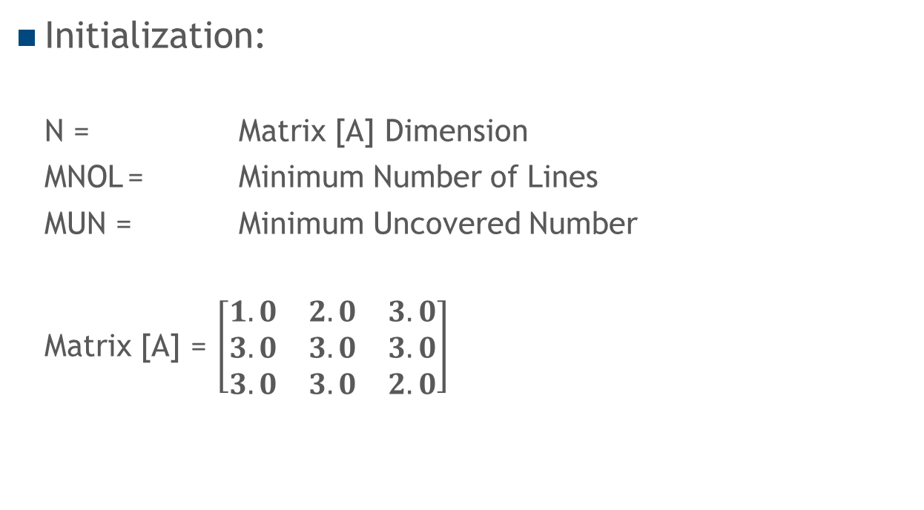
Hungarian Algorithm Steps
Initialization:
N = Matrix [A] Dimension
MNOL = Minimum Number of Lines
MUN = Minimum Uncovered Number
Matrix [A] = $\left[\begin{matrix}1.0 & 2.0 & 3.0 \\ 3.0 & 3.0 & 3.0 \\ 3.0 & 3.0 & 2.0\end{matrix}\right]$

Slide 6
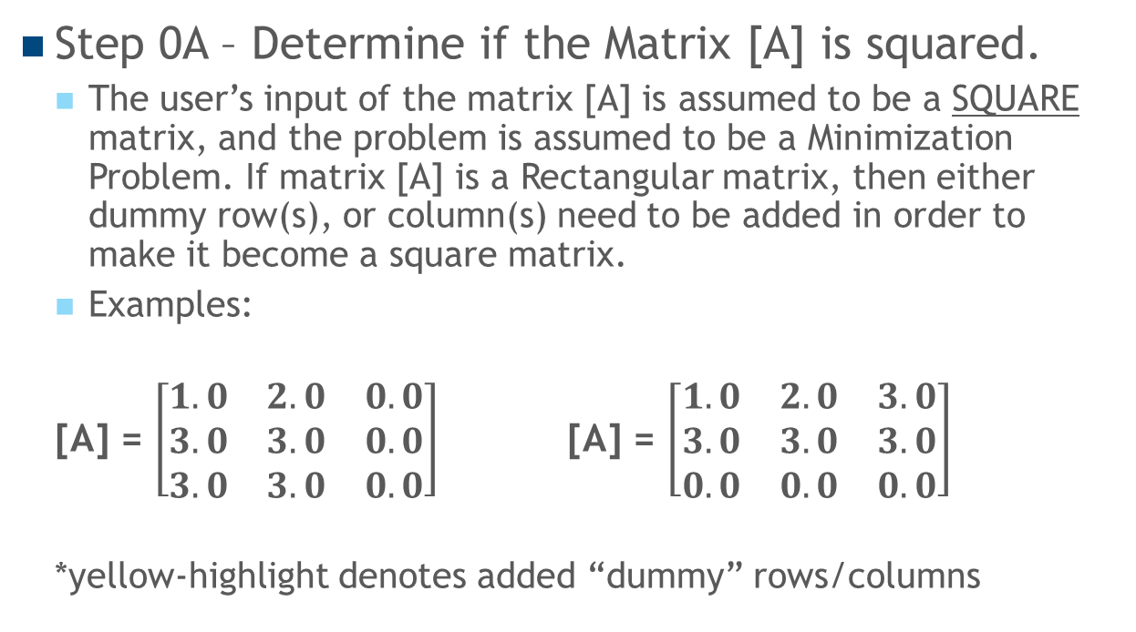
Hungarian Algorithm Steps
Step 0A – Determine if the Matrix [A] is squared.
The user’s input of the matrix [A] is assumed to be a SQUARE matrix, and the problem is assumed to be a Minimization Problem. If matrix [A] is a Rectangular matrix, then either dummy row(s), or column(s) need to be added in order to make it become a square matrix.
Examples:
[A] = $\left[\begin{matrix}1.0 & 2.0 & 0.0 \\ 3.0 & 3.0 & 0.0 \\ 3.0 & 3.0 & 0.0\end{matrix}\right]$ [A] = $\left[\begin{matrix}1.0 & 2.0 & 3.0 \\ 3.0 & 3.0 & 3.0 \\ 0.0 & 0.0 & 0.0\end{matrix}\right]$
*yellow-highlight denotes added “dummy” rows/columns

Slide 7
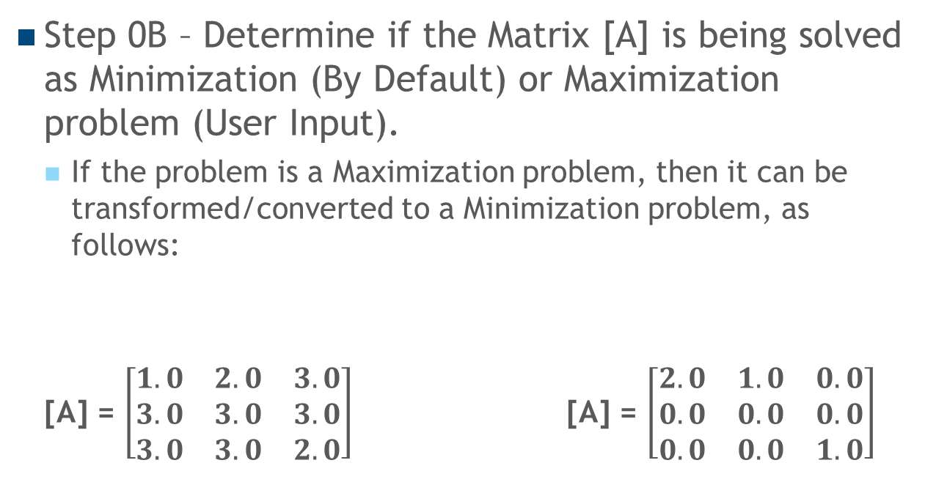
Hungarian Algorithm Steps
Step 0B – Determine if the Matrix [A] is being solved as Minimization (By Default) or Maximization problem (User Input).
If the problem is a Maximization problem, then it can be transformed/converted to a Minimization problem, as follows:
[A] = $\left[\begin{matrix}1.0 & 2.0 & 3.0 \\ 3.0 & 3.0 & 3.0 \\ 3.0 & 3.0 & 2.0\end{matrix}\right]$ [A] = $\left[\begin{matrix}2.0 & 1.0 & 0.0 \\ 0.0 & 0.0 & 0.0 \\ 0.0 & 0.0 & 1.0\end{matrix}\right]$
Replace each cell entry A_{ij} with negative A_{ij} + C,
where C equals the maximum cell value (C = 3)
Maximization matrix
Minimization matrix

Slide 8

Hungarian Algorithm Steps
Step 1 – Subtract each row with its corresponding minimum value in Matrix [A].
[A] = $\left[\begin{matrix}1.0 & 2.0 & 3.0 \\ 3.0 & 3.0 & 3.0 \\ 3.0 & 3.0 & 2.0\end{matrix}\right]$ [A] = $\left[\begin{matrix}0.0 & 1.0 & 2.0 \\ 0.0 & 0.0 & 0.0 \\ 1.0 & 1.0 & 0.0\end{matrix}\right]$

Slide 9

Hungarian Algorithm Steps
Step 2 – Subtract each column with its corresponding minimum value in Matrix [A].
[A] = $\left[\begin{matrix}0.0 & 1.0 & 2.0 \\ 0.0 & 0.0 & 0.0 \\ 1.0 & 1.0 & 0.0\end{matrix}\right]$ [A] = $\left[\begin{matrix}0.0 & 1.0 & 2.0 \\ 0.0 & 0.0 & 0.0 \\ 1.0 & 1.0 & 0.0\end{matrix}\right]$

Slide 10

Hungarian Algorithm Steps
Step 3 - Cover ALL zeros with the MNOL drawn through columns and rows.
[A] = $\left[\begin{matrix}0.0 & 1.0 & 2.0 \\ 0.0 & 0.0 & 0.0 \\ 1.0 & 1.0 & 0.0\end{matrix}\right]$
Cover Column 1 with a line
Cover Column 3 with a line
Cover Row 2 with a line

Slide 11
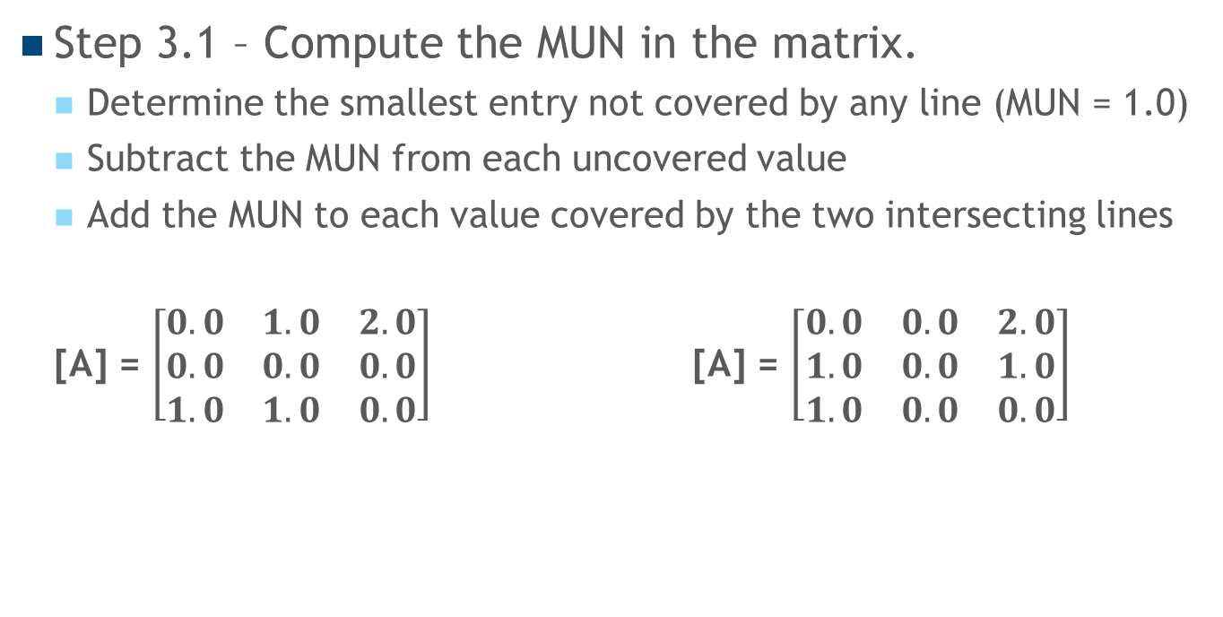
Hungarian Algorithm Steps
Step 3.1 – Compute the MUN in the matrix.
Determine the smallest entry not covered by any line (MUN = 1.0)
Subtract the MUN from each uncovered value
Add the MUN to each value covered by the two intersecting lines
[A] = $\left[\begin{matrix}0.0 & 1.0 & 2.0 \\ 0.0 & 0.0 & 0.0 \\ 1.0 & 1.0 & 0.0\end{matrix}\right]$ [A] = $\left[\begin{matrix}0.0 & 0.0 & 2.0 \\ 1.0 & 0.0 & 1.0 \\ 1.0 & 0.0 & 0.0\end{matrix}\right]$
MUN = 1.0
Rectangles denotes added entries
Ovals denotes subtracted entries

Slide 12
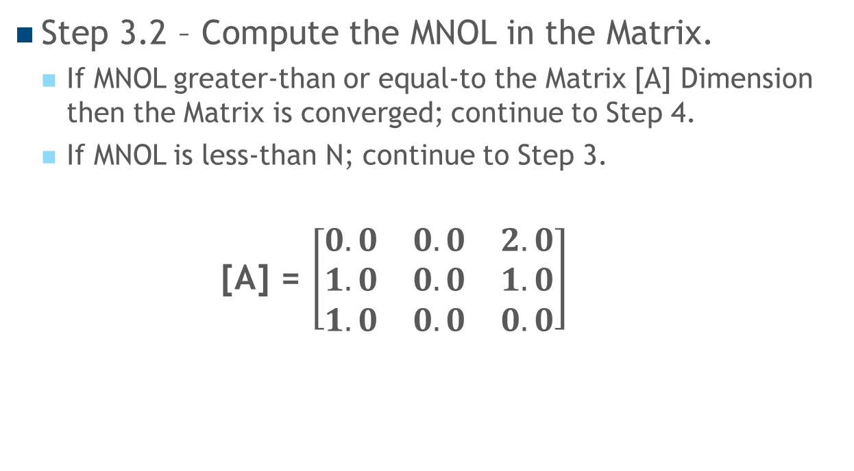
Hungarian Algorithm Steps
Step 3.2 – Compute the MNOL in the Matrix.
If MNOL greater-than or equal-to the Matrix [A] Dimension then the Matrix is converged; continue to Step 4.
If MNOL is less-than N; continue to Step 3.
[A] = $\left[\begin{matrix}0.0 & 0.0 & 2.0 \\ 1.0 & 0.0 & 1.0 \\ 1.0 & 0.0 & 0.0\end{matrix}\right]$
MNOL = 3 is greater-than equal-to N = 3
Matrix [A] is Converged
Continue to Step 4

Slide 13
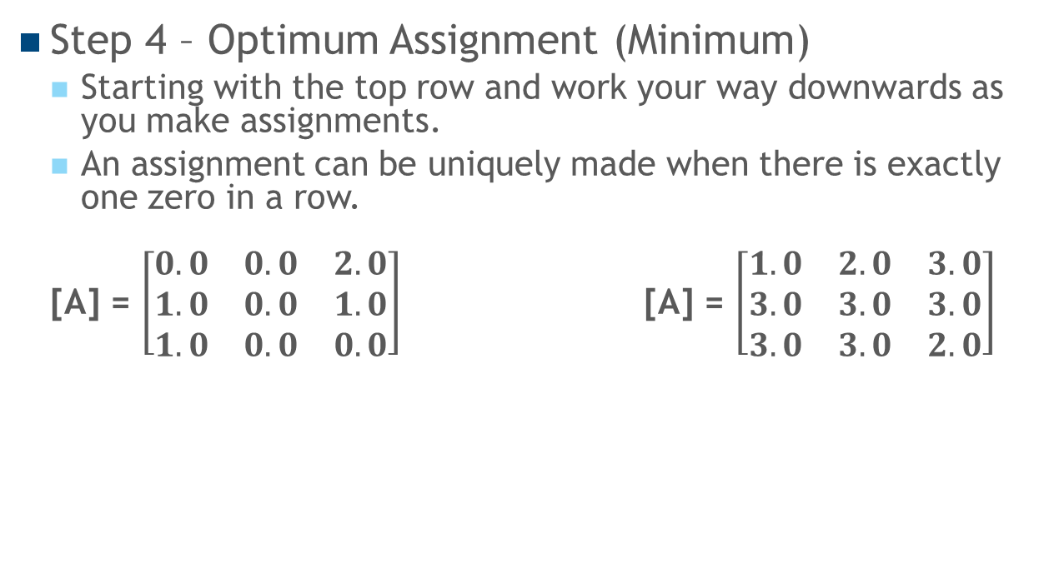
Hungarian Algorithm Steps
Step 4 – Optimum Assignment (Minimum)
Starting with the top row and work your way downwards as you make assignments.
An assignment can be uniquely made when there is exactly one zero in a row.
[A] = $\left[\begin{matrix}0.0 & 0.0 & 2.0 \\ 1.0 & 0.0 & 1.0 \\ 1.0 & 0.0 & 0.0\end{matrix}\right]$ [A] = $\left[\begin{matrix}1.0 & 2.0 & 3.0 \\ 3.0 & 3.0 & 3.0 \\ 3.0 & 3.0 & 2.0\end{matrix}\right]$
Assignment Score
Worker #1 assigned to Job #1 1.0
Worker #2 assigned to Job #2 3.0
Worker #3 assigned to Job #3 2.0
-------
Optimum Minimum Score: 6.0

Slide 14
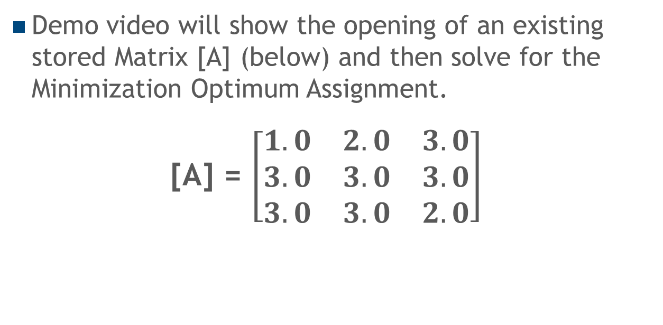
Demo – Minimization Optimum Assignment Problem
Demo video will show the opening of an existing stored Matrix [A] (below) and then solve for the Minimization Optimum Assignment.
[A] = $\left[\begin{matrix}1.0 & 2.0 & 3.0 \\ 3.0 & 3.0 & 3.0 \\ 3.0 & 3.0 & 2.0\end{matrix}\right]$

Slide 15

Demo Video

Slide 16

Questions/Comments
Additional Demos Online: http://www.lions.odu.edu/~imako001/

Slide 17
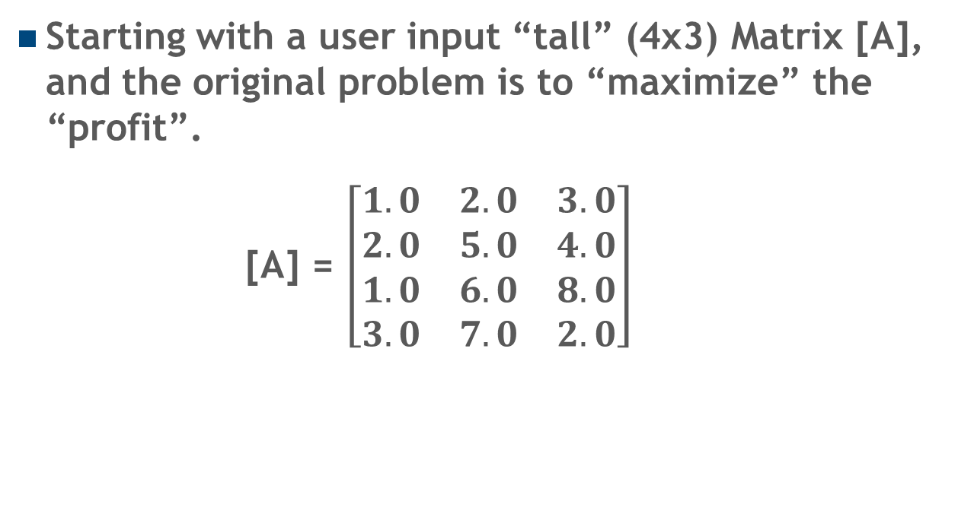
Appendix A: 4x3 Maximization Problem Step-by-Step
Starting with a user input “tall” (4x3) Matrix [A], and the original problem is to “maximize” the “profit”.
[A] = $\left[\begin{matrix}1.0 & 2.0 & 3.0 \\ 2.0 & 5.0 & 4.0 \\ 1.0 & 6.0 & 8.0 \\ 3.0 & 7.0 & 2.0\end{matrix}\right]$

Slide 18
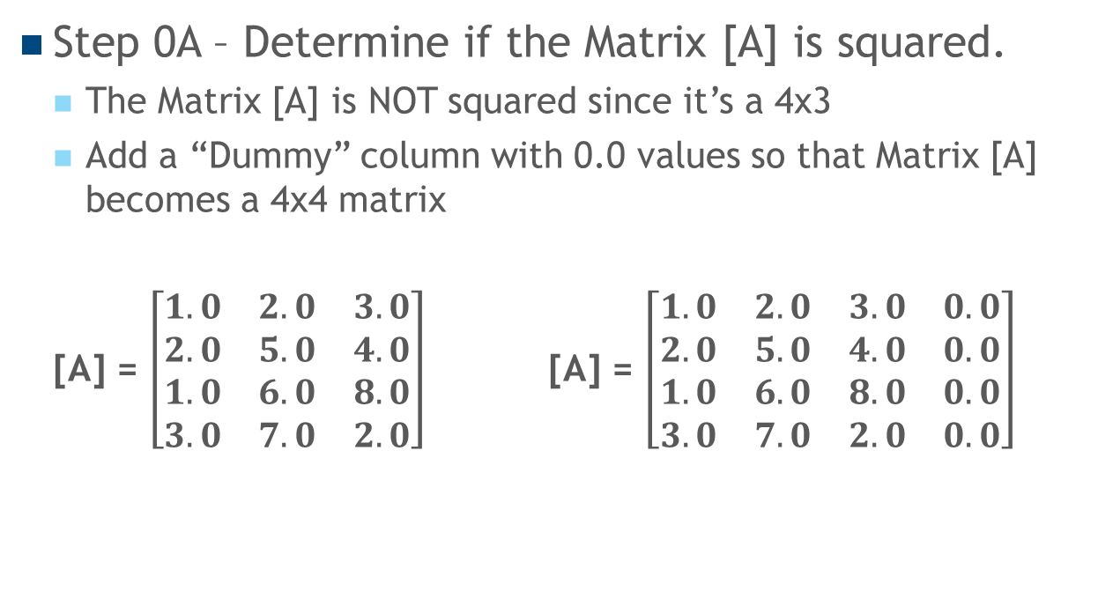
Hungarian Algorithm Steps
Step 0A – Determine if the Matrix [A] is squared.
The Matrix [A] is NOT squared since it’s a 4x3
Add a “Dummy” column with 0.0 values so that Matrix [A] becomes a 4x4 matrix
[A] = $\left[\begin{matrix}1.0 & 2.0 & 3.0 \\ 2.0 & 5.0 & 4.0 \\ 1.0 & 6.0 & 8.0 \\ 3.0 & 7.0 & 2.0\end{matrix}\right]$ [A] = $\left[\begin{matrix}1.0 & 2.0 & 3.0 & 0.0 \\ 2.0 & 5.0 & 4.0 & 0.0 \\ 1.0 & 6.0 & 8.0 & 0.0 \\ 3.0 & 7.0 & 2.0 & 0.0\end{matrix}\right]$
*yellow-highlight denotes the added “dummy” columns with zeros

Slide 19
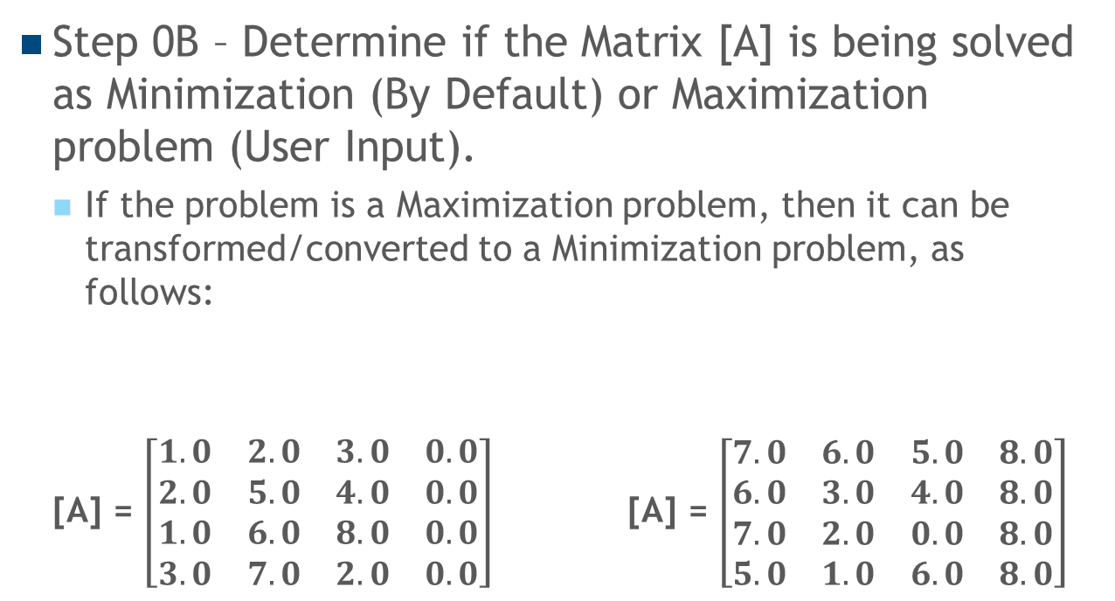
Hungarian Algorithm Steps
Step 0B – Determine if the Matrix [A] is being solved as Minimization (By Default) or Maximization problem (User Input).
If the problem is a Maximization problem, then it can be transformed/converted to a Minimization problem, as follows:
[A] = $\left[\begin{matrix}1.0 & 2.0 & 3.0 & 0.0 \\ 2.0 & 5.0 & 4.0 & 0.0 \\ 1.0 & 6.0 & 8.0 & 0.0 \\ 3.0 & 7.0 & 2.0 & 0.0\end{matrix}\right]$ [A] = $\left[\begin{matrix}7.0 & 6.0 & 5.0 & 8.0 \\ 6.0 & 3.0 & 4.0 & 8.0 \\ 7.0 & 2.0 & 0.0 & 8.0 \\ 5.0 & 1.0 & 6.0 & 8.0\end{matrix}\right]$
Replace each cell entry A_{ij} with negative A_{ij} + C,
where C equals the maximum cell value (C = 8)
Maximization matrix
Minimization matrix

Slide 20
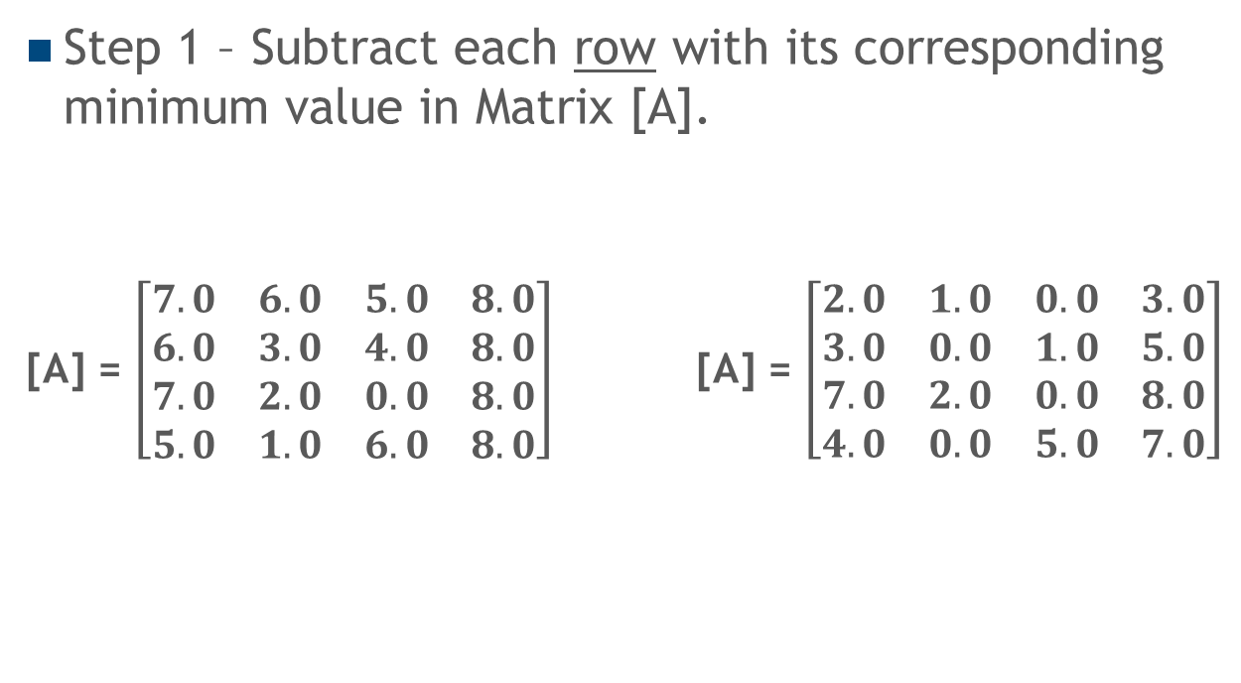
Hungarian Algorithm Steps
Step 1 – Subtract each row with its corresponding minimum value in Matrix [A].
[A] = $\left[\begin{matrix}7.0 & 6.0 & 5.0 & 8.0 \\ 6.0 & 3.0 & 4.0 & 8.0 \\ 7.0 & 2.0 & 0.0 & 8.0 \\ 5.0 & 1.0 & 6.0 & 8.0\end{matrix}\right]$ [A] = $\left[\begin{matrix}2.0 & 1.0 & 0.0 & 3.0 \\ 3.0 & 0.0 & 1.0 & 5.0 \\ 7.0 & 2.0 & 0.0 & 8.0 \\ 4.0 & 0.0 & 5.0 & 7.0\end{matrix}\right]$
Subtract 5.0 from each value in Row 1
Subtract 3.0 from each value in Row 2
Subtract 0.0 from each value in Row 3
Subtract 1.0 from each value in Row 4

Slide 21
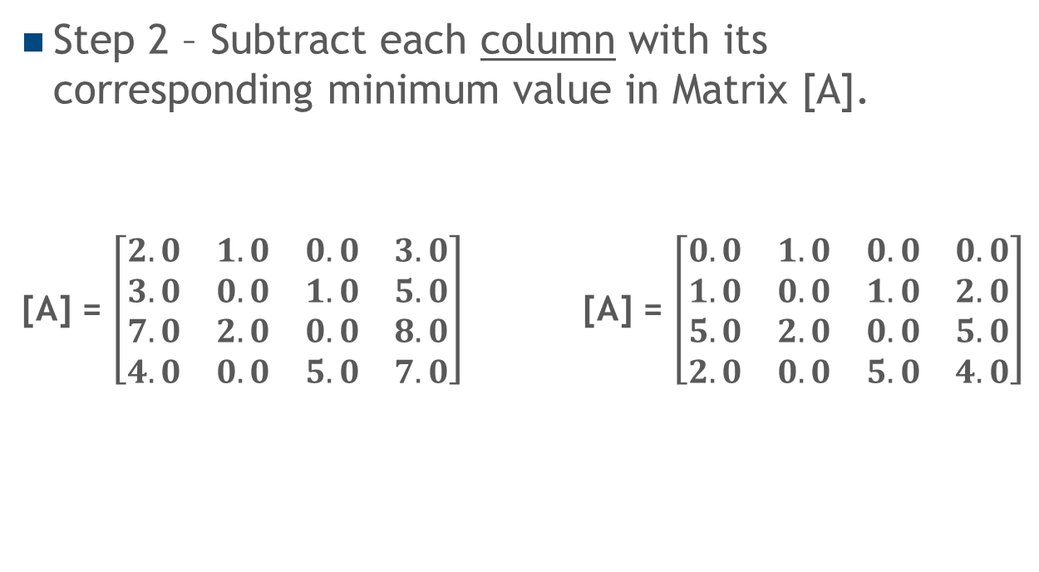
Hungarian Algorithm Steps
Step 2 – Subtract each column with its corresponding minimum value in Matrix [A].
[A] = $\left[\begin{matrix}2.0 & 1.0 & 0.0 & 3.0 \\ 3.0 & 0.0 & 1.0 & 5.0 \\ 7.0 & 2.0 & 0.0 & 8.0 \\ 4.0 & 0.0 & 5.0 & 7.0\end{matrix}\right]$ [A] = $\left[\begin{matrix}0.0 & 1.0 & 0.0 & 0.0 \\ 1.0 & 0.0 & 1.0 & 2.0 \\ 5.0 & 2.0 & 0.0 & 5.0 \\ 2.0 & 0.0 & 5.0 & 4.0\end{matrix}\right]$
Subtract 2.0 from each value in Column 1
Subtract 0.0 from each value in Column 2
Subtract 0.0 from each value in Column 3
Subtract 3.0 from each value in Column 4

Slide 22
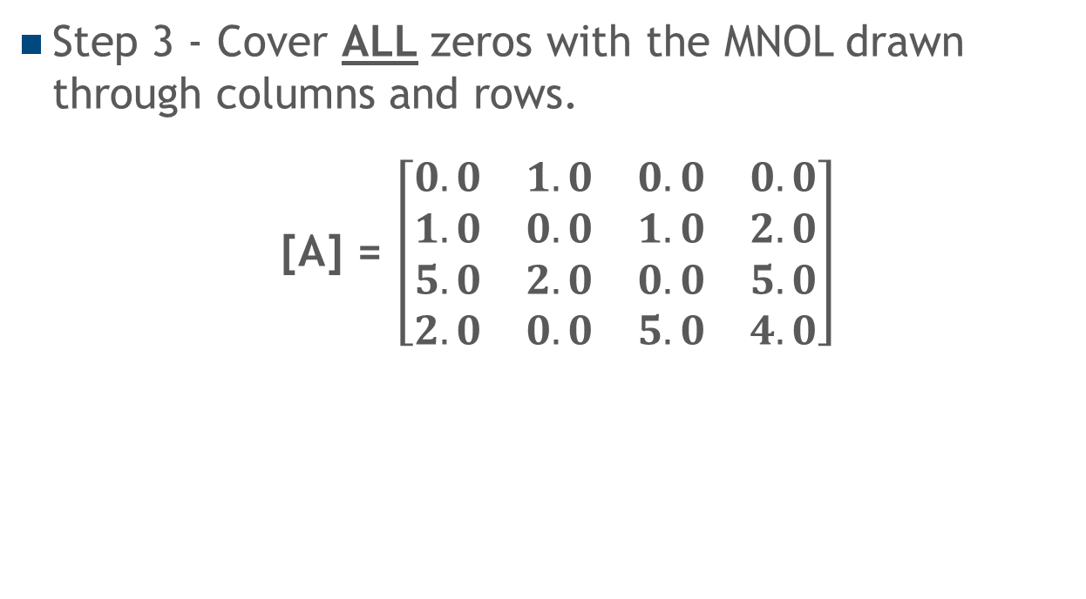
Hungarian Algorithm Steps
Step 3 - Cover ALL zeros with the MNOL drawn through columns and rows.
[A] = $\left[\begin{matrix}0.0 & 1.0 & 0.0 & 0.0 \\ 1.0 & 0.0 & 1.0 & 2.0 \\ 5.0 & 2.0 & 0.0 & 5.0 \\ 2.0 & 0.0 & 5.0 & 4.0\end{matrix}\right]$
Cover Column 2 with a line
Cover Column 3 with a line
Cover Row 1 with a line

Slide 23
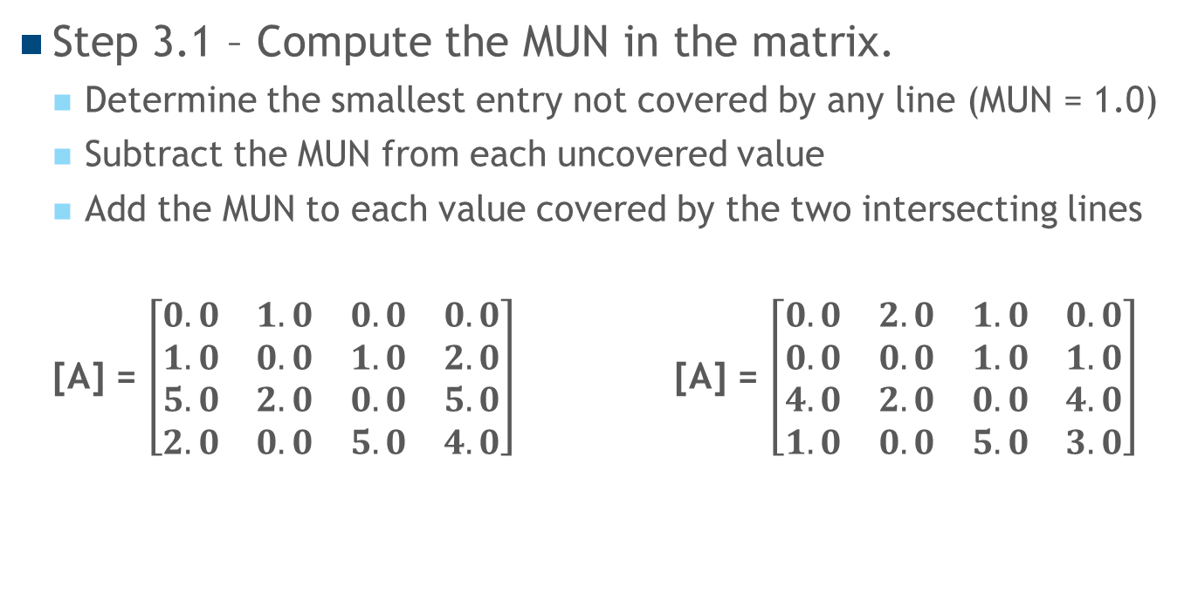
Hungarian Algorithm Steps
Step 3.1 – Compute the MUN in the matrix.
Determine the smallest entry not covered by any line (MUN = 1.0)
Subtract the MUN from each uncovered value
Add the MUN to each value covered by the two intersecting lines
[A] = $\left[\begin{matrix}0.0 & 1.0 & 0.0 & 0.0 \\ 1.0 & 0.0 & 1.0 & 2.0 \\ 5.0 & 2.0 & 0.0 & 5.0 \\ 2.0 & 0.0 & 5.0 & 4.0\end{matrix}\right]$ [A] = $\left[\begin{matrix}0.0 & 2.0 & 1.0 & 0.0 \\ 0.0 & 0.0 & 1.0 & 1.0 \\ 4.0 & 2.0 & 0.0 & 4.0 \\ 1.0 & 0.0 & 5.0 & 3.0\end{matrix}\right]$
MUN = 1.0
Rectangles denotes added entries
Ovals denotes subtracted entries

Slide 24
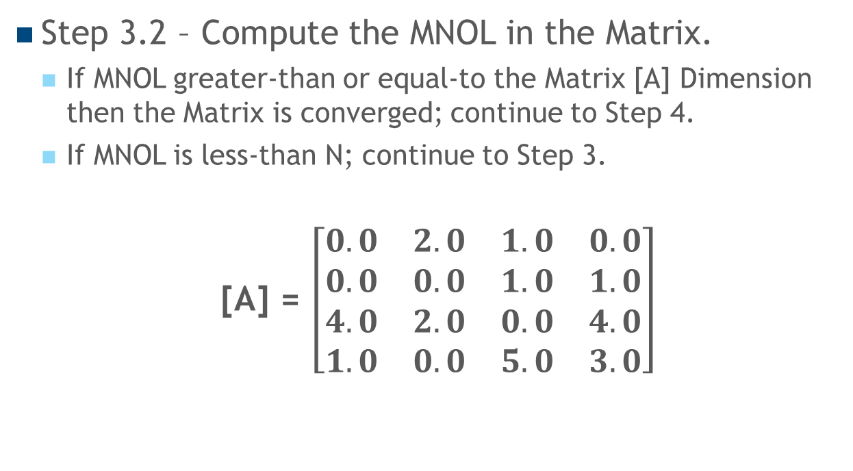
Hungarian Algorithm Steps
Step 3.2 – Compute the MNOL in the Matrix.
If MNOL greater-than or equal-to the Matrix [A] Dimension then the Matrix is converged; continue to Step 4.
If MNOL is less-than N; continue to Step 3.
[A] = $\left[\begin{matrix}0.0 & 2.0 & 1.0 & 0.0 \\ 0.0 & 0.0 & 1.0 & 1.0 \\ 4.0 & 2.0 & 0.0 & 4.0 \\ 1.0 & 0.0 & 5.0 & 3.0\end{matrix}\right]$
MNOL = 3 is NOT greater-than equal-to N = 4
Matrix [A] is NOT Converged
Clear ALL lines & Repeat Step 3

Slide 25
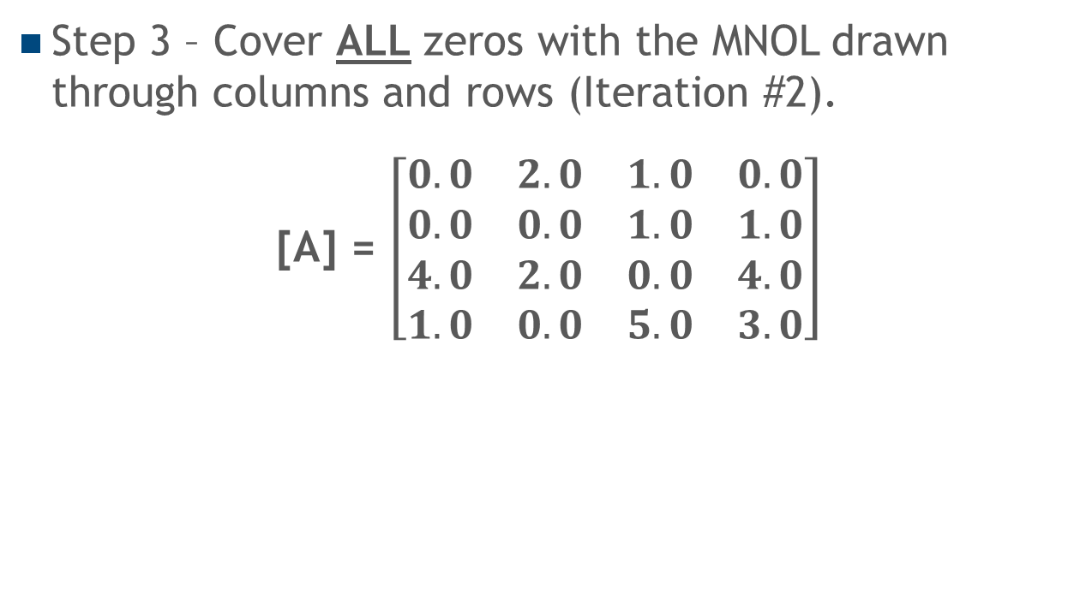
Hungarian Algorithm Steps
Step 3 – Cover ALL zeros with the MNOL drawn through columns and rows (Iteration #2).
[A] = $\left[\begin{matrix}0.0 & 2.0 & 1.0 & 0.0 \\ 0.0 & 0.0 & 1.0 & 1.0 \\ 4.0 & 2.0 & 0.0 & 4.0 \\ 1.0 & 0.0 & 5.0 & 3.0\end{matrix}\right]$
Cover Column 3 with a line
Cover Column 2 with a line
Cover Row 1 with a line
Cover Column 1 with a line

Slide 26
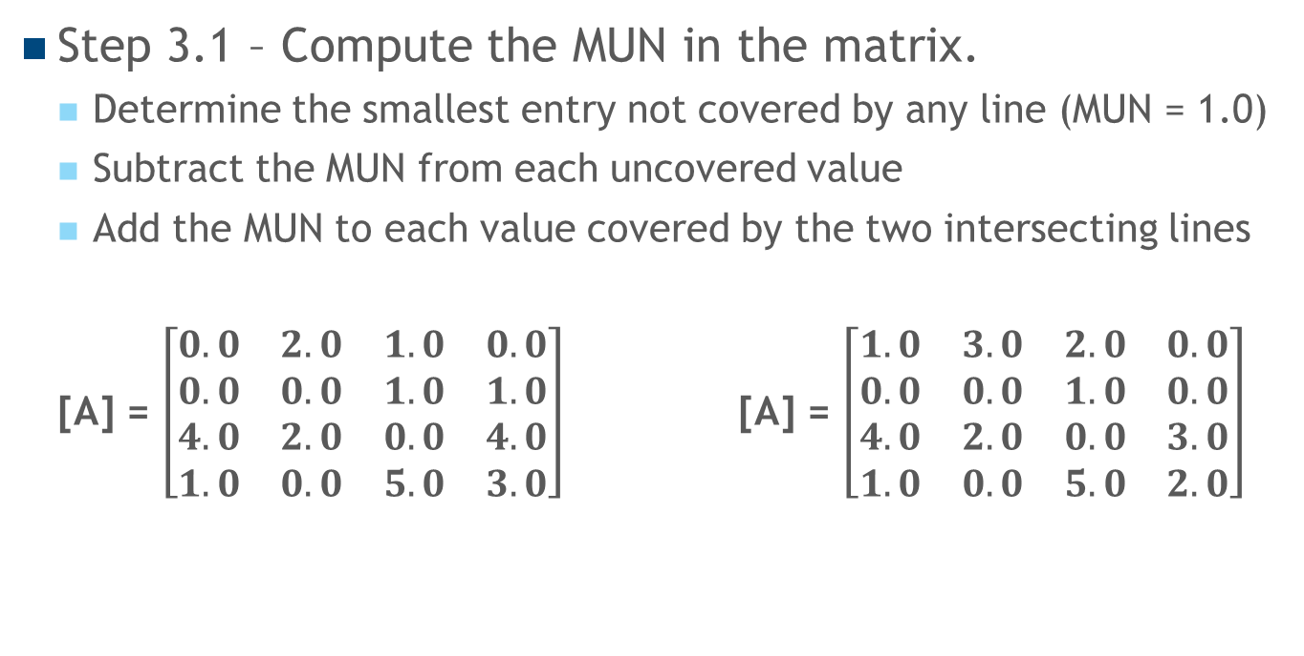
Hungarian Algorithm Steps
Step 3.1 – Compute the MUN in the matrix.
Determine the smallest entry not covered by any line (MUN = 1.0)
Subtract the MUN from each uncovered value
Add the MUN to each value covered by the two intersecting lines
[A] = $\left[\begin{matrix}0.0 & 2.0 & 1.0 & 0.0 \\ 0.0 & 0.0 & 1.0 & 1.0 \\ 4.0 & 2.0 & 0.0 & 4.0 \\ 1.0 & 0.0 & 5.0 & 3.0\end{matrix}\right]$ [A] = $\left[\begin{matrix}1.0 & 3.0 & 2.0 & 0.0 \\ 0.0 & 0.0 & 1.0 & 0.0 \\ 4.0 & 2.0 & 0.0 & 3.0 \\ 1.0 & 0.0 & 5.0 & 2.0\end{matrix}\right]$
MUN = 1.0
Rectangles denotes added entries
Ovals denotes subtracted entries

Slide 27
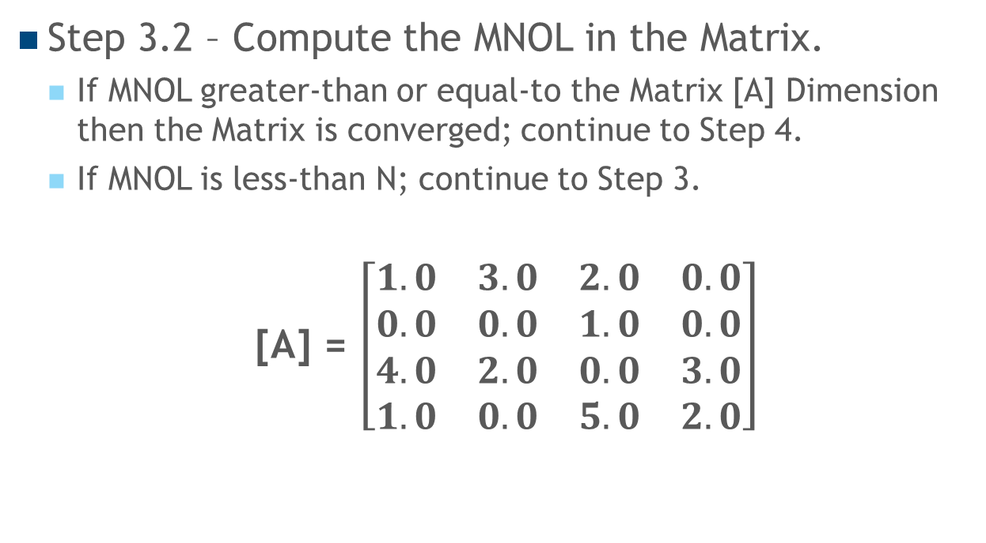
Hungarian Algorithm Steps
Step 3.2 – Compute the MNOL in the Matrix.
If MNOL greater-than or equal-to the Matrix [A] Dimension then the Matrix is converged; continue to Step 4.
If MNOL is less-than N; continue to Step 3.
[A] = $\left[\begin{matrix}1.0 & 3.0 & 2.0 & 0.0 \\ 0.0 & 0.0 & 1.0 & 0.0 \\ 4.0 & 2.0 & 0.0 & 3.0 \\ 1.0 & 0.0 & 5.0 & 2.0\end{matrix}\right]$
MNOL = 4 is greater-than equal-to N = 4
Matrix [A] is Converged
Continue to Step 4

Slide 28
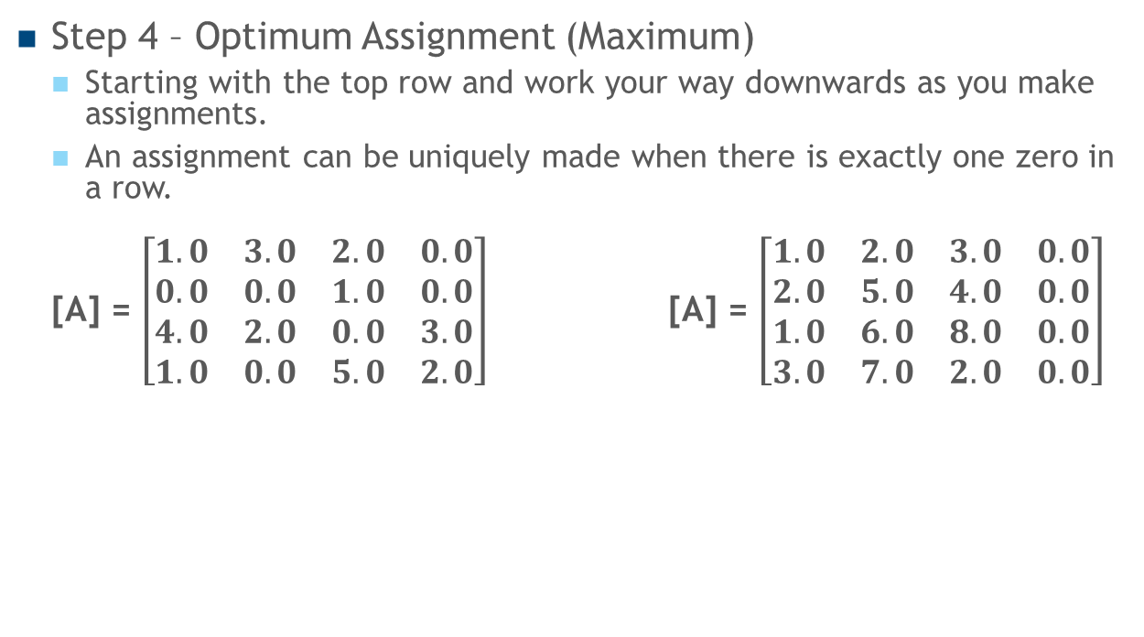
Hungarian Algorithm Steps
Step 4 – Optimum Assignment (Maximum)
Starting with the top row and work your way downwards as you make assignments.
An assignment can be uniquely made when there is exactly one zero in a row.
[A] = $\left[\begin{matrix}1.0 & 3.0 & 2.0 & 0.0 \\ 0.0 & 0.0 & 1.0 & 0.0 \\ 4.0 & 2.0 & 0.0 & 3.0 \\ 1.0 & 0.0 & 5.0 & 2.0\end{matrix}\right]$ [A] = $\left[\begin{matrix}1.0 & 2.0 & 3.0 & 0.0 \\ 2.0 & 5.0 & 4.0 & 0.0 \\ 1.0 & 6.0 & 8.0 & 0.0 \\ 3.0 & 7.0 & 2.0 & 0.0\end{matrix}\right]$
Assignment Score
Worker #1 assigned to Job #4 0.0
Worker #2 assigned to Job #1 2.0
Worker #3 assigned to Job #3 8.0
Worker #4 assigned to Job #2 7.0
-------
Optimum Maximum Score: 17.0

