Slide 1
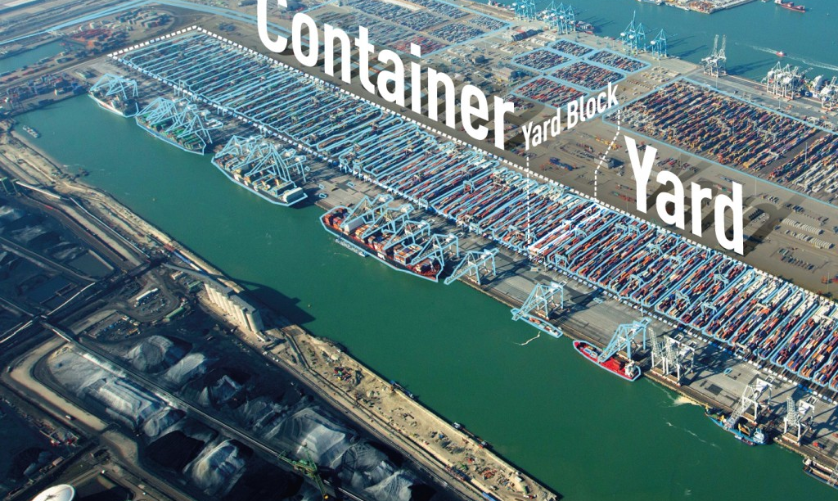

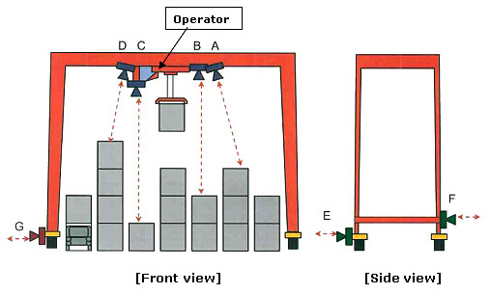

Transportation Research Board (TRB) Conference
Unloading and Pre-Marshalling Algorithms with Java Computer Animation for Terminal Yard Operations January 10-14, 2016
Ivan Makohon
Graduate Student*
Modeling, Simulation & Visualization Engineering (MSVE) Department
Phone: 757-481-0832
imako001@odu.edu
Mecit Cetin (corresponding author)
Associate Professor*
Civil & Environmental Engineering (CEE) Department
Phone: 757-683-6700
mcetin@odu.edu
Manwo Ng
Assistant Professor*
Department of Information Technology and Decision Sciences
Phone: 757-683-6665
mng@odu.edu
Duc T. Nguyen
Professor*
CEE and MSVE Departments
Phone: 757-683-3761
dnguyen@odu.edu
*Old Dominion University

Slide 2

Abstract
Unloading and pre-marshalling (or reshuffling) operations have been considered as basic/important tasks in port terminals’ activities, since the economic impacts can be significant. The primary goal for this paper is to develop simple heuristic unloading and pre-marshalling algorithms. Detailed explanations for the proposed algorithms are given in the form of step-by-step numerical procedures, so that the reported results can be reproduced by the readers. Several numerical examples (including the ones considered by other researchers) are used to validate the proposed unloading and pre-marshalling algorithms.
A secondary goal for this paper is to develop a user-friendly and easy-to-use Java Graphical User Interface (GUI) software application that provides precise and clear step-by-step instructions with visual animation and voice for the unloading and pre-marshalling algorithms for Terminal Container Yard operations. The developed Java software can be used as an additional/educational tool that would serve both academia students and transportation professionals in solving any complex dynamic Terminal Container Yard layout visually with provided steps to show the “final/optimal” results. A demo video of the both the unloading and pre-marshalling algorithm’s animation and result can be viewed online from any web browser using the website provided in reference [4].
Keywords: Terminal, Yard, Cargo, Container, Unloading, Pre-marshalling, Reshuffling, Algorithm, Java, Animation

Slide 3
Overview (1 of 2)
Container Terminal Yard Operations:
  Quay Crane (Port-side) unload cargo containers from docked vessels pier side to horizontal transport trucks which transports them to the container yards.
  Container Yards are storage yards for cargo containers.
  Container trucks transport cargo containers to their destinations.
Quay Crane (Port Side)
Container Yard
Transport
(Horizontal)
Yard Crane
Container Truck
Vessel

Slide 4
Overview (1 of 2)
Container Terminal Yard:
  Crane The yard crane that services bays.
  Bay Contains a set of container stacks.
  Stack Contains stackable cargo containers up to MNCPS.
  Tier Height (level) of the stack.
Container Yard
Yard Crane
Legend
Bay
Stack
Tier

Slide 5
Introduction
Container Terminal Yards are an import storage point since it links the seaside with landside transportation. It’s an important storage point for loading/unloading cargo containers between vessels and vehicles (i.e. trucks or trains) for further distribution.
Increasing traffic of cargo container shipments around the world which is why critical planning decision with great importance is needed for optimizing the terminal container yard’s unloading and pre-marshalling (or reshuffling) for cargo containers within the container yard.
Very similar to the Blocks World planning domain problem which consists of a finite number of blocks stacked into columns. The goal is to turn the initial state into a goal state with the minimal number of moves. This would save time in port operations which would lead to significant economic gains.
Two algorithms (unloading and pre-marshalling) are revisited with the primary goal to demonstrate simple heuristic algorithm for port operations to visually showing step-by-step animation to solve for the unloading and pre-marshalling problem.

Slide 6
Unloading Algorithm
The Unloading Algorithm approach is based upon having the container stacks reshuffled to get to the priority cargo container when a vehicle arrives.
  When a vehicle arrives for pick up, the container stack is then reshuffled to get to the priority cargo container so that it can be unloaded onto the vehicle.
  The container stacks remain the same until the next vehicle arrives.

Slide 7
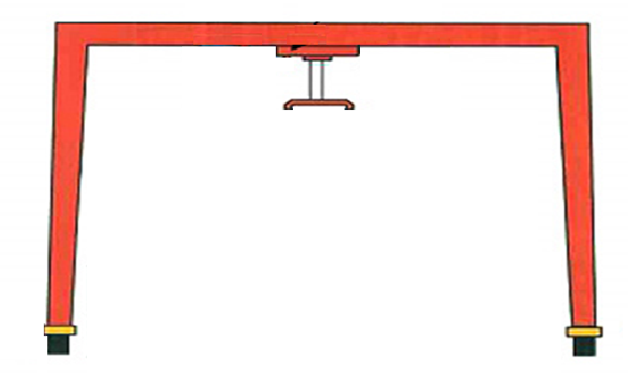
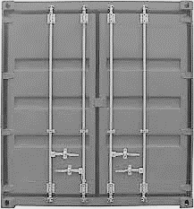
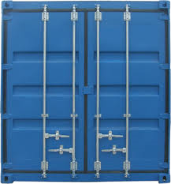
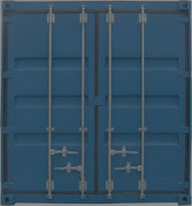

Unloading Algorithm (1 of 5)
4
4
8
2
6
1
8
8
2
6
1
7
5
3
1
7
5
3
  Initial Layout
  NS = 4, MNCPS = 3
  NS > MNCPS
  NM = 0, NR = 0
  Move 8 to Stack 2
  Unload 1
  NM = 1, NR = 1

Slide 8
Unloading Algorithm (2 of 5)
4
6
2
8
2
6
3
8
6
4
7
5
3
4
7
5
3
  Move 4 to Stack 1
  Unload 2
  NM = 2, NR = 2
  Move 6 to Stack 2
  Unload 3
  NM = 3, NR = 3

Slide 9
Unloading Algorithm (3 of 5)
6
6
4
8
5
8
4
7
5
7
5
5
  Unload 4
  NM = 3, NR = 4
  Unload 5
  NM = 3, NR = 5

Slide 10
Unloading Algorithm (4 of 5)
6
6
8
7
8
7
8
7
  Unload 6
  NM = 3, NR = 6
  Move 8 to Stack 1
  Unload 7
  NM = 4, NR = 7

Slide 11
Unloading Algorithm (5 of 5)
8
8
  Unload 8
  NM = 4, NR = 8
  Done Unloading
  NM = 4, NR = 8

Slide 12
Unloading Algorithm (1 of 4)
Layout Validation: Determine if there’s enough empty spaces to perform the algorithm.
  If the number of available empty spaces (NAES) is greater-than or equal to the number of empty spaces required (NESR) minus 1. The NESR-1 should allow us to get to the priority cargo container for removal.
  If the number of container stack (NS) is greater-than 1 container stacks. Need at least 2 or more container stacks to be able to do unloading. NAES should provide enough empty spaces initially to get to the priority cargo container if it’s on the bottom.

Slide 13
Unloading Algorithm (2 of 4)
Step 0: Initialization
  Initialize the Number of Stacks (NS)
  Initialize the Maximum Number of Containers Per Stack (MNCPS)
  Initialize the initial stack layout
  Initialized variable for determining the number of spaces available
Step 1: Verify the Number of available spaces required (do only once)
  Simple check to determine if number available spaces is greater-than equal to the number of number of empty spaces required (in our case we use MNCPS)

Slide 14
Unloading Algorithm (3 of 4)
Step 2: Find next cargo container to be removed
Step 2.1: Determine if cargo container is on top of the stack
  If stacks are empty
    We are done.
  Else if next cargo container to be removed is on top
    Proceed to Step 4: Remove Container
  Else if next cargo container not on top
    Proceed to Step 3: Move Container
  Proceed to Step 2: Find next cargo container to be removed

Slide 15
Unloading Algorithm (4 of 4)
Step 3: Move Container
  Determine the stack with the highest-lowest cargo container
  Move cargo container to that stack
Step 4: Remove Container
  Remove (pop) the cargo container from the stack

Slide 16
Pre-Marshalling (Reshuffling) Algorithm
The pre-marshalling (reshuffling) algorithm approach is based on having the container stacks ordered before the first vehicle arrives so that the priority container is on top.
  No more reshuffling is required since the container stacks are reshuffled with the priority containers on top prior to the first vehicle arriving.
  As each vehicle arrives, the priority container is on top and is unloading onto the vehicle.

Slide 17
Pre-Marshalling Algorithm (1 of 3)
4
4
8
2
6
8
6
2
6
1
7
5
3
1
7
5
3
  Initial Layout
  NS = 4; MNCPS = 3
  NS > MNCPS
  NM = 0, NR = 0
  Move 6 to Stack 2
  NM = 1, NR = 0

Slide 18
Pre-Marshalling Algorithm (2 of 3)
3
4
3
4
8
6
2
8
6
2
1
7
5
3
1
7
5
8
  Move 3 to Stack 2
  NM = 2, NR = 0
  Move 8 to Stack 4
  NM = 3, NR = 0

Slide 19
Pre-Marshalling Algorithm (3 of 3)
3
4
3
6
2
4
6
2
4
1
7
5
8
1
7
5
8
  Move 4 to Stack 4
  NM = 4, NR = 0
  Done Reshuffling
  Begin Unloading
  NM = 4, NR = 0 → 8

Slide 20
Pre-Marshalling Algorithm (1 of 4)
Layout Validation: Determine if there’s enough empty spaces to perform the algorithm.
  If the number of available empty spaces (NAES) is greater-than or equal to the number of empty spaces required (NESR). Need NAES in order to do reshuffling without removal.
  If the number of container stacks (NS) is greater-than 2 container stacks. Need at least 3 or more container stacks to be able to do reshuffling. Note: some layouts can be solved without these validations for reshuffling, though these verifications avoid deadlock cases.

Slide 21
Pre-Marshalling Algorithm (2 of 4)
Step 0: Initialization
  Initialize the Number of Stacks (NS)
  Initialize the Maximum Number of Containers Per Stack (MNCPS)
  Initialize the initial stack layout
  Initialized variable for determining the number of spaces available
Step 1: Verify the Number of available spaces required (do only once)
  Simple check to determine if number available spaces is greater-than equal to the number of number of empty spaces required (in our case we use MNCPS)

Slide 22
Pre-Marshalling Algorithm (3 of 4)
Step 2: Reshuffle Stacks
  Determine if all the stacks are in order, if so proceed to Step 4: Removing Containers From Stacks.
  Calculate costs for all stacks (determine the number of moves)
  Find container with the lowest cost value (number of moves).
  If cost value is greater-than 0.0
    Perform Step 2.1
  Else if cost is equal-to 0.0
    Perform Step 3: Move Containers (info is provided from Calculating Costs for all stacks)
  Perform Step 2: Reshuffle Stacks (Recursion)
Step 2.1: Determine if there’s a Stack with One container that can be moved
  If so then try to find a stack that’s in order with a container with the highest-lowest container that this container being moved. Also, check stack to determine if it’s less-than MNCPS.

Slide 23
Pre-Marshalling Algorithm (4 of 4)
Step 3: Move Container
  Move cargo container to container stack. Basically, removes (pops) the cargo container from the existing (source) stack and adds (pushes) it to the new (destination) stack.
Step 4: Removing Containers From Stacks
  Stack should be in order (lowest (on top) and highest (on bottom)).
  Loop through container stack and find the next lowest cargo container to be removed.

Slide 24
Java Computer Animation (1 of 3)
A user-friendly and easy-to-use Java Graphical User Interface (GUI) software application that provides precise and clear step-by-step instructions with visual animation and voice for the unloading and pre-marshalling algorithms for Terminal Container Yard operations.
The software can be used as an additional/educational tool that would serve both academia students and transportation professionals in solving any complex dynamic Terminal Container Yard layout visually with provided steps to show the “final/optimal” results.

Slide 25
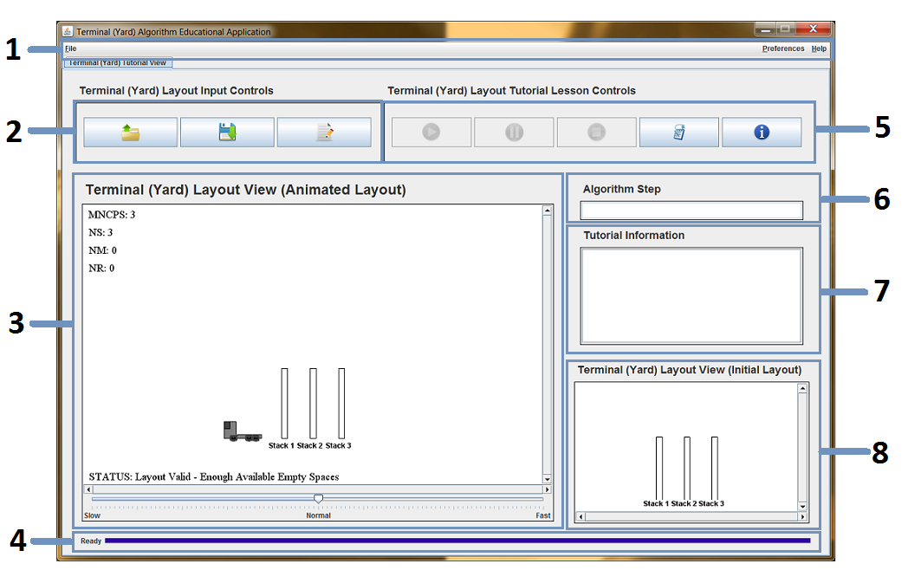
Java Computer Animation (2 of 3)
MAIN Graphical User Interface (GUI):
Menu Buttons (File, Preferences, and Help)
Input Control Buttons
Terminal Yard Layout (Animation View)
Status View
Lesson Control Buttons
Algorithm Step
Tutorial Information View
Terminal Yard Layout (Initial View)

Slide 26
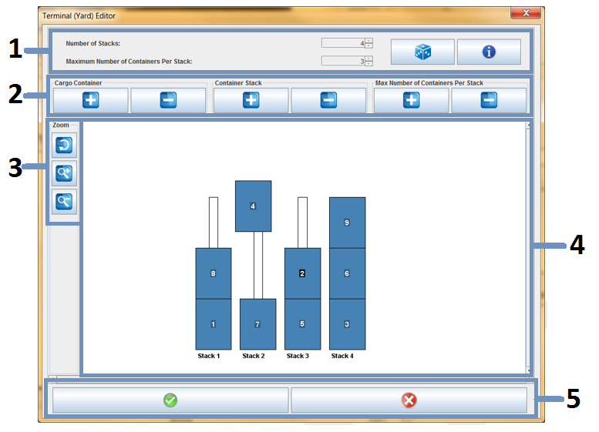
Java Computer Animation (3 of 3)
Terminal Yard Editor GUI:
Display & Information View
Editor Buttons
Zoom Buttons
Visualization Editor View
Confirmation/Close Button

Slide 27
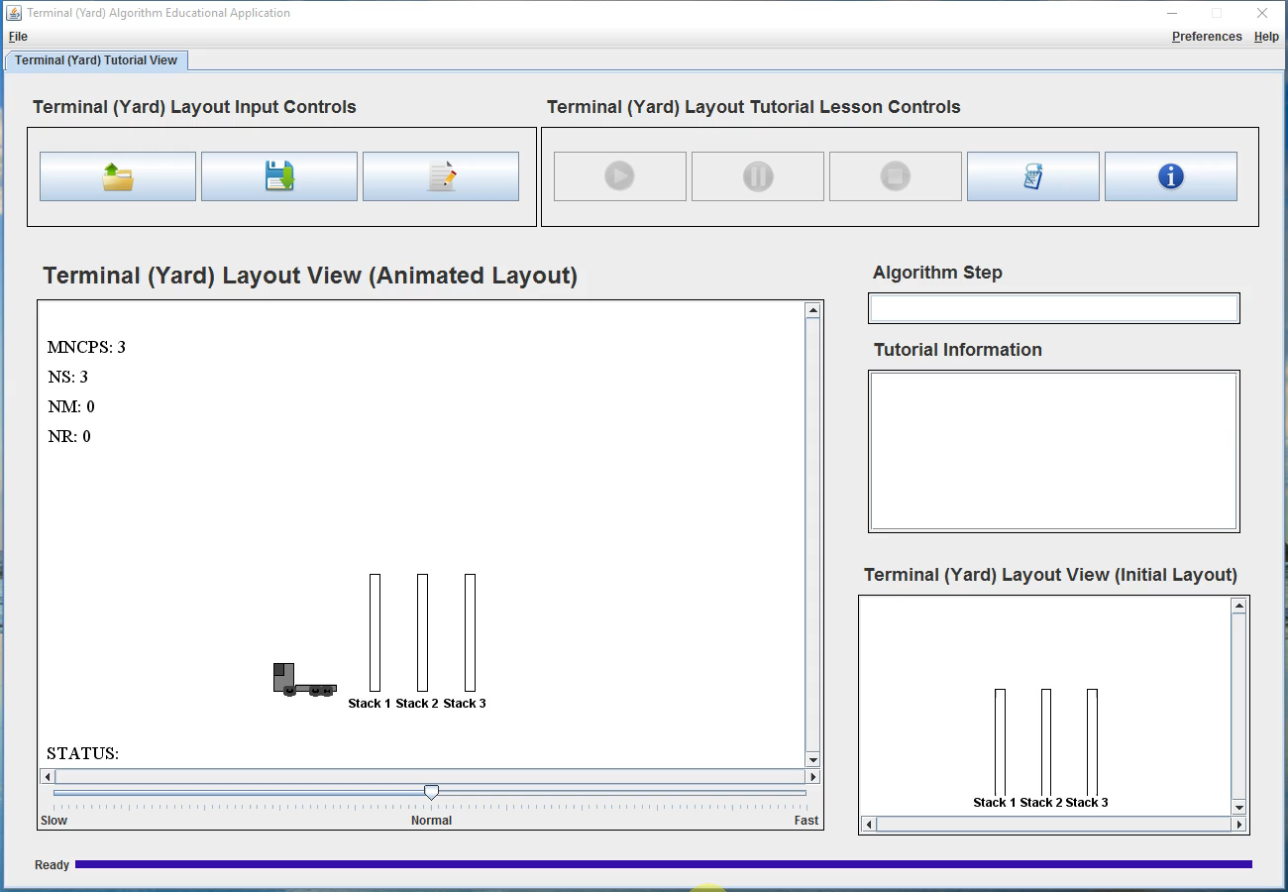
Unloading Algorithm Demo

Slide 28
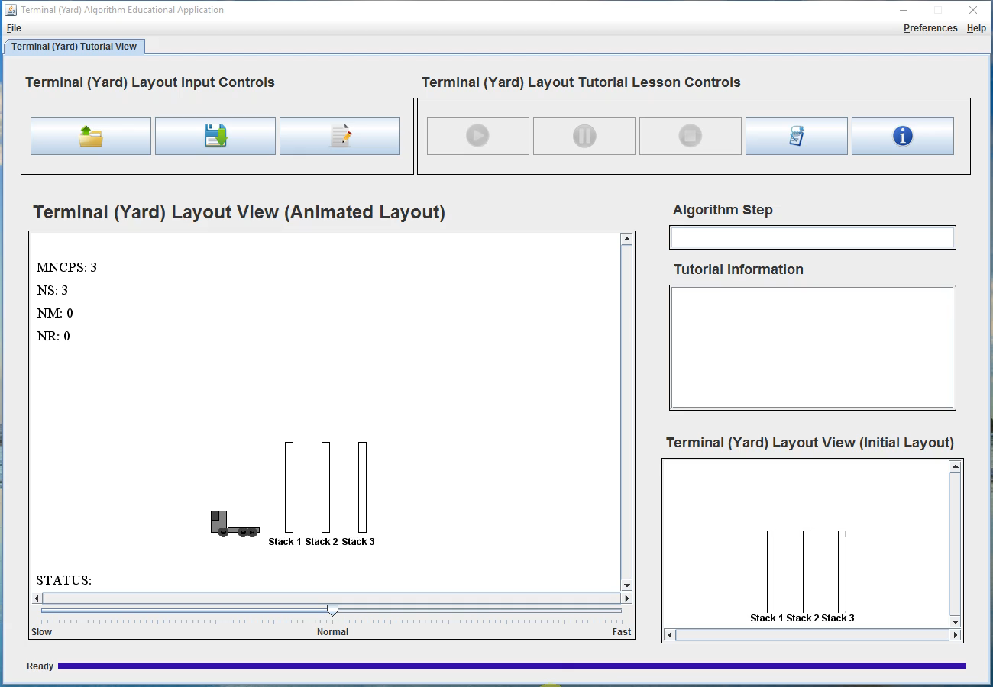
Pre-Marshalling Algorithm Demo

Slide 29
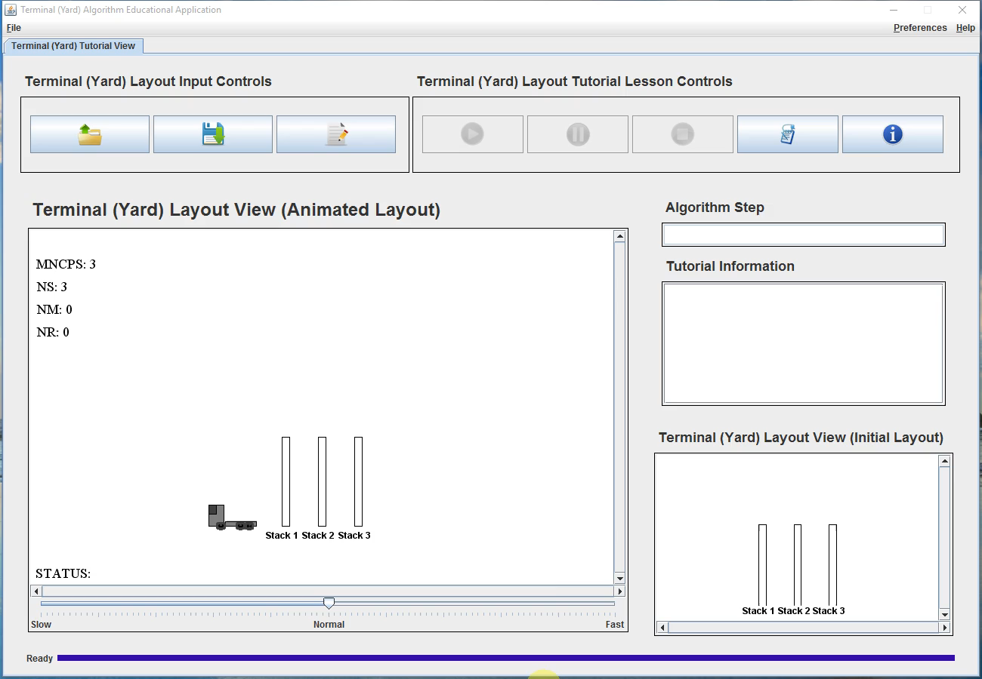
Terminal Yard Editor Demo

Slide 30
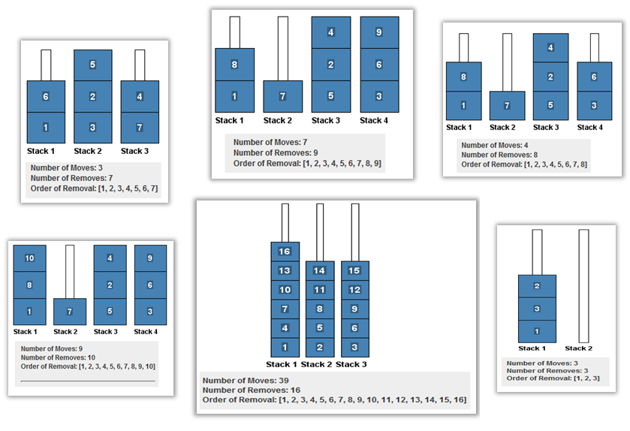
Experimental Results

Slide 31

Questions/Comments

Slide 32
Acronyms
NS Number of Stacks
MNCPS Maximum Number of Containers Per Stack
NAES Number of Available Empty Spaces (a.k.a. NAES = TNS – NCC)
NESR Number of Empty Spaces Required (a.k.a. NESR = MNCPS)
NCC Number of Cargo Containers
TNS Total Number of Spaces (a.k.a. TNS = M x N)
NM Number of Moves
NR Number of Removes
M The number of Rows (a.k.a. MNCPS)
N The number of Columns (a.k.a. NS)

Slide 33
Extra Slides
Additional Slides

Slide 34
Pre-Marshalling Algorithm
Pre-Marshalling (Reshuffling)
(Examples)

Slide 35
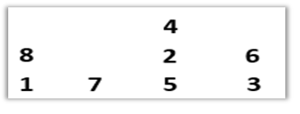
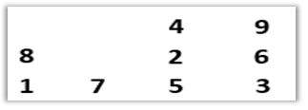
HW Set #1 – Problem 6 Special Team’s Project
Referring to the instructor’s (26 page) notes on “Port Container Terminals”, and based on the explanation/discussion and illustrated example shown on page 17-26 (Pre-marshalling, or Reshuffling algorithm):
  Write a “General” step-by-step computer program (any computer language) for the reshuffling operations.
  Solve for the initial storage layout:
    NS = 4
    MNCPS = b_max = 3
    NS > MNCPS
  Solve for the initial storage layout:
    NS = 4
    MNCPS = b_max = 3
    NS > MNCPS
  NS = Number of Stacks
  MNCPS = Maximum Number of Containers Per Stack

Slide 36
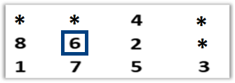
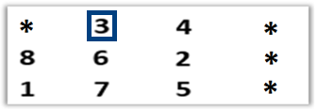
HW Set #1 – Problem 6 (h) - Solution
Solve for the initial storage layout:
  NS = 4
  MNCPS = b_max = 3
  NS > MNCPS
Iteration # 1
  Moved Container 6 to Stack 2
Iteration # 2
  Moved Container 3 to Stack 2

Slide 37
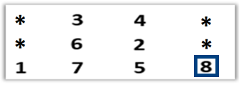
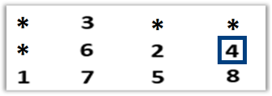
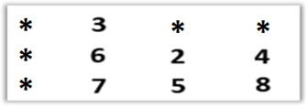
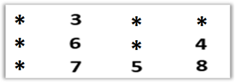
HW Set #1 – Problem 6 (h) - Solution
Iteration # 3
  Moved Container 8 to Stack 4
Iteration # 4
  Moved Container 4 to Stack 4
Iteration # 5
  Removed Container 1
Iteration # 6
  Removed Container 2
  * = Denotes empty space

Slide 38
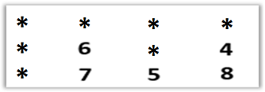
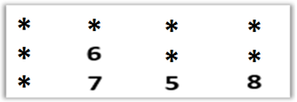
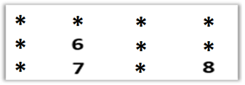
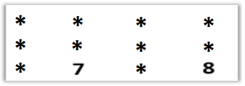
HW Set #1 – Problem 6 (h) - Solution
Iteration # 7
  Removed Container 3
Iteration # 8
  Removed Container 4
Iteration # 9
  Removed Container 5
Iteration # 10
  Removed Container 6
  * = Denotes empty space

Slide 39
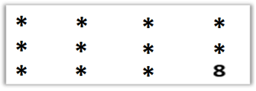
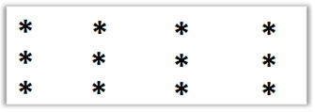
HW Set #1 – Problem 6 (h) - Solution
Iteration # 11
  Removed Container 7
Iteration # 12
  Removed Container 8
  * = Denotes empty space

Slide 40
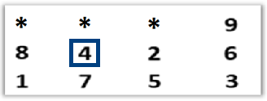
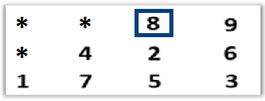
HW Set #1 – Problem 6 (h) - Solution
Solve for the initial storage layout:
  NS = 4
  MNCPS = b_max = 3
  NS > MNCPS
Iteration # 1
  Moved Container 4 to Stack 2
Iteration # 2
  Moved Container 8 to Stack 3

Slide 41
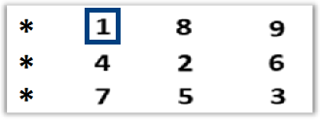
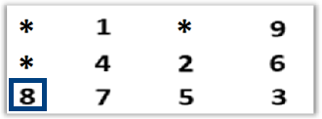
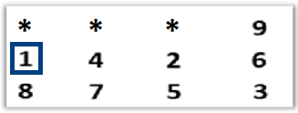
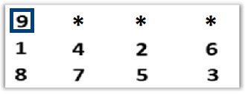
HW Set #1 – Problem 6 (h) - Solution
Iteration # 3
  Moved Container 1 to Stack 2
Iteration # 4
  Moved Container 8 to Stack 1
Iteration # 5
  Moved Container 1 to Stack 1
Iteration # 6
  Moved Container 9 to Stack 1
  * = Denotes empty space

Slide 42
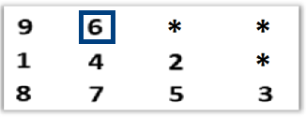
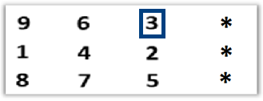
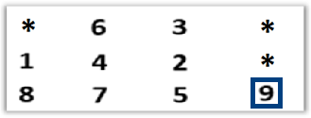
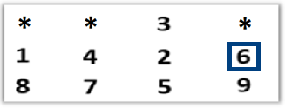
HW Set #1 – Problem 6 (h) - Solution
Iteration # 7
  Moved Container 6 to Stack 2
Iteration # 8
  Moved Container 3 to Stack 3
Iteration # 9
  Moved Container 9 to Stack 4
Iteration # 10
  Moved Container 6 to Stack 4
  * = Denotes empty space

Slide 43
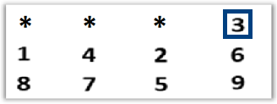
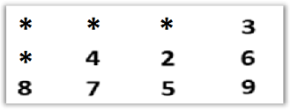
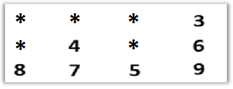
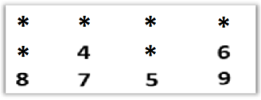
HW Set #1 – Problem 6 (h) - Solution
Iteration # 11
  Moved Container 3 to Stack 4
Iteration # 12
  Removed Container 1
Iteration # 13
  Removed Container 2
Iteration # 14
  Removed Container 3
  * = Denotes empty space

Slide 44
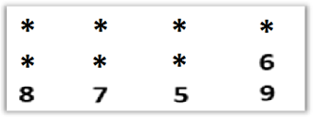
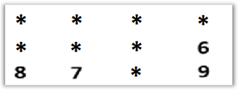
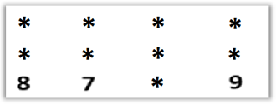
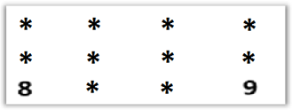
HW Set #1 – Problem 6 (h) - Solution
Iteration # 15
  Removed Container 4
Iteration # 16
  Removed Container 5
Iteration # 17
  Removed Container 6
Iteration # 18
  Removed Container 7
  * = Denotes empty space

Slide 45
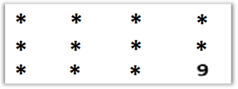

HW Set #1 – Problem 6 (h) - Solution
Iteration # 19
  Removed Container 8
Iteration # 20
  Removed Container 9
  * = Denotes empty space

Slide 46
Results
Solve for the initial storage layout
  NS = 4
  MNCPS = b_max = 3
  NS > MNCPS
Solve for the initial storage layout
  NS = 4
  MNCPS = b_max = 3
  NS > MNCPS
Results:
  Number of Moves: 4
  Number of Removes: 8
  Remove [Order]: 1, 2, 3, 4, 5, 6, 7, 8
  Start Time: 2015.04.18.17.022.14
  End Time: 2015.04.18.17.022.14
Results:
  Number of Moves: 11
  Number of Removes: 9
  Remove [Order]: 1, 2, 3, 4, 5, 6, 7, 8, 9
  Start Time: 2015.04.18.17.023.12
  End Time: 2015.04.18.17.023.12

Slide 47
Unloading Algorithm
Unloading
(Examples)

Slide 48
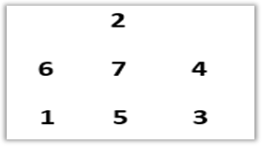

HW Set #1 – Problem 5 Special Team’s Project
Referring to the instructor’s (26 page) notes on “Port Container Terminals”, and based on the explanation/discussion and illustrated example shown on page 13 (see Figure 11: Unloading Operations, and based on your results in Problem 4a,b,c):
  Write a “General” step-by-step computer program (any computer language) for the unloading operations.
  Solve for the initial storage layout
    NS = 4
    MNCPS = b_max = 3
    NS > MNCPS
  Solve for the initial storage layout
    NS = 3
    MNCPS = b_max = 4
    NS < MNCPS
  NS = Number of Stacks
  MNCPS = Maximum Number of Containers Per Stack

Slide 49
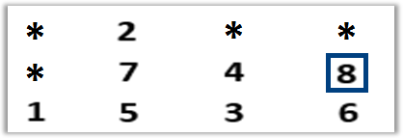
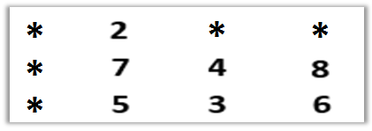
HW Set #1 – Problem 6 (e) - Solution
Solve for the initial storage layout
  NS = 4
  MNCPS = b_max = 3
  NS > MNCPS
Iteration # 1
  GOAL: Remove Container 1
  Moved Container 8 to Stack 4
Iteration # 2
  Removed Container 1
  * = Denotes empty space

Slide 50
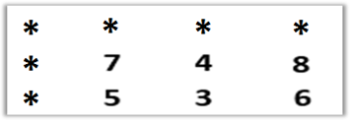
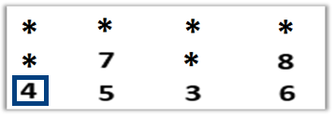


HW Set #1 – Problem 6 (e) - Solution
Iteration # 3
  Removed Container 2
Iteration # 4
  GOAL: Remove Container 3
  Moved Container 4 to Stack 1
Iteration # 5
  Removed Container 3
Iteration # 6
  Removed Container 4
  * = Denotes empty space

Slide 51




HW Set #1 – Problem 6 (e) - Solution
Iteration # 7
  GOAL: Remove Container 5
  Moved Container 7 to Stack 1
Iteration # 8
  Removed Container 5
Iteration # 9
  GOAL: Remove Container 6
  Moved Container 8 to Stack 2
Iteration # 10
  Removed Container 6
  * = Denotes empty space

Slide 52


HW Set #1 – Problem 6 (e) - Solution
Iteration # 11
  Removed Container 7
Iteration # 12
  Removed Container 8
  * = Denotes empty space

Slide 53


HW Set #1 – Problem 6 (f) - Solution
Solve for the initial storage layout
  NS = 3
  MNCPS = b_max = 4
  NS < MNCPS
Iteration # 1
  GOAL: Remove Container 1
  Moved Container 6 to Stack 4
Iteration # 2
  Removed Container 1
  * = Denotes empty space

Slide 54




HW Set #1 – Problem 6 (f) - Solution
Iteration # 3
  Removed Container 2
Iteration # 4
  GOAL: Remove Container 3
  Moved Container 6 to Stack 1
Iteration # 5
  GOAL: Remove Container 3
  Moved Container 4 to Stack 2
Iteration # 6
  Removed Container 3

Slide 55




HW Set #1 – Problem 6 (f) - Solution
Iteration # 7
  Removed Container 4
Iteration # 8
  GOAL: Remove Container 5
  Moved Container 7 to Stack 3
Iteration # 9
  Removed Container 5
Iteration # 10
  Removed Container 6

Slide 56

HW Set #1 – Problem 6 (f) - Solution
Iteration # 11
  Removed Container 7

Slide 57

Results
Solve for the initial storage layout
  NS = 4
  MNCPS = b_max = 3
  NS > MNCPS
Solve for the initial storage layout
  NS = 3
  MNCPS = b_max = 4
  NS < MNCPS
Results:
  Number of Moves: 4
  Number of Removes: 8
  Remove [Order]: 1, 2, 3, 4, 5, 6, 7, 8
  Start Time: 2015.04.18.15.022.43
  End Time: 2015.04.18.15.022.43
Results:
  Number of Moves: 4
  Number of Removes: 7
  Remove [Order]: 1, 2, 3, 4, 5, 6, 7
  Start Time: 2015.04.18.15.027.13
  End Time: 2015.04.18.15.027.13

