Slide 1
Quantum Physics
Chapter 28

Slide 2
Need for Quantum Physics
Problems remained from classical mechanics that relativity didn’t explain
Blackbody Radiation
The electromagnetic radiation emitted by a heated object
Photoelectric Effect
Emission of electrons by an illuminated metal
Spectral Lines
Emission of sharp spectral lines by gas atoms in an electric discharge tube

Slide 3
Photoelectric Effect

Slide 4
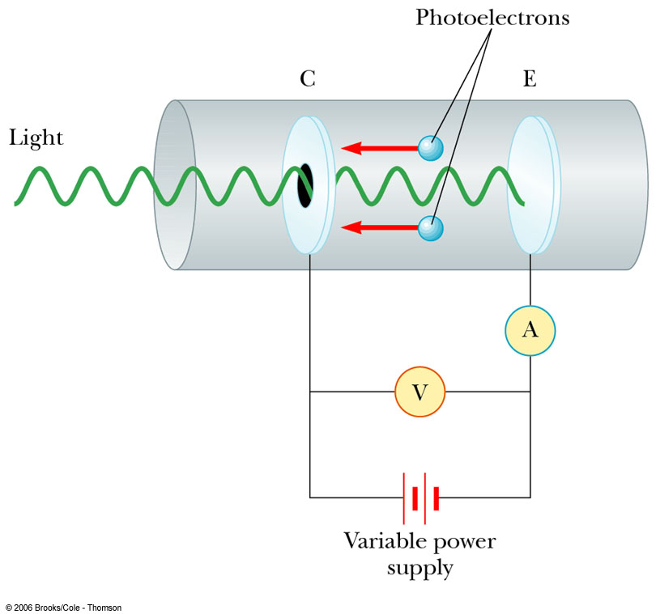
Photoelectric Effect
When light is incident on certain metallic surfaces, electrons are emitted from the surface
discovered by Hertz
The successful explanation Einstein in 1905
Parameters: intensity, frequency
Observed: electron current, electron energy

Slide 5
Features Not Explained by Classical Physics/Wave Theory
No electrons are emitted if the incident light frequency is below some cutoff frequency that is characteristic of the material being illuminated
The maximum kinetic energy of the photoelectrons is independent of the light intensity
The maximum kinetic energy of the photoelectrons increases with increasing light frequency
Electrons are emitted from the surface almost instantaneously, even at low intensities

Slide 6
Einstein’s Explanation
A tiny packet of light energy, called a photon, would be emitted when a quantized oscillator jumped from one energy level to the next lower one
The photon’s energy E = hƒ
Each photon can give all its energy to an electron in the metal

Slide 7
Explanation of Classical “Problems”
The effect is not observed below a certain cutoff frequency since the photon energy must be greater than or equal to the work function
  Without this, electrons are not emitted, regardless of the intensity of the light
The maximum KE depends only on the frequency and the work function, not on the intensity
The maximum KE increases with increasing frequency
The effect is instantaneous since there is a one-to-one interaction between the photon and the electron

Slide 8
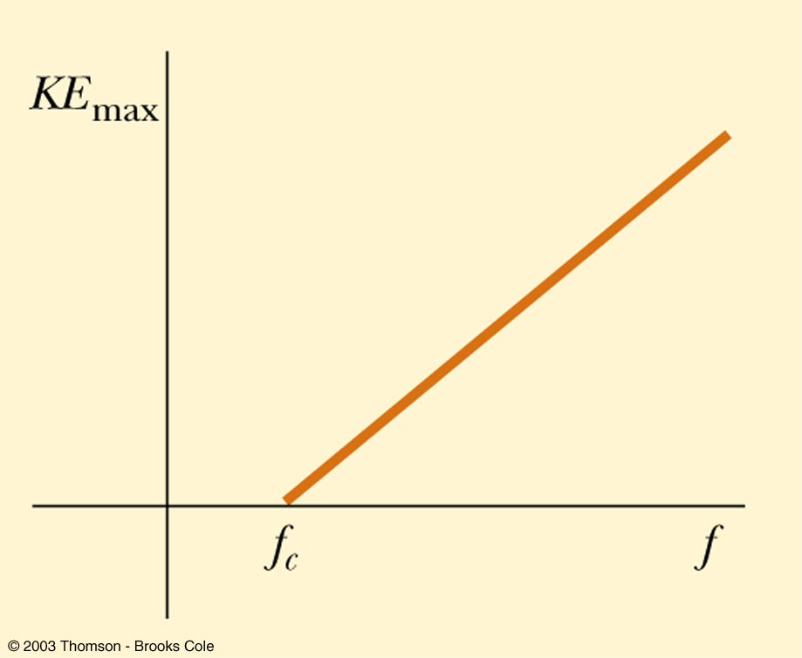
Verification of Einstein’s Theory
Experimental observations of a linear relationship between KE and frequency confirm Einstein’s theory
The x-intercept is the cutoff frequency

Slide 9
Photocells
Photocells are an application of the photoelectric effect
When light of sufficiently high frequency falls on the cell, a current is produced
Examples
  Streetlights, garage door openers, elevators

Slide 10
Wave-particle duality

Slide 11
Photons – particles or waves
Light has a dual nature.
It exhibits both wave and particle characteristics

Slide 12
Wave Properties of Particles
In 1924, Louis de Broglie postulated that because photons have wave and particle characteristics, perhaps all forms of matter have both properties
Furthermore, the frequency and wavelength of matter waves can be determined

Slide 13
de Broglie Wavelength
The de Broglie wavelength of a particle is
𝛌=h/p

Slide 14
Dual Nature of Matter
The de Broglie equations show the dual nature of matter
Each contains matter concepts
  Energy and momentum
Each contains wave concepts
  Wavelength and frequency

Slide 15
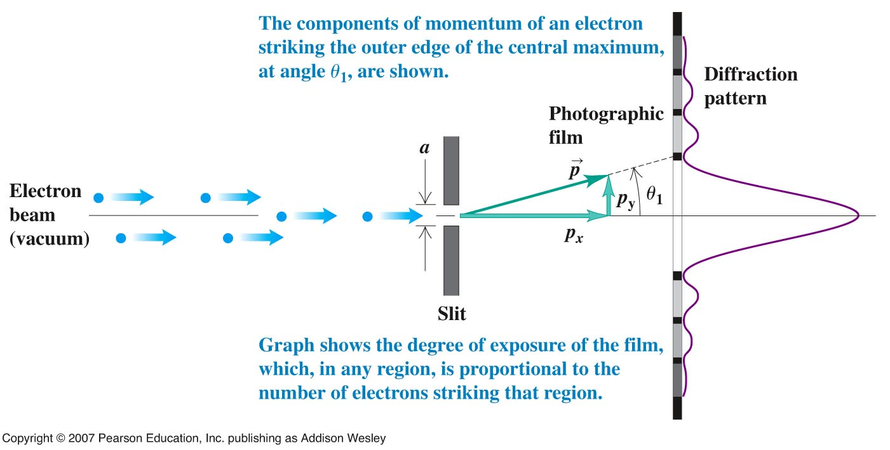
electron diffraction

Slide 16
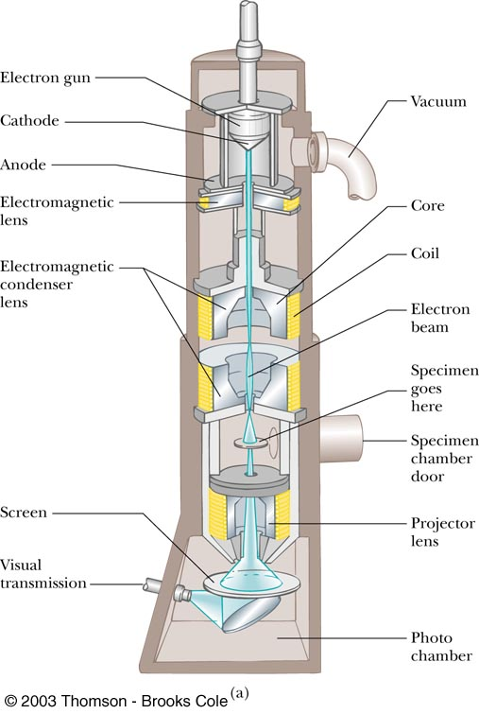
The Electron Microscope
The electron microscope depends on the wave characteristics of electrons
Microscopes can only resolve details that are slightly smaller than the wavelength of the radiation used to illuminate the object
The electrons can be accelerated to high energies and have small wavelengths

Slide 17
The Uncertainty Principle

Slide 18
The Uncertainty Principle
When measurements are made, the experimenter is always faced with experimental uncertainties in the measurements
  Classical mechanics offers no fundamental barrier to ultimate refinements in measurements
  Classical mechanics would allow for measurements with arbitrarily small uncertainties

Slide 19
The Uncertainty Principle, 2
Quantum mechanics predicts that a barrier to measurements with ultimately small uncertainties does exist
In 1927 Heisenberg introduced the uncertainty principle
  If a measurement of position of a particle is made with precision Δx and a simultaneous measurement of linear momentum is made with precision Δp_{x}, then the product of the two uncertainties can never be smaller than h/4π

Slide 20
The Uncertainty Principle, 3
Mathematically,
It is physically impossible to measure simultaneously the exact position and the exact linear momentum of a particle
Another form of the principle deals with energy and time:
𝛥x𝛥p~h
𝛥t𝛥E~h

Slide 21
Quantum tunneling

Slide 22
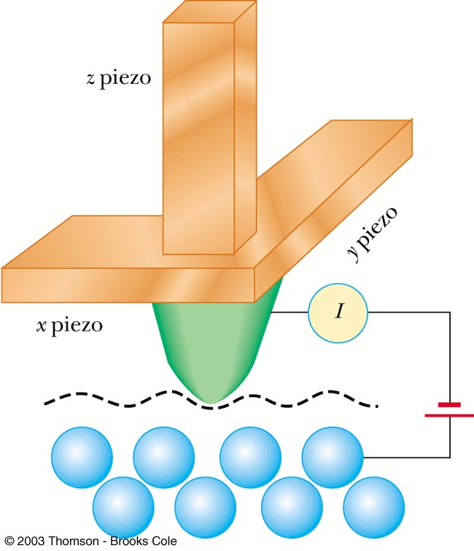
Scanning Tunneling Microscope (STM)
Allows highly detailed images with resolution comparable to the size of a single atom
A conducting probe with a sharp tip is brought near the surface
The electrons can “tunnel” across the barrier of empty space

Slide 23
Scanning Tunneling Microscope, cont
By applying a voltage between the surface and the tip, the electrons can be made to tunnel preferentially from surface to tip
The tip samples the distribution of electrons just above the surface
The STM is very sensitive to the distance between the surface and the tip
  Allows measurements of the height of surface features within 0.001 nm

Slide 24
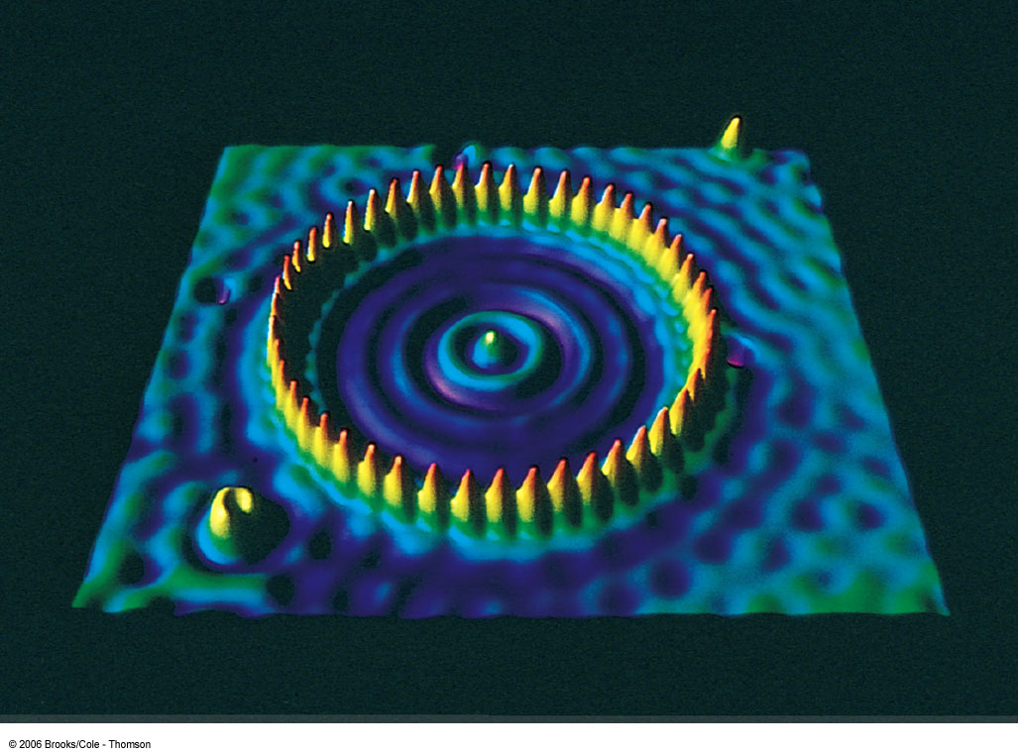
STM Result, Example
This is a “quantum corral” of 48 iron atoms on a copper surface
The diameter of the ring is 143 nm
Obtained with a low temperature STM

Slide 25
Limitation of the STM
There is a serious limitation to the STM since it depends on the conductivity of the surface and the tip
  Most materials are not conductive at their surface
  An atomic force microscope has been developed that overcomes this limitation
  It measures the force between the tip and the sample surface
  Has comparable sensitivity

