Slide 1
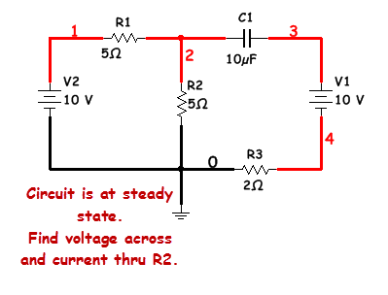
Since circuit is at steady state the capacitor will be open-circuited. See
the next slide.

Slide 2
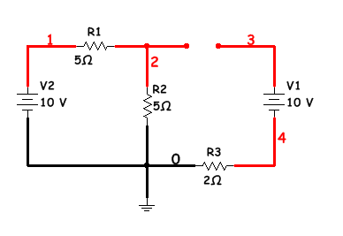
As can be seen here, the capacitor has been open-circuited. With this
loop opened, current can’t flow, therefore it does not exist to the rest
of the circuit. See the next slide.

Slide 3
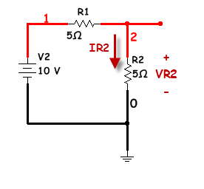
Method 1: We will find the total current (which will be the current thru R2, and then use OHMs Law to find VR2.

Slide 4
Method 2: We will use a voltage divider to find VR2 and the use OHMs Law to find IR2.

Slide 5
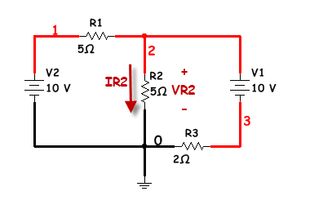
2nd question:
You asked how it would be solved if the capacitor had not been in the problem. We will solve it via MESH and then NODAL.

Slide 6
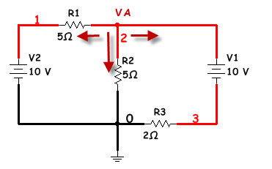
Nodal
This is a single node problem. We will assume all currents are leaving the top node (even though that is not really true.

Slide 7
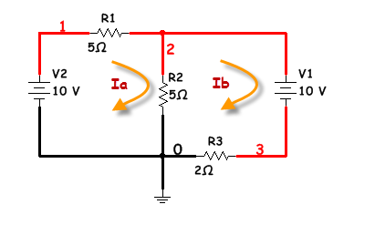
Mesh
This is a two mesh problem. Both mesh currents are drawn clockwise and then the KVL equations are created.

Slide 8
Mesh
Next we solve the two equations simultaneously. The two currents are subtracted to find IR2. Ia went first since
It is going in the direction of IR2.

